Slide 1
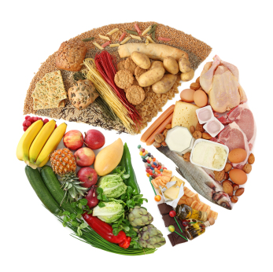
The Power of Food
Vanderbilt Student Volunteers for Science
Training Presentation
Fall 2012

Slide 2
Important!!!
Please use this resource to reinforce your understanding of the lesson! Make sure you have read and understand the entire lesson prior to picking up the kit!
We recommend that you work through the kit with your team prior to going into the classroom.
This presentation does not contain the entire lesson—only selected experiments that may be difficult to visualize and/or understand.

Slide 3
I. Intro-Defining Energy
Energy - allows us to do work
Can be stored for later use or it may be used immediately to do something such as provide light, heat, or motion
May view energy as something that lets you do things like run, walk, or just stay alive

Slide 4
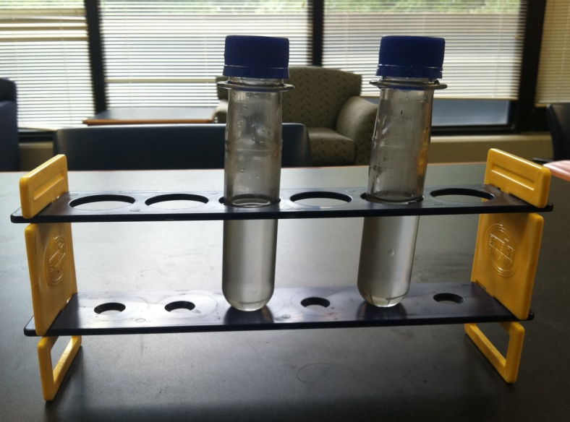
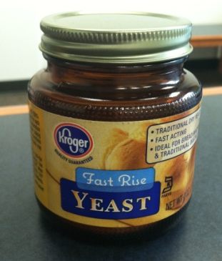
II. Activity 1- Energy for Life
Pass out materials- check lesson plan for materials list
Have racks and tubes set up (as detailed on the next slide, before you begin teaching)
Tell the class they will be investigating the behavior of a common fungus, baker’s yeast, when it is fed
Ask the class to share anything they know about yeast and to answer the hypothesis questions
What do you think will happen when yeast is combined with water alone?
What do you think will happen when sugar and water are added to the yeast?

Slide 5
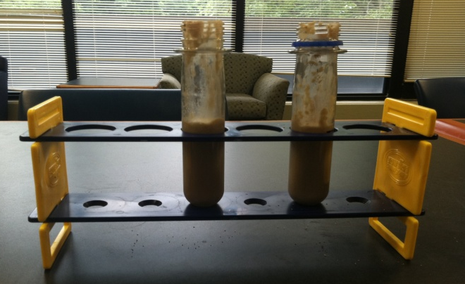
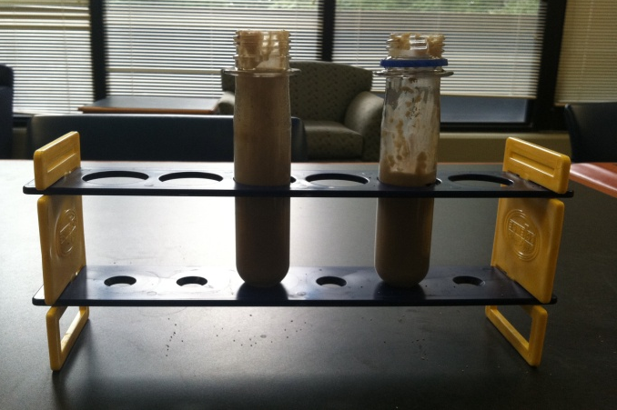
II. Activity 1- Energy for Life (cont.)
Have the test tube racks set up for the students with two large test tubes in each rack
Put one scoop of yeast into each test tube using the yellow scooper
Use the empty liter bottle as a decanter and fill it with warm water
Pour warm water into each test tube up to the marked line (approximately 50mL)
Have students stir the mixtures gently with the craft sticks
Students add a sugar packet to one of the test tubes and again gently stir
Have each group measure the height of the mixture in each test tube; record this height as initial height in the second table of the Activity 1 worksheet.
Have them check the height after about five minutes
If the reaction is slow to occur set the test tube rack off to the side. Return to Activity 1 after there is a noticeable change in height. Have students note the final height on the Activity 1 worksheet.
Tubes may overflow
initial
Tube containing sugar
4 min.

Slide 6
II. Activity 1- Energy for Life (cont.)
While you are waiting for the reaction to occur begin a discuss with the entire class
Possible Questions:
What are the basic needs of living things? Do all organisms need exactly the same things to live? What do plants need? What about animals? Do animals need the same things as plants?
Possible Answers:
All organisms need energy. Plants are producers, meaning they are able to produce everything they need from very basic raw materials, including carbon dioxide from air, water, nutrients from soil and energy from sunlight through a process known as photosynthesis. Animals that rely on photosynthetic organisms as their source of energy are called consumers, this also includes fungi. Producers get theirs from the sun and consumers get it from eating the appropriate foods.

Slide 7
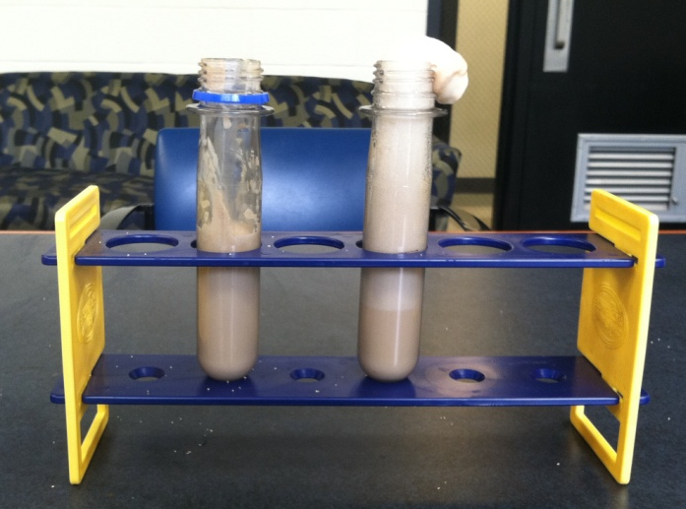
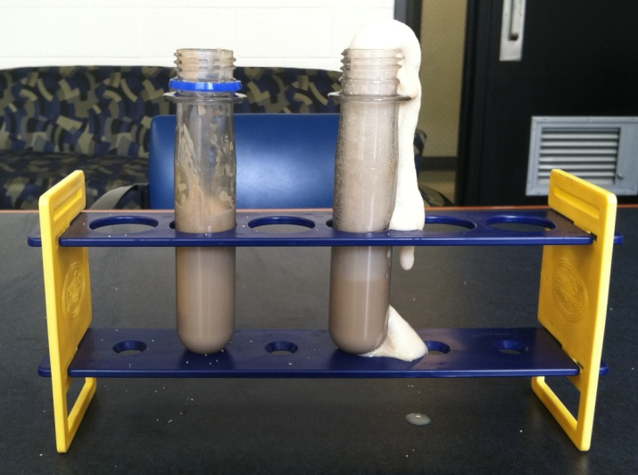
II. Activity 1- Energy for Life (cont.)
When a noticeable reaction has occurred, (similar to visual at right) initiate closing discussion
Ask “What is happening to the yeast?”
The yeast cells have begun to grow and multiply in the presence of water and food (sugar)
The gas being produced is carbon dioxide
Help them understand, that they used different pieces of evidence to come to the conclusion that yeast uses sugar as an energy source.
Yeast was breaking down sugar to obtain energy, and released carbon dioxide (visible as bubbles, increasing the height of the mixture)
Yeast-sugar mixture became warmer over the course of the lesson. Heat was released as a by-product of the energy conversion
Yeast mixture with no sugar did not have energy to grow, and so the mixture did not have bubbles or increase in temperature
7 min.
Tube containing sugar
15 min.

Slide 8
III. Activity 2 -What is a Calorie?
Calorie -1 calorie is the amount of energy it takes to raise the temperature of one milliliter of pure water one degree Celsius at sea level
1 food Calorie is equal to 1,000 calories
Note that a food Calorie has a capital “C” whereas the other is lowercase
The calorimeter will calculate calories, make sure to convert this answer to food Calories

Slide 9
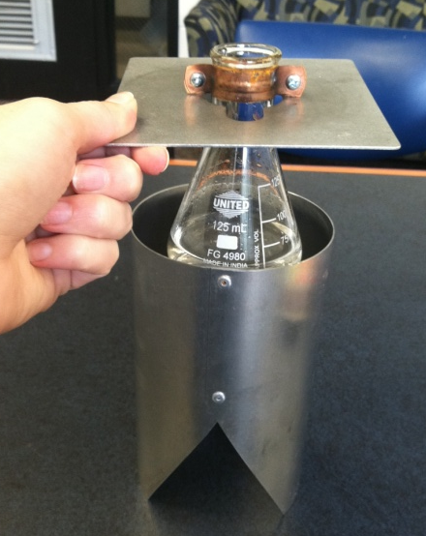
III. Activity 2 -What is a Calorie? (cont.)
Introduce the calorimeter and explain that we can measure the amount of energy in a piece of food by measuring the change in temperature as the fire, from the burning piece of food, heats the water
Ask students to Hypothesize the number of calories in each piece of food based on the three choices given on the worksheet
Which food provides the largest amount of energy?

Slide 10
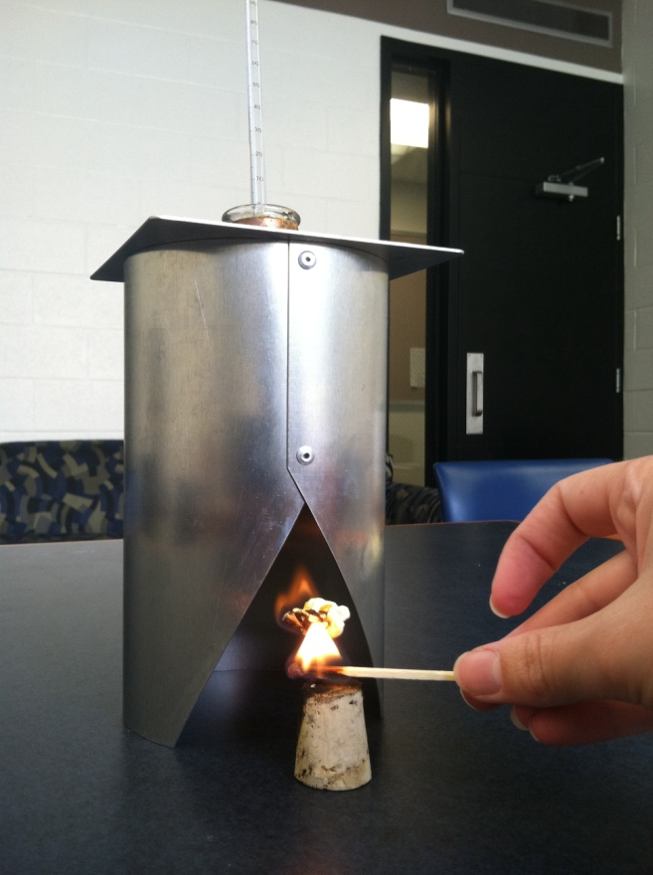
III. Activity 2 -What is a Calorie? (cont.)
Make sure students wear their safety goggles for this portion and never let the students handle a flame
Pour 50 mL of water into the flask.
Measure the temperature of the water using the thermometer. Record this initial temperature on the board and have students note the temperature in the second table of the Activity 2 worksheet.
Attach the food to the pin attached to the cork.
Use the match (or stick lighter) to light the piece of food on fire.
Pull the calorimeter over the lit piece of food making sure the food is still visibly burning through the triangular shaped slit in the heat shield
Once the food has been burned completely, record the final temperature of the water.

Slide 11
III. Activity 2 -What is a Calorie? (cont.)
The popcorn burns for less than a minute
The nut can burn as long as three or four minutes
Make sure to use only a quarter of the nut so as to avoid overheating the water! You do NOT want the water to reach or go over 100 degrees Celsius
Tell students a calorie is the amount of energy required to raise the temperature of one mL of water by one degree Celsius
Based on this information follow the calculations on the following slide to determine the calorie content of each piece of food

Slide 12
III. Activity 2 -What is a Calorie? (cont.)
Q = heat (cal)
ρ= density of water 1g/mL
C = specific heat of water (1 cal/g°C)
∆T = change in temperature (°C)
Explain density as the amount of mass in a given volume
Explain specific heat as the energy required to raise the temperature of an object by a certain amount
Ask students to solve the ΔT for you, using the second table on the Activity 2 worksheet. Explain Δ (delta) just means the change in
Walk students through how to set up the equation and solve for the unknown variables. Ask students to record the answer on their worksheet
This equation will show students how to calculate the amount of Calories in a piece of food. This should give students a better grasp of the concept of food Calories as listed on nutrition labels

Slide 13
III. Activity 2 -What is a Calorie? (cont.)
Q = (1 g/mL)(50 mL)(1 cal/g°C)(ΔT)
In words: calories equal density of water times the amount of water we used times the specific heat of water times the change in temperature of the water
Q = ____ cal
Next convert the calories calculated to food Calories. Remind the students that 1 food Calorie is equivalent to 1,000 calories
A sample problem is detailed in the lesson plan

Slide 14
III. Activity 2 -What is a Calorie? (cont.)
Ask students: “Which food contained the most Calories?”
Briefly discuss food:
Carbohydrates, fats, and proteins are the primary sources of energy in food
Fats and oils provide about nine cal/g
Proteins and carbohydrates each provide four cal/g
Sugars, starches, and fiber are the main source of carbohydrates.
Carbohydrates provide most people with about 50% of their energy needs
Foods rich in carbohydrates include: pasta, potatoes, and bread
Foods rich in fat include: oil, butter and cream
Protein is found in meat, eggs, nuts and beans
Fats are a good source of energy, but certain fats are healthier than others
Fats that are solid at room temperature, such as lard, shortening, and margarine should be avoided, as well as the fats found in some red meats, chocolate, cake, cookies and some crackers.
Healthier options include olive, nut, or fatty fish oils

Slide 15
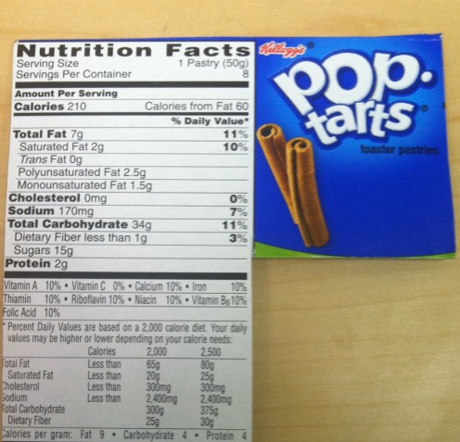
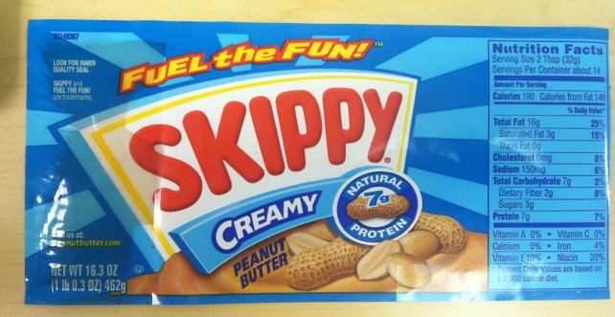
IV. Activity 3- Energy Balance
Energy intake
Pass out food labels to each group of students
Make sure to mention how the nut and the popcorn experiment they just conducted relates to the food labels passed out.
For example, nuts are high in fat and oil
Explains why it was able to burn so well
Therefore it had a high calorie content
The popcorn on the other hand is mostly a carbohydrate
Unlike carbohydrates such as pasta or potatoes, popcorn is very light and doesn’t provide the flame with much fuel
Therefore it did not have as high of a caloric value
Make sure to mention that just because a particular food choice has fewer calories does not mean it is better for you
Students should try to eat food from all the food groups: protein, carbohydrates, fats, etc in moderate amounts to get all the nutrients that they need to continue growing and to stay healthy

Slide 16
IV. Activity 3- Energy Balance (cont.)
Energy output
The Energy Balance Equation E_{in} = E_{out}
Shows the relationship between energy input (E_{in}) and energy output (E_{out})
Energy input and output are expressed in Calories
Adults who consistently consume more Calories than they expend are in positive energy balance:
E_{in} > E_{out}. They GAIN weight
Adults who consistently expend more Calories than they consume are in negative energy balance:
E_{in} < E_{out}. They LOSE weight

Slide 17
IV. Activity 3- Energy Balance (cont.)
BMR
Multiple factors make up the Energy_{out} component of the equation
First there is the number of calories your body needs while at rest, Basal Metabolic Rate (BMR), which uses energy to perform functions such as breathing, digestion, and heart beat that you do not consciously control yet are continuously doing
BMR’s vary from person to person but we can get a close approximation using an individual’s age, gender, height, and weight
Help students calculate their own BMR on the worksheet for Activity 3
Make sure each group has access to at least two calculators and help them with their math
Additionally help students figure out how tall they are in inches (5ft.= 60 in) and how much they weigh

Slide 18
IV. Activity 3- Energy Balance (cont.)
BMR example chart for average VSVS facilitator
BMR example chart for average VSVS participant

Slide 19
IV. Activity 3- Energy Balance (cont.)
The other component of Energy_{out} is the amount of physical activity an individual does each day
When someone runs, jumps, or goes for a bike ride they are using energy in order to do each task.
The more difficult the activity the more energy an individual will use to perform it, so they need to consume more Calories to supply their body with the energy it needs.
Have students select their activity level from the three choices on the Activity 3 worksheet. Their relative activity level will be multiplied by their calculated BMR in order to determine their total Energy_{out}

Slide 20
IV. Activity 3- Energy Balance (cont.)
Activity level example chart
Female
example
Male
example

Slide 21
IV. Activity 3- Energy Balance (cont.)
Growth
Explain to students that in order to grow properly and maintain a healthy state, children, adolescents, and teenagers must be in positive energy balance E_{in} > E_{out}
They need to consume more Calories than needed for BMR and physical activities (E_{out}) because the extra calories they consume are used for increasing the amount of important body tissues such as bone, muscle, and blood needed for growth (E_{growth})
An approximation of growth rates for both males and females is on the next slide

Slide 22
IV. Activity 3- Energy Balance (cont.)
Growth example chart

Slide 23
IV. Activity 3- Energy Balance (cont.)
If there are still more Calories taken in than used in for either Energy_{out} or Energy_{growth} they may be stored as fat (E_{stored})
Remember energy is never lost so the calories must go somewhere if not used for growth, basic bodily functions, or during physical activity
For healthy children, adolescents, and teenagers, the energy balance equation is:
E_{in} = E_{out} + E_{growth} + E_{stored}

Slide 24
IV. Activity 3- Energy Balance (cont.)
Example Seesaw
Female
Male

Slide 25
Lesson developed for VSVS by:
Jackie Whitehead of
California Lutheran University ’13
and
Jessica Campos’12 and Lina Aboulmouna’11 of Vanderbilt University
for Dr. Jamey Young’s NSF CAREER Award
#0955251

