Slide 1
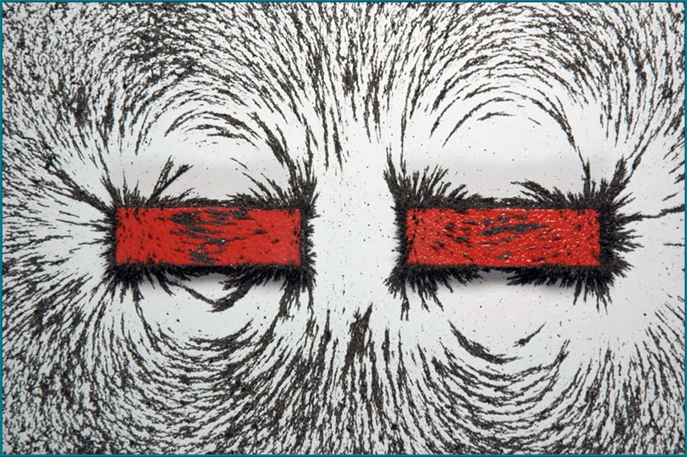
MAGNETISM

Slide 2
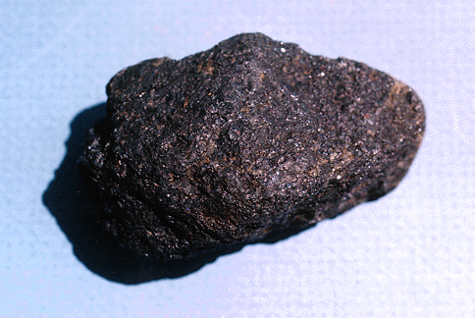
BACKGROUND
Man has been fascinated by magnetic properties since 600 B.C. (One story tells of a Greek shepherd boy called Magnes who discovered that the iron tip on his staff was mysteriously attracted to a rock.) This rock was a naturally occurring magnetic rock called lodestone.
Show students a piece of magnetite, and show them that a small magnet is attracted to it.
The mariners compass was the first important magnetic device. It is thought to have come from the Chinese, who had discovered that a free-hanging magnet always pointed in the same N/S direction.
There are 4 types of magnets. The most common ones are made from an alloy called alnico (Al, Ni, Co). Others are Ceramic (strontium ferrite), Samarium Cobalt, and Neodymium.
Uses for magnets: Ask students some everyday uses for magnets.
Magnets are everywhere – they help seal refrigerator doors tight, compasses, used in the production of electricity, Car ignition, etc.

Slide 3
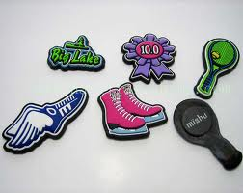
WHY DO MAGNETS STICK TO THE REFRIGERATOR?
Magnets attract other magnetic materials. The most common magnetic metal is iron. You don't see too many products made of pure iron but you do see a lot of products made of steel. Since steel has a lot of iron in it, steel is attracted to a magnet.

Slide 4
HOW ARE MAGNETS MADE?
The most common magnetic materials are the metals iron, cobalt, and nickel or combinations of these with other materials. To make any of these substances into magnets, the material to be magnetized is placed into a device called a magnetizer. The magnetizer has a powerful electric current traveling through coils of wire. The electricity of the magnetizer creates a strong magnetic field, which magnetizes the material.
What do you know about magnets and magnetism?
Magnets have north and south poles.
The south poles on 2 magnets will repel each other.
The north poles on 2 magnets will repel each other.
The north and south pole on 2 magnets will attract each other. This attraction and repulsion is called magnetism.

Slide 5
WHAT MATERIALS WILL MAGNETS ATTRACT?

Slide 6
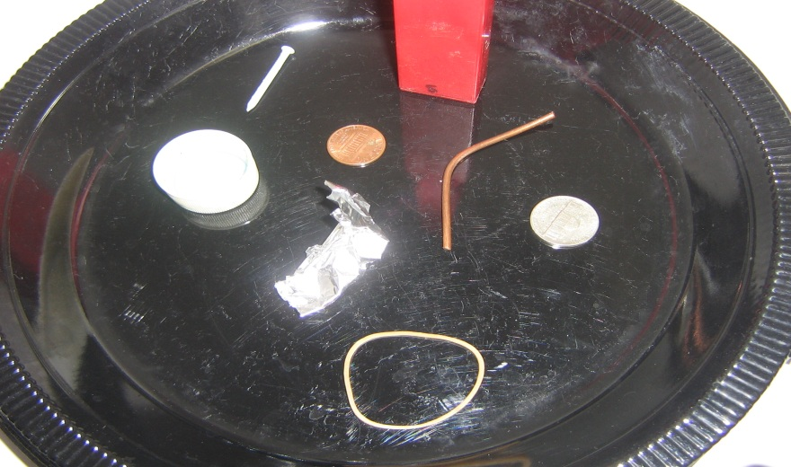
WHAT MATERIALS WILL MAGNETS ATTRACT?
Pour the materials from the jars onto the plate and test each item to determine if it is magnetic. It is magnetic if it is attracted to, and sticks to the magnetic wand.
Separate the magnetic items from the non-magnetic ones into 2 groups (on either side of the plate).
Record the results by placing a check beside the name of each item if it is magnetic. Young students may need help identifying the items and their names. OR, VSVS members will record the results on the board.
Ask them if they can identify anything the magnetic items have in common?
All the items are metallic and contain iron.

Slide 7
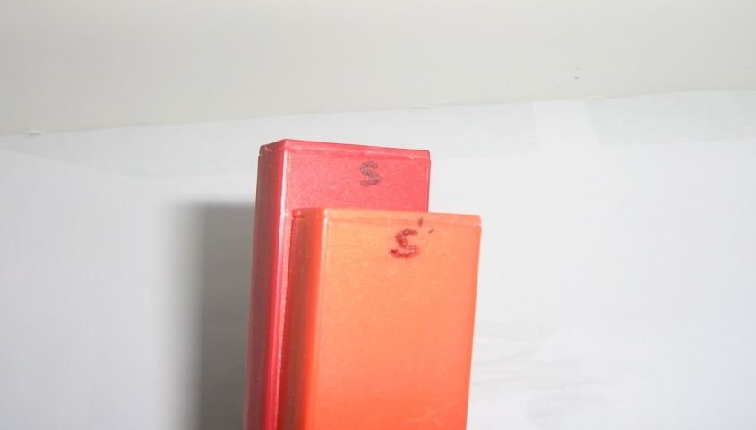
FINDING THE POLES OF A MAGNET
Tell students to:
Look at the magnets and find the labeled north (N) and south (S) poles.
Hold the magnets so that the “N”’s are facing each other.
Tell the pair to move the magnets towards each other. What happens?
Have 1 partner turn the second bar magnet around (180 degrees) so that an “N” and “S” face each other, and move the 2 magnets towards each other. What happens?
Magnets have north and south poles.
The south poles on 2 magnets will repel each other.
The north poles on 2 magnets will repel each other.
The north and south pole on 2 magnets will attract each other.
Opposites attract, like repels. You can now find the poles on any unmarked magnet.

Slide 8
HOW STRONG IS THE ATTRACTION OR REPULSION IN A MAGNET?
Test how many paper clips a magnet will hold.
Place the first paper clip on one end of the magnet. This paper clip is now magnetic (by induction)
Add a second paper clip to the bottom of the 1st clip.
Try adding a 3rd and 4th.
Does gravity always win after same number paper clips?

Slide 9
HOW STRONG IS REPULSION?
Look at ring magnets on rod.
Place 2 magnets on rod so that they repel each other
Measure distance between magnets
Put washers on top of magnet (slide onto rod) until magnets touch. Record the # of washers.

Slide 10
WHAT IS STRONGER—MAGNETIC ATTRACTION OR GRAVITY?
Tape free end of thread and paper clip to table.
Hold paper clip up in air and bring magnet to within ½ inch above it.
Let go clip.
What happens?
Move magnet back and forth and up.
How far can the magnet be moved before the paper clip falls?

Slide 11
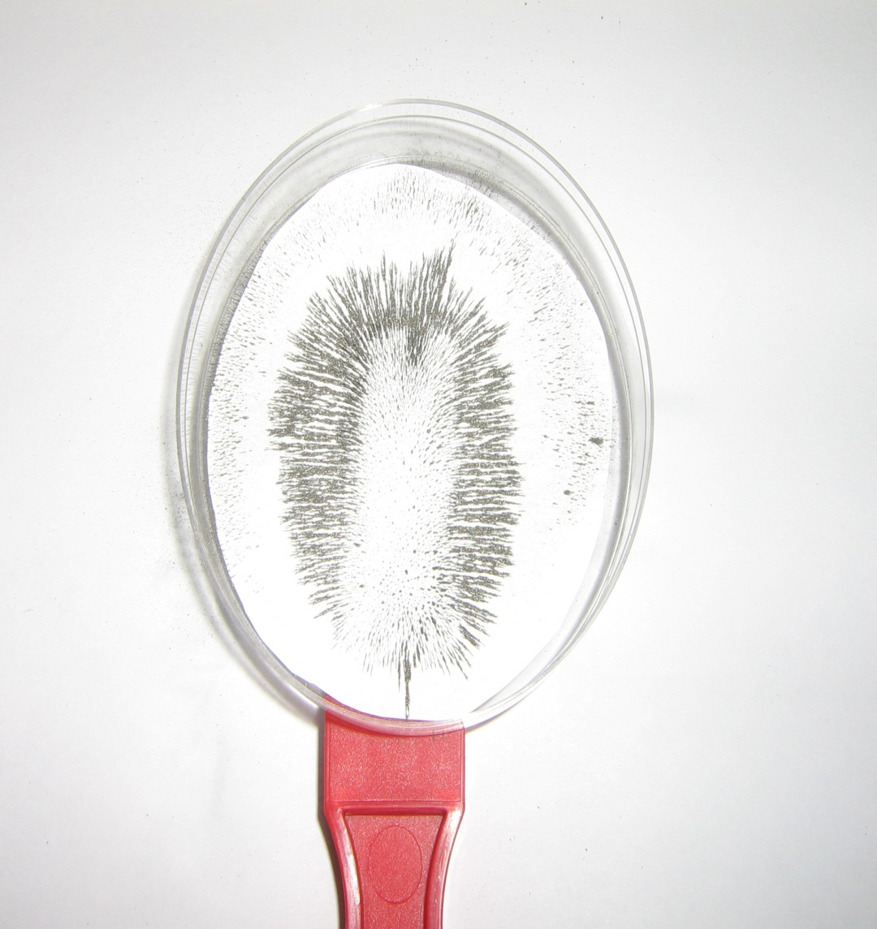
SEEING THE MAGNETIC FIELD
Place a bar magnet on table.
Place the petri dish on top of the magnet so that the magnet is in the center.
Slowly shake the iron filings over the paper until you can see a pattern.
Look at the shape of the pattern the filings form around the bar magnet.
Repeat for the different shaped magnets.
Return ALL materials to VSVS member.

Slide 12
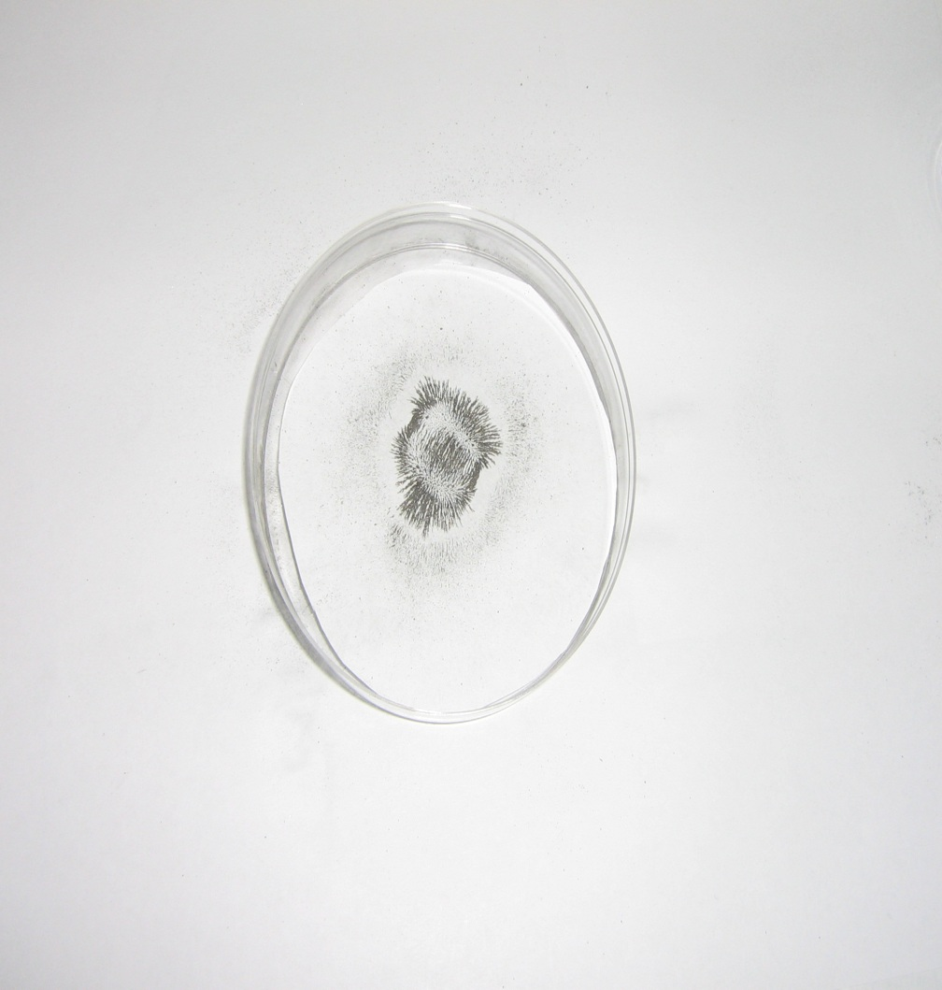
SEEING THE MAGNETIC FIELD
A magnetic field is the area around magnet where the magnetic force acts.
What does the magnetic field look like for the different shapes?
Where is the magnetic force the strongest? Weakest?

