Slide 1
Magic Sand
Vanderbilt Student Volunteers for Science
Fall 2013

Slide 2
I. Background
Since sand can get wet, it means that the water molecules are attracted to the sand grains.
Water-loving property of sand is called hydrophilic.
Magic sand is regular sand covered with an oil-like substance that is water-hating or hydrophobic.

Slide 3
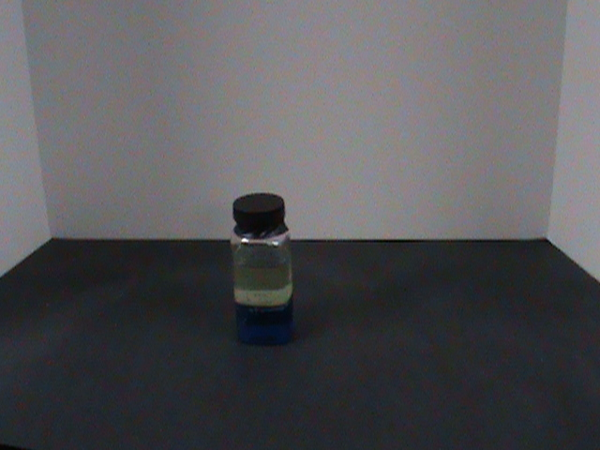
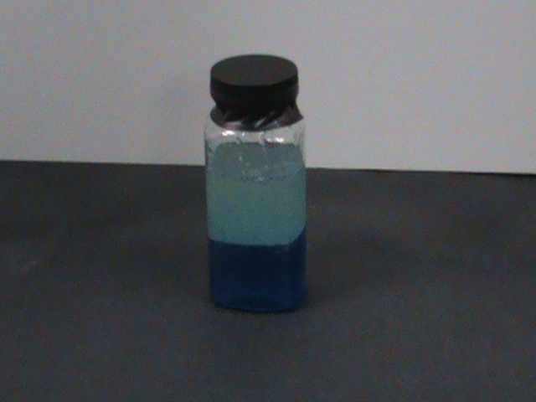
II. Activities
Demonstration: show that water and oil don’t mix.
Shake the bottle containing the oil and water.
Explain that the oil on top is hydrophobic.

Slide 4
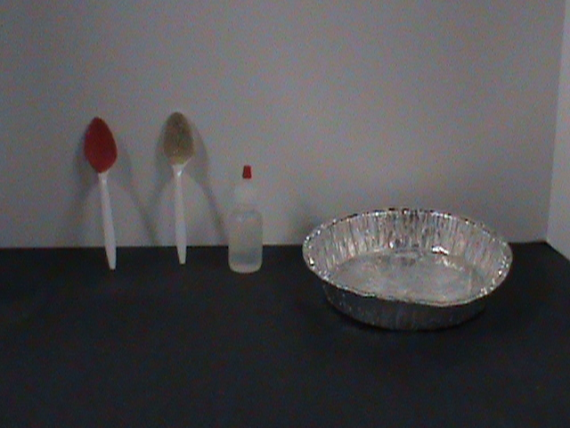
Investigating Hydrophobic and Hydrophilic Properties
Use the 1-oz dropper bottle to add two drops onto the magic sand spoon (red) and regular sand spoon.
Tilt the spoons.
The water on the magic sand spoon will not stick. But the water will stick on the regular sand.
Explain that the magic sand is like the oil (hydrophobic); it will not stick to water.
Explain that the regular sand is hydrophilic, therefore the water molecules are attracted to the sand grains and soak into it.

Slide 5
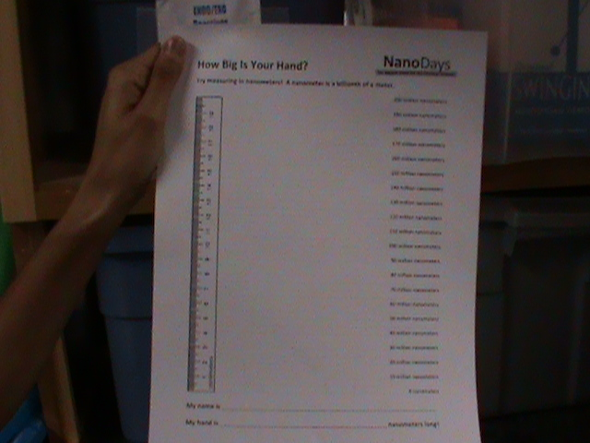
Nanotechnology
Explain that a nanometer is a billionth of a meter.
Provide examples of different objects at the nanoscale.
Ordinary materials have different properties at the nanoscale.
Show the Nano-Tex fabric.
Explain how nanotechnology has allowed the development of stain resistance.

Slide 6
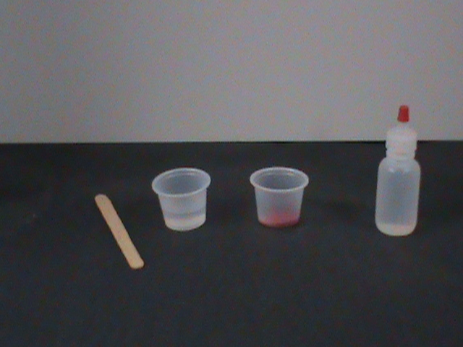
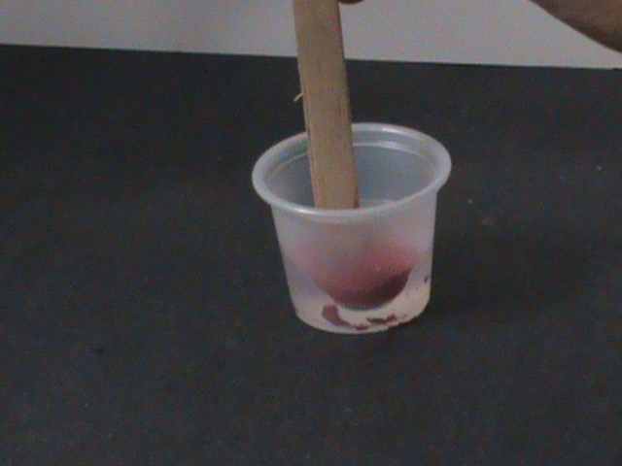
More Activities
Use the dropper bottle to add water to the 1 oz cup.
Sprinkle magic sand on top of the water in the cup.
Take the popsicle stick and slowly push through the layer of magic sand.
Explain why the stick isn’t wet.
Add 2 drops of water onto the sand in the cup. Keep adding until a large drop of water forms.
Explain why the droplet forms.

Slide 7
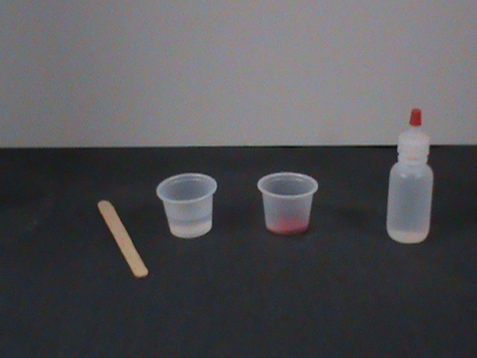

More Activities (cont.)
Mix the magic sand and water.
Ask what the magic sand looks like (should have a silvery sheen).
Carefully pour off the water from the sand into the waste container.
Make sure to leave the sand in the cup behind!

Slide 8
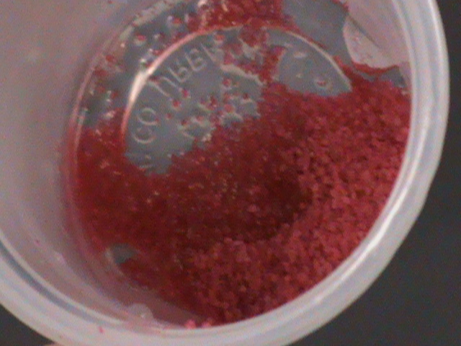
Magic Sand and Oil
Use 1 oz dropper bottle to add 2 drops of the oil onto the magic sand.
Explain why the oil soaks into the sand.
The oil and the magic sand have similar properties (hydrophobic). This means that the oil is attracted to the magic sand and will soak into it.

Slide 9
Clean-Up
If the magic sand has not been contaminated, the teacher can keep it.
Place the 1oz cups with contaminated sands into the trash bag and dispose of it.

