Slide 1
Fossils
Vanderbilt Student Volunteers for Science
Fall 2012
Training Presentation

Slide 2
IA. Introduction
Tell Students:
The Geologic Time Scale covers Earth’s entire history
It is divided into 4 major time intervals called eons
The eons are not the same length, but are based on major events
The Earth is 4.6 billion years old (or 4600 million years old)

Slide 3
IB. Time Scale Model
Hand out the Fossils Observation Sheet (1 per student). Draw the same table on the Observation Sheet on the board and fill it out as you go through the timescale. (A filled-out version of the table is shown below.)
Since this lesson is a short mini lesson, have students answer these questions as a class. VSVS members can write the correct answer on the board. Tell students to copy down the time ranges and major events/dominant organisms/fossils/rocks information.

Slide 4
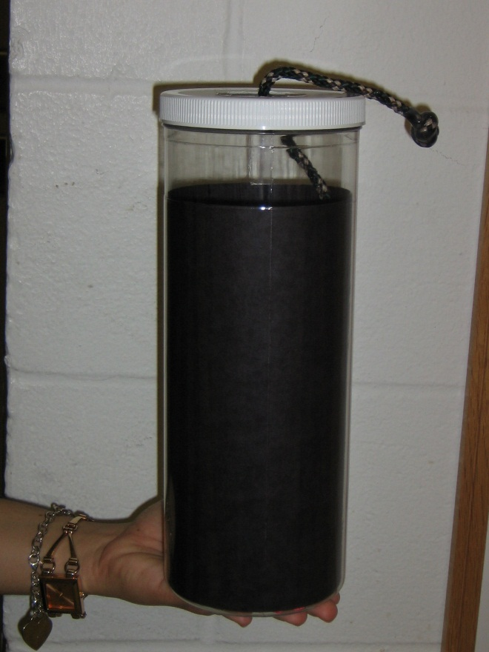
IB. Time Scale Model
Hold up the timescale model & tell students:
The container has some string that represents the timeline of Earth’s history
The string represents the complete geologic time scale over a time of 4.6 billion years
The string is divided into the 4 eons. Each eon will be described as it is removed from the container, starting with the oldest
Note: The string is 19 feet long!
Also: Pull the string out so that the container is on the students’ right & the string is pulled out to their left (so it will match their timeline at the end)
Timescale Model

Slide 5
1B. Time Scale Model 1. Hadean Eon
Pull the first (camouflage) section of the string out & stop as soon as you get to the first knot (between color changes)
Tell Students:
4.6-3.8 billion years ago
Major event: the earliest known rocks were formed The oldest Earth rock in North America is found in the Canadian Rockies & is dated at 4030 mill years ago
The only known older rocks come from meteorites and the moon
Rocks are dated using radioactive isotopes

Slide 6
B. Time Scale Model 2. Archean Eon
Pull the string out until the second knot is reached at the end of the tan section
Tell Students:
3.8-2.5 billion yrs ago
Major event: the first single-celled organism evolved – fossils of these are found in Australia & are given an age of 3770 million yrs
Hadean Eon (Camouflage)
Archean Eon (Tan)

Slide 7
B. Time Scale Model cont. 3. Proterozoic Eon
Pull the string out until the next knot is reached at the end of the white section
Tell Students:
2.5 billion years – 540 million yrs ago
Major event: multi-celled organisms evolved; the earliest multi-celled fossil was found in Michigan & is dated at 2.2 billion years
Hadean Eon (Camouflage)
Archean Eon (Tan)
Proterozoic Eon (White)

Slide 8
B. Time Scale Model cont. 4. Phanerozoic Eon
Pull the string out until the end is reached
Tell Students:
540 million years ago – Present day
Major events: life evolves from multi-celled organisms to plants, fish, and animals as we know them today
Humans only existed in the very last knot of the rope (see the dangling skeleton!)
The eon is subdivided into 3 smaller time intervals called eras, which are color coded with colored string twisted around the black cord
Hadean Eon (Camouflage)
Archean Eon (Tan)
Proterozoic Eon (White)
Phanerozoic Eon (Black)
Mr. Skeleton

Slide 9
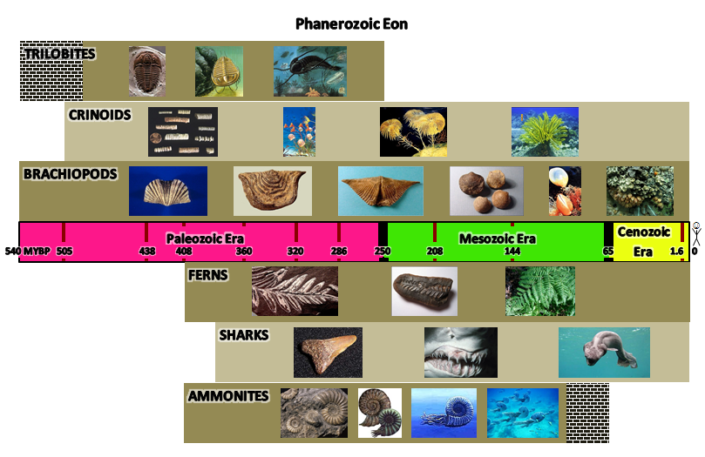
1C. Timeline Mats
Pass out the timeline mats, one per pair of students, while the rope is still stretched out
Briefly explain the layout of their timeline
The center rectangle with the numbers, era names, and three different colors is the time scale of the Phanerozoic Eon.
The numbers represent millions of years before present with 0 being present day
The different colors show the different eras. The mat’s colors match the rope’s colors!
The thick black lines also represent mass extinctions
The tan rectangles correspond to the life spans of the organisms in the rectangles.

Slide 10
IC. Timeline Mats cont. Paleozoic Era
Pink Sections – The Paleozoic Era:
Invertebrates such as trilobites, brachiopods, crinoids, and ammonites flourished in this era
Invertebrates lack a backbone.
Early fish develop
Image of frilled shark, considered a “living fossil” – it still exists but is rarely seen because it lives deep in the sea)
Sharks constantly shed their teeth. The skeleton of the shark is cartilaginous and so the teeth (which are bony) are more likely to be found as fossils
Early land plants develop - ferns
Early reptiles developed Ends with the largest mass extinction– 90% of all species became extinct.
Make sure students know what extinction means. The species will never be alive again.

Slide 11
IC. Timeline Mats cont. Mesozoic Era
Green Sections – The Mesozoic Era:
Age of Reptiles - many major reptile groups were dominant life forms
Dinosaurs, birds, small mammals, flowering plants, and flies flourished Ends with mass extinction of 50% of all species, including dinosaurs
It coincides with the impact of a huge meteorite in Mexico

Slide 12
IC. Timeline Mats cont. Cenozoic Era
Yellow Sections – The Cenozoic Era:
Cenozoic means “recent life”.
This is the Age of Mammals. Note - Some are already extinct (woolly mammoth, saber-toothed cat.)
The last knot represents the time that humans have lived on earth.

Slide 13
II. Fossils IIA. What are Fossils?
Q. What is the definition of the word “fossil”?
A fossil is a preserved piece of ancient life. It may look like the original life form, or it may be a piece of evidence that a creature lived. It takes millions of years to form.
Stress that in most cases, a fossil is not the actual flesh and bone (or stem/leaf) of the organism. Fossilized organisms look like the original form, but the parts have been replaced with rocks or minerals that took the shape of the organism’s remains.
Q. Which parts of animals are preserved as fossils?
Hard parts of animals’ bodies (bones, teeth, shells) have the ability to be preserved as fossils. Soft parts of their bodies are almost never preserved as fossil because they decompose too quickly.
Answer to Question 1 in worksheet: What parts of an organism can turn into a fossil?
Hard parts like teeth, bones, or shells

Slide 14
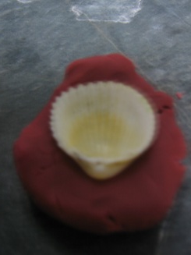
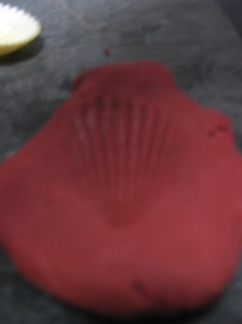
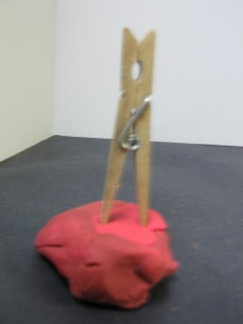
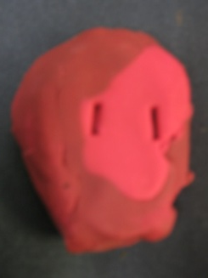
II Fossils cont. IIB. Types of Fossils
There are 2 main types of fossils:
Trace fossils
Body fossils
Activity: Play-Doh fossils
VSVS members should pass out a bag containing a piece of Play-Doh, one bivalve (clam) shell and one clothespin per pair.
Demonstrate putting Play-Doh inside of the bivalve shell and taking it out to make a model of it, and making an imprint of the shell’s ridges in the Play-Doh - this is an example of a body fossil because we can see actual features of the organism.
Demonstrate making a print in the Play-Doh with the clothespin. Tell the students to pretend that the clothespin is the leg of a dinosaur and that this imprint is its footprint – this is a trace fossil.
The oldest fossil found is dated at 2.2 billion years old – we don’t have fossils spanning earth’s entire history.

Slide 15
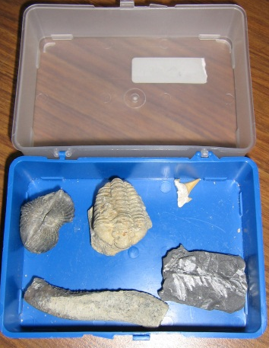
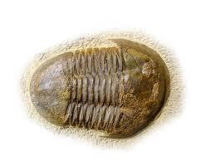
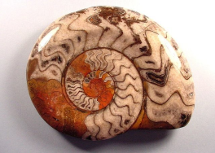
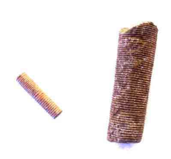
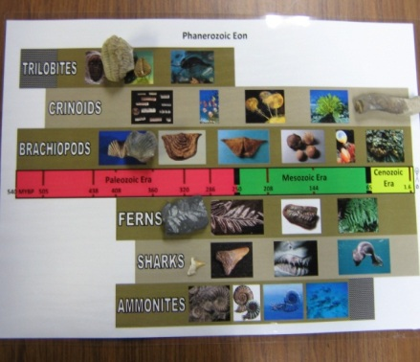
II Fossils cont. IIC. Looking at Real Fossils
Complete Fossil Box
DO NOT PASS OUT THE FOSSIL BOXES UNTIL YOU HAVE DONE THE FOLLOWING: Open each fossil box and count the number of fossils. There must be 6 in each. Boxes must be returned with all 6 fossils.
Tell the students that we will now look at real fossils of past organisms.
Tell students to identify each fossil and put it in the correct place on the timeline, using the pictures as a guide.
Some images are at the right for your reference (left = trilobite, right = ammonite, bottom = crinoid stem).
Tell students to return all of their fossils to the box and to leave the lid off.
A VSVSer will count the fossils . If any fossils are missing and students say they do not know where they are, tell the teacher immediately and have him or her help you find the missing fossils.
DO NOT CONTINUE UNTIL ALL FOSSILS ARE ACCOUNTED FOR.
Correct Placement of
Fossils on Timeline

Slide 16
III. Usefulness of Fossils
Q. Why are fossils useful?
Fossils telling us how earth has changed over time.
Finding the age of rocks.
Learning what type of environment once existed in a region.
Showing evidence that species evolve over time.

Slide 17
III. Usefulness of Fossils cont. A. Dating with Index Fossils
Tell students that fossils can be used to determine the age of rock layers - these are called index fossils.
Fossils are chosen to be index fossils if they:
Lived only a short time.
Are found in many areas worldwide.
Are easy to find (abundant).
Are easy to identify.
Perspective: The layer cake
In which cakes are the chocolate chips “index fossils”?
Answer Question 2 on worksheet: What are the four requirements for being an index fossil?
Lived only a short time, found in many areas worldwide, easy to find (abundant), and easy to identify.

Slide 18
III. Usefulness of Fossils cont. A. Dating with Index Fossils (cont.)
Which fossils are index fossils in the chart to the right (Handout #1)?
Answer Question 3 on worksheet : Which fossils on your timeline are used as index fossils? Ammonites and trilobites
Ammonites and trilobites are index fossils because they are in just one layer of the “cake” (timeline). Trilobites can be used to date rocks 540 – 490 million years old. Ammonites can be used to date rocks 100 – 65 million years old.

Slide 19
III. Usefulness of Fossils cont. B. Paleoenvironments
Fossils of marine invertebrates are found in Nashville – 400 million years ago, Nashville was under a shallow ocean!
Fossilized tree stumps in Antarctica – the continent used to have a much warmer climate

Slide 20
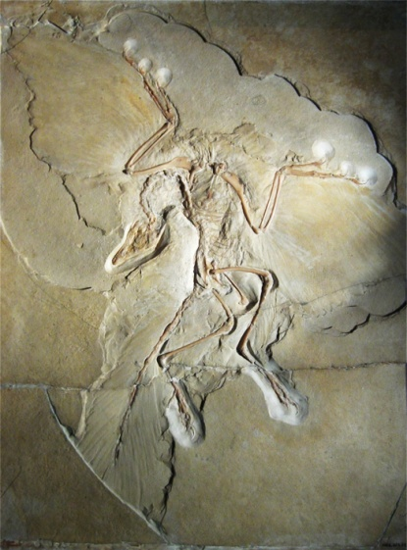
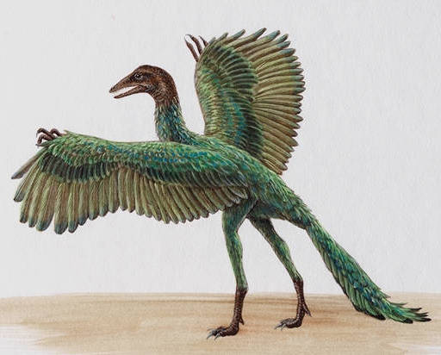
III. Usefulness of Fossils cont. C. Evolution
Note – if a student asks about creationism during this segment, say that that is a subject for the teacher to discuss and that you instead will finish talking about the uses of fossils, one of which is evidential support for evolution.
Tell students to look at the picture of a fossilized Archaeopteryx, a type of ancient dinosaur (Handout #1, pictures to the right).
Dinosaur characteristics (sharp teeth and a dinosaur-like head), bird like characteristics (wings).
This is evidence that the few dinosaurs that survived the mass extinction evolved into birds, not reptiles. So birds are actually the closest ancestors of the dinosaurs, not reptiles!
This is the Archeaopteryx (ARE-kee-OP-ter-rix), a transitional fossil between dinosaurs and birds. It has characteristics of dinosaurs like sharp teeth and a dinosaur-like head, but it contained many feathers which were modified scales (and still are on modern birds). Above is an artist’s reconstruction drawing based on several fossil specimens.

