Slide 1
Pediatric Videofluoroscopic Seating System for Swallow Studies
Katie Henderson, Noah Mallory, Justin Cruz, & John Kerr
Notes:
Katie
-Hello everyone, thank you for being here today. My name is Katie, and these are my teammates Noah, Justin, and John.
Today we will be giving you an overview of our senior design project, which is to design a pediatric videofluoroscopic seating system for swallow studies. We will start with a brief background of the problem before diving into our needs assessment, progress to date, and timeline moving forward.

Slide 2
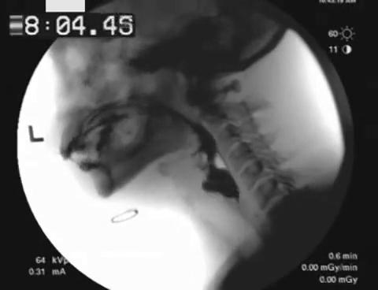
Background
What are pediatric videofluoroscopic swallow studies?
Performed on kids that have developmental and/or birth defects
Enable providers to identify patient's risks and concerns while swallowing
Goal is to mitigate risks through interventional surgeries or feeding tubes
Take X-rays in real time while patient swallows liquids/foods mixed with barium
https://gfycat.com/frailspryfly
Notes:
Katie
-At Monroe Carell Jr. Children's Hospital at Vanderbilt, dozens of videofluoroscopic swallow studies are performed each week for kids that have developmental and birth defects.
-These studies enable providers to identify each patient's potential risks and concerns when swallowing, such as aspiration or an inability to consistently use the epiglottis and pharynx muscles.
-If potential risks can be quickly addressed with interventional surgeries or feeding tubes, physicians can greatly improve patient comfort and safety and put their families at ease.
-These swallow studies are performed by taking X-rays in real time while the patient swallows liquids/foods mixed with barium.

Slide 3
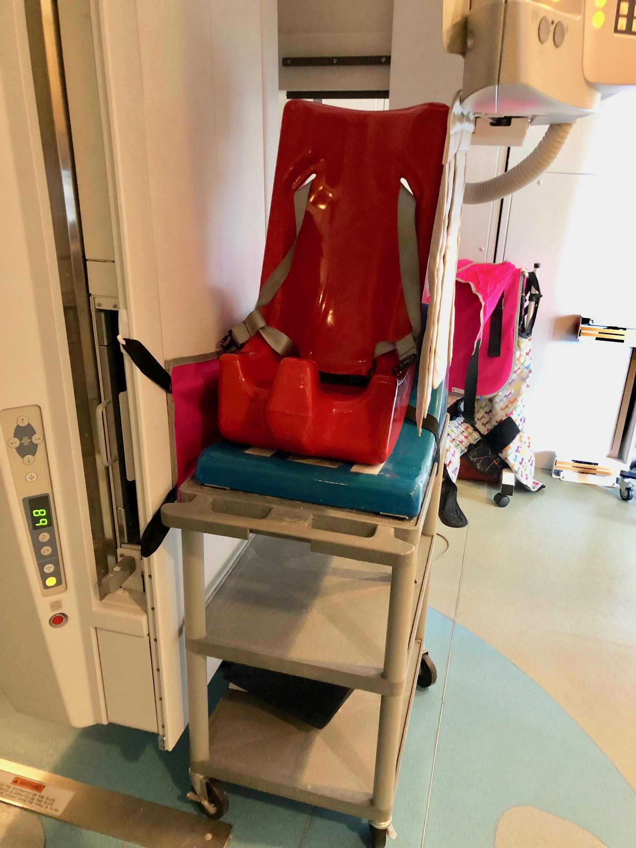
Problem Statement
The current chair is:
Unstable for children with motor deficiencies
Incompatible with other medical machinery
Not adjustable for patients of different ages and sizes.
Notes:
Noah
The current positioning system used for pediatric videofluoroscopic swallow studies is unstable for children with motor deficiencies, incompatible with other medical machinery, specifically the X-ray machine, and not adjustable for patients of different ages and sizes.

Slide 4
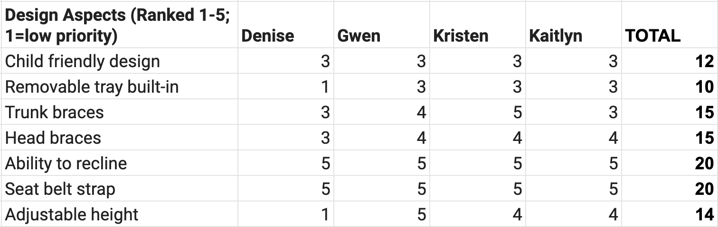
Needs Assessment Based on The Clinicians
Crucial needs:
Ability to recline
Support from braces and straps
Notes:
Noah

Slide 5
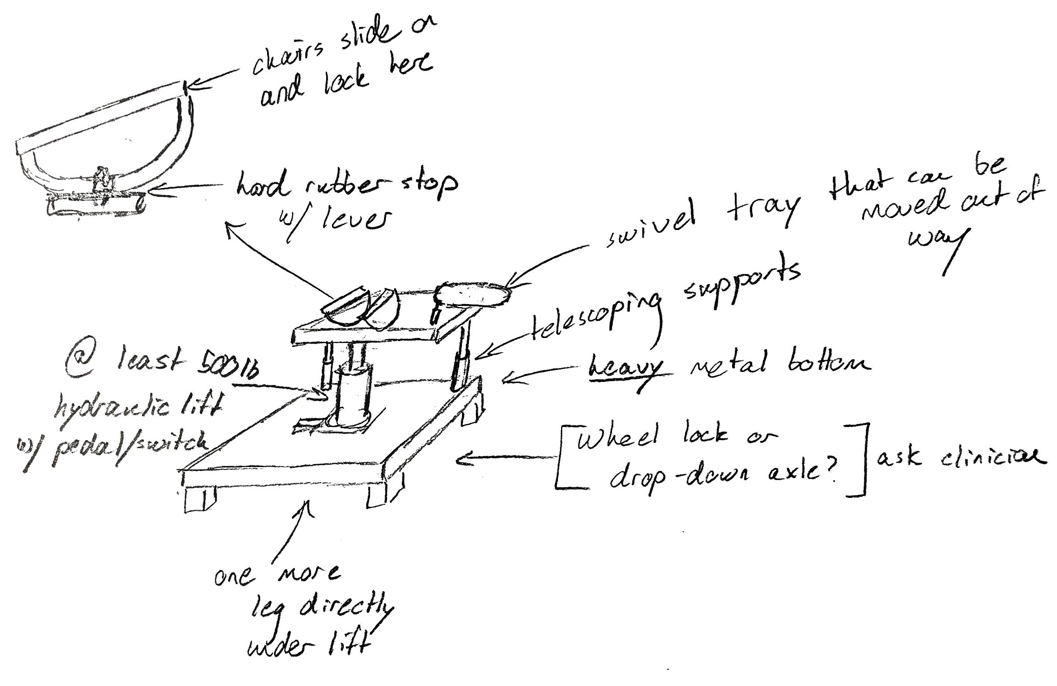
Previous Design
Telescoping design for the back legs
D-rail design for reclining
Hydraulic lift in the center
Notes:
Person 3 - Justin
Based on current needs assessment and problem statement…current goals we plan to meet and aspects we are incorporating in our first model
Will be prototyping initial designs soon...
Based on what we saw in our clinical observations:
From perspective of the nurses: easily switch between states, height adjustable (in), radiotranslucent material
Families: topple resistant
System: catch-all solution.

Slide 6
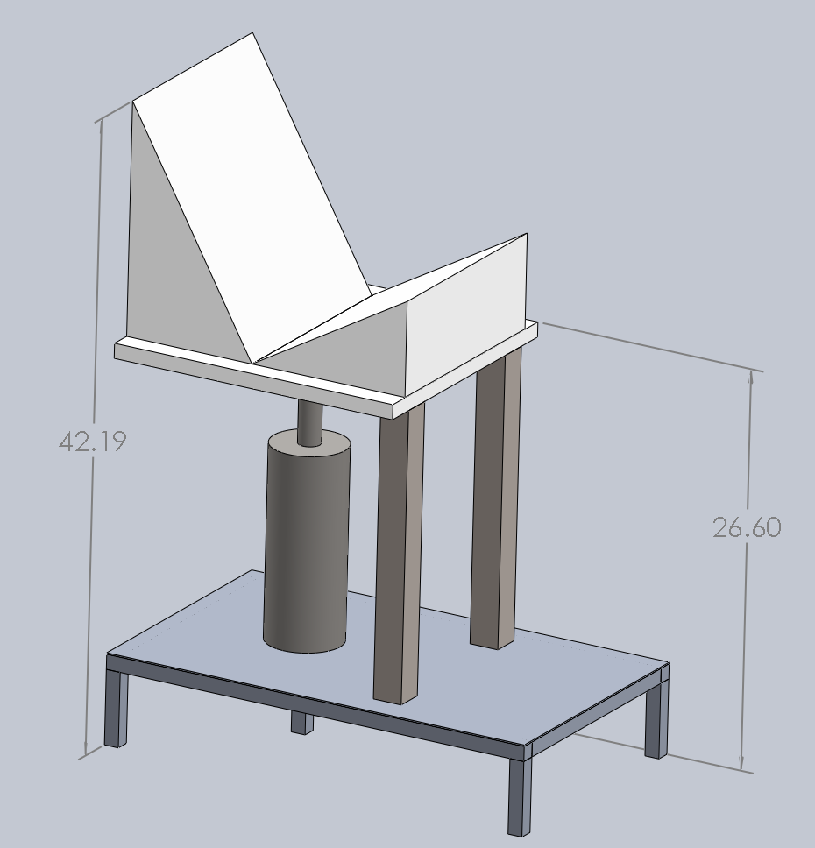
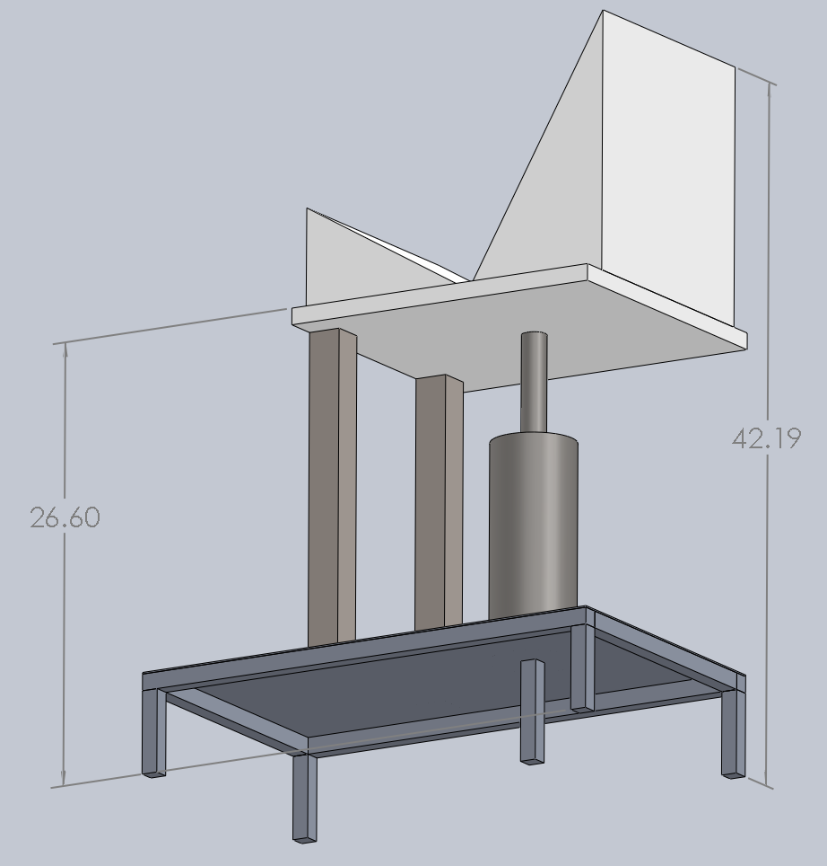
CAD Design - SolidWorks
Overall weight: 201.71 pounds
Floor to seat base height: 26.6 inches
Specific materials:
  Aluminum base and legs
  Steel front supporting legs
  Steel hydraulic lift
  Composite plastic base for chair
Hydraulic lift used to incline and decline chair
Special Tomato Sitter will strap into plastic base for easy switching between sizes
Notes:
Katie
-need to move lift further back for greater rotation
-seat base alone is ~50 pounds and size 5 sitter is 19 pounds → 70 pounds being lifted by pump, not including child

Slide 7
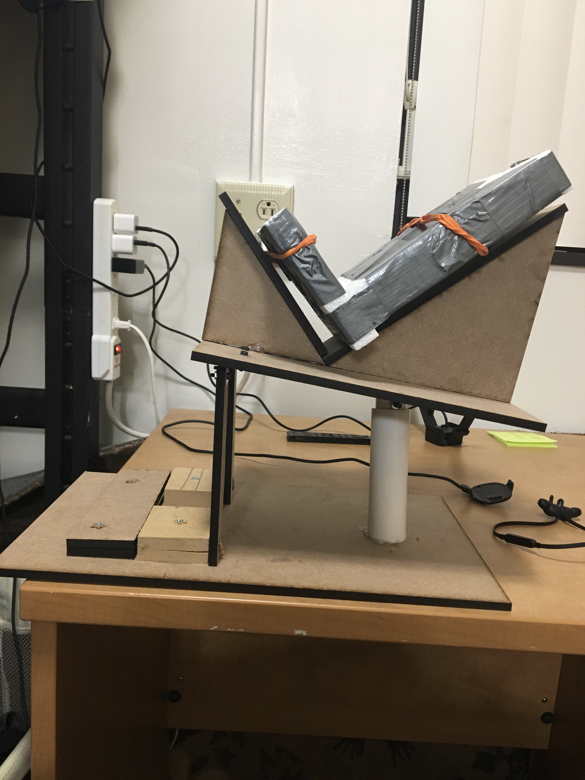
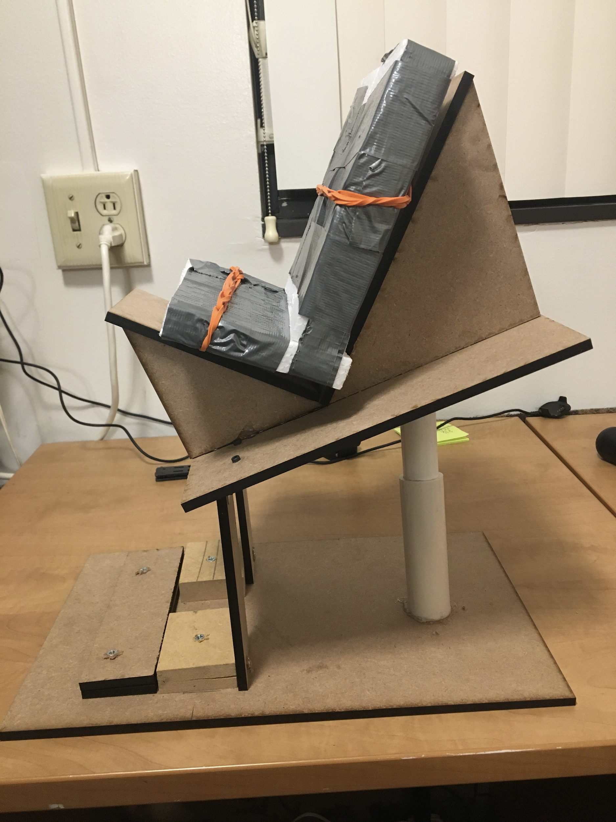
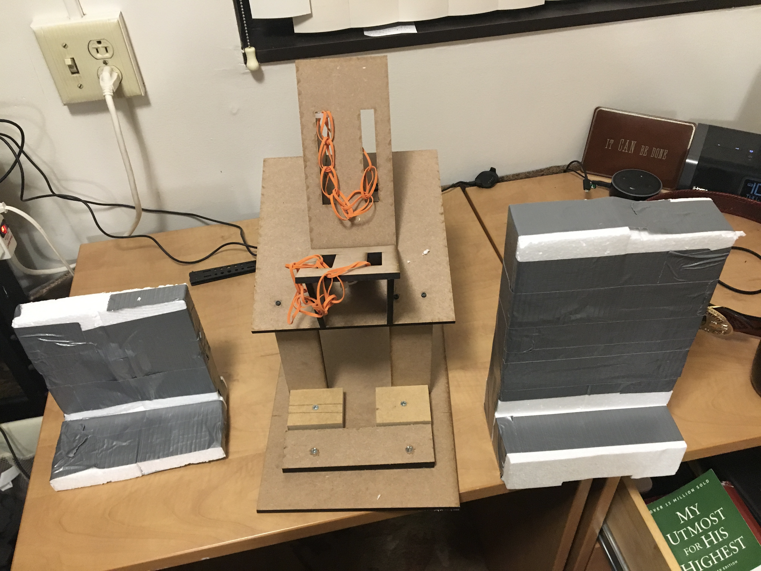
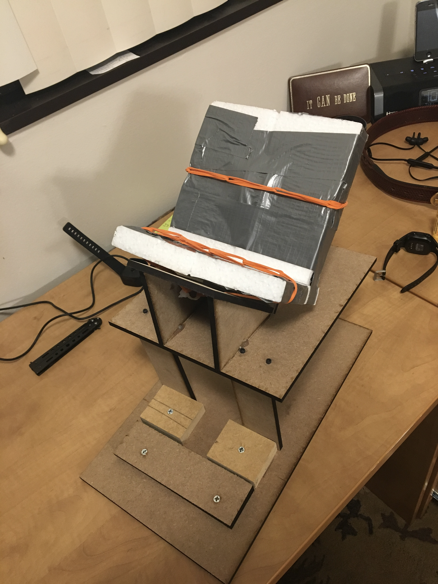
First Prototype
Strengths we see
  Utilizes a simpler, single pole hydraulic lift design for reclining in the rear
  Universal anchor points that all three seat sizes fit in. No seat modifications necessary
  More stable than the telescoping model
What we have learned
  Current design cannot adjust height
    The importance of this is will depend on the measurements we take later this week
  Range of the chair angle must increase
  Foot supports must be attached to base
Notes:
Noah

Slide 8
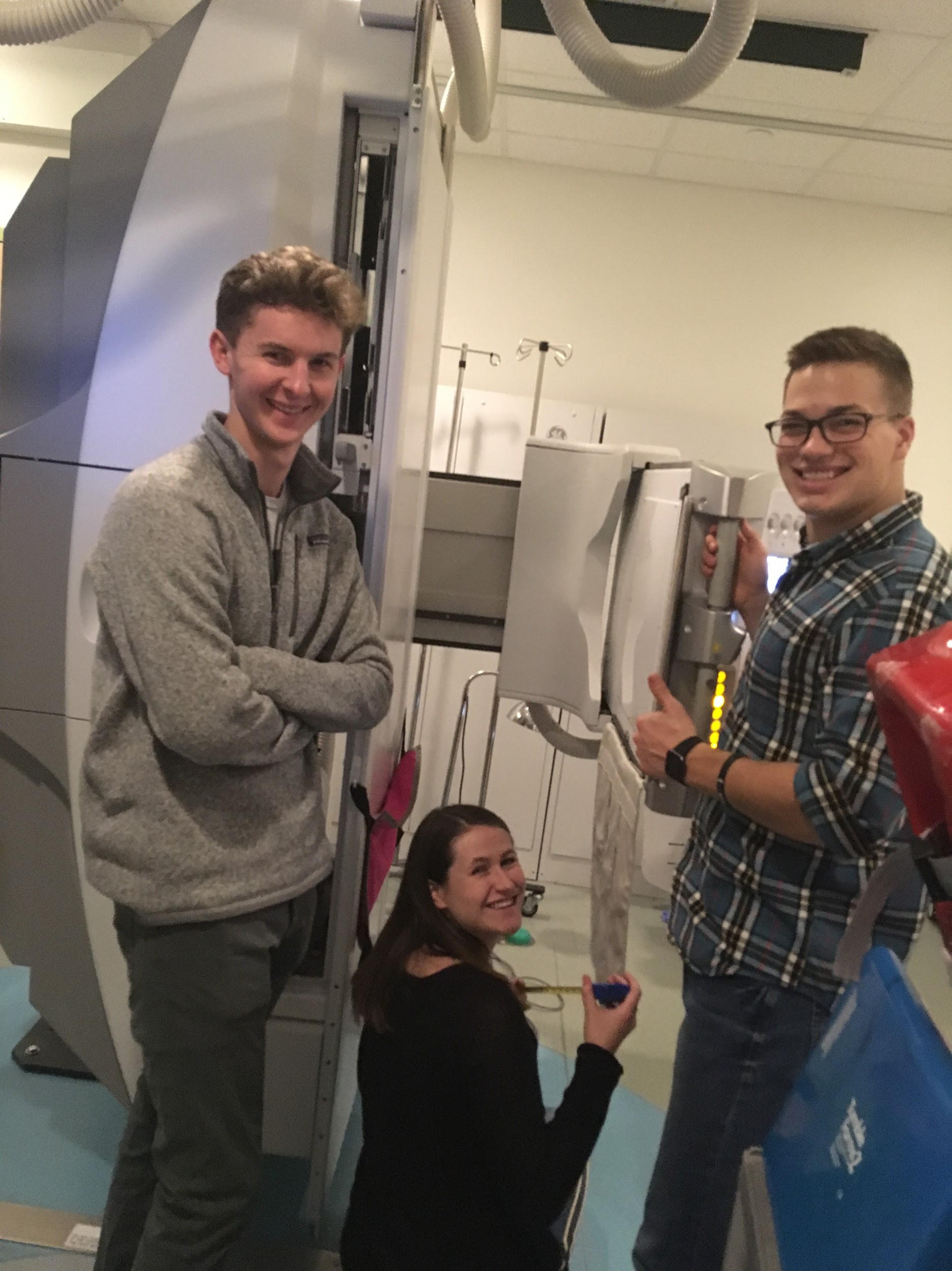
Design Challenges
Height range of motion
  Size restraints for the large model
  Must serve Size 1 Sitter (25” height) to Size 5 (44” height)
Structure mobility
  Drop down axle
  Industrial wheels with a hard stop
Materials and weight
  Lowering the center of mass
  Needs to move easily on wheels
Notes:
John
-Based on input from VFSS staff
-Material has been found to break down after repeated cleanings - looking into protectant/sealant
-Base can be designed to work for all three chair sizes
-12, 16, and 20 inch widths

Slide 9
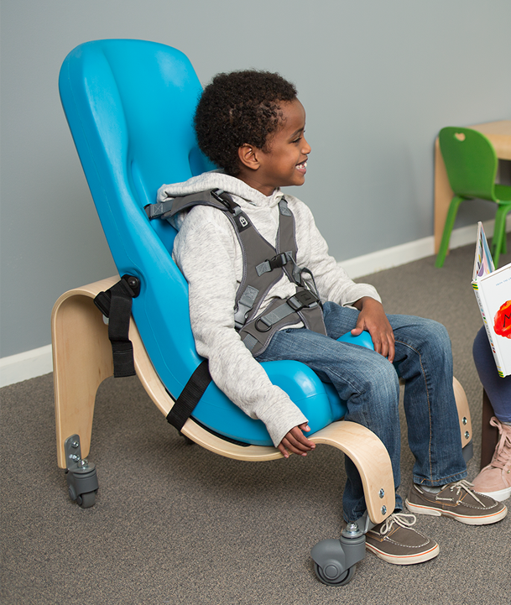
Parts Ordered
Special Tomato Soft-Touch Sitter: 3 sizes
  Size one: 20-30 lbs (infant to toddler)
  Size three: 40-80 lbs (5-11 years)
  Size five: 90-200 lbs (11 years-adult)
We have set up an appointment to take these seats into the clinic
Hydraulic chair base and receptacle
  Supports up to 800 lbs
https://www.adaptivemall.com/special-tomato-soft-touch-sitter.html
Notes:
Katie
-Base can be designed to work for all three chair sizes
-feedback from clinicians: better stability; five-point harness
-12, 16, and 20 inch widths
-25 to 44 inches total height

Slide 10
Meeting Updates
Dr. Galloway
  Recommended prototyping techniques and ideas for the reclining feature
    Foam board modeling
    Involve clinicians
  Emphasized finding materials to incorporate and minimize customization requirements
Speech Pathologists
  Updates on our progress
  Discussed Special Tomato Soft-Touch Sitter
    Further clarity on wear and tear issue
    Warranty and potential donors to order new chairs
  Patient testing on preliminary designs
Notes:
John

Slide 11
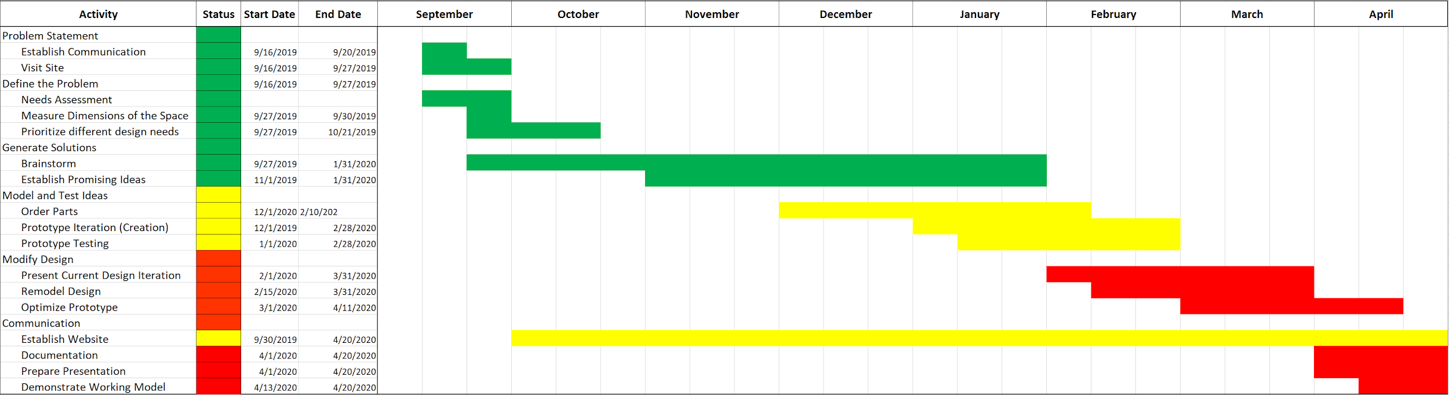
Updated Project Plan
Notes:
John
We have organized our optimal timetable into a gantt chart. In early september we established communication with our adviser, Kaitlyn Minchin and the rest of the Video Fluoroscopy team with Noah as our primary point of contact. We were then able to tour the facility and the observe important aspects of the fluoroscopy process the seating system would be designed for. Over the past month we have used this information to establish a foundation for the list of needs we identified to be ranked by Kaitlyn and her team. Currently, we are brainstorming and developing promising ideas to pursue based on our list of prioritized needs. In the future we would like to start prototyping with the tools available in the Wondry, before ordering parts over the next couple of months. Then we will proceed with iterative prototyping to optimize our design model all while continuously recording our progress online through our website platform.

Slide 12
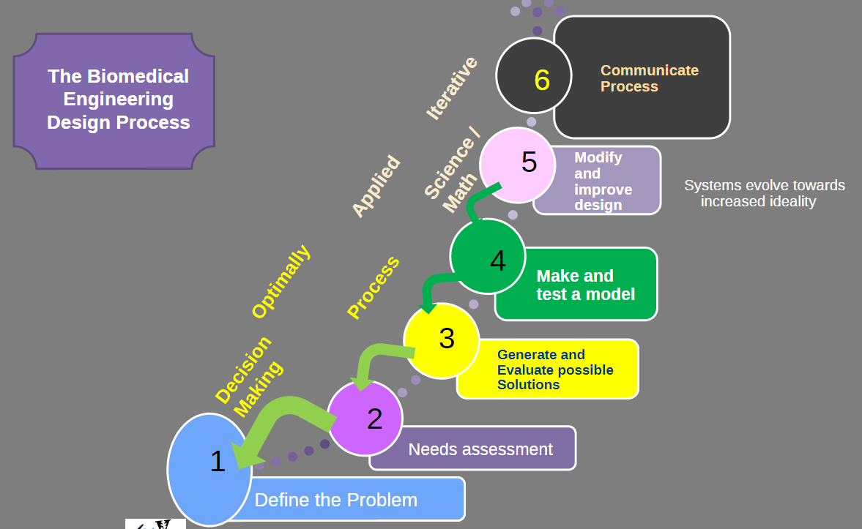
Future Design Path
Currently in step four: make and test a model
Future plans include:
  Bring Special Tomato Sitters into hospital procedure room to test height limitations
  Complete CAD model to determine overall mass of design
  Bring in multiple design ideas to speech pathologists and technicians to gain feedback
https://brightspace.vanderbilt.edu/d2l/le/content/142254/viewContent/1111865/View
Notes:
John
Where we are and where we’re going
Diving further into the current stage of our design process. We have started to generate possible design pathways by brainstorming seating models consistent with the needs diagnosed by our team as well as Kaitlyn and her fellow physicians at Monroe carroll. This includes sketches like the one Justin described previously as well as researching past products and analyzing what worked well and what did not. We will continue to communicate our ideas and include drawings in our team meetings, but will also look to start creating physical models in the makerspace out of free, raw materials like plywood and PVC available at the maker’s space.
All members have completed Makerspace training and have scheduled a meeting for this week with Dr. Kevin Galloway to begin prototyping
prototyping

Slide 13
Acknowledgements
We would like to that Dr. Matthew Walker III, Bonnie Walton, Kaitlyn Johnston Minchin, and the entire VFSS staff for their continued support throughout this design process.
Notes:
John

