Slide 1
Pediatric Videofluoroscopic Seating System for Swallow Studies
Katie Henderson, Noah Mallory, Justin Cruz, & John Kerr
Notes:
Person 1 - Katie
Hello everyone, thank you for being here today. My name is Katie, and these are my teammates Noah, Justin, and John.
Today we will be giving you an overview of our senior design project, which is to design a pediatric videofluoroscopic seating system for swallow studies. We will start with a brief background of the problem before diving into our needs assessment, progress to date, and timeline moving forward.

Slide 2
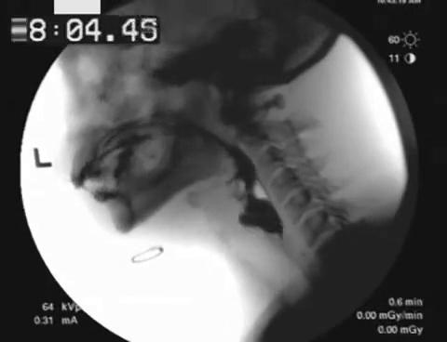
Background
What are pediatric videofluoroscopic swallow studies?
Performed on kids that have developmental and/or birth defects
Enable providers to identify patient's risks and concerns while swallowing
Goal is to mitigate risks through interventional surgeries or feeding tubes
Take X-rays in real time while patient swallows liquids/foods mixed with barium
https://gfycat.com/frailspryfly
Notes:
Person 1 - Katie
-At Monroe Carell Jr. Children's Hospital at Vanderbilt, dozens of videofluoroscopic swallow studies are performed each week for kids that have developmental and birth defects.
-These studies enable providers to identify each patient's potential risks and concerns when swallowing, such as aspiration or an inability to consistently use the epiglottis and pharynx muscles.
-If potential risks can be quickly addressed with interventional surgeries or feeding tubes, physicians can greatly improve patient comfort and safety and put their families at ease.
-These swallow studies are performed by taking X-rays in real time while the patient swallows liquids/foods mixed with barium.

Slide 3
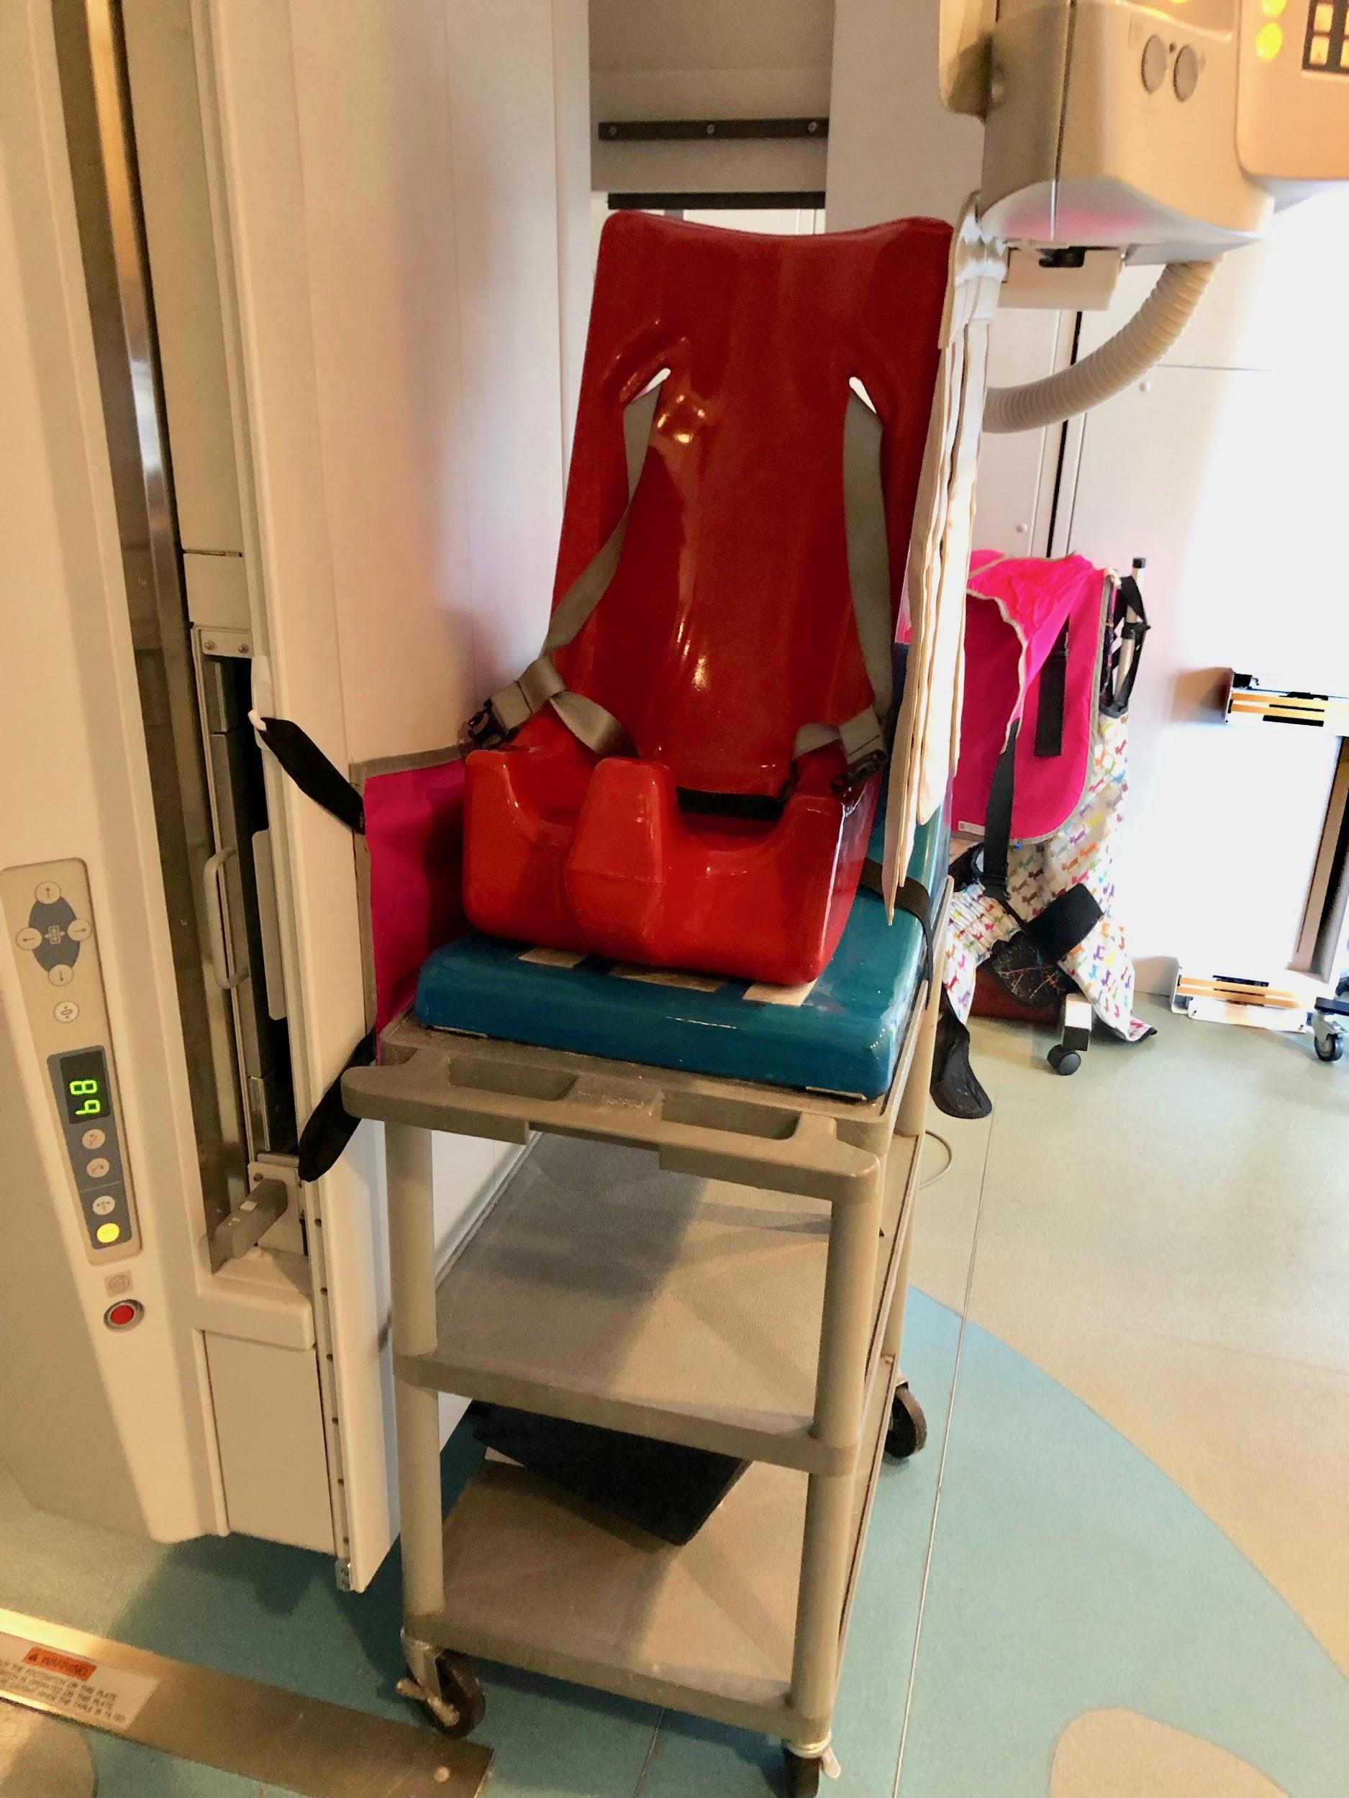
Problem Statement
The current design is:
Unstable for children with motor deficiencies
Incompatible with other medical machinery
Not adjustable for patients of different ages and sizes.
Notes:
Person 2 - Noah
The current positioning system used for pediatric videofluoroscopic swallow studies is unstable for children with motor deficiencies, incompatible with other medical machinery, specifically the X-ray machine, and not adjustable for patients of different ages and sizes.

Slide 4
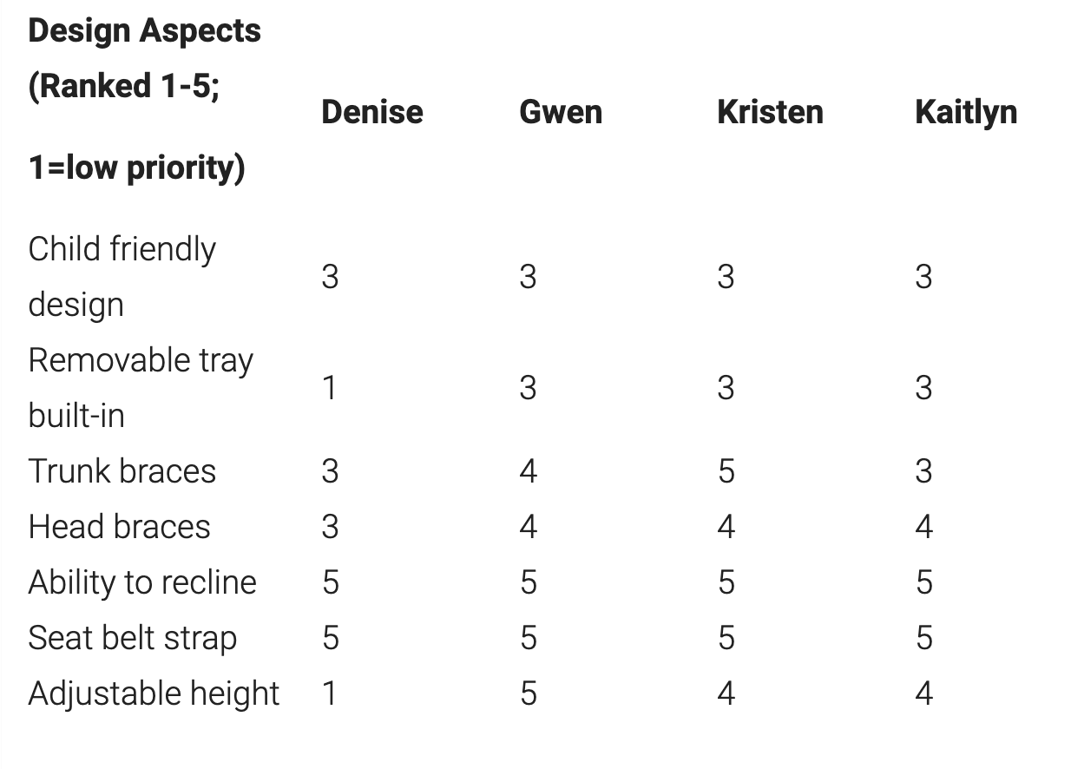
Needs Assessment
Crucial needs:
Stability (of patient and system)
Accommodates variety of ages/sizes
Mobile
Washable
Does not block image
Fits in required dimensions
Notes:
Person 2 - Noah

Slide 5
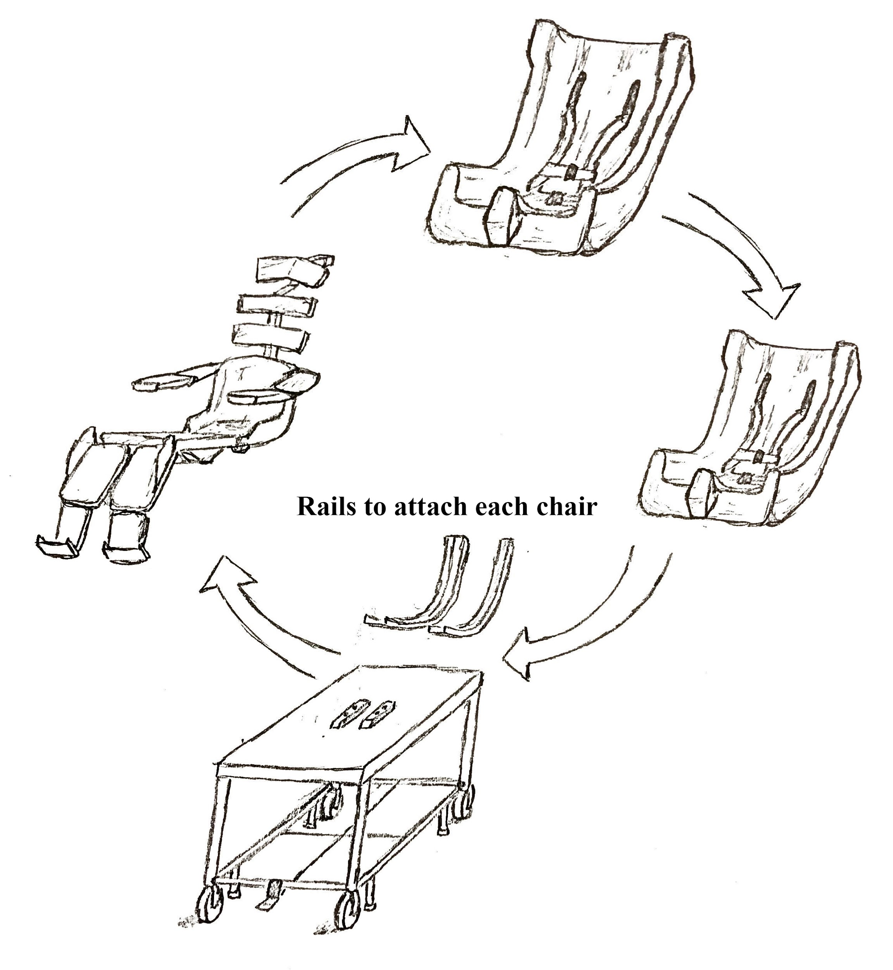
Design Components and Constraints
Easily switches between mobile and static states
Topple-resistant
Radiotranslucent around head, neck, and upper trunk
Accommodate patients with range of motor capabilities and dependencies
Max dimensions: 19.125” width, 31.5” depth
Stabilize patient’s head 53-55” above floor
Supports patients up to 250 lbs and 6 ft tall
Notes:
Person 3 - Justin
Based on current needs assessment and problem statement…current goals we plan to meet and aspects we are incorporating in our first model
Will be prototyping initial designs soon...
Based on what we saw in our clinical observations:
From perspective of the nurses: easily switch between states, height adjustable (in), radiotranslucent material
Families: topple resistant
System: catch-all solution.

Slide 6
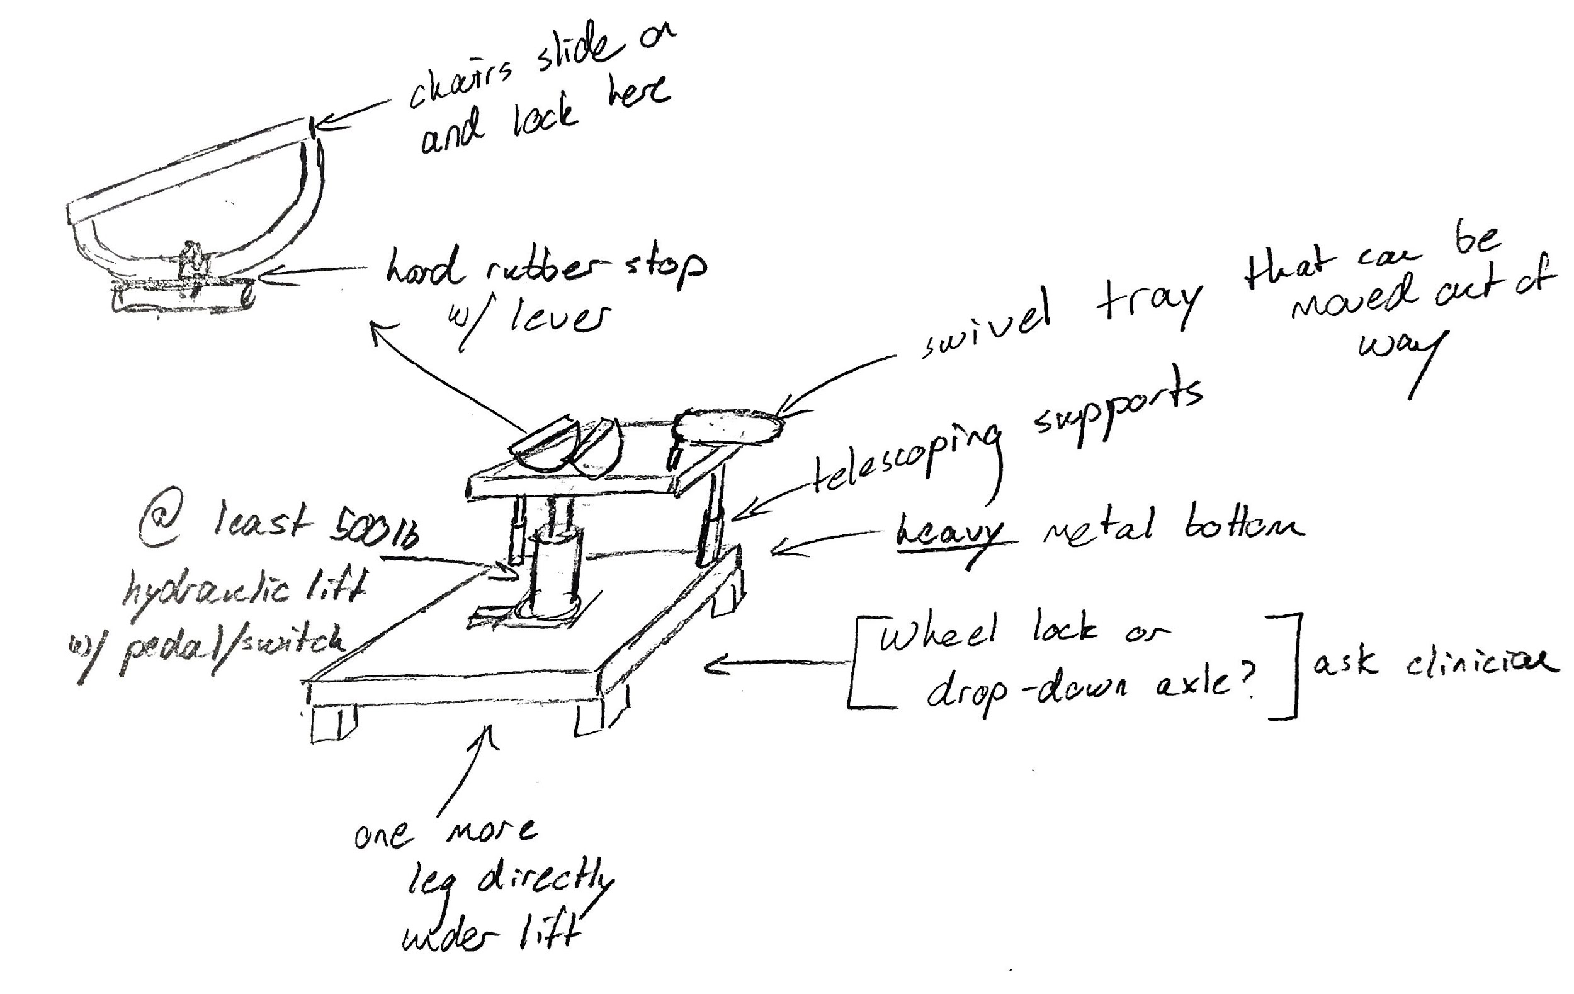
Updated Design
Improvements:
Hydraulic lift
Detailed loading system
Optional food tray
Topple-resistant
Front half of raised platform removed
Further Assessment For:
Axle design
Telescoping supports
Notes:
Focuses on improved stability, challenges previous design components,
Designing in makerspace now

Slide 7
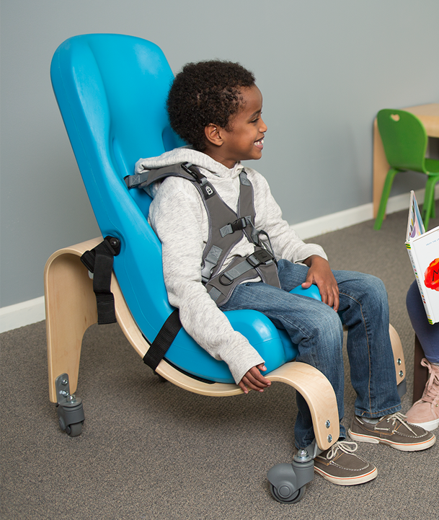
Parts Ordered/Requested
Special Tomato Soft-Touch Sitter: 3 sizes
  Size one: 20-30 lbs (infant to toddler)
  Size three: 40-80 lbs (5-11 years)
  Size five: 90-200 lbs (11 years-adult)
Special Tomato chair provides better support than Tumble Form
  5-point harness
Hydraulic chair base and receptacle
  Supports up to 800 lbs
https://www.adaptivemall.com/special-tomato-soft-touch-sitter.html
Notes:
-Based on input from VFSS staff
-Material has been found to break down after repeated cleanings - looking into protectant/sealant
-Base can be designed to work for all three chair sizes
-12, 16, and 20 inch widths

Slide 8
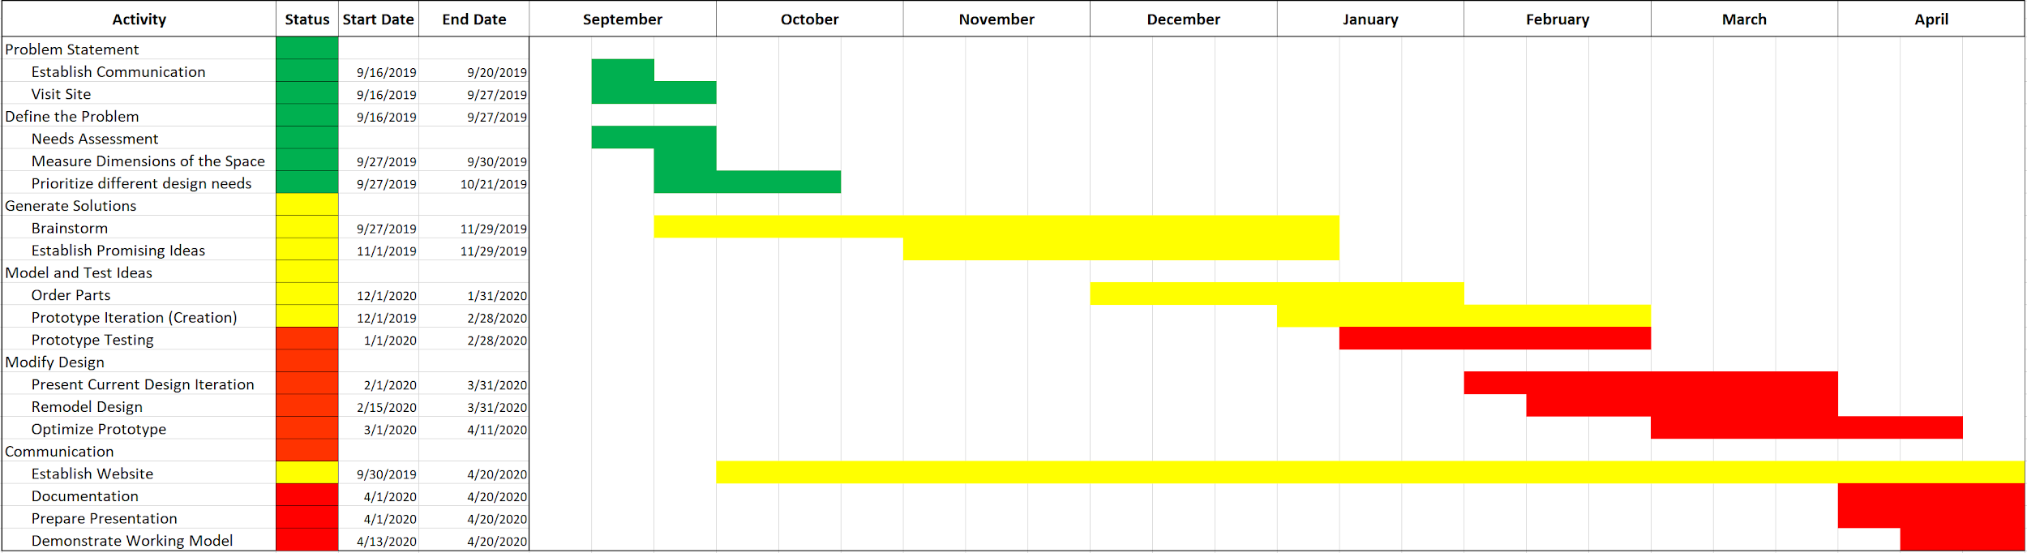
Updated Project Plan
Notes:
Person 4 - John
We have organized our optimal timetable into a gantt chart. In early september we established communication with our adviser, Kaitlyn Minchin and the rest of the Video Fluoroscopy team with Noah as our primary point of contact. We were then able to tour the facility and the observe important aspects of the fluoroscopy process the seating system would be designed for. Over the past month we have used this information to establish a foundation for the list of needs we identified to be ranked by Kaitlyn and her team. Currently, we are brainstorming and developing promising ideas to pursue based on our list of prioritized needs. In the future we would like to start prototyping with the tools available in the Wondry, before ordering parts over the next couple of months. Then we will proceed with iterative prototyping to optimize our design model all while continuously recording our progress online through our website platform.

Slide 9
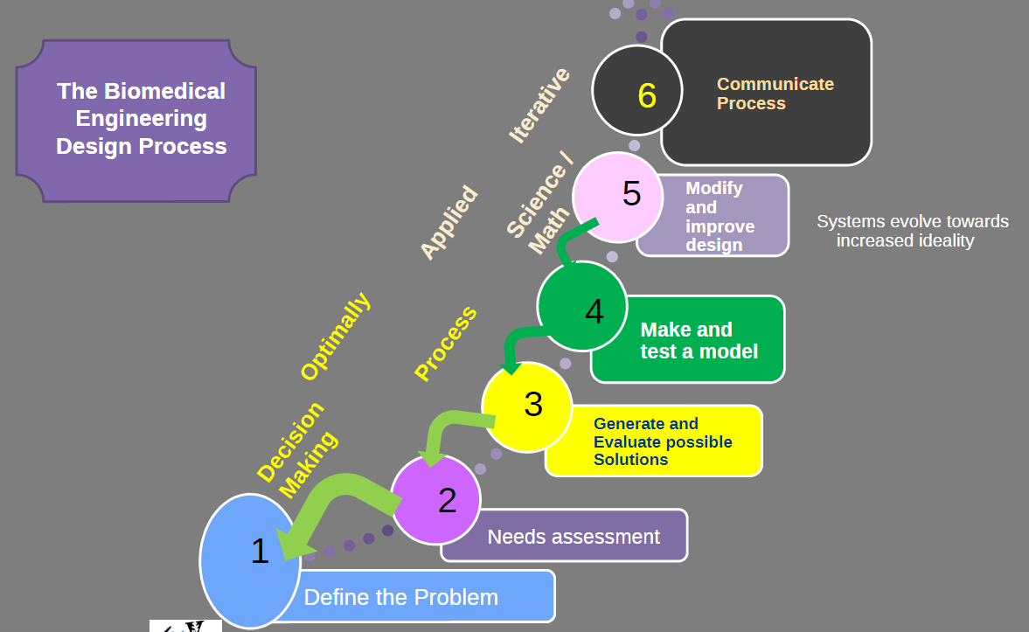
Future Design Path
Currently in step four: make and test a model
Order requests
  Special Tomato
  Hydraulic Lift
Completed makerspace certification to begin prototyping
Future plans include experimenting with chair material and incorporating lift system
  We have a meeting scheduled with Prof. Galloway regarding sealant
https://brightspace.vanderbilt.edu/d2l/le/content/142254/viewContent/1111865/View
Notes:
Person 4 - John
Where we are and where we’re going
Diving further into the current stage of our design process. We have started to generate possible design pathways by brainstorming seating models consistent with the needs diagnosed by our team as well as Kaitlyn and her fellow physicians at Monroe carroll. This includes sketches like the one Justin described previously as well as researching past products and analyzing what worked well and what did not. We will continue to communicate our ideas and include drawings in our team meetings, but will also look to start creating physical models in the makerspace out of free, raw materials like plywood and PVC available at the maker’s space.
All members have completed Makerspace training and have scheduled a meeting for this week with Dr. Kevin Galloway to begin prototyping
prototyping

Slide 10
Acknowledgements
We would like to that Dr. Matthew Walker III, Bonnie Walton, Kaitlyn Johnston Minchin, and the entire VFSS staff for their continued support throughout this design process.
Notes:
Person 1 - Katie

