Slide 1
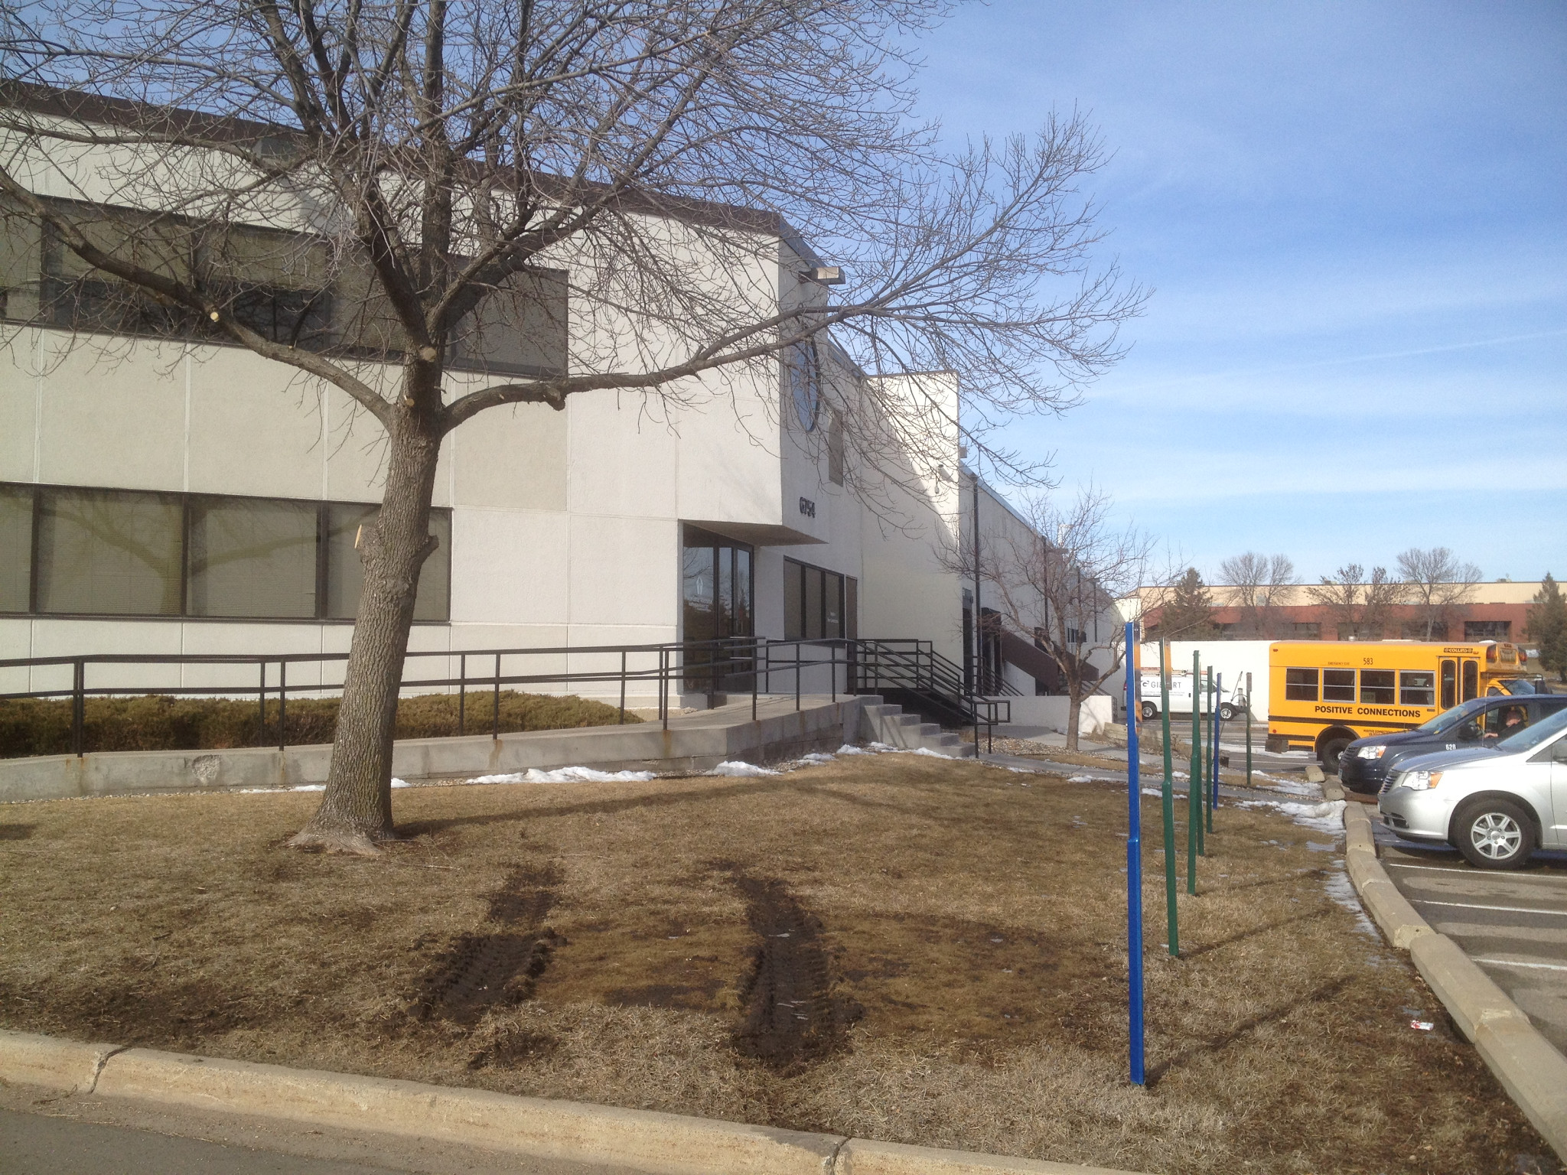
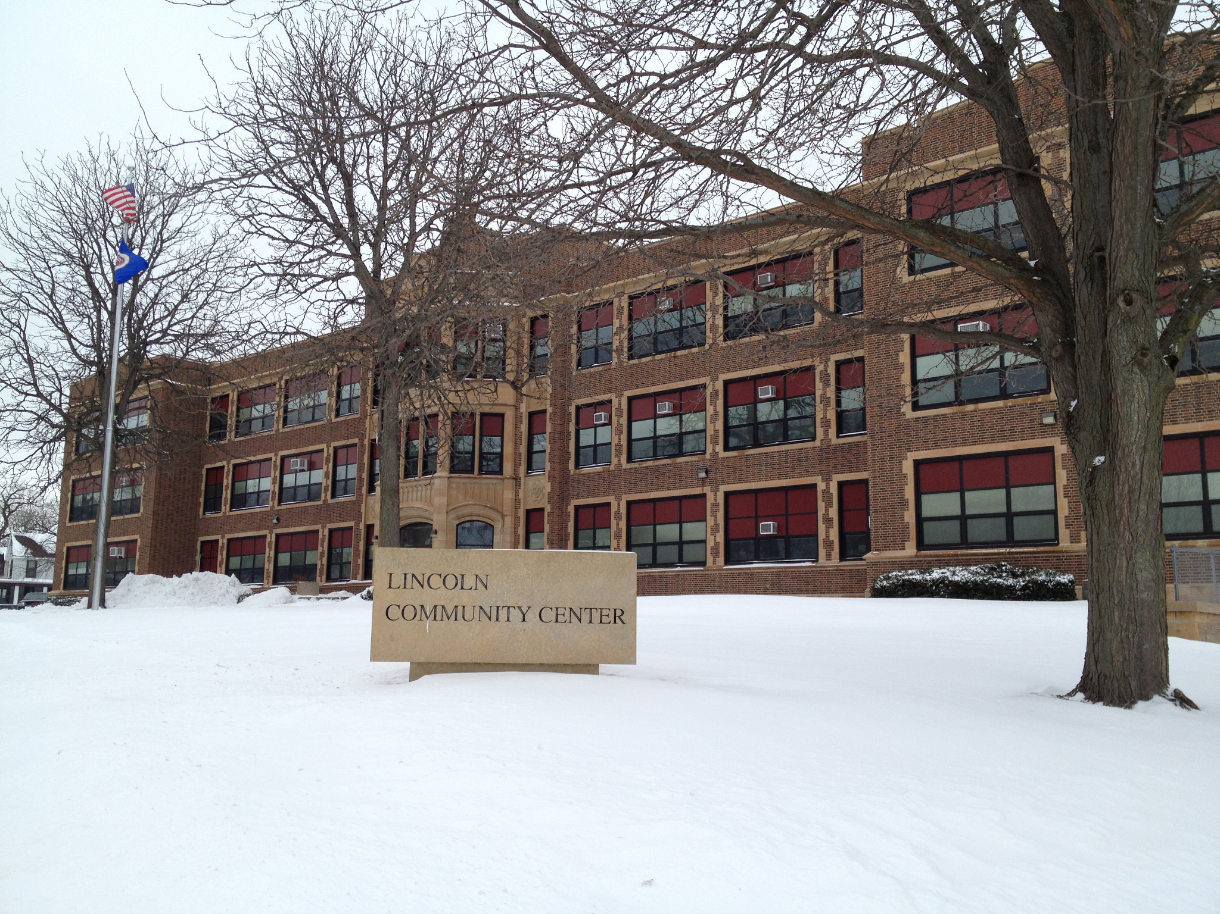
Peer support as a mechanism for relapse prevention among adolescents in recovery
Holly L. Wegman Vanderbilt University, Nashville, TN
Introduction
It seems obvious that grouping together youth who are working toward sobriety would allow them to support one another. However, it also seems obvious that grouping together youth who have issues with substance use might lead to increased temptation and relapse. So – is it beneficial or detrimental to group together peers with similar risk-behavior issues, specifically, substance use disorders?
Research around the effect of peers on drug use suggests two competing theories of influence:
Peer contagion theory and iatrogenesis suggest that grouping high risk youth together could lead to higher risk for relapse.^{1, 2}
Peer-based recovery support programs improve treatment-related outcomes for youth.³
Recovery High Schools operate on the assumption that teens in recovery provide positive support to one another. These schools provide an alternative ecology for students in recovery from alcohol and drug addictions by creating a space where all students are working to overcome addiction and maintain sobriety.⁴
The present study examines data from qualitative interviews with staff at Recovery High Schools to understand how peers influence recovery programming and continuing care support – both in helpful and in potentially detrimental ways.
Results
Conclusions
When discussing peer influence in schools, staff discussed the positive aspects – encouraging one another, connecting each other with community resources, and providing empathy and accountability – far more often than they discussed negative aspects – pressure to use drugs or negative relationship dynamics.
However, there seemed to be a sense that positive peer influence was reserved for particular peers – only those with a very serious commitment to sobriety – and that “other” peers were the source of negative influence.
Sense of community – built on the foundation of positive peer support – is discussed as a key influence in Recovery Schools’ programming. Positive peer supports for adolescents in recovery should continue to be explored as a key resource.
Positive Peer Support (19 instances)
“It’s like all of a sudden where they’ve never had that opportunity to have a venue to share, now they do. And it kind of gives them hope and then they get the feedback from their peers saying, ‘You can make it… ‘cause I’m going through the exact same thing.’ So that sense of support is pretty strong.” ~Counselor at School 1
“Our kids will take new kids in, take them to meetings, say ‘this is my favorite group.’ We talk about… what’s working, what’s not working, what’s your favorite group, what’s the favorite thing you heard a speaker say?” ~Director at School 4
“The reality is that we’ve created a culture here that most of our students really take their recovery seriously. And because of that they care about their fellow student here, they care about their experience here.” ~Director at School 3
“You can’t be with those friends that are using because of the fragile nature of your recovery, and so they really depend upon each other.” ~Principal at School 6
Negative Peer Influence (7 instances)
“I had a student say to me last week, ‘I relapsed,’ and he’s relapsed twice since he’s come to our school and it’s been with two students who also came to the school who dealt him… But he’s like, ‘that’s messed up.’” ~Counselor at School 1
“Last year we had a lot of people who were worried about other people’s sobriety and not as worried about their own. And then that got in to a lot of, you know, just drama, high school drama.” ~Teacher at School 4
“You know, there was a party that happened a month and a half ago. [Our] students were there. All [our] students got completely out of control, a lot of boundaries were blurred, and it was crazy around here for that week or so.” Director at School 3
“There’s so many kids here that are vulnerable and I’m asking [students who are not committed to sobriety] to help us out… And most… students will do the right thing. They’re like, ‘You’re right. I’m not helping this community, I’m hurting it’ and they will leave.” ~Counselor at School 1
© File copyright Colin Purrington. You may use for making your poster, of course, but please do not plagiarize, adapt, or put on your own site. Also, do not upload this file, even if modified, to third-party file-sharing sites such as doctoc.com. If you have insatiable need to post a template onto your own site, search the internet for a different template to steal. File downloaded from http://colinpurrington.com/tips/academic/posterdesign.
Literature cited
¹Gifford-Smith, M., Dodge, K. A., Dishion, T. J., & McCord, J. (2005). Peer influence in children and adolescents: Crossing the bridge from developmental to intervention science. Journal of Abnormal Child Psychology, 33, 255-265.
²Dishion, T. J., McCord, J., & Poulin, F. (1999). When interventions harm: Peer groups and problem behavior. American Psychologist, 54(9), 755-764.
³Kelly, J. F., Dow, S. J., Yeterian, J. D., & Kahler, C. W. (2010). Can 12-step group participation strengthen and extend the benefits of adolescent addiction treatment? A prospective analysis. Drug and Alcohol Dependence, 110, 117-125.
⁴Moberg, D. P., & Finch, A. J. (2007). Recovery high schools: A descriptive study of school programs and students. Journal of Groups in Addiction and Recovery, 2, 128-161.
Peer Relationships (16 instances)
“Being smaller schools it seems like there’s a lot of relationship drama that happens where kids start dating each other and then they break up and… someone leaves because being in a small school makes it very challenging for them to see the one they love so dearly and broke their heart.” ~Counselor at School 1
“[Students in recovery] really struggle with boredom and loneliness and that’s something they all report. A lot of them turn to the internet and they turn to gaming and they seclude themselves even more which is something we keep wanting to work through… I think there’s some, there’s connectedness, but it hasn’t gotten to the point of necessarily hanging out, out of school. And some of that could be barriers of transportation and things like that.” ~Social worker at School 4
“And then there can be times where you just feel energetically that there’s an undercurrent of something but you don’t know exactly what it is. And then that’s when you sort of realize well So-and-So knows that So-and-So is using. You know what I mean?” Counselor at School 2
Two recovery schools in Minnesota where interviews were conducted.
Acknowledgments
Research reported in this poster was supported by the National Institute On Drug Abuse of the National Institutes of Health under Award Number R01DA029785. The content is solely the responsibility of the author and does not necessarily represent the official views of the National Institutes of Health.
The template for this poster was downloaded from:
http://colinpurrington.com/tips/academic/posterdesign
Materials and Methods
Eleven interviews were conducted with school staff (teachers, counselors, social workers, and administrators) at 6 different Recovery Schools in the Midwest. Schools were initially recruited for collaboration on a longitudinal quasi-experimental study.
Interviews lasted approximately 1-hour and followed semi-structured protocols. Interviews were transcribed and then coded according to previously determined themes relating to peer support. Because coding at this stage is for descriptive purposes, transcripts were only coded by one researcher.
Sense of Community (41 instances)
“They can’t hide here. They’re accountable for their actions because there’s a focus on it. There’s a sense of community and family here that they, a lot of the students take pride in and want to do well.” ~Counselor at School 1
“So that’s to me what a Recovery School is all about. That intimacy, that sort of, you know, really getting to know people… I just don’t know if you’d have that in another setting.” ~Counselor at School 2
“You have to work it, you know, the site’s so small if you don’t work as a community you’re toast, and so we work as a community.” ~Director at School 4
“So many of them don’t have a family, you know, and we, almost the program becomes their family, so they really depend upon each other and upon us. We see a lot of them come back just to update us on how they’re doing.” ~Principal at School 6
Further information
For more information, please contact Holly Wegman: holly.wegman@gmail.com
You are also invited to visit our project website at:
https://my.vanderbilt.edu/recoveryhighschools/

