Slide 1
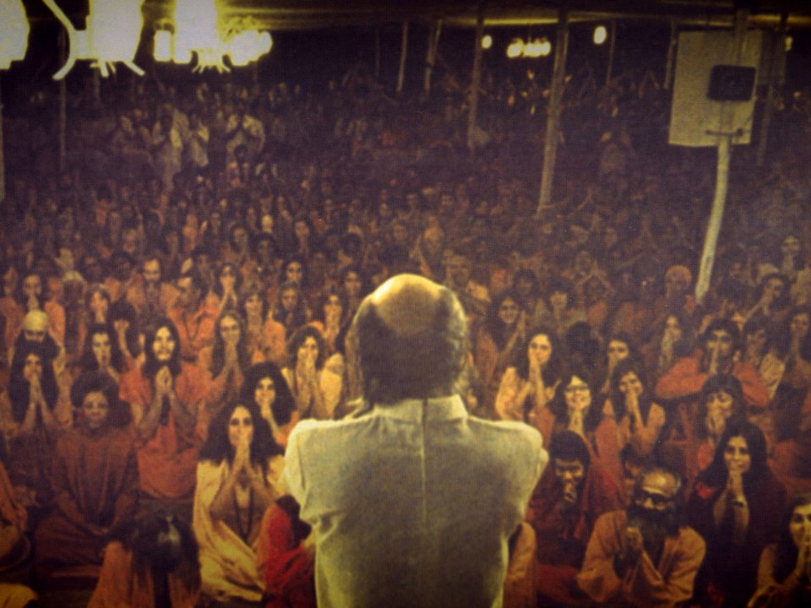
Rajneeshpuram
Mark Pickett

Slide 2
Time and Place
Rajneeshpuram was a intentional community constructed in rural Oregon near the small town of Antelope, OR
The land that became Rajneeshpuram was purchased by the Rajneesh group in 1981
The community met its demise in 1985 when a large group of commune leaders fled the community and criminal activity was uncovered

Slide 3
Philosophy and Practices
Dynamic meditation: Bhagwan Shree Rajneesh (commune leader) stated this would enable people to experience divinity
Free love, sex, peace, community
Sex as the first step toward superconsciousness
Notes:
https://www.biography.com/people/bhagwan-shree-rajneesh-20900613

Slide 4
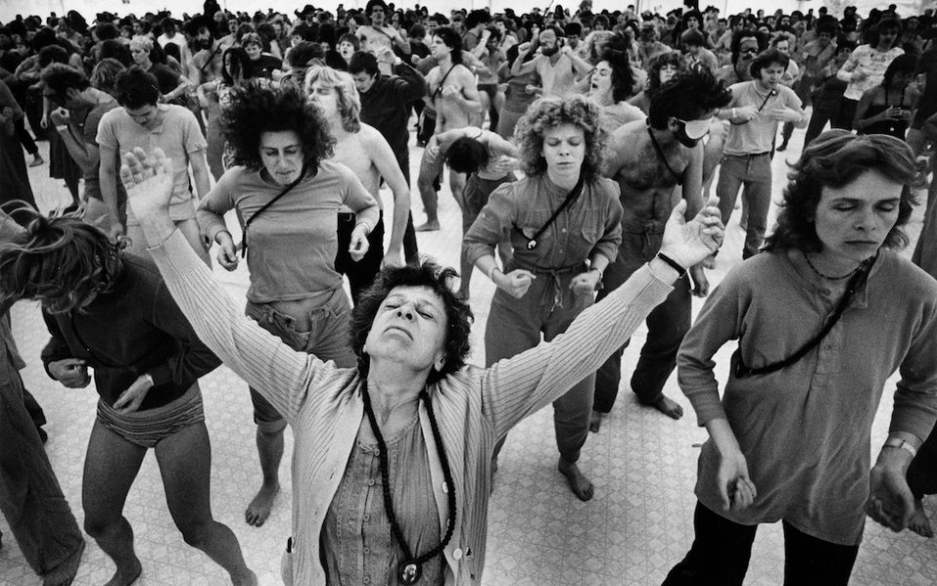
Dynamic Meditation
https://www.youtube.com/watch?v=bRXcbXnLwvM

Slide 5
Cult, Commune, Community
After moving the group from India to Oregon, the Sannayasins set up an agriculturally based community that blossomed into a full blown community with the resources of a small city
Legal battles with the city of Antelope ensued, but Rajneeshees prevailed with a court decision in their favor

Slide 6
Governor Vic Atiyeh: “Regardless of the religious beliefs or practices of this group, they are entitled to every right afforded under our Constitution”
Notes:
https://www.oregonlive.com/rajneesh/2011/04/part_two_thwarted_commune_goes.html

Slide 7
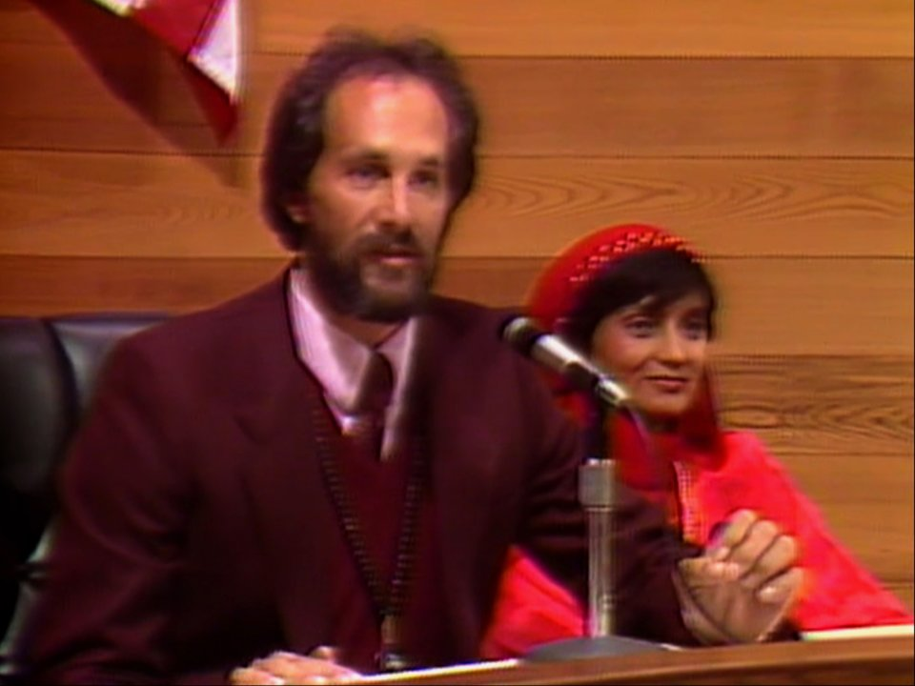
Extralegal Expansion Tactics
The commune’s downfall came about after several criminal activities including the largest bioterror attack in US history, alleged attempted murder, and a forced influx of homeless people to the commune to add voting power to the Rajneeshees
Largest illegal wire tapping operating ever discovered
Planned assassination of US Attorney Charles Turner
Notes:
https://www.businessinsider.com/netflix-wild-wild-country-sex-cult-largest-bioterror-attack-us-history-2018-3

Slide 8
Similarities to other Communes
The basis for Rajneeshpuram was initially a self-sustaining agricultural community, but things spiraled out of control when they attempted to incorporate as a town
Locals did not want this, and Sannyasins turned to illegal tactics to bypass their protests
Notes:
https://www.businessinsider.com/netflix-wild-wild-country-sex-cult-largest-bioterror-attack-us-history-2018-3

Slide 9
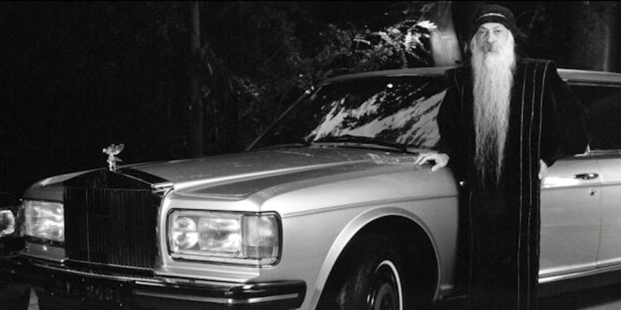
Capitalism in the Commune?
The Bhagwan (leader) taught about the value of material goods and wealth
The New York Times reported in 1986 that he had approximately 85 New Rolls-Royces

