Slide 1


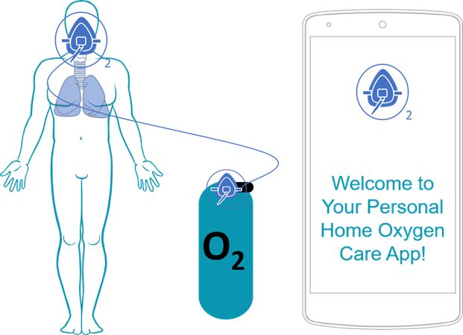
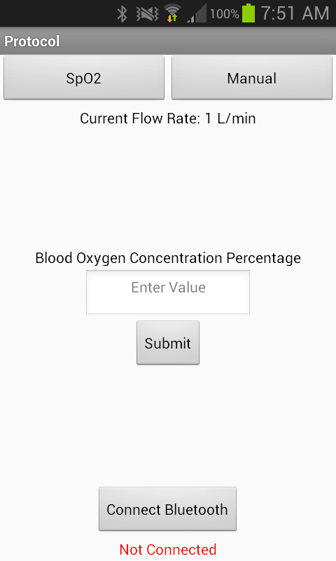
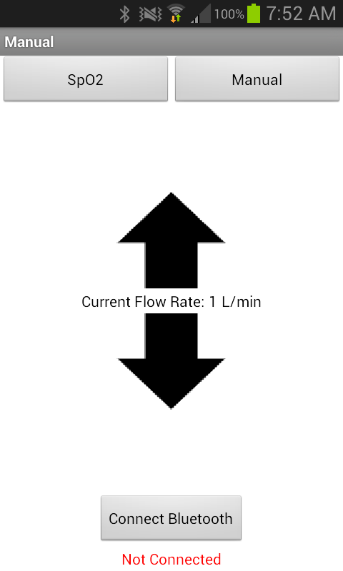

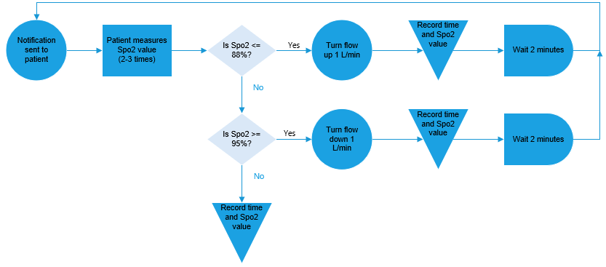
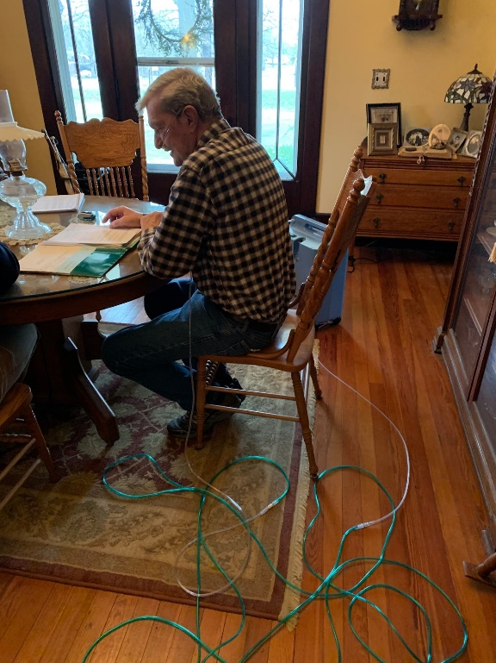
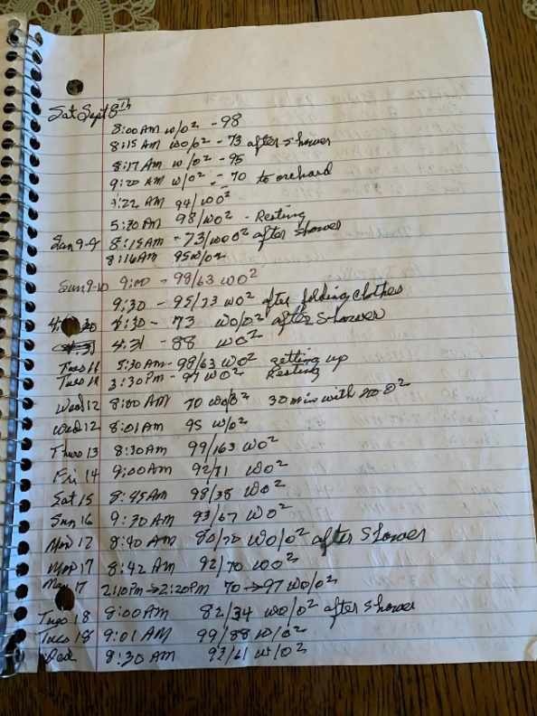
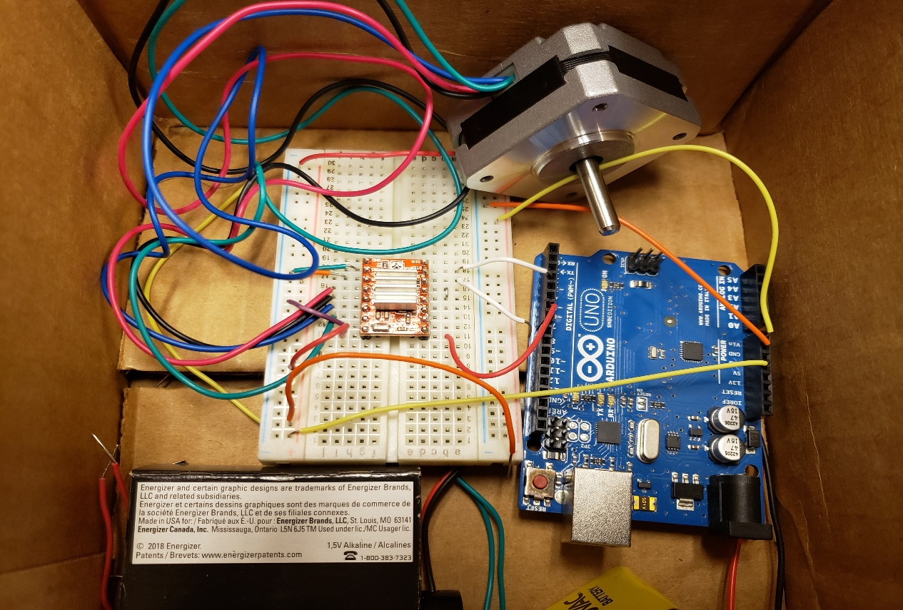
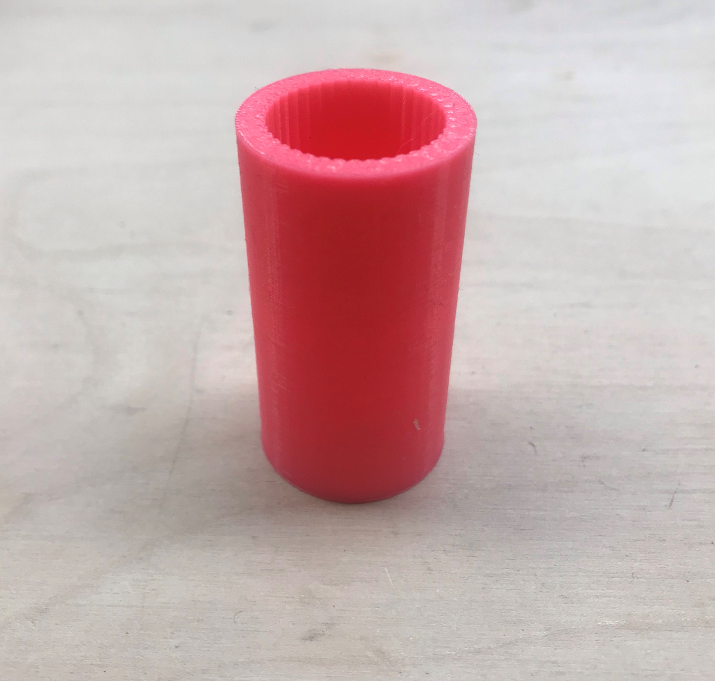
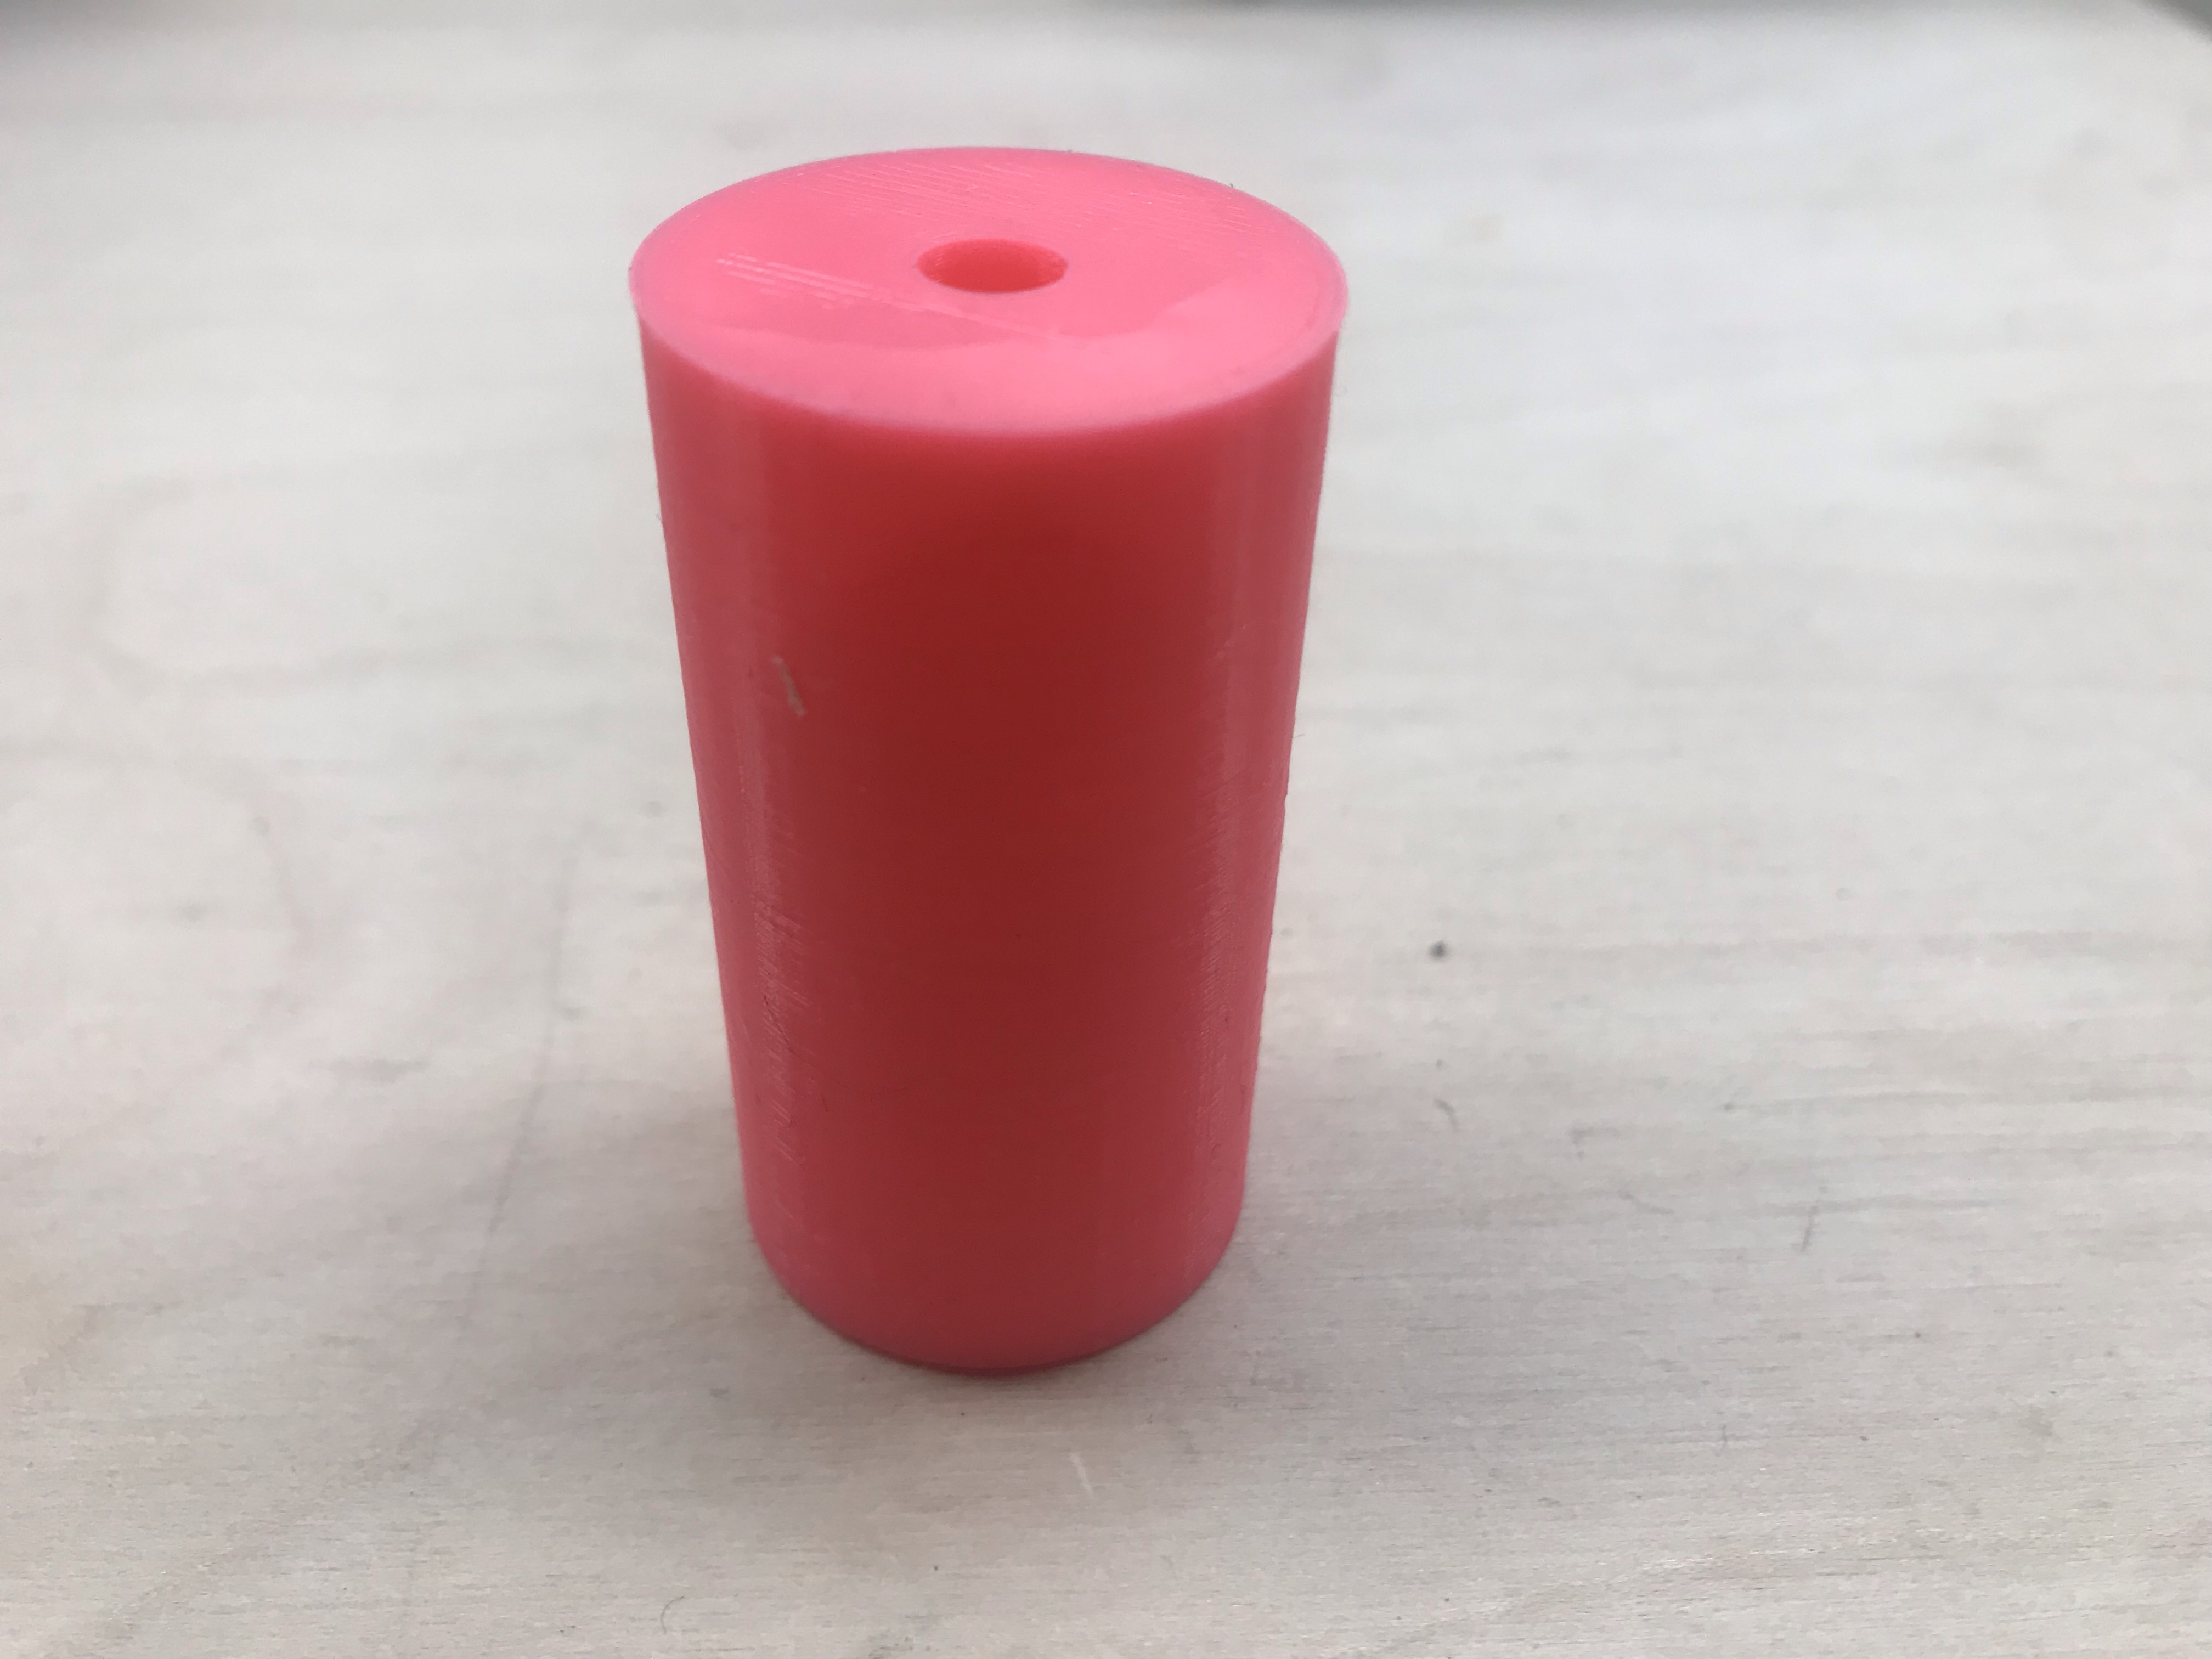
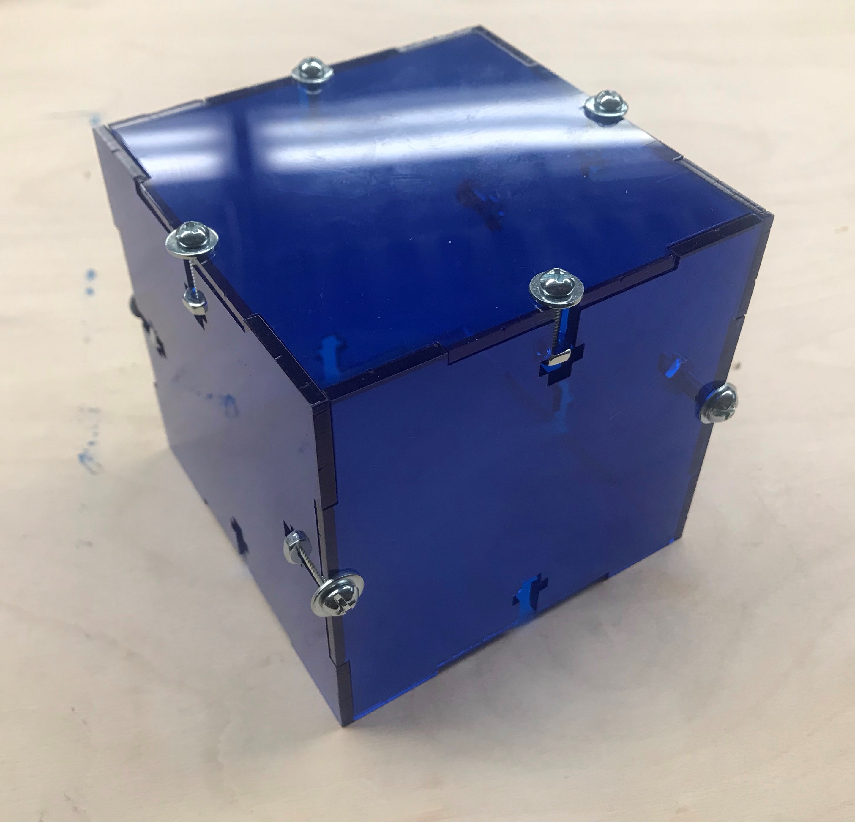
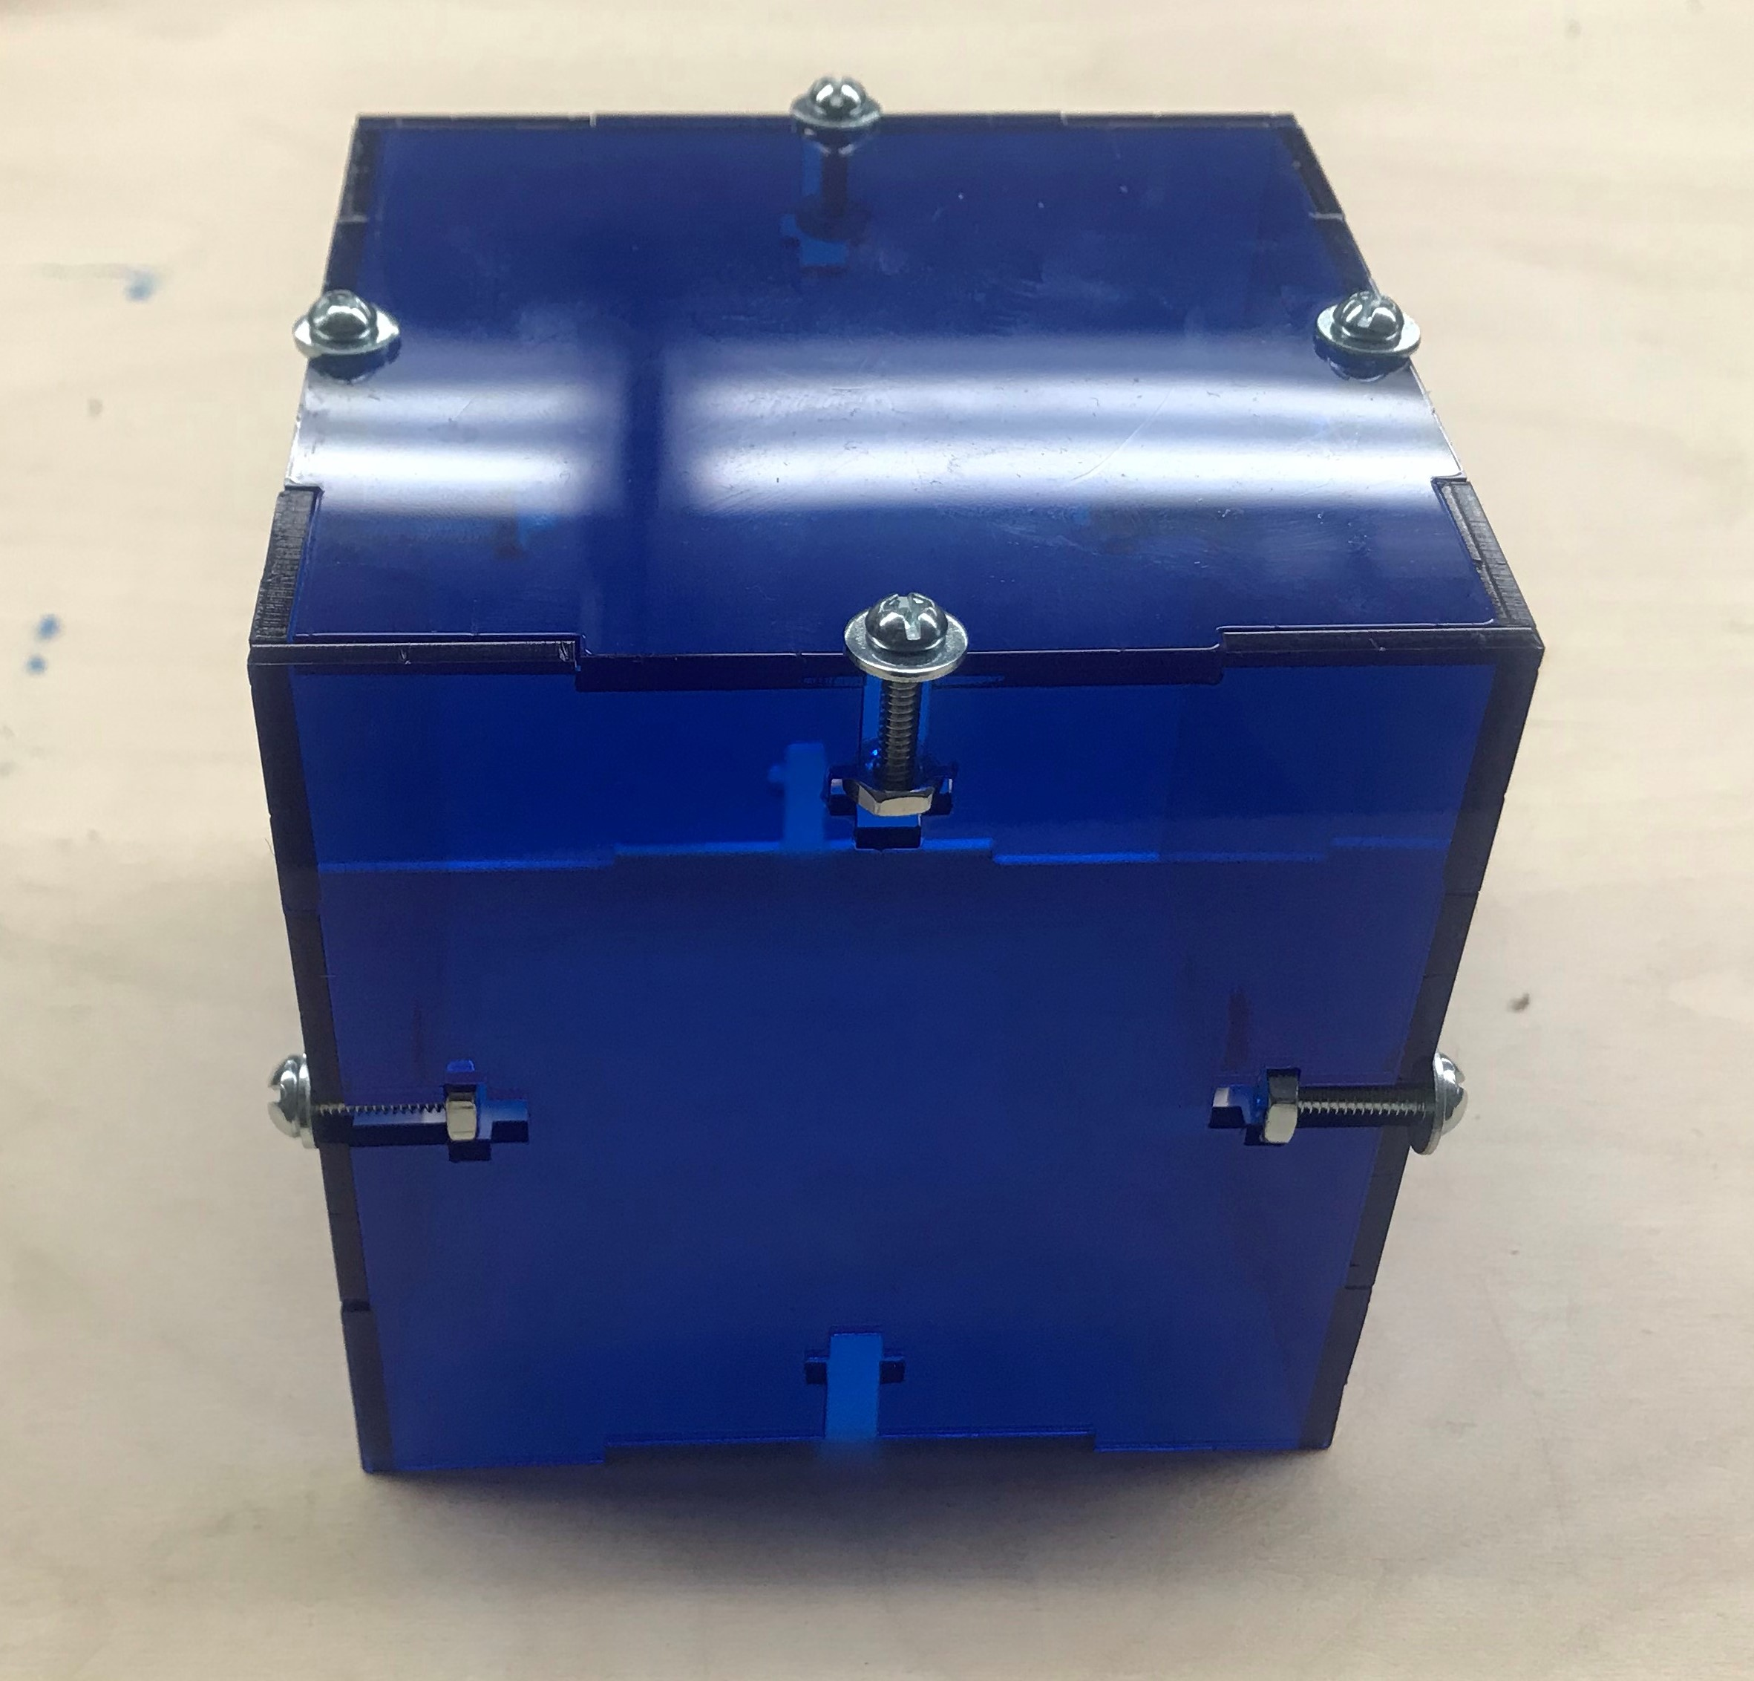

Wireless Control of O2 Liter Flow Rate on In-Home Oxygen Concentrators
Elliott Grant¹, Gabriel Hoppock¹, Lamya Jaigirdar¹, Carla Pax¹
Advisors: Dr. Lisa Lancaster², Ms. Wendi Mason², Dr. Mathew Walker III^{1,2}
1 Vanderbilt University Department of Biomedical Engineering, 2 Vanderbilt University Medical Center
Background
Our Goal:
Application Design
Idiopathic Pulmonary Fibrosis (IPF) is a chronic disease that causes the individuals’ lung tissue to thicken and scar, thus decreasing their rate of lung - to - blood oxygen transfer [1]. Individuals diagnosed with IPF are placed on Long-Term Oxygen Therapy (LTOT) to improve their blood oxygen concentrations. Currently, there are 110,000 individuals in the US with IPF and with a growing geriatric patient population; this number is expected to rise [2].
We have designed a device to attach to a standard in-home oxygen concentrator in addition to a smartphone application for the user to wirelessly control the device to adjust the oxygen liter flow rate. The application will use an algorithm to adjust the flow rate based on a a patient's blood oxygen saturation level. Together, the device and application will allow individuals on LTOT to conveniently wirelessly adjust their oxygen liter flow rate to receive an adequate amount of oxygen accounting for varying activity levels.
Problem Statement
Figure 3: Overview of final system design
Often patients on LTOT keep their oxygen concentrators in one location and set at a constant oxygen flow rate. However, human bodies require different oxygen flow rates for different activity levels. For this reason, an IPF patient can suffer long-term side effects as a result of not adjusting the flow rate on their oxygen concentrators depending on their activity.
Figure 6: User interface created with MIT App Inventor 2 to control oxygen flow rate
Figure 1: Everyday Changes In Physical Activity
Device Design
Visiting an IPF Patient
Mechanism Design
Fortunately, we had the opportunity to visit the home of an IPF patient to better identify and understand challenges faced surrounding LTOT. From this experience, we recognized the patient’s lack of knowledge on the oxygen liter flow rate he required in addition to his inability to easily communicatee with physicians and simply track and store health information. Overall, these shortcomings cause general frustration and confusion for the patient regarding his illness and treatment.
Figure 7: Protocol implemented for Backend Design
Results
Figure 2: These are images from our visit to IPF patient in March. The left image shows the general set-up of LTOT and the right image shows how this patient tracked his lung function health.
Figure 4: Circuit design for device
We have developed a working Android app and mechanical device to control the O₂ liter flow rate on an in-home concentrator based on the patient’s blood O₂ saturation level. Our system allows the user to wirelessly adjust their O₂ flow rate which should improve their quality of life over time by accounting for change in physical activity. Additionally, adjustments based on patients’ blood O₂ saturation and protocol will ensure adequate O₂ for the patient and reduce the risk associated with arbitrarily changing the O₂ liter flow rates and the lack of oxygen liter flow rate adjustments before adverse physiological effects arise.
Knob and Container Design
Needs Assessment
To seek an inexpensive and novel way to
Wirelessly control the oxygen liter flow on the oxygen concentrator
Noninvasively monitor oxygen needs of IPF patients
Inform the specific patient on what their oxygen liter flow should be based on their oxygen requirement
Provide the user a way to monitor and track their oxygen liter flow
Figure 5: Design for device container and knob
To create the device, we used an Arduino Uno board with a stepper motor driver and Bluetooth driver to control a stepper motor. The Bluetooth driver will be used to connect to the application. The mechanistic driver will be contained in an acrylic box atop an acrylic shield that can be placed next to the oxygen tank.
Future Steps
Increase app functionality (user authentication, data storage, etc.)
Clinical Testing
Incorporate IR technology on Android phones
Create customizable features
References and Acknowledgements
[1] G. H. (n.d.). Idiopathic pulmonary fibrosis. Retrieved April 10, 2019, from Genetics Home Reference
[2] LEY, B. AND COLLARD, H., 2013. Epidemiology of idiopathic pulmonary fibrosis. Dove Medical Press, 5, 483-492.
We would like to acknowledge the Vanderbilt University School of Engineering for providing us with this amazing opportunity to apply the skills we have been honing over our student career. We would also like to thank our sponsors, Dr. Matthew Walker III for teaching us design essentials and guiding us through our project, Dr. Lisa Lancaster for her knowledge of IPF and the clinical aspects of our algorithm. We would also like to thank Alex Stephens for his continuous help in creating and envision this project.
Notes:
Put figure legends down under all of the figures image of concentrator and motor. Actual logo needed. Picture of the knob on the concentrator and connected to the motor. QR code lower right hand corner

