Slide 1

We Created a CMS Training Course in Six Easy Steps. You Won’t Believe What Happens Next!
Kevin Webb
HighEdWeb 2018

Slide 2
What to expect today
First half: training overview and examples
Traditional Content Management System (CMS) training
Online CMS training options
  Free vs. Paid online CMS training
  Making your own online CMS training
Learn what VU Digital discovered creating our own CMS 101 course
Second half: Online training framework
  Guidelines for creating an online CMS training
Slides will be posted at the end
Notes:
First half we talk about some of why we train and then the second half we discuss a framework for how you might create your own

Slide 3

About Me
Kevin Webb
Web developer at Vanderbilt University
11 years at VU
Nashville, TN
Lead our CMS 101 training course initiative
Notes:
There I am

Slide 4
About Vanderbilt Digital
Part of Division of Communications
Web development and design for the university
Centralized website support division
Decentralized content editing model
The CMS training we offer is done by our developers
(no full time e-learning staff)
Our office is not an e-learning specialist. Just creating CMS training materials as needed for our division

Slide 5
About Vanderbilt Digital
8000: registered CMS users (OmniUpdate and WordPress)
2200: websites (VU online since 1994)
10: Staff
Support methods
Online CMS training
Online documentation
Office hours (2/weekly)
Help desk tickets

Slide 6
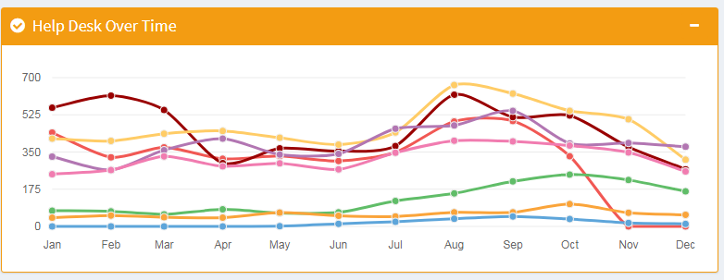
Help desk stats
September
2011: 47
2012: 66
2013: 212
2014: 400
2015: 544
2016: 625
2017: 514
2018: 496

Slide 7
Traditional CMS Training
Classroom style
Typically done in person
1:1 setting or group classes
Our method until March 2015
Notes:
Story
Until 2015, just live training
Twice a month
Need to attend (web access)
Class size = 1 student
Trainer = frustrated

Slide 8
Why offer CMS training?
Empower faculty and staff to use the CMS
Increase user base
Don’t break anything

Slide 9

Online CMS training
Image: https://www.vecteezy.com
Convenient
Learners don’t have to go to you
Staff don’t travel to train (also helps as user base scales)
Learners study at their own pace and schedule
Image credit: https://www.vecteezy.com/
Notes:
Online training = screencast video and some written documentation materials
Learners can study on their time
Doesn’t need live 1:1 interaction
Staff are freed to do other things
When questions – more likely to have some concepts/knowledge
It isn’t a hard sell to see the advantages of online training. You may not have time for regular live trainings

Slide 10



Online CMS Training options – Free and purchased
Notes:
Online training isn’t a hard sell. It’s very convenient for users
Free options – Youtube

Slide 11

Extensive training collection
High quality materials
$Cost
Extensive training collection
High quality materials
$Cost
$Free (ad supported)
Variable content quality
Lots of topics to choose from
Platform changes influencing content creators

Slide 12

Online CMS Training – Making your own
Image credit: https://www.vecteezy.com/
Advantages
University branding and terminology
Tailor training to your needs
Control over topics/tech covered
Less expensive
Own the media files
Disadvantages
You are creating all the material
Can take a lot of time to create
You will need to fix/amend if there are changes to address
Notes:
Online training isn’t a hard sell. It’s very convenient for users
Free options - Youtube
Today we are talking about Content Management System training or (CMS) training for short. If you use a popular CMS, then there might be some free materials already out there that could suit your needs

Slide 13
Why we made our own online CMS training
Learning materials didn’t exist yet for our OU 10
Training a large user base (~800 registered users)
Get existing users up to speed. Plan for new users
Customer demand (online CMS training)
Vanderbilt branding
Vanderbilt visual styling (website theme)
Tailored to our OmniUpdate configuration
Notes:
Our customers wanted an online option
Up to this point the only way to get training and gain access to your website was to take a twice monthly training

Slide 14
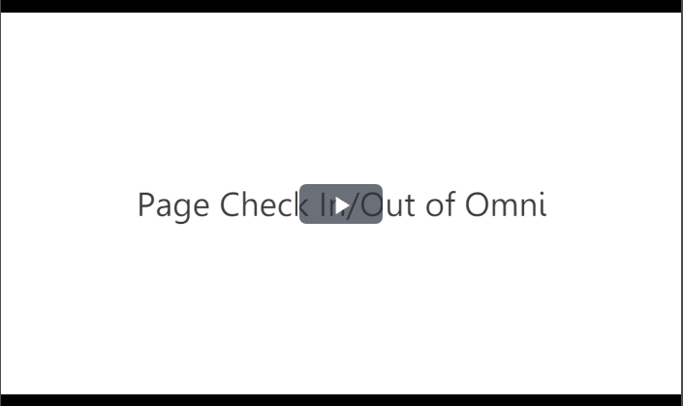
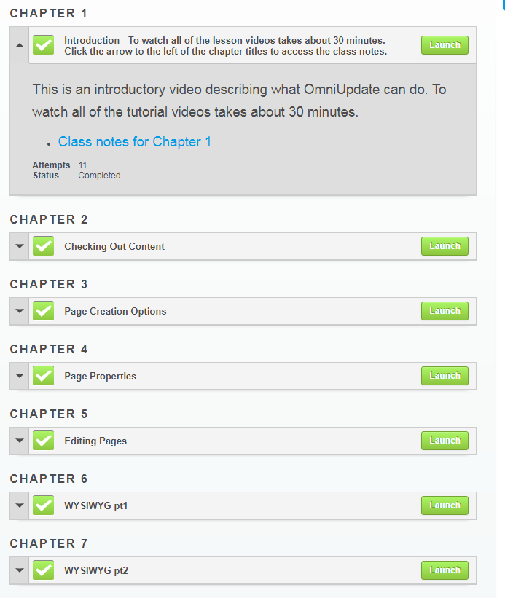

What we made: Omni 101
Watch training videos
Signup
Request access to Sandbox
Request exercise review and access to departmental website
Complete exercises in sandbox environment
Image credit: https://www.vecteezy.com/
Notes:
How training works
Sign up for training in the Learning Exchange
Watch the videos
Get access to the sandbox and complete the exercises (there’s a practice portion you must complete before we grant you access to your website)
Request review and access to your departmental website
Takes about an hour to complete all steps (videos take about 30 minutes total)
Goal was to keep the training short and get users up to speed quickly

Slide 15
Omni 101 notes
Launched March of 2015
10 video modules (5min or less each)
Practice exercises (basic page editing)
Took about 4 months to create (not full time effort)
Since launch 280 new users trained
  On track to have over 300 trained by year end
  Average ~100 new users a year
Working on Omni 101 v2
Notes:
Averaging about 100 users a year
Took me about 6 months. I wasn’t working on this full time, just finding time as I could. Plus our beta testing lasted about 2 months
There was a lot of trial and error as I worked on this
I think we could create the same course in 2-3 months or maybe even less time if dedicated more time and resources (for a full course)
A simple how-to lesson could be done in a couple of days

Slide 16
What we learned
Users love training (ha ha – no... But people are learning!)
Help tickets didn’t go down dramatically
Better user questions after training
Online CMS training isn’t going to put us out of work.
Users still need help
Some people actually do work on their own
Keep it short
Know your primary audience
Have online written reference to support training
Notes:
Expect questions anyway. Even if you have the perfect training
We found many users don’t really read the instructions or documentation – they skim
Put important information at the top of the page or a section so it stands out. That way they’re more likely to catch that info even if they are skimming through it

Slide 17
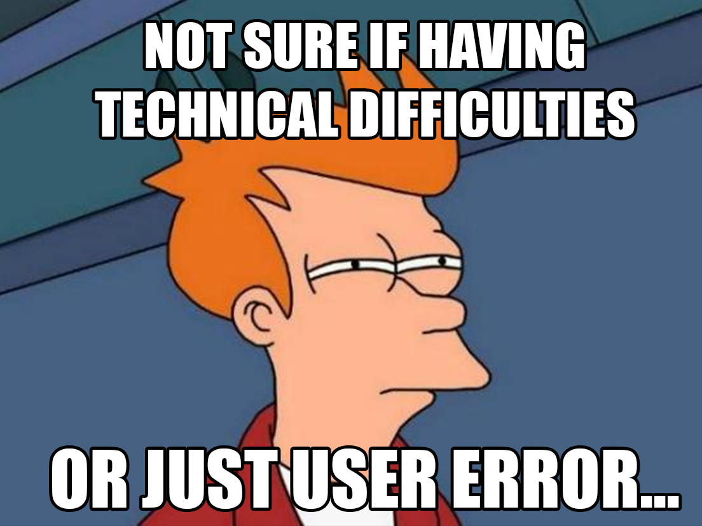
Notes:
If you have users do practice exercises on a website, be prepared to be amazed!
Users will break things in ways you never dreamed
I asked myself this every day. Are they having technical difficulties... Or are they just doing it wrong..

Slide 18
Creating your own online CMS training
Write Brainstorm/Outline/script
Record video
Documentation
Upload
Beta Test
Launch and distribute

Slide 19
1: Write!
Brainstorm
Outline
Script
Including basic steps to get work done
Users learn how to log in, edit, save and publish
Ask users to complete a quiz at the end
How to log in
How to edit a page
How to save
How to publish
In the first step, you log in by...

Slide 20
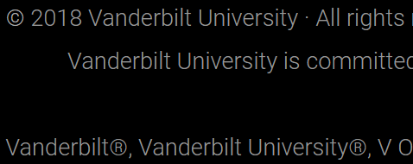
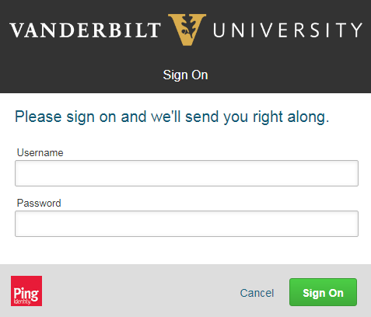

Limit scope
Use brief concise language
A full training course is just a collection of smaller lessons
How to log into OmniUpdate at VU
Scroll to the bottom of the page
Click on the copyright symbol (©) in the footer
Enter your VUnetID and ePassword

Slide 21



2: Record!
Camtasia
Captivate
Screenflow
Use a screen recording program (Captivate, Camtasia, Screenflow)
Keep it short
  5 min or less for individual lessons
  15-20 min or less for an overview video
Use bullet points rather than a script if that works for you
Be professional, but try to be conversational when possible.
A link to how-to tutorials posted at the end of this presentation
Notes:
Some tips for recordings
Keep to the material
We don’t typically speak how we write
I’m not perfect at any of this. I’m still perfecting my skills just like you

Slide 22


Record! – Audio Editors
Adobe Audition
Audio editors let you tweak the sound
You can record your walkthrough audio separately

Slide 23


Basic Tools
Samson Go Mic

Slide 24



Upgrades
Adobe Premiere
Adobe Audition
Blue Yeti
Microphone

Slide 25
Audio and Video tips
MP4
Create/export video to at least 720p video (HD)
Avoid fancy video transitions (bounce, spin, swirl)
Freeze frame to give more time to talk about a step
Compress video output (if possible under 1 GB)
Stream video. Don’t make users download huge MP4 files
(use a streaming server, YouTube or Vimeo)

Slide 26

3: Writing Documentation
Double check your info in the vendor documentation
if you are unsure about a step or process
Use your notes from script
More formal than the screencast
Provide the steps needed assuming the user didn’t watch the video
Add screenshots where needed
Keep steps short and easy to read (Hemingway writer)
http://www.hemingwayapp.com/
Image credit: https://www.vecteezy.com/

Slide 27

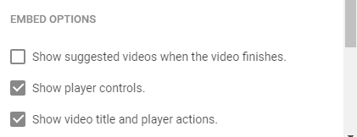
4: Upload
Create web pages for the exercises, tutorials and documentation
Upload media files (images, pdfs, ect)
Upload video files (MP4)
If upload to Youtube and embed, disable recommended videos
when you generate code.
Image credit: https://www.vecteezy.com/
Notes:
For video, you could upload to YouTube and then embed on your pages

Slide 28

5: Beta test
Have users go through your training
Test users who aren’t in your department and
don’t know the technology
Do users consistently miss a step or concept?
Do users have complaints or suggestions?
Review and revise based on feedback
Image credit: https://www.vecteezy.com/

Slide 29

6: Launch
Post to your news, social media and mailing lists
Keep looking user feedback. Can training be improved?
Refer users to your training materials when they ask questions
Image credit: https://www.vecteezy.com/

Slide 30
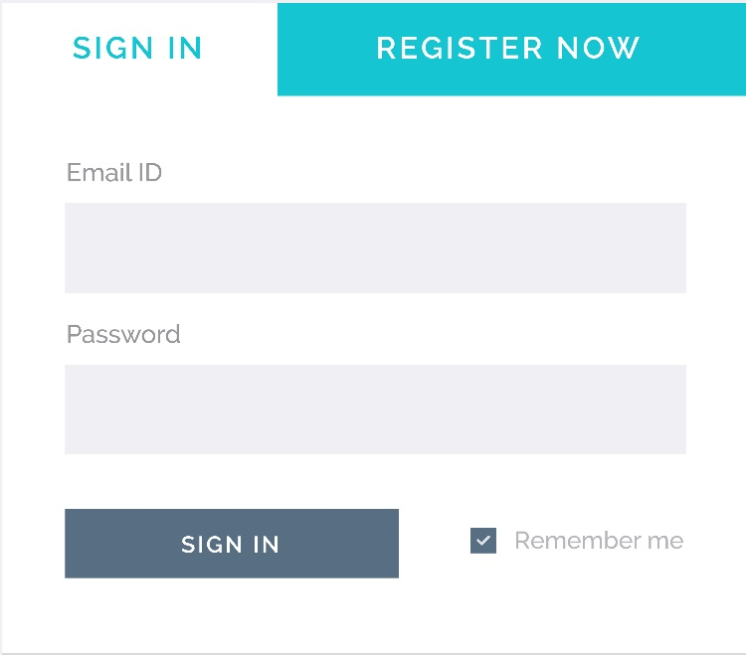
6a: Signup method (optional)
Typically for restricted environment
(LMS, secured web pages, etc.)
Sign up via help desk ticketing system
Other form options: (Typeform or Google Forms)
Increase participation
  Online quizzes (Survey Monkey or Typeform)
  Require test exercises to be completed before
  site access is granted
Image credit: https://www.vecteezy.com/

Slide 31
Thank you!
Kevin Webb
Web Developer, Vanderbilt University
Kevin.Webb@Vanderbilt.edu
https://my.vanderbilt.edu/cms-training-course/

