Slide 1
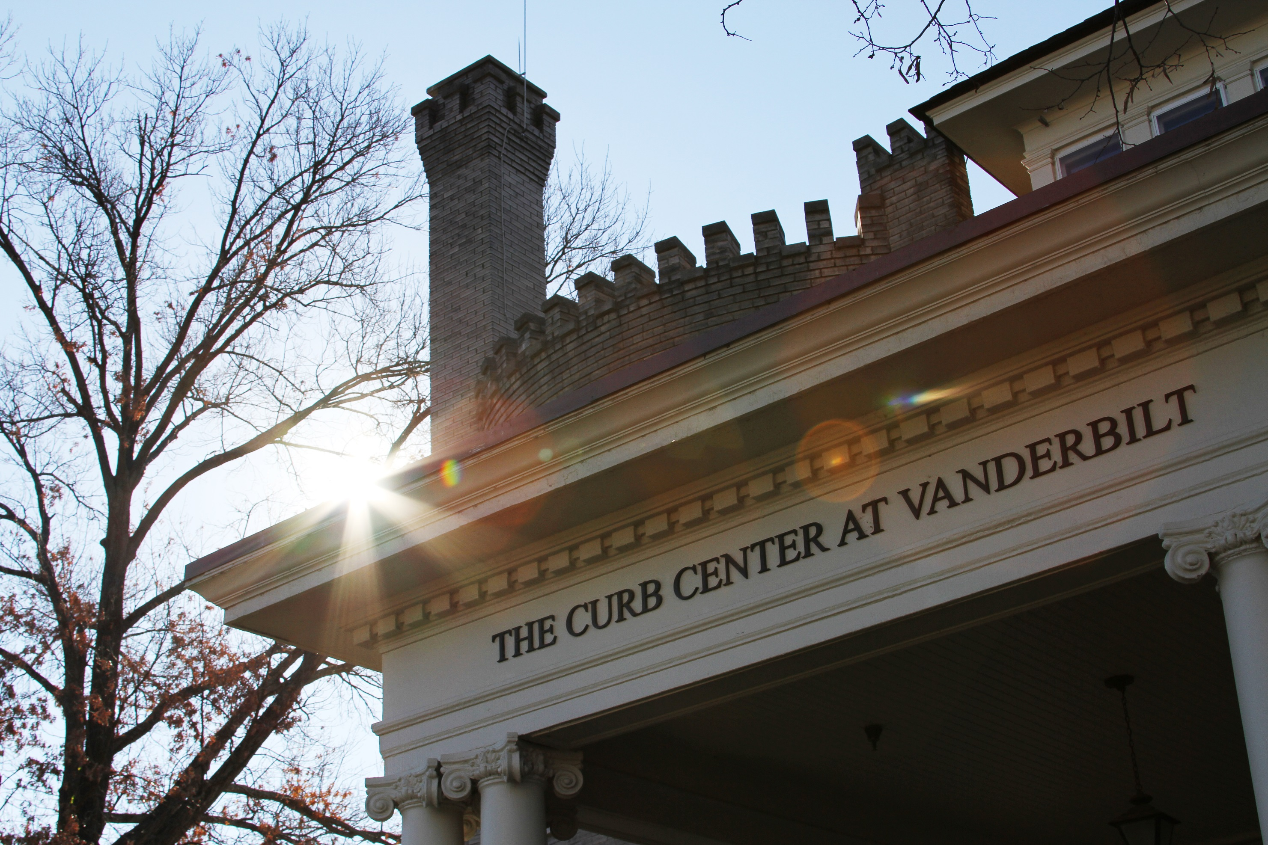
Arts policy research center
Creative Campus initiative
Public Partnerships

Slide 2

Students and faculty participating in Creative Campus programs in 2018
Martha Ingram Commons, 1,500+
A & S, 1,000+
Engineering, 200+
Divinity, Law, Blair, Nursing, 500+
Medical School, 500+

Slide 3
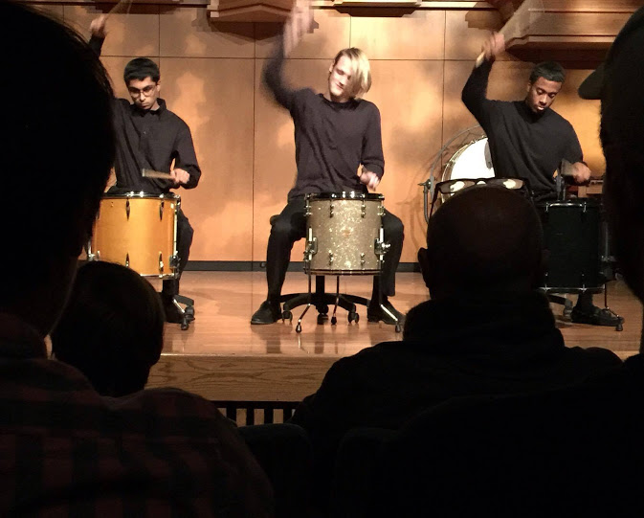
Why does
this matter?

Slide 4
Creativity is
key to the 21st-
century economy

Slide 5
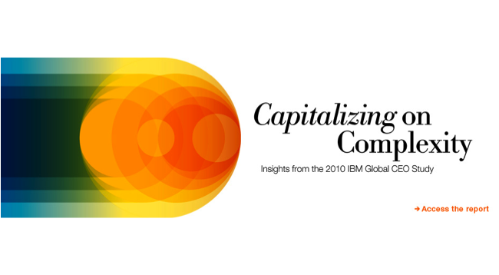
IBM poll of 1,500 CEOs found “creativity” to be #1 leadership skill for the 21st Century

Slide 6
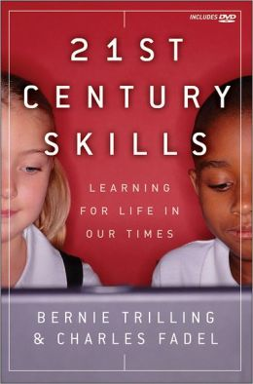
“Creativity and innovation are very high on the list of 21st Century skills…”

Slide 7

The Creative Class is a driving force for economic development in cities in the United States

Slide 8
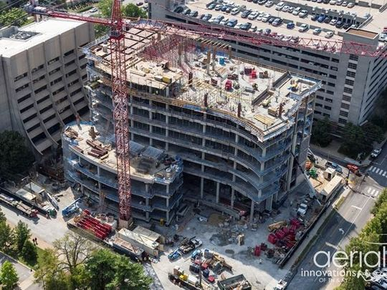
Copyright industries
add over $930 billion annually
to the U.S. GDP
Notes:
If we return to the copyright industries, you see that they comprise a greater volume of U.S. exports than auto manufacturing, chemicals, the agricultural sector and electronics.

Slide 9
INDUSTRY | FOREIGN SALES/EXPORTS (billions)
 | 2006 | 2007
Core Copyright Industries | 115 | 125
Chemicals and Allied Products | 106 | 122
Motor Vehicles, Equipment & Parts | 46 | 56
Agricultural Sector | 36 | 48
Source: Stephen Siwek, Copyright Industries in the US Economy: The 2007 Report, Washington DC: Economists Incorporated and the International Intellectual Property Alliance, 2007.
Notes:
If we return to the copyright industries, you see that they comprise a greater volume of U.S. exports than auto manufacturing, chemicals, the agricultural sector and electronics.

Slide 10

What skills are involved in creativity?
Colton, et al., “Computational Creativity Coming of Age”
“We agree with those that believe that creativity is an advanced form of our reasoning that involves memory, analogy, learning, and reasoning under constraints” (14)

Slide 11
What skills are involved in creativity?
Colton, et al., “Computational Creativity Coming of Age”
“We agree with those that believe that creativity is an advanced form of our reasoning that involves memory, analogy, learning, and reasoning under constraints” (14)

Slide 12
What skills are involved in creativity?
Colton, et al., “Computational Creativity Coming of Age”
“We agree with those that believe that creativity is an advanced form of our reasoning that involves memory, analogy, learning, and reasoning under constraints” (14)

Slide 13
Portfolio of skills
Improvisation
Analogical, metaphorical and associative thinking
Idea generation
Conditional thinking and counter-factuals
Expressive agility
Radical revision and critical feedback
Creative collaboration
Flexibility, tolerance for ambiguity
Empathetic reasoning
Epistemic curiosity
Problem Finding
Pattern recognition and deep observation
Abstraction
Risk taking and learning from failure
Ability to consider the ethical, social and policy consequences of innovation
Notes:
You are learning the skills that are required to succeed in life and work in the 21st century. An arts training will not only inscribe the values of craft and dedication to artistry; but it will give a portfolio of skills that will produce a high quality of life….

Slide 14
