Slide 1
Fast & Furious
Amanda McCausland, Nick Jelinek, Taylor Studer, William Holder

Slide 2
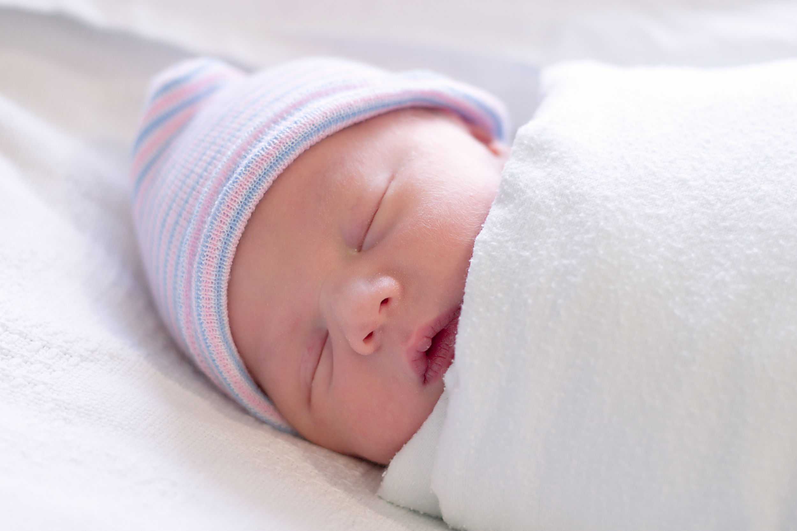
Introduction
Birth defects affect 1 in every 33 babies born in America
Annual disabilities-at-birth count [1]
  CNS: 2660 new cases
    Anencephaly, spina bifida
  Musculoskeletal: 5889 new cases
    Reduction deformities
[My Pregnancy Expert 2014]

Slide 3

Executive Summary
What are our four goals?
Granting mobility
Building social skills
Cognitive development
Introduction to power chair technology

Slide 4
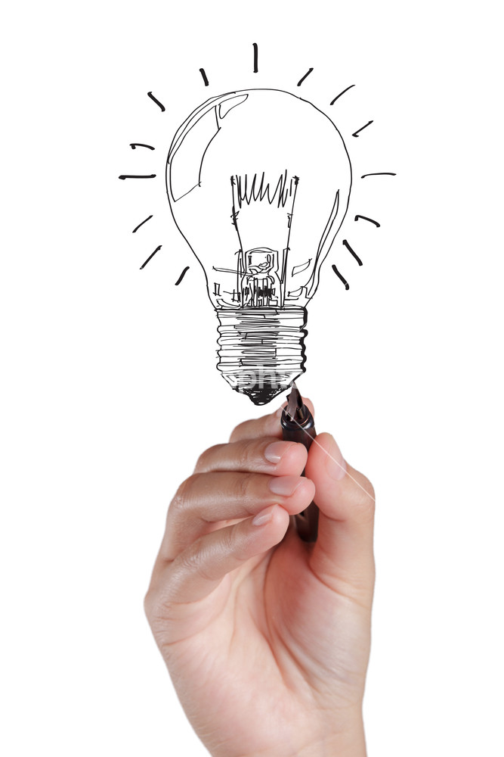
Our solution
Battery-powered toy car
Modular control design
  Customizable accommodations
[GraphicStock 2016]
Notes:
We aim to meet these four needs by designing a child’s toy that can be learnt to be controlled by children of varying disabilities, grant them a wide range of mobility, and through these controls build positive physical habits in these children. We believe the best solution comes through the form of a toy car. The concept of an appropriately-sized, battery powered, ride-in car, not unlike those currently on the market as conventional toys, will both allow the child the freedom to move about in their environment, and through custom-tailored toy buttons or switches in place of the conventional controls will allow the child the ability to adequately control the car and encourage the development of positive physical habits and skills as well. However, since our aim is for our product to reach as large an audience as possible, and since with such a large sample comes a wide array of varying disabilities, we aim to create a toy car that can be uniquely designed through an assortment of control attachments and modifications appropriate for differing disabilities that can be purchased separately in addition to a stock car base and easily assembled and modified by the parents or guardian of the child

Slide 5
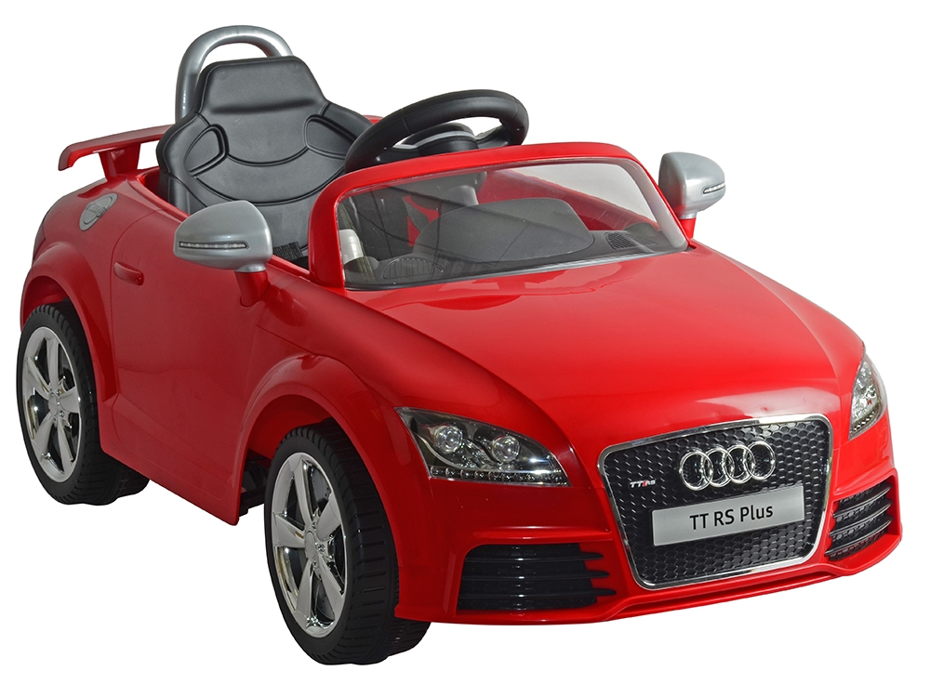
Competition?
Our product is first to offer unique solution
  Conventional product
  Take-home option
Pre-existing toy manufacturers
  Modification of current toy models to enter market
Modular customization is our edge
[Toys R Us 2016]

Slide 6
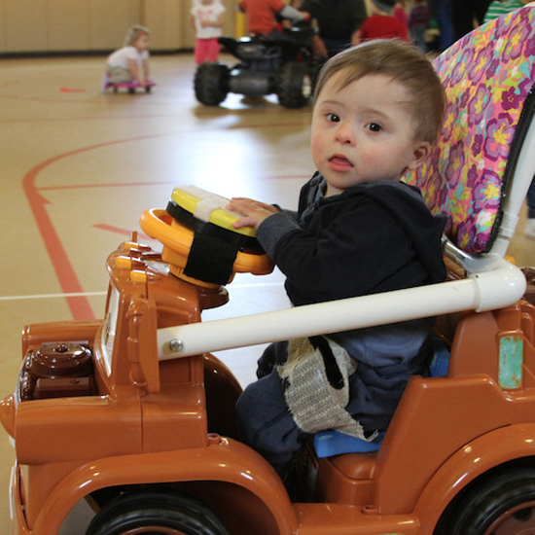
Feasibility?
Modified toy cars already exist
Go Baby Go program (U Delaware)
  At-home, custom-made cars for children
  Varying success in meeting our same goals
Modular adaptations are uniquely ours
  Feasible solution
[NationSwell 2014]

Slide 7

Purchasing possibilities
Our product is a toy, not a medical device
Avoidance of FDA regulations/restrictions
Purchased out-of-pocket online or at toy stores
  Large chains (Toys R Us, etc.)
  Disability-targeted stores (Fun and Function, etc.)
Cost kept closer to that of toy car than power chair
[Matan 2016]

Slide 8
Project objective statement
Observe children at One Hundred Oaks and High Hopes Preschool
Modular car with a base model and attachable pieces
  Appropriate control options and therapeutic efficacy
Provide power mobility at a low cost to physically disabled children
  Easy-to-assemble and uniquely customizable
Notes:
Amanda

Slide 9
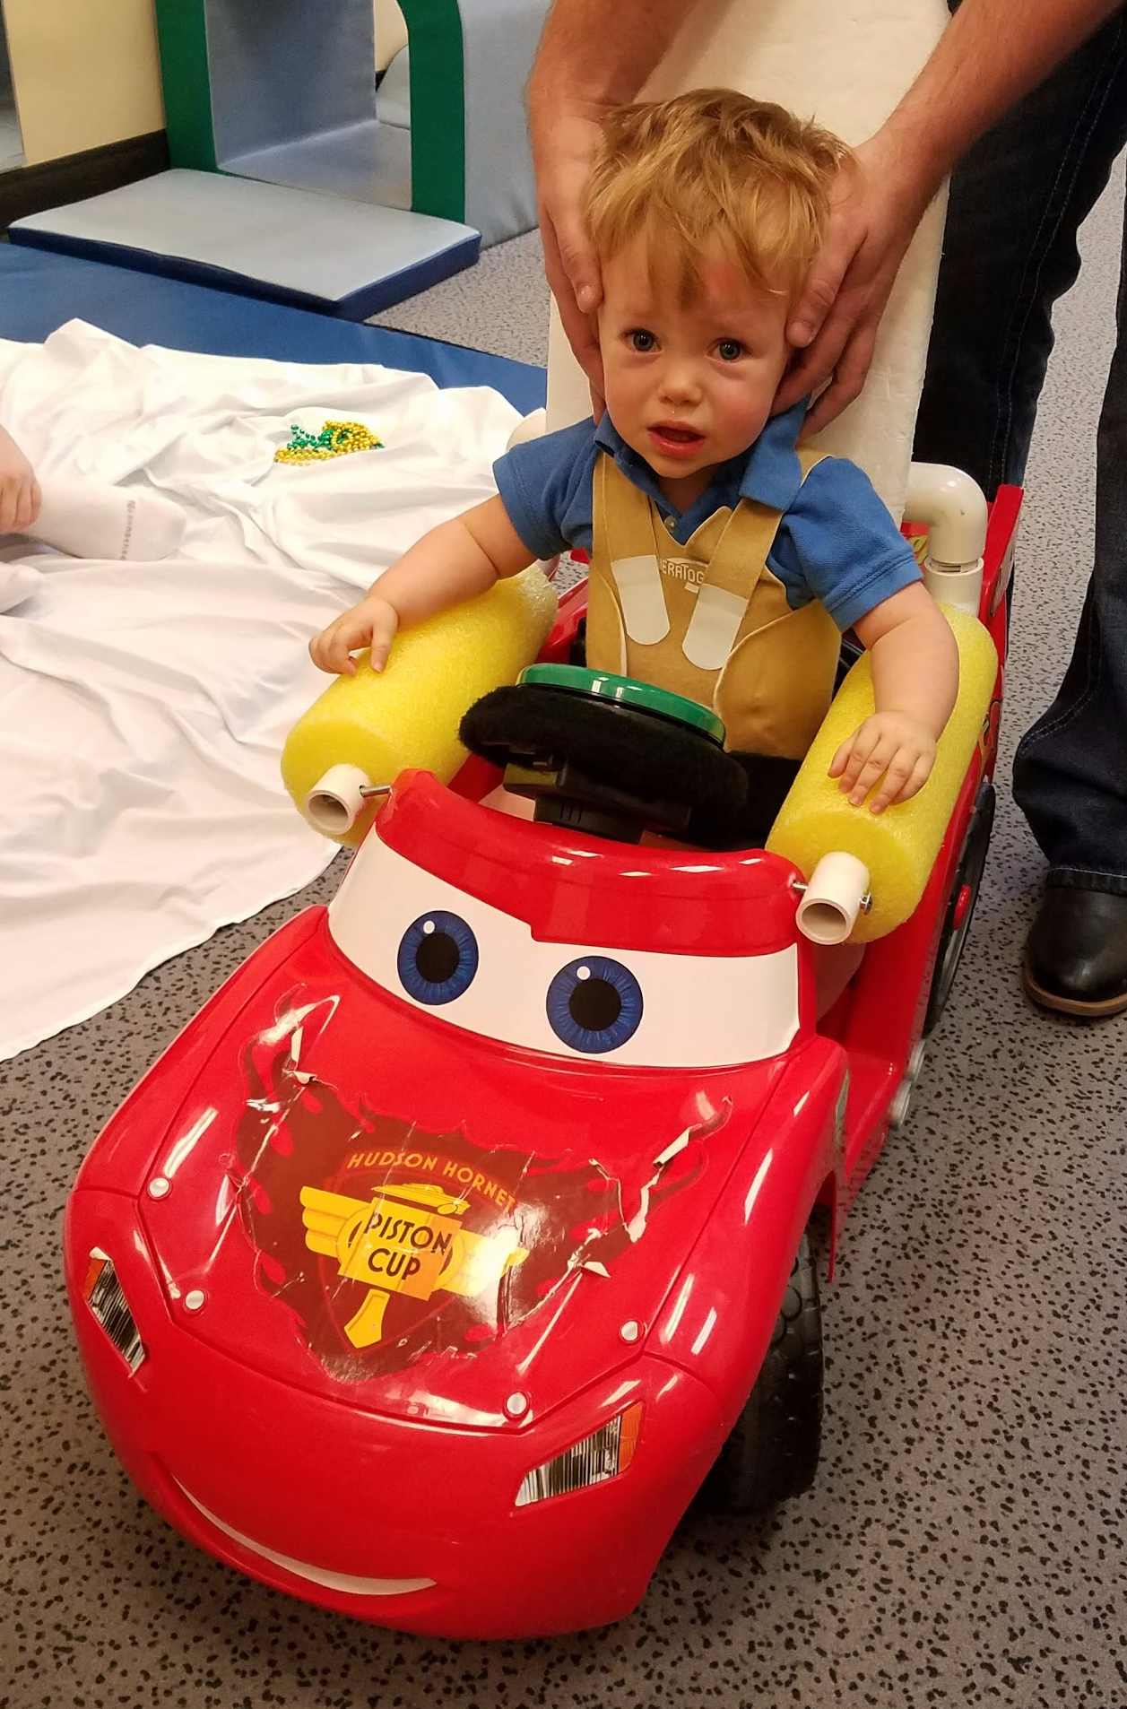
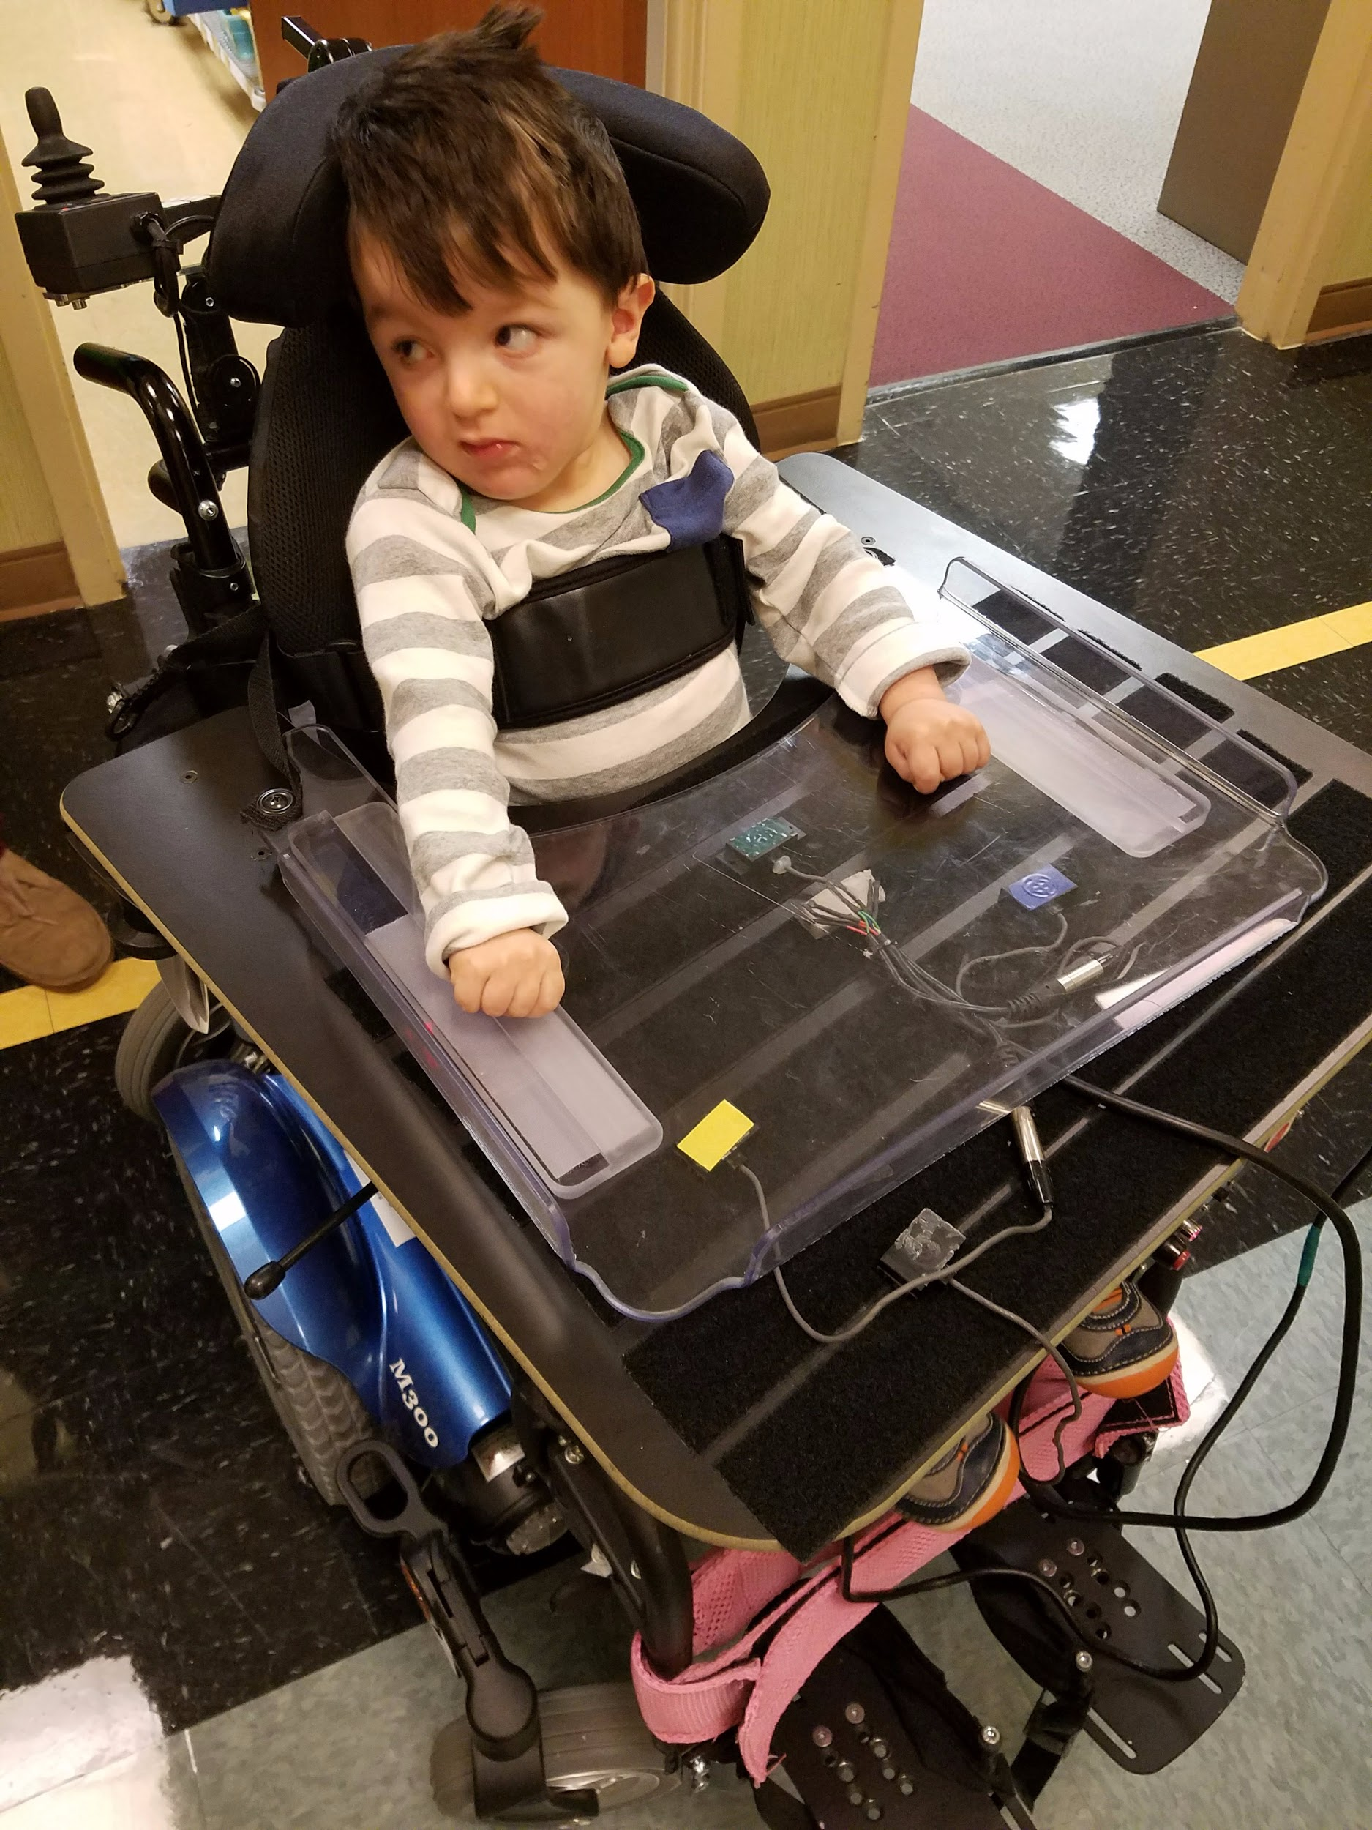
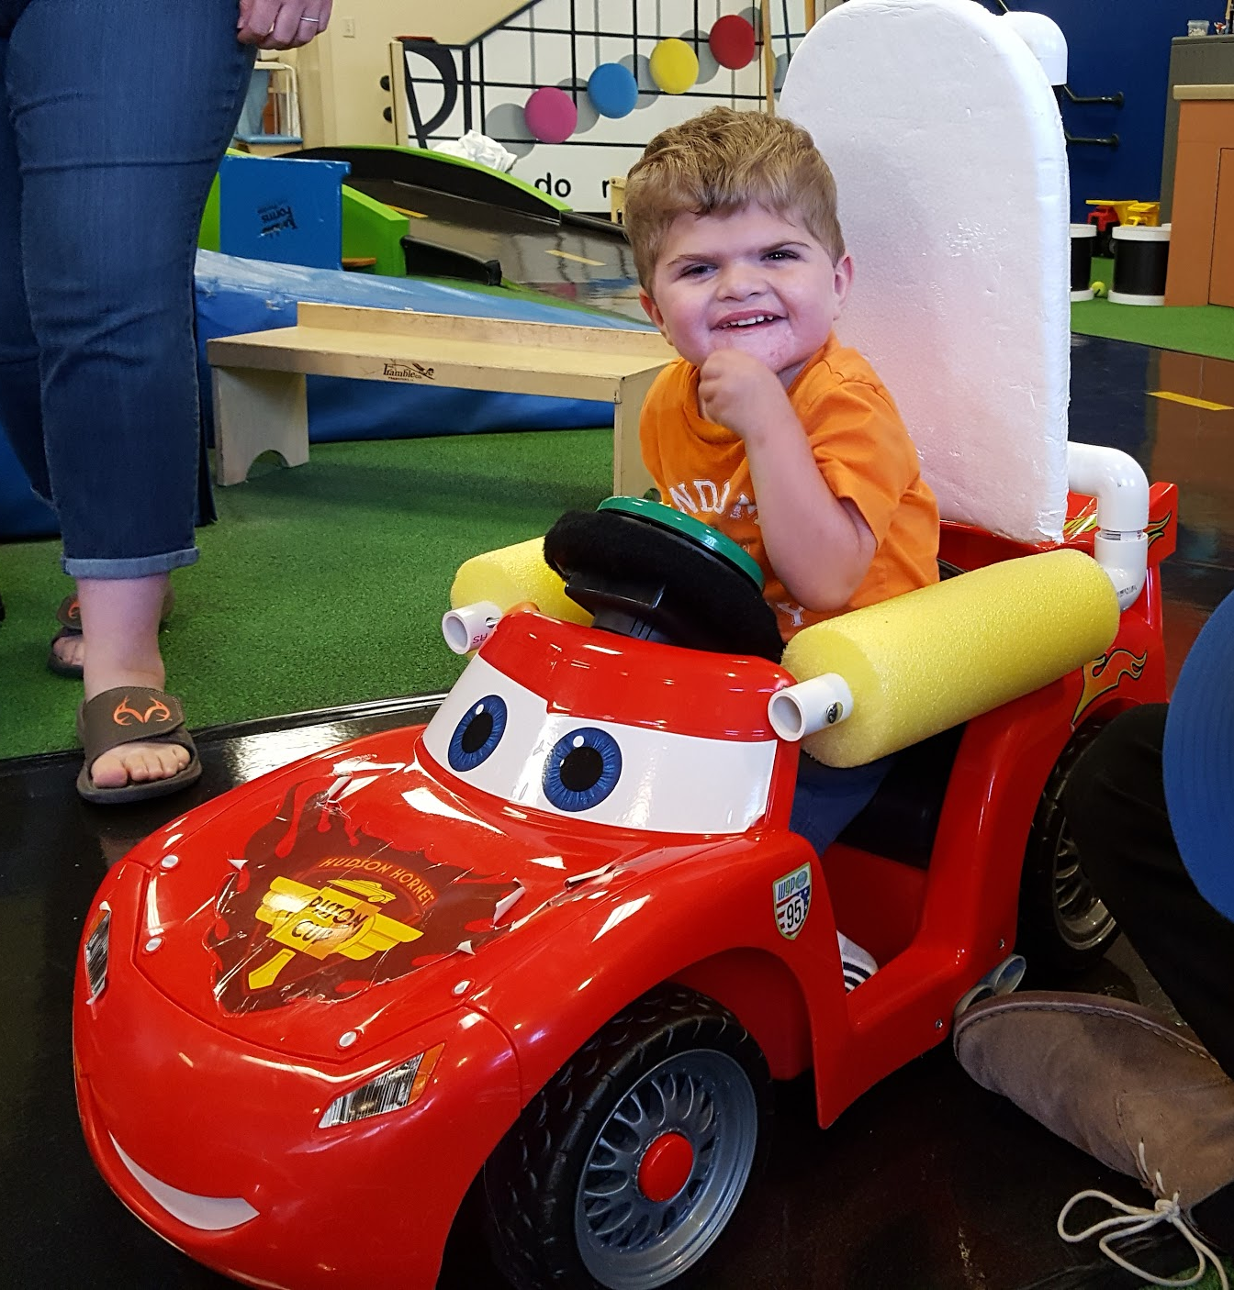
Meet the Kids
Keagan
Luke
Clayton
Notes:
Amanda
Keagan- 14 months old. Has congenital muscular dystrophy, so it will get worse as he gets older. he can’t sit up straight. Want to get his hips as in line as possible and he needs forearm support. Needs an adjusted seat and steering wheel
often have hypotonia (decreased muscle tone, floppiness), and may have reduced movements and contractures (tightness) in the hips, knees and elbows
Luke- 2 years old. ATNR reflex, had 4 strokes, Duchenne's Muscular dystrophy, moyamoya, he’s getting trained for a power chair,
Duchenne’s Muscular Dystrophy (DMD) is a genetic disorder characterized by progressive muscle degeneration and weakness. It’s caused by an absence of dystrophin, a protein that helps keep muscle cells intact
Moyamoya is a cerebrovascular disorder caused by blocked arteries at the base of the brain in an area called the basal ganglia
Clayton- 3.5 years. he has hydrocephalus (cerebrospinal fluid in his brain, makes him have a big head), L1CAM so he also has adducted thumbs which means they’re bent toward the palm, spasticity of the lower limbs, and severe intellectual disability. And he has a Ph.D. from Handsome Academy. He can’t crawl yet but he wants to

Slide 10
Documentation of final design
Adjustable seating
Adjustable steering design
Acceleration options
Appropriate support features
Parental control remote
Uphold pre-existing Consumer Product safety standards
Risks of operation
Notes:
Amanda
CPSC = consumer product safety commission
Risks: safety! Don’t want to explode things

Slide 11
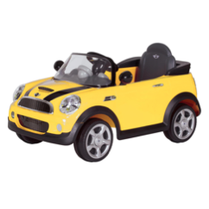
Prototype of the final design
Adaptable as the child grows
Low retail price
Pieces added as necessary
Notes:
Amanda

Slide 12
Proof that the design is functional and will solve the problem
Wide range of studies indicating that self-controlled mobility plays a key role in the development of children (Ragonesi et al. 2010, Ragonesi et al. 2011, Lynch et al. 2009, Galloway et al. 2007)
Design will support a variety of modular components in order to accommodate children with different disabilities
Notes:
several studies regarding powered vehicle use by mobility impaired children suggest that the children gain better socialization skills (Ragonesi et al. 2010, Ragonesi et al. 2011), driving, cognition, and language scores (Lynch et al. 2009), and confidence to move independently using a mobile robot
found that power wheels toy cars give mobility impaired children the chance to explore both physical and social environments more readily, providing the children with a “general learning environment” in the clinic, school, and home (Huang & Galloway 2012). The toys were able to address movement goals and body function and structure goals.

Slide 13
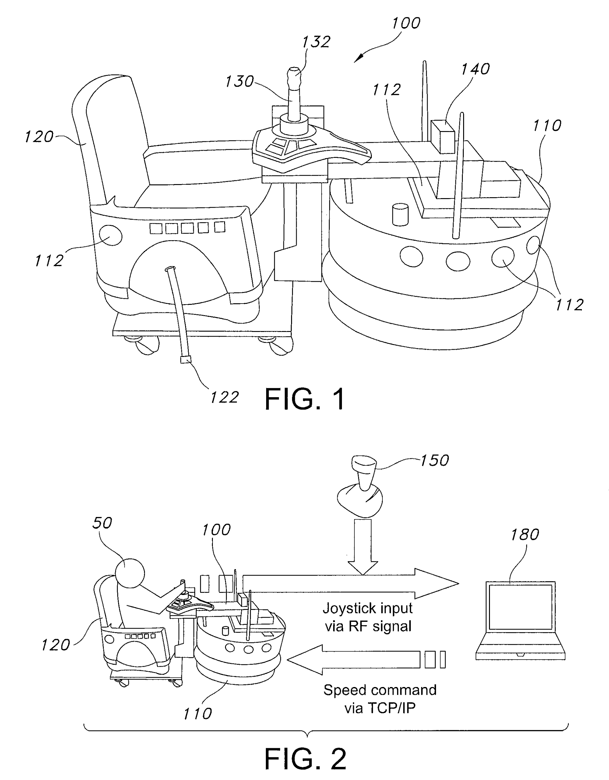
Results of a patent search and/or search for prior art, assessment and patentability
Haptic feedback design
Moves along predetermined path, but allows the children to control movement
Improves learning rates for driving
Notes:
When compared to a no feedback design

Slide 14
Anticipated regulatory pathway
We don’t expect the power wheels vehicles to require any regulation because they will be considered toys
They won’t require insurance
If at all, a class I classification could possibly be obtained

Slide 15
Reimbursement
Reimbursement not possible
Considered a toy
Not necessary for child’s mobility
Notes:
Helps integration into social environment but not necessary for mobility
Kid could actually use power chair but it’s not as convenient and has a stigma behind it and kids will not understand why they are different

Slide 16
Estimating manufacturing cost
Initial cost of the car : $150 - $350
Donated car for prototype
Accessory components : not known at this time
Materials we know will be used : pvc pipe, fabric, cushioning
No volume discount (only a few cars made at a time) ; custom cars
No labor fee for our product

Slide 17
Potential market
Children under the age of 5 with limited mobility will be end user
Common diagnoses of child : cerebral palsy, spina bifida, epilepsy, muscular dystrophy
Sell directly to families that are interested
Sell to preschools or elementary schools
Focus on Nashville area for now
Selling price: cost of car + needed accessories + labor
Possible distribution : case by case basis(all custom); manipulation lab course

Slide 18
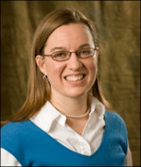
Advisor
Amanda Lowery
Ph.D. in Bioengineering
Replaced advisor position for Shirley Gogliotti
Has past experience working with Go Baby Go! Organization and building modified cars

Slide 19
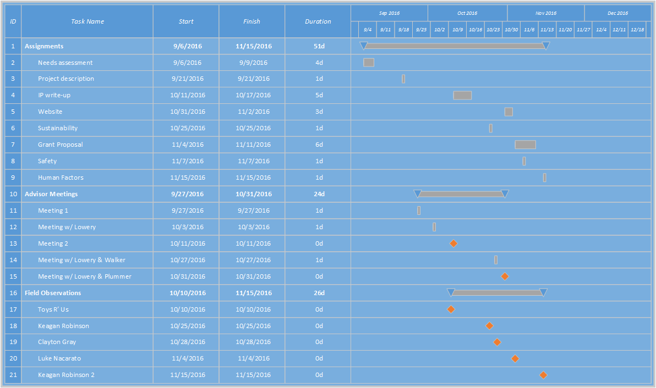
Project Schedule
Notes:
This is our Gantt Chart which will be updated as the project progresses.
Some of the assignments were integral to our project design.

Slide 20
References
“Birth Defects– Data and Statistics”. Centers for Disease Control and Prevention, 21 Sept 2016, http://www.cdc.gov/ncbddd/birthdefects/data.html. Accessed 13 Nov 2016.
A.F. v. Office of Health Insurance Programs of the New York State Department of Health. FH#6630954H. Onondoga County Appellate Court, NY. 2014. Neighborhood Legal Services, Inc. Web. 13 Nov 2016.
http://www.ninds.nih.gov/disorders/moyamoya/moyamoya.htm
https://www.mda.org/disease/duchenne-muscular-dystrophy
http://www.ninds.nih.gov/disorders/hydrocephalus/detail_hydrocephalus.htm
https://ghr.nlm.nih.gov/condition/l1-syndrome
https://www.cpsc.gov/Business--Manufacturing/Business-Education/Toy-Safety

Slide 21
Fast & Furious
Amanda McCausland, Nick Jelinek, Taylor Studer, William Holder

