Slide 1
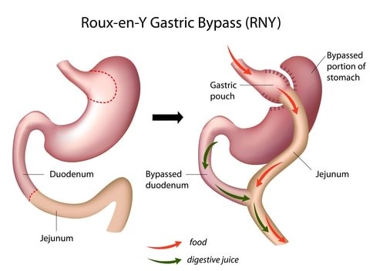
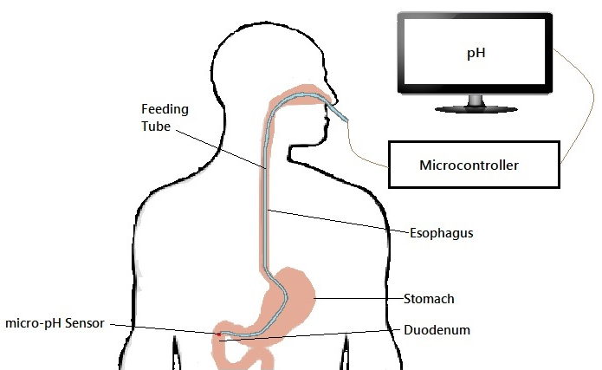
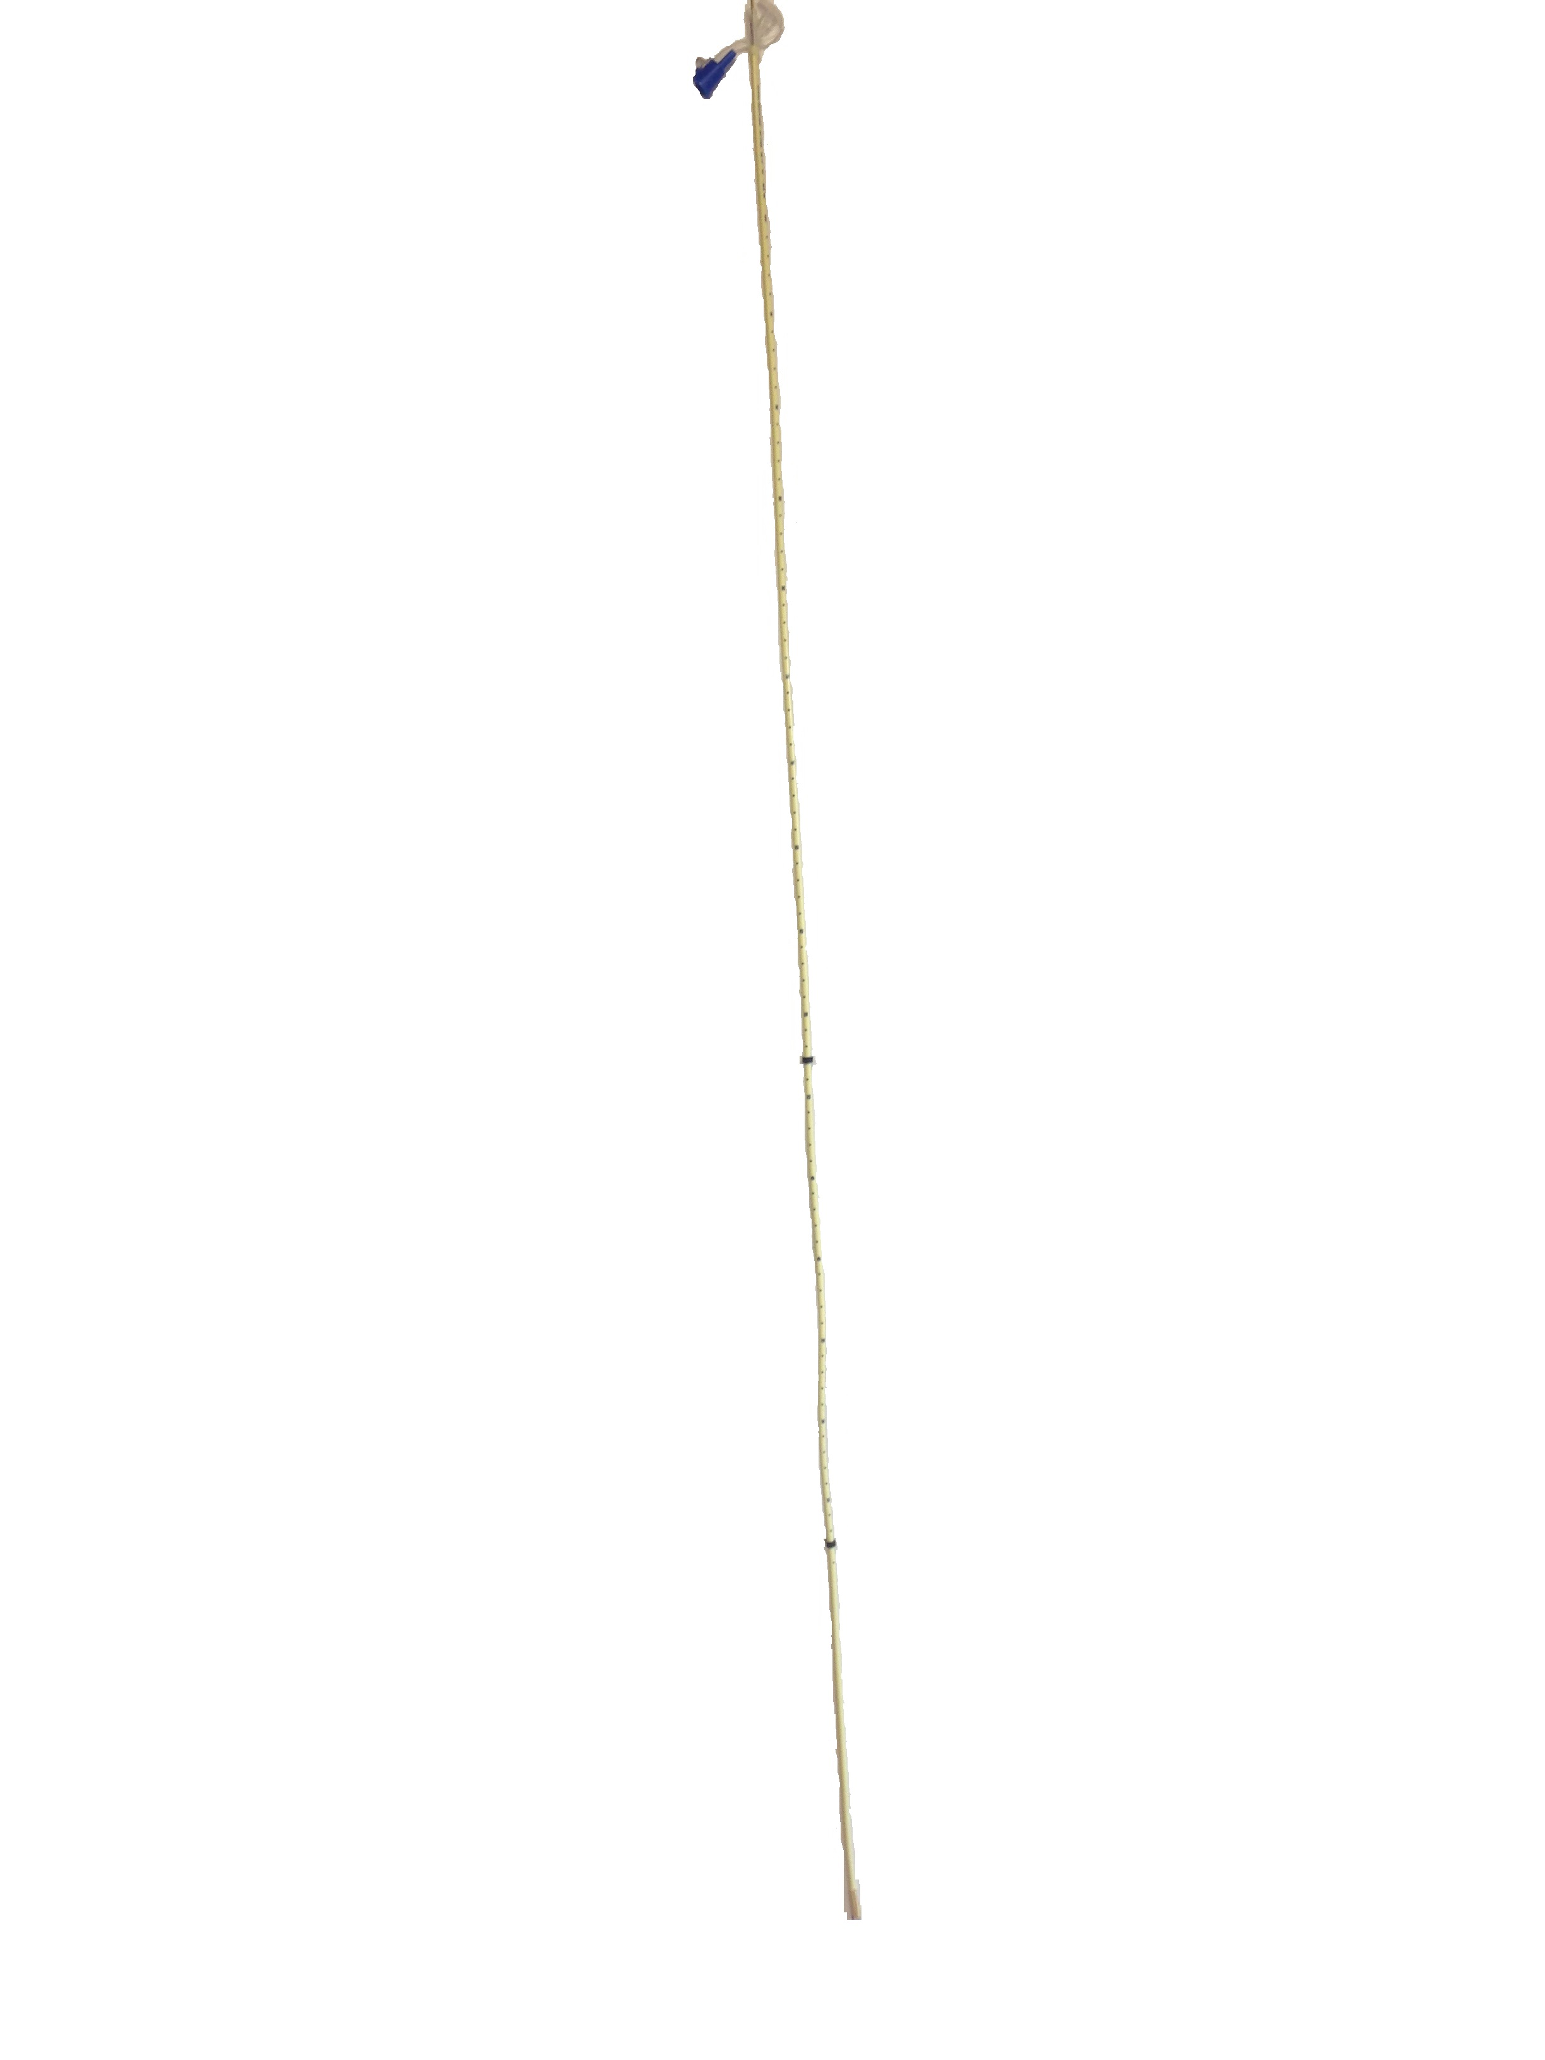
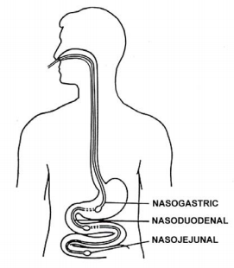
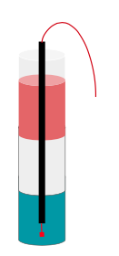
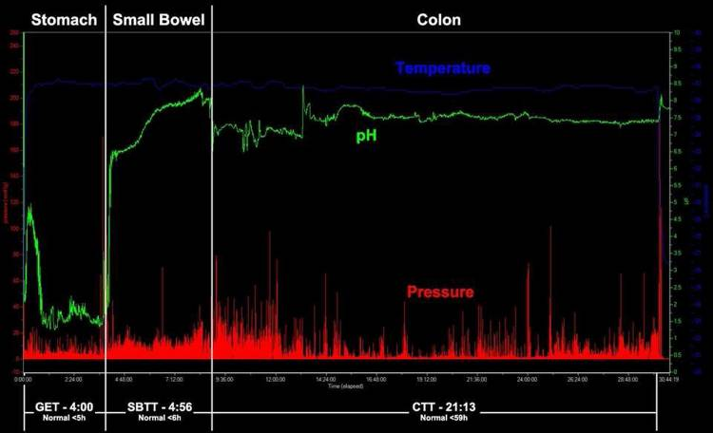
FeedRite Feeding Tube Placement System
Alexander Heilman, Graham Husband, Katherine Jones, Ying Lin
Advisors: Dr. Naji Abumrad and Dr. Matthew Walker III
Biomedical Engineering Department, Vanderbilt University, Nashville, TN
Problem Statement
Needs Assessment
Results
The current gastric bypass procedure is invasive, expensive, and has an incredibly narrow patient population.
This limits the number of patients who can benefit from its use by:
Requiring long hospitalization periods post-op
Limiting qualifying patients to those with a BMI >40 (and >35 with obesity-related conditions)
And, costing roughly $25,000 depending on state of residence
Current analogs to gastric bypass – the nasoduodenal feeding tube – are less invasive and expensive, but are more dangerous.
This affects patient health by:
Allowing quicker recovery times post-op
Using repeated fluoroscopy exposure throughout treatment
We seek to create a novel product to act as an analog to gastric bypass by creating a nasoduodenal feeding tube placement system that:
Broadens patient population by:
Requiring a single outpatient appointment for placement
Increasing portability and decreasing cost such that the device can be used throughout a hospital
Creating a primary placement tool that is detachable from the tube post-op
Provides confident tube placement by:
Integrating a second method to determine tube location
Providing high resolution between the stomach and duodenum
Equipping the device to make real-time measurements
Increases safety of tube placement as compared to gastric bypass or its analogs by:
Using biocompatible tubing
Triangulating location with a radiation-free method
(PLOTS OF pH AND PRESSURE)
Future Directions
Transition from large-scale prototype to physiologic-scale final design through the use of microsensors
Submit Institutional Review Board application so that device can be tested in human volunteers
Create predictive algorithm that can amalgamate information from physiological sensors and predict the region in which the pressure sensor lies
Clinical Background
Design Components
Gastric bypass surgery is an invasive, risky, expensive, but often effective treatment for obesity and obesity-related illnesses, such as Type II diabetes (Figure 1A).
Bypassing the foregut using a nasoduodenal or nasojejunal feeding tube may mimic the effects of gastric bypass without surgical intervention (Figure 1B).
Current tube placement systems have definitive weaknesses
The correct placement of feeding tube is difficult to confirm without using X ray.
Current systems cannot definitely differentiate between the lung and stomach until alimentation
Pressure and pH change in a predictable and characteristic pattern as you travel through the gastrointestinal tract (Figure 2). Our design detects the pH and pressure as the feeding tube advances through the digestive system, indicating the position of tube’s tip.
pH Probe: Gather pH information from physiological environment and relay to Arduino
Pressure Probe: Receive pressure profile from gastrointestinal tract and relay to Arduino
Conclusions
Our feeding tube placement system will provide a safe and inexpensive but effective alternative to weight loss surgery.
Our design successfully:
Increases safety of weight loss treatment by:
Eliminating the need for high risk, permanent gastric bypass surgery
Eliminating the use of radiation common in other naso-duodenal feeding tube placement systems
Provides reliable tube placement prior to alimentation by combining three metrics (length, pH, and pressure)
Widens the patient population through decreased cost and increased portability
We anticipate this device will revolutionize the way we approach the growing obesity epidemic and related diseases.
Figure 3: Pressure and pH measurements are taken in the gastrointestinal tract, relayed to the Arduino microcontroller, and used to determine tip placement.
Figure 4: Our biocompatible feeding tube includes 1 cm graduations as well as markings indicating the average location of the entrance of the stomach and entrance of the duodenum.
Tubing: Provide biocompatible food transport tube while housing wires to probes and using graduated markings on tube to provide healthcare provider with third data point for healthcare providers to ensure confident placement. Our tube is also marked with the approximate location of landmarks of interest so that healthcare providers can anticipate the change in pH (Figure 4).
References
Figure 1: A) The traditional gastric bypass procedure removes the lower portion of the stomach, and connects the upper portion to the jejunum.¹ B) The use of nasoduodenal feeding tube² as an alternative solution to gastric bypass surgery has been proven promising.
Cylindrical Density Chamber
Used for calibration and demonstration
Allows variance of metrics of interest (pH and pressure)
Markings on chamber indicate average location of regions of interest
Esophagus/stomach and stomach/duodenum interface
Clear, polycarbonate pipe allows visualization of internal fluids
Increasing depth allows increase in pressure based on density and height of fluid
Internal fluids simulate environment of different areas of the gastrointestinal system (Table 1)
Rovito, Peter F. "Gastric Bypass Surgery: Complete Patient Guide." Bariatric Surgery Source, Web.
“Enteral Nutrition.” PINNT. Web.
Tran K, Brun R, Kuo B. Evaluation of regional and whole gut motility using the wireless mobility capsule: Relevance in clinical practice. Therap Adv Gastroenterol. 2012; 5: 249-60.
Bitar KN, Raghavan S, Zakhem E. Tissue engineering in the gut: Developments in neuromusculature. Gastroenterology. 2014; 146: 1614-24.
Bortolotti M, Sarti P, Barbara L, Brunelli F. Gastric myoelectric activity in patients with chronic idiopathic gastroparesis. J Neurogastroenterol Motil. 1990; 2: 104-8.
Holmes GM, Swartz EM, McLean MS. Fabrication and implantation of miniature dual-element strain gages for measuring in vivo gastrointestinal contractions in rodents. J Vis Exp. 2014; 91: 51739.
Shi Q, Wang J, Chen D, et al. In vitro and in vivo characterization of wireless and passive micro system enabling gastrointestinal pressure monitoring. Biomed Microdevices. 2014; 16: 859-68.
Towe BC. Piezoelectric contrast materials for ultrasound imaging. IEEE Trans Ultrason Ferroelectr Freq Control. 2005; 52: 1483-8.
Table 1: pH and density of liquids in density column simulating the gastrointestinal system
Region of Gastrointestinal System | Simulation Solution | Density (g/mL) | Measured pH
Esophagus | 91% Isopropyl Rubbing Alcohol | 0.79 | 7.2
Stomach | Diet Coke | 1.00 | 3.7
Duodenum | Hand Soap | 1.06 | 8.4
Acknowledgements
Figure 2: A 2012 study¹ of the gastrointestinal tract in healthy adult volunteers showed drastic changes in pH and pressure profile between different regions of the tract. These changes can be used to differentiate these regions.
In addition to our sponsor, Dr. Naji Abumrad, and advisor, Dr. Matthew Walker III, we would also like to thank Ms. Jean Barnes for her support and guidance. Funding for this project was provided by the Biomedical Engineering Department of Vanderbilt University.

