Slide 1


February 22, 2016

Slide 2
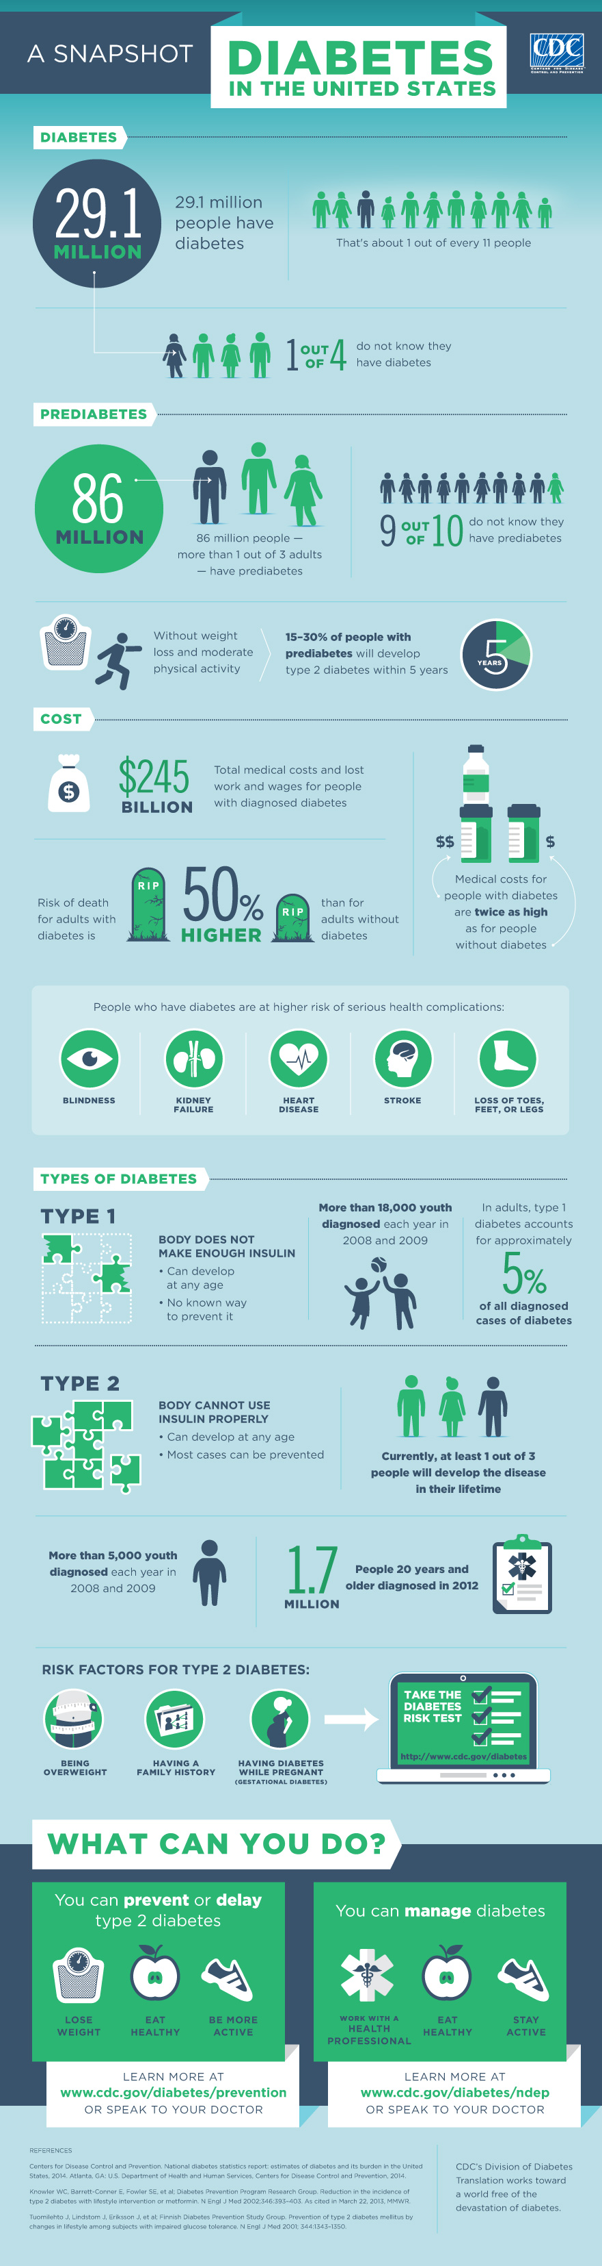
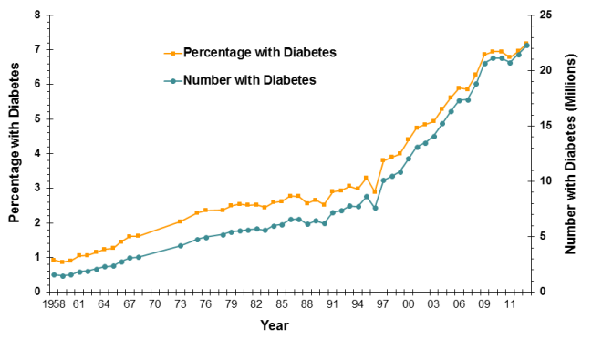

Medical Need
That’s about 1 out of every 11 people
Total medical costs and lost work and wages for people with diagnosed diabetes
than for adults without diabetes
Risk of death for adults with diabetes is

Slide 3
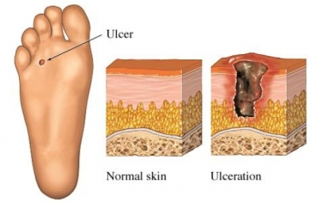
Medical Need – Problem Statement
1 in 4 diabetics develop foot ulcers over their lifetime
Wounds can reach chronic state
Approx. 80,000 diabetic patients require lower-limb amputations per year
Currently no active healing process
Patient compliance is a large treatment-
management complication
http://www.drugs.com/health-guide/images/205064.jpg

Slide 4
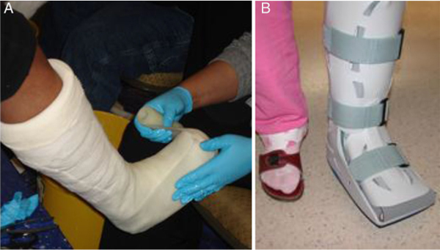
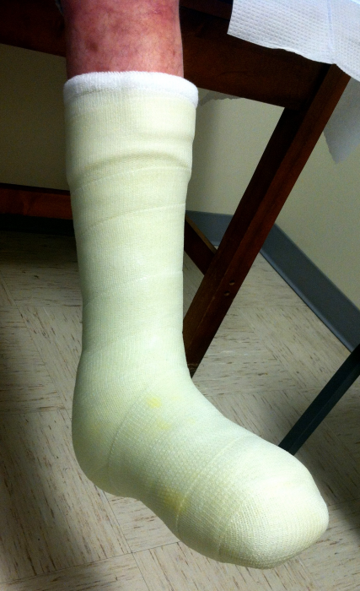
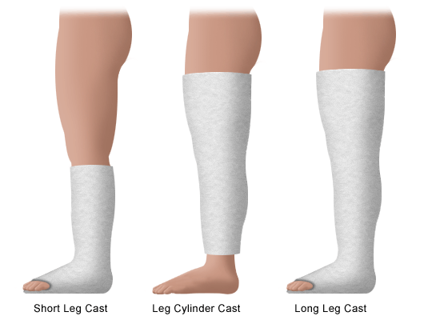
Current Standard of Care
Total-Contact Cast
Load-bearing
Antimicrobial absorbent dressing
Requires weekly maintenance
Cost per treatment : $8,000 - $17,000
Method of passive healing
http://diabeticfootandankle.net/index.php/dfa/article/viewFile/21177/html/99139
http://www.stanfordchildrens.org/content-public/topic/images/06/126006.gif
http://www.podiatrytoday.com/files/imagecache/normal/FitzgeraldBlog1.png

Slide 5
Needs Assessment Summary
Patient
Retain gold standard with no additional harm to patient
Proven to reduce healing time and infection
Safe
Provider
Simple application
Minimal preparation
Simple maintenance
Compatible with current standards
System
Low cost
Dependable
Durable
Willing insurance companies
Dosage Requirements:
Operate 10min daily for one week before battery change
Produce therapeutic light at 50mW/cm²
(Adamskaya et al.)

Slide 6

Our Solution
Low-level light therapy (LLLT) delivery to wounds
Active healing method
Second-line therapy
Eventual replacement of SC
Maintains patient compliance
Automated, preset
Safe
Waterproof/heat resistant/shock resistant

Slide 7
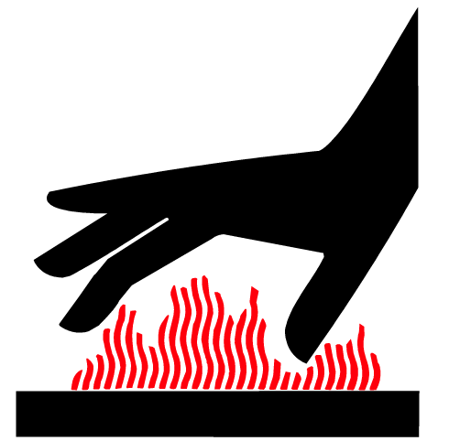

Mitigating Risks
Waterproof
Prevent water spills and shallow submersion from damaging circuitry
Heat Resistant
Effectively mitigate heat produced by circuitry
Prevent burns and circuit meltdown
Shock Resistant
Withstand impact forces
Little to no concern of light risks to patient

Slide 8
Please see the 3D Mold Model under the LumaSil tab on our website

Slide 9
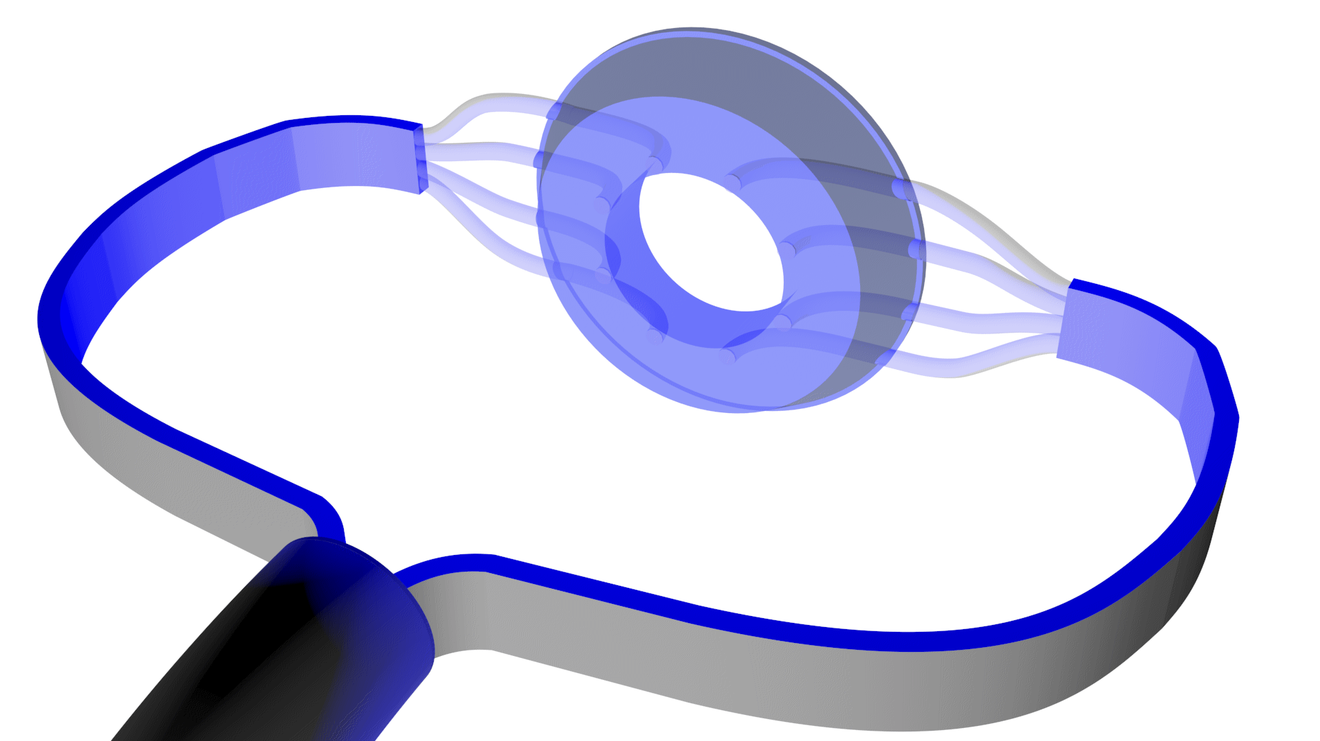

Device Design – Silicone Halo
2.5 cm
4.5 cm
Fiber optics
1 cm
Silicone Patch
5.5 cm

Slide 10
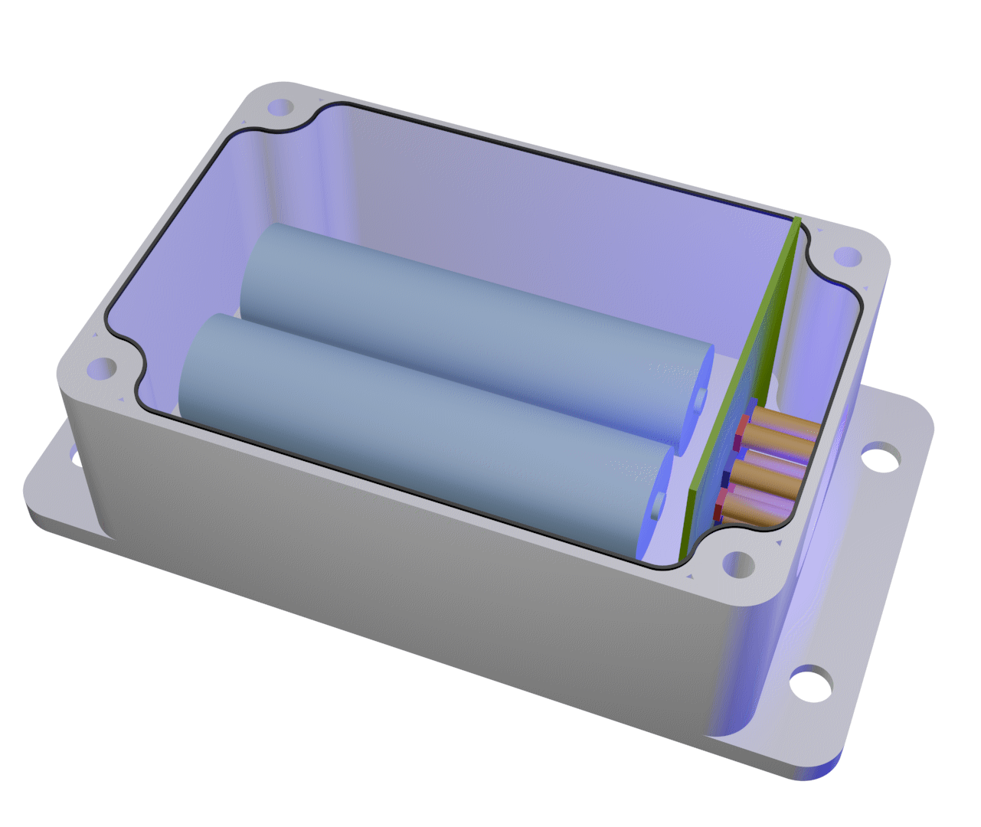
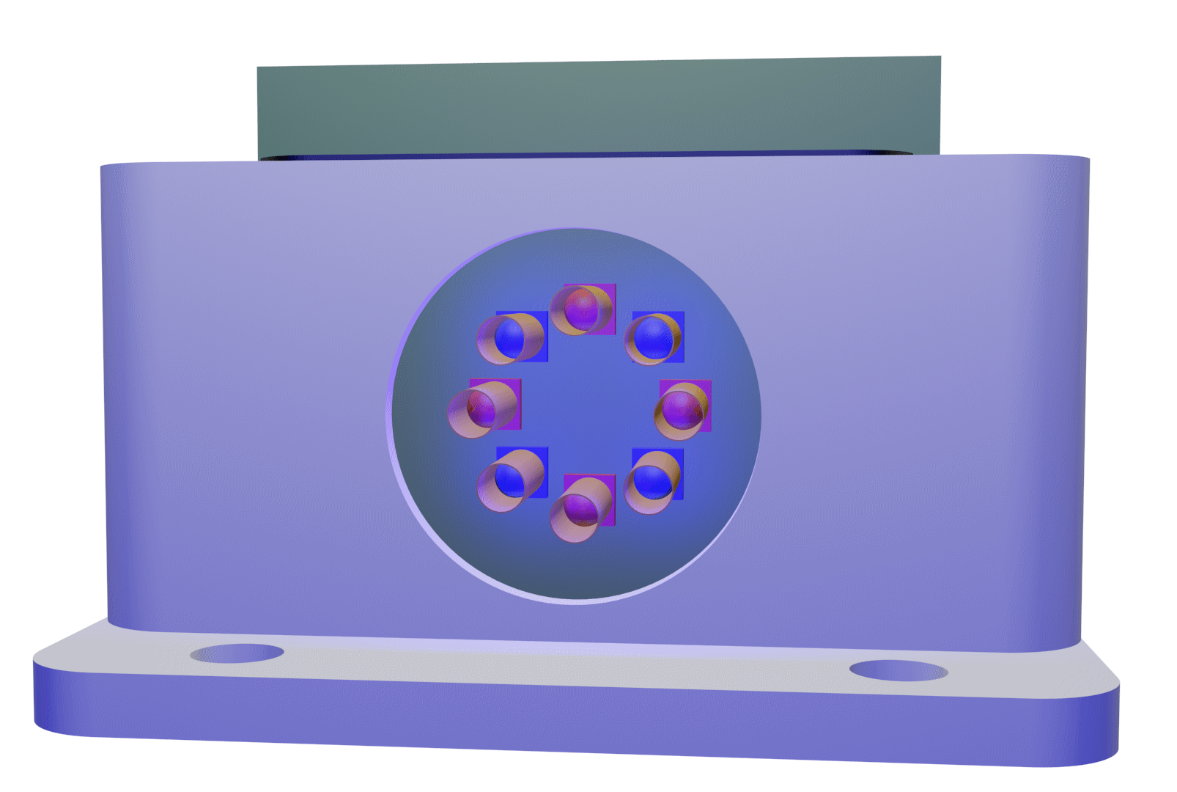
Device Design – Module

Slide 11
Please refer to the 3D Model Video under the LumaSil tab on our website.

Slide 12
Feasibility Study
Pre-study criteria
2 weeks of standard of care
Two treatment groups
Group 1 (n = 10): Standard of Care – total-contact cast
Group 2 (n = 10): LumaSil device – total-contact cast + light therapy
Return for weekly visits
Remove cast and clean wound site
Replace device battery
Wound assessment / measurements
Lasts 2-4 weeks

Slide 13
Recent Accomplishments IRB Application and Protocol
Pre-Submission
Added Dr. Hicks and MDRAP adjustments
CITI Training from Dr. Hicks
Dr. Hicks’s and Dr. Giorgio’s signature
Submitted
Post-Submission
Under pre-review
Contact IRB board regarding previous communication with MDRAP

Slide 14
Recent Accomplishments
Everything below module finalized
Power study
Observed a 5.3% loss of illuminance
Intend to do more tests later
Condition | Illumination (lux)
Ambient | 24
Straight (0°) | 250
Bent 90° | 250
Bent Device° | 238

Slide 15
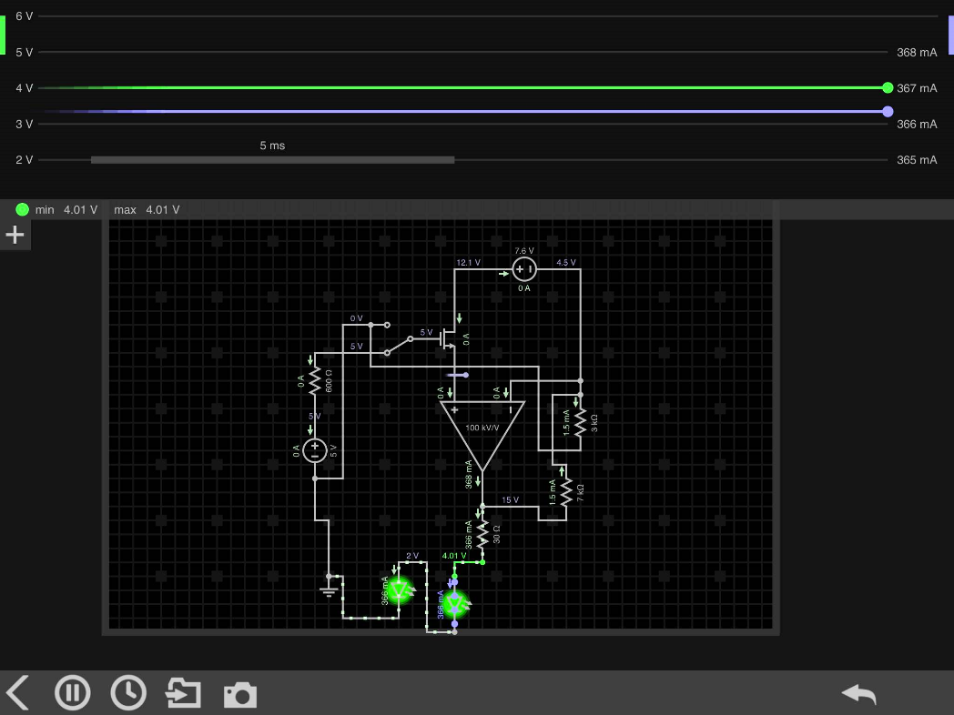
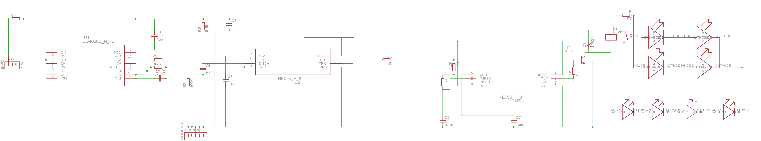
Recent Accomplishments Circuit
Optimizing size of PCB
Circuit drawn

Slide 16
Current Tasks
IRB
Awaiting approval/corrections
Design
Battery source with sufficient current/voltage
Incorporating thermal pads
Design water-tight FO attachment
Constructing prototype

Slide 17
Next Steps
IRB Application
Expecting 2-4 week turnover
Informational brochure
Prototype construction
Circuit/PCB ordering
Casing
Cast testing II
https://d1ybwah56txnv1.cloudfront.net/assets/v2/landing_pages/irb_assistance_0-3773a4e6fbcb5c3fd0f23f9e5134f0d4.jpg

Slide 18
Current Timeline
IRB Submission: Third week of February
*assuming corrections for initial return
IRB Approval: First weeks of March
Feasibility Study
Mid march to first week of April (latest acceptable)
Prototype Construction & Testing (cont’d)
February
March
April

