Slide 1


February 8, 2016

Slide 2
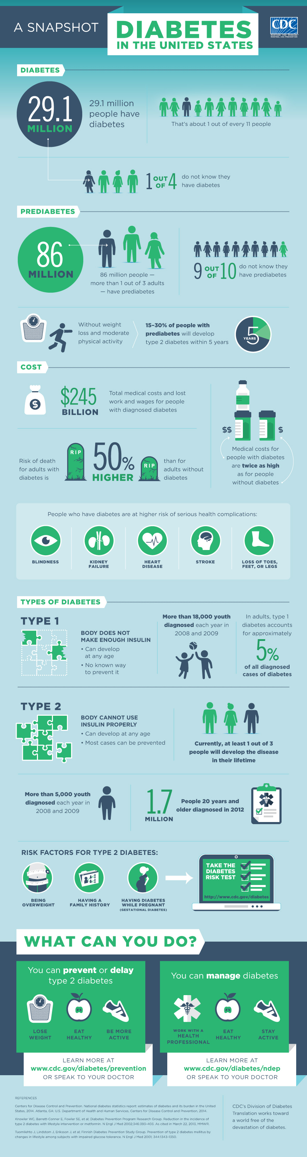
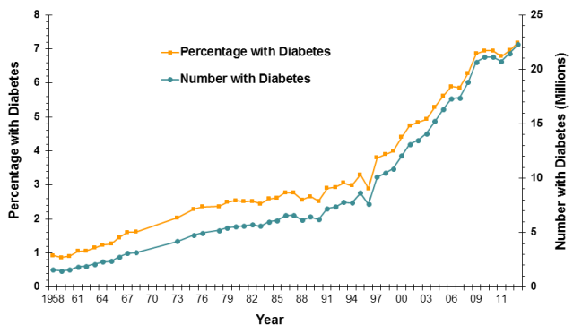

Medical Need
That’s about 1 out of every 11 people
Total medical costs and lost work and wages for people with diagnosed diabetes
than for adults without diabetes
Risk of death for adults with diabetes is

Slide 3
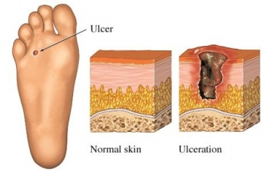
Medical Need – Problem Statement
1 in 4 diabetics develop foot ulcers over their lifetime
Wounds can reach chronic state
Approx. 80,000 diabetic patients require lower-limb amputations per year
Currently NO ACTIVE healing process
Patient compliance is a large treatment-
management complication
http://www.drugs.com/health-guide/images/205064.jpg

Slide 4
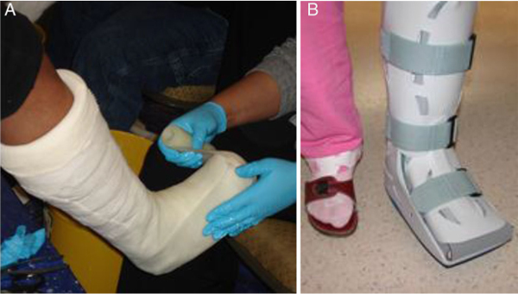
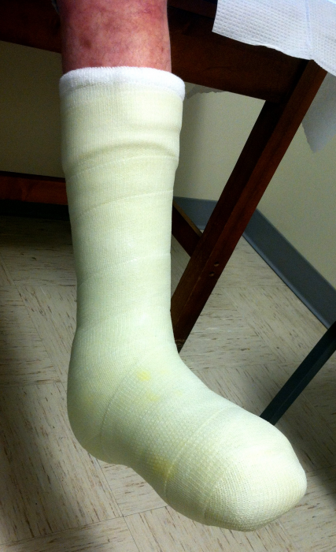
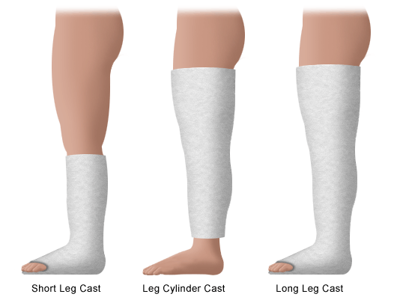
Current Standard of Care
Total-Contact Cast
Load-bearing
Antimicrobial absorbent dressing
Requires weekly maintenance
Cost per treatment : $8,000 - $17,000
Method of passive healing
http://diabeticfootandankle.net/index.php/dfa/article/viewFile/21177/html/99139
http://www.stanfordchildrens.org/content-public/topic/images/06/126006.gif
http://www.podiatrytoday.com/files/imagecache/normal/FitzgeraldBlog1.png

Slide 5
Needs Assessment Summary
Patient
Retain gold standard with no additional harm to patient
Proven to reduce healing time and infection
Safe
Provider
Simple application
Minimal preparation
Simple maintenance
Compatible with current standards
System
Low cost
Dependable
Durable
Willing insurance companies
Dosage Requirements:
Operate 10min daily for one week before battery change
Produce therapeutic light at 50mW/cm²
(Adamskaya et al.)

Slide 6

Our Solution
Low-level light therapy (LLLT) delivery to wounds
Active healing method
Second-line therapy
Eventual replacement of SoC
Maintains patient compliance
Automated, preset
Safe
Waterproof/heat resistant/shock resistant

Slide 7
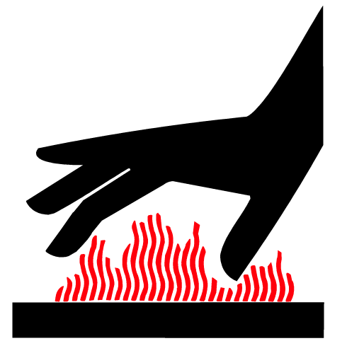

Mitigating Risks
Waterproof
Prevent water spills and shallow submersion from damaging circuitry
Heat Resistant
Effectively mitigate heat produced by circuitry
Prevent burns and circuit meltdown
Shock Resistant
Withstand impact forces
Little to no concern of light risks to patient

Slide 8
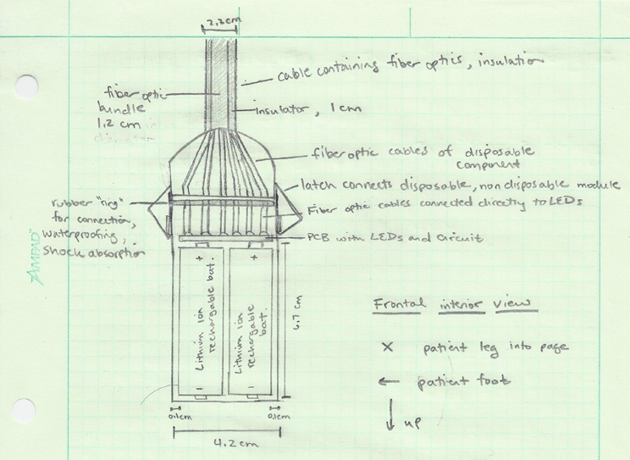
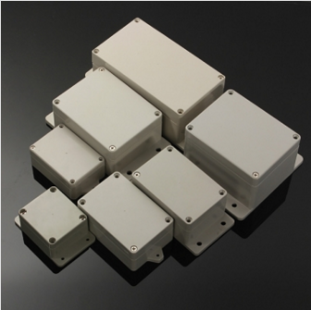
Device Design - Module
New casing: Electrical box

Slide 9
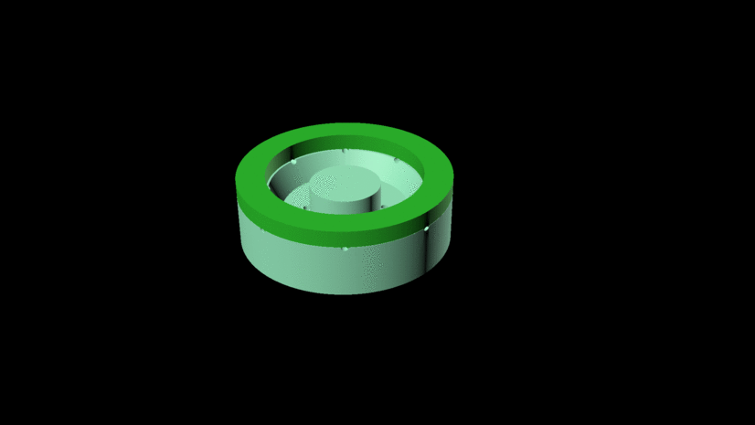
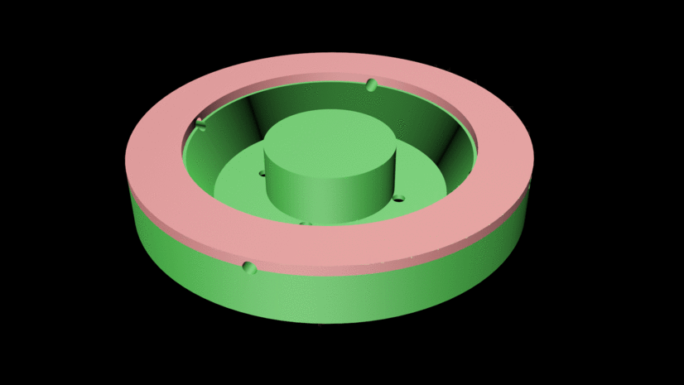
Device Design – Mold

Slide 10

Device Design - Patch
2.5 cm
4.5 cm
1 cm
5.5 cm

Slide 11

Recent Accomplishments
New patch design
New 3D-printed mold (version 5)
8-fiber optic silicone patch
Curing method
Oven heating – failed
Heat lamp: 24-48hrs » ~1hr
Logo!
Material procurement
Silicone, circuit components, fiber optics

Slide 12
Recent Accomplishments
IRB Application and Protocol
“Finalized”
Waiting on
CITI Training from physician(s)
Dr. Hicks adjustments & details
Updates
2-4 week treatment (under physician’s discretion)
2 additional physicians
Circuit design “finalized”
Cast testing
Vanderbilt Orthopaedics Foot and Ankle Center
Testing cast/device application process

Slide 13
Please See Cast Testing I Video under the LumaSil Tab of our Website

Slide 14
Current Tasks
Gathering information from Dr. Hicks
Battery source with sufficient current/voltage
Heat sinks vs. thermal pads
Design water-tight FO-FO attachment
Constructing prototype

Slide 15
Ideas & Solutions
Lithium-ion battery
Water-tight FO-FO attachment

Slide 16

Next Steps
IRB Application
Submission within one week
Expect 2-4 week turnover
Prototype construction
Circuit/PCB ordering
Casing
FO-FO attachment
Cast testing II
https://d1ybwah56txnv1.cloudfront.net/assets/v2/landing_pages/irb_assistance_0-3773a4e6fbcb5c3fd0f23f9e5134f0d4.jpg

Slide 17
Current Timeline
IRB Submission: Second Week of February
*assuming corrections for initial return
IRB Approval: First Weeks of March
Feasibility Study
Mid march to first week of April (latest acceptable)
Prototype Construction & Testing (cont’d)
February
March
April

