Slide 1

LumaSil
Brandon Fross John Mendoza Laurel Piper
Siegfried Schlunk Liza Stedman Ahbid Zein-Sabatto

Slide 2
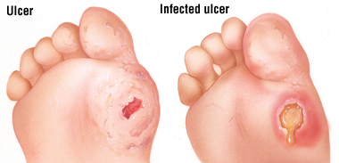
Problem Statement
Foot ulcers are common in patients with diabetes mellitus
These wounds can become chronic
Can lead to amputations if left untreated
Management often requires patient compliance
No current proactive healing process, only passive healing
http://www.drugs.com/health-guide/images/205064.jpg

Slide 3
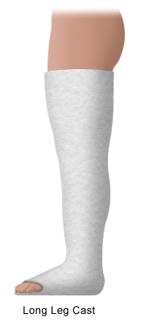
Current Standard of Care
Load bearing shoe / cast
Clean and take pressure off wound
Cast and dressing changed weekly
Overall treatment/therapy is expensive
http://www.stanfordchildrens.org/content-public/topic/images/06/126006.gif

Slide 4
LumaSil
Low-Level Light Therapy delivery to wounds
Active healing method
Second-line therapy
Cost effective
Addition onto Standard of Care
Automated, preset
Waterproof
Safe

Slide 5
Needs Assessment Summary
Patient
  Low impact
  Retain gold standard
  Bring no harm or discomfort
  Proven to reduce healing time
  Waterproof
Provider
  Simple application
    (no special training required)
  Minimal preparation
  Simple maintenance
  Compatible with current standards
System
  Low cost
  Dependable
  Durable
  Willing insurance companies

Slide 6
Efficacy
LLLT treatment must
  Decrease healing time
  Reduce infection
  Improve sensation in extremities (foot)
Operate 10min daily for a week before battery change (Adamskaya et al.)
Produce therapeutic light at 50mW/cm² (Adamskaya et al.)

Slide 7
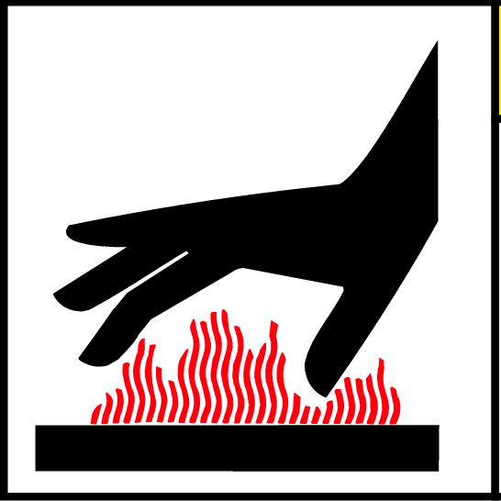

Safety
Waterproof
  Prevent water spills and shallow submersion from damaging circuitry
Heat Resistant
  Effectively mitigate heat produced by circuitry
  Prevent burns and circuit meltdown
Shock Resistant
  Withstand impact forces
Little to no concern of light risks to patient

Slide 8
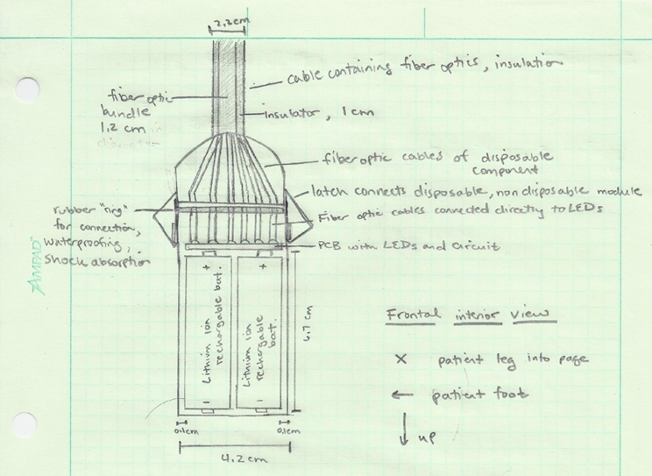
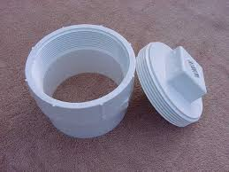
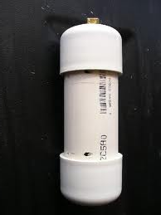
Device Design - Module
New Casing: PVC Pipe
https://encrypted-tbn3.gstatic.com/images?q=tbn:ANd9GcSOcX5tf4sIODWCeddOpZYTkYzSV6phPFM6fCxgEHiDNotsJl4zIA
http://dockglo.com/cap_and_uv_coated_pipe.jpg

Slide 9
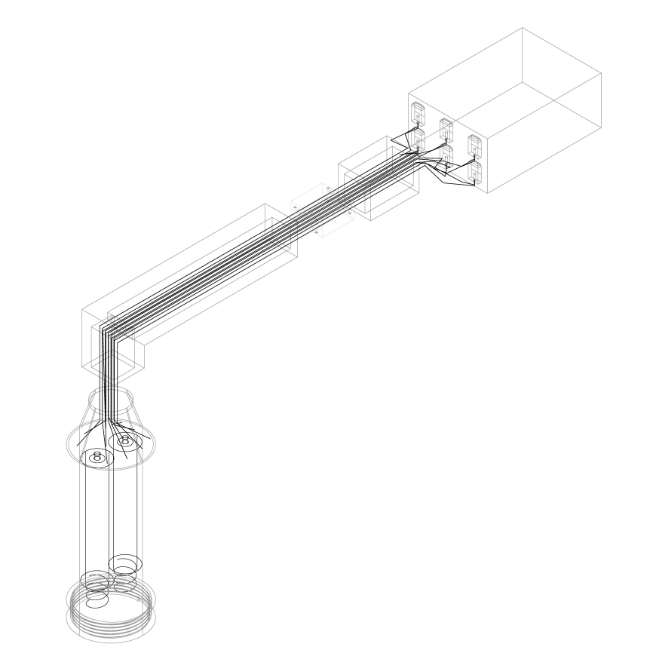
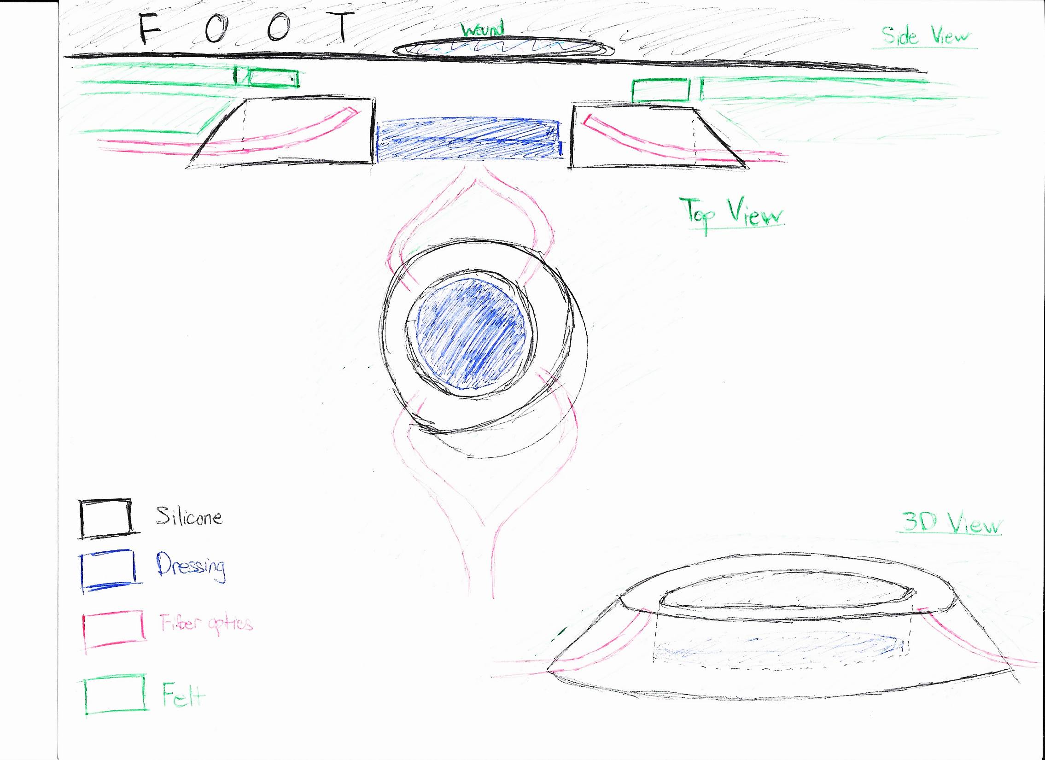
Device Design - Patch

Slide 10
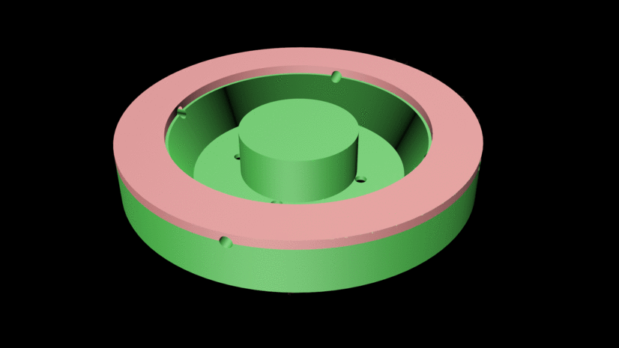
Device Design - Mold

Slide 11
Recent Accomplishments
IRB Application and Protocol
  “Feasibility Study”
  Inclusion/Exclusion Criteria
  Now 2-week treatment with 2 treatment groups (SoC vs LumaSil)
Name! LumaSil
New patch design
  Created new donut shaped design
  Printed 3-D mold
  Created silicone patch – mixing strategy incorporates airless mixing
Material procurement (e.g. silicone)

Slide 12
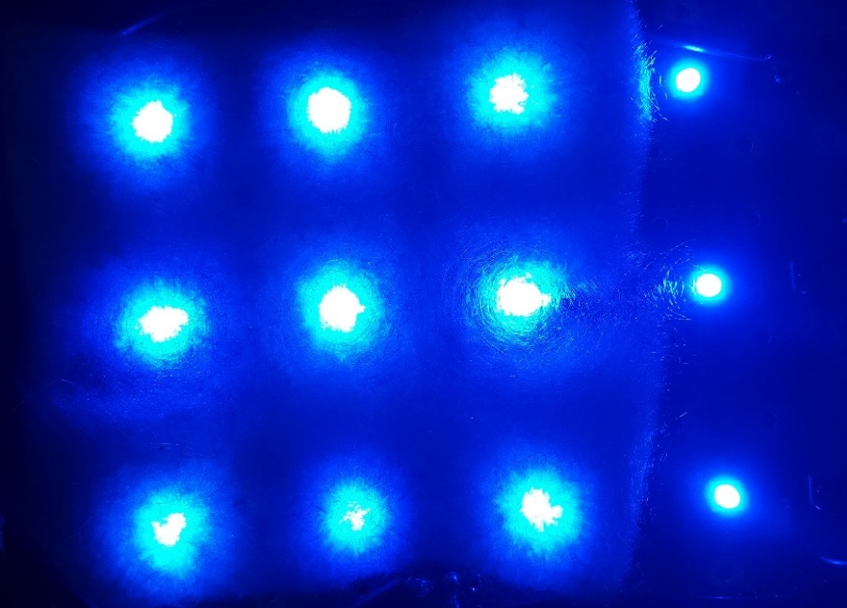
Current Challenges
Gathering information from Dr. Hicks
Figuring out pulsating light automation
Battery source with sufficient current/voltage
Design of battery pack
  Waterproofing

Slide 13

Solutions
Schedule face-to-face time with Dr. Hicks, MDRAP
Talk to experts in appropriate areas where assistance and knowledge is useful
More frequent meetings – brainstorming
https://info.examtime.com/files/2014/04/brainstorming.jpg

Slide 14
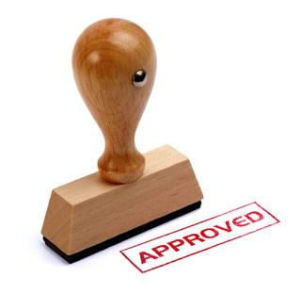
Next Steps
IRB Application
  To be completed: Device Protocol / Discovr-e Online Application
  Meeting with MDRAP 1/27
    Update on project progress
    Risk Assessment
    Answer questions (Data Monitoring Plan, Conflict of Interest, etc.)
  Meeting with Dr. Hicks 1/27
    Ok’ed patch design
    “Changes and suggestions”
    Answer questions (Specify Documents/Artifacts collected in study, specifics on a repository of data, Technical Assistant information, etc.)
https://d1ybwah56txnv1.cloudfront.net/assets/v2/landing_pages/irb_assistance_0-3773a4e6fbcb5c3fd0f23f9e5134f0d4.jpg

Slide 15
Next Steps
Prototype Construction
  Mold/Patch
    Success with 4-fiber optic mold, will adjust for 8-fiber optic channel
  Circuitry/PCB
    Potential complication with automation of treatment
    Current hopeful: two timed-switches (one 24 hrs, one 10 min, repeat…)
      Possible alternative: Arduino

Slide 16
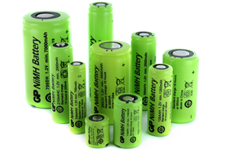
Next Steps
  Power Source
    Challenge: sufficient battery current/voltage supply + small size + cost effective
    Considerations: Li ion battery, cellphone battery, NiMH battery
  Casing / Splicer
  PVC pipe
    Water proofing, easy to work with
http://cellpacksolutions.co.uk/wp-content/uploads/2013/06/nickel-metal-hydride-nimh-batteries.jpg

Slide 17
Current Timeline
Prototype Construction
&
Testing
Patch
Circuitry
Casing
Testing (power, waterproof, overheating)
IRB Submission: First Week of February
*assuming corrections for initial return
Feasibility Study
Mid march to first week of April (latest acceptable)
IRB Approval: First Weeks of March
IRB Application
Meet with MDRAP 1/27 to discuss questions (Device Protocol, Risk Assessment, Discovr-e Online Application)
Hicks meeting 1/27
  Administrative
Prototype Construction & Testing (cont’d)
January
February
March
April

