Slide 1

Brandon Fross John Mendoza Laurel Piper
Siegfried Schlunk Liza Stedman Ahbid Zein-Sabatto

Slide 2
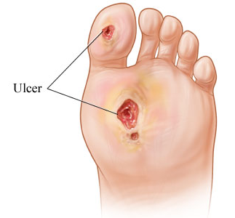
Problem Statement
Foot ulcers are common in patients with diabetes mellitus
These wounds can become chronic
Can lead to amputations if left untreated
Management often requires patient compliance
http://img.webmd.com/dtmcms/live/webmd/consumer_assets/site_images/media/medical/hw/h9991432_001.jpg

Slide 3
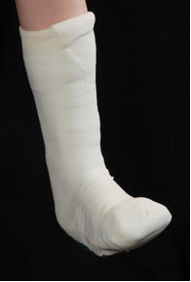
Current Standard of Care
Load bearing shoe / cast
Clean and take pressure off wound
Cast and dressing changed every two weeks
No current proactive healing process,
only passive healing
http://userscontent2.emaze.com/images/0fdc4a2a-2ae4-4395-bea0-932fdc35eb28/9c17d690-8ad2-4910-8ea5-3cfbfa5d5099image4.jpg

Slide 4
Background
Exposure of superficial abrasions to 400-450nm at 1.0 W/cm²
- Increased healing in superficial abrasions
- Mild photocoagulation
Burns infected with A baumannii exposed to 415nm at 19.2mW/cm²
- 16.5-fold decrease in bacterial burden in mice
- No resistance developed with extended exposure

Slide 5
Background
MRSA exposure to 415nm at 19.5-15.0 mW/cm²
- Keratinocytes had 25-fold less inactivation than MRSA
- in vivo inactivation was more efficient than in vitro
- Mouse abrasions infected with MRSA rid of infection after 41.4 J/cm² treatment
Ischemic rats exposed to 470nm at 50 mW/cm²
- Significant increase in tissue perfusion after 7days
- Reduced tissue necrosis and shrinkage

Slide 6
Background
Human epithelial cells and rats exposed to 880nm at 8J/cm²
- increased proliferation by 171% increase in growth
- Increased secretion of collagen 2 fold
- LEDs alone reduced rat wound size by 20% in 7 days
- 50% increase in laceration healing when used broad spectrum
2239 patients exposed to monochromatic infrared photo energy (890nm)
- Improved foot sensation (66%) and reduction in neuropathic pain (67%) in
medicare aged patients
-1106 patients (53%) no longer had loss of protective sensation after treatment

Slide 7
Low Light Level Therapy (Mechanism Evidence)
Increase in
  Local nitric oxide
  Mitochondria count
  ATP production
  Vascular dilation
  Macrophage Activation
  Synthesis of procollagen in fibroblasts
Notes:
Light produced from LEDs interact with photoactivated processes and increase levels of ATPase and cAMP enzymes. This triggers a chain reaction of immunological responses, activating macrophages and increasing synthesis of procollagen in fibroblasts. These responses lead to the activation of endothelial cells and accelerated degranulation which are responsible for wound healing. LLLT is also capable of changing the permeability of cell membranes to calcium, sodium, and potassium altering the cell proton gradient. As a result, receptor activity for endorphins, enkephalins, and growth factors are increased while pain response modulated by bradykinins is decreased.

Slide 8
Needs Assessment Summary
Patient
  Low impact
  Retain gold standard
  Bring no harm or discomfort
  Proven to reduce healing time
  Waterproof
Provider
  Simple application
    (no special training required)
  Minimal preparation
  Simple maintenance
  Compatible with current standards
System
  Low cost
  Dependable
  Durable
  Willing insurance companies

Slide 9
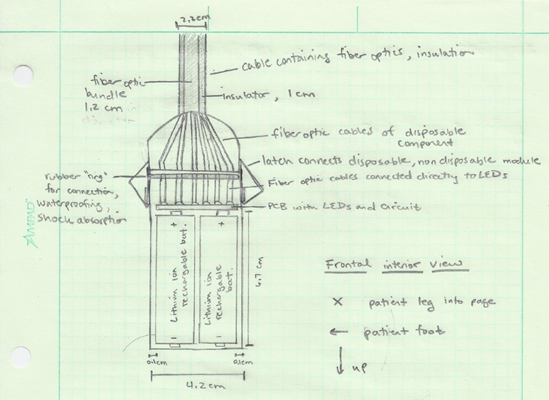
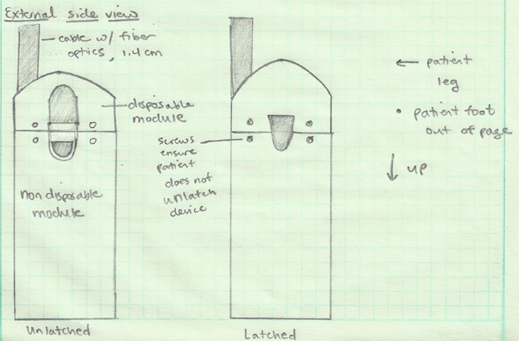
Design Components

Slide 10
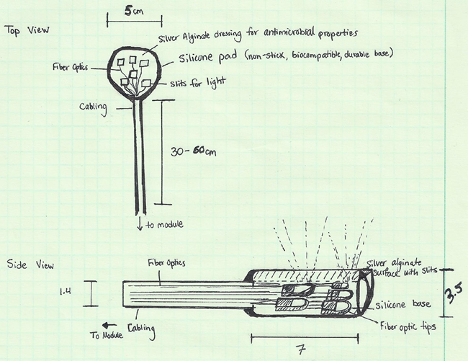
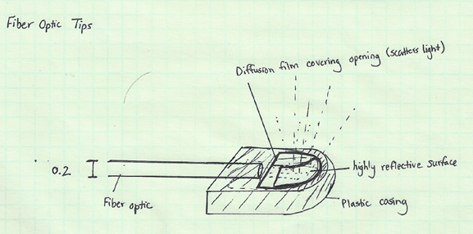
Design Components

Slide 11
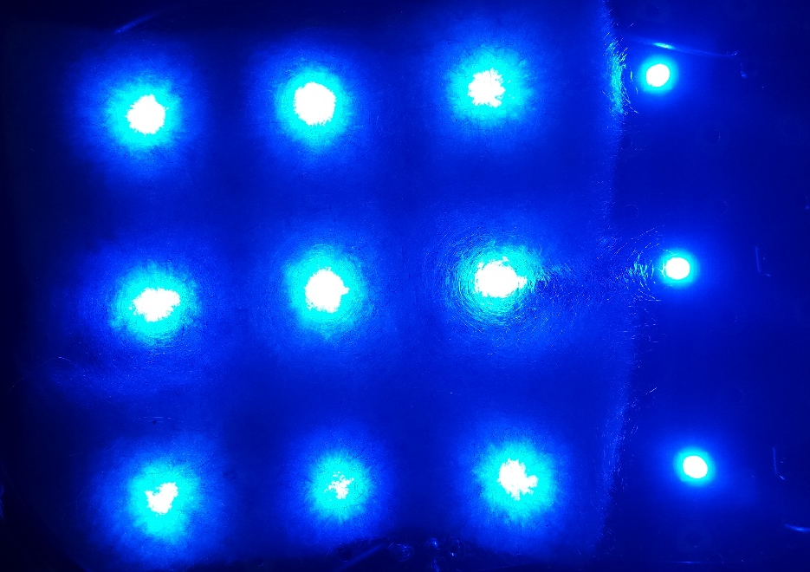
Device Specifications
LED
  Wavelength: 470 nm, 880 nm
  Intensity: 50 mW/cm²
  Size: 3 mm x 3 mm x 2.23 mm
Patch dimensions
  2’’ diameter circle
Battery specs
  High current

Slide 12
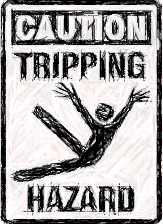
Risk Assessment
Electrical
Heat
Moisture
Sterility
Biocompatibility

Slide 13
Work Completed
Created Website
Drafted Project Proposal
Determined division of labor
Met with MDRAP and Office of IRB
CITI Training
Notes:
We made strides in approaching the IRB process properly. We met with Lynda O’Rear of the Human Research Protection Program. She referred us to Angela Howard, who is Vanderbilt’s device analyst for IRB approval. She was able to give us many valuable insights on what goes into an IRB application, how to achieve an expedited approval, and how to complete other aspects of the approval process, such as CITI training for all key study personnel. We plan to have all of our immediate team members complete CITI training by this Thursday.
On Friday we met with Vanderbilt Medical Device Regulatory Affairs Program (MDRAP) to discuss the specifics of our design, its production, and the associated risk. This risk assessment is integral for our IRB application, as we must show the device is low risk to obtain expedited approval.

Slide 14
Future Work
Risk Assessment
IRB Application
Research Materials

Slide 15
Next Steps
November
  Draft IRB application components
December
  Material Procurement / Construct & Test Components
  Submit IRB application
January-February
  Prototype Construction / Testing
  Begin Clinical Trials
March-April
  Finish Clinical Trials
  Communicate

Slide 16
Immediate Next Steps: Details
Requirements Specifications
wavelength/ power/size of LED
patch dimensions
battery specs
safety/efficacy boundaries
Prototype Visualization
Creo Drawings
Specs
Dimensions
Manufacturers
Component #s
Pre-Clinical & Benchmark Testing
Component Testing
CELA simulation
Previous publications
Power studies
IRB
Clinical Trials
Risk Assessment
Probability and Severity of :
Electrical
Heat
Moisture
Sterility
Biocompatibility**
Prototype Construction & Testing
November
December
January
February…

Slide 17
Questions?

