Slide 1
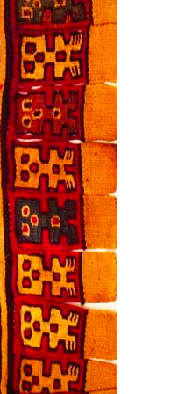
Teaching the African Diaspora in the Americas with Their Eyes Were Watching God: Students Researching through Fieldwork and Fiction

Slide 2
warm up
Listen to this recording of Zora Neale Hurston singing a U.S. Southern folk song, “Halimuhfack” and talking about where how she learned it.
https://www.floridamemory.com/audio/hurston.php

Slide 3
warm up
Where did she find out about this song?
How did she learn it?
Why do you think she wanted to learn it?

Slide 4
warm up
What else could we learn about human experiences from participant observation, or fieldwork?

Slide 5
Zora Neale Hurston’s Fieldwork
She wanted to be “the authority on Afro-American folklore,” and worked in various parts of the U.S. and Latin America. She followed her questions to various communities that are part of the African Diaspora
Notes:
[folklore: the traditional beliefs, customs, and stories of a community, passed through the generations by word of mouth]

Slide 6
African Diaspora in the Americas
Notes:
Diaspora (noun): Scattering of language, culture, or people. A dispersion of a people, language, or culture that was formerly concentrated in one place. Example- the African Diaspora.

Slide 7
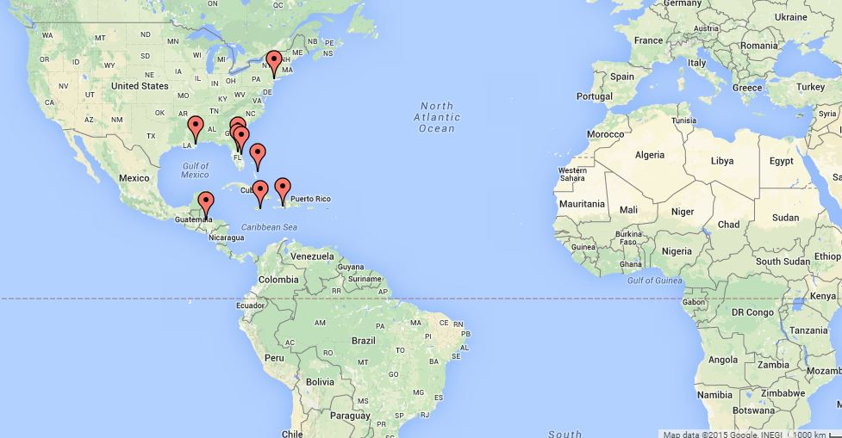
Zora Neale Hurston’s Fieldwork
Notes:
Was also diasporic

Slide 8
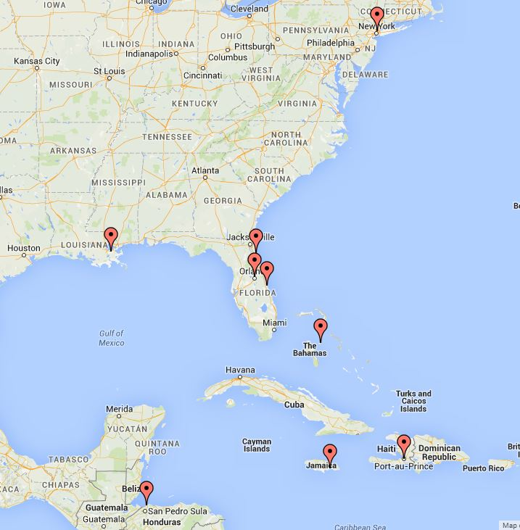
Zora Neale Hurston’s Fieldwork
Notes:
Was also diasporic. She wrote Their Eyes Were Watching God in Haiti

Slide 9
Zora Neale Hurston’s Fieldwork
Wrote Their Eyes Were Watching God while doing research in Haiti
Notes:
Was also diasporic. She wrote Their Eyes Were Watching God in Haiti

Slide 10
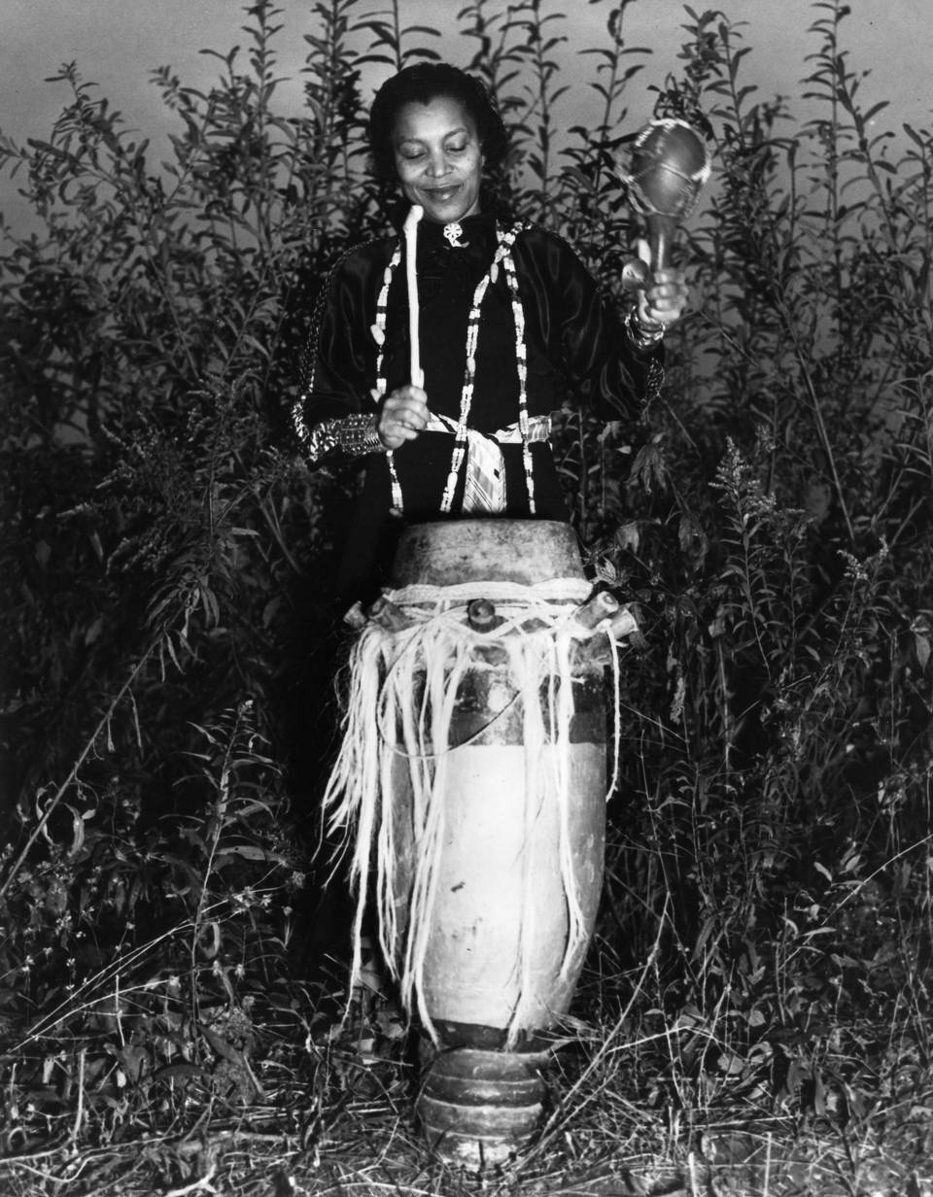
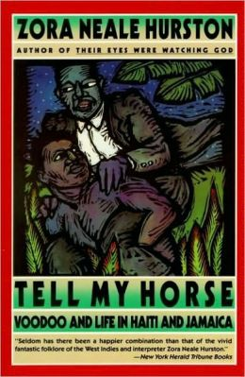
Themes she explored in Jamaica and Haiti…
Spirituality, ceremonies (Christian inspired and voodoo), faith/beliefs, rituals
Belief in Zombies
Gender Roles
Race/Racism
Relationships with Plants and Non-human Animals
Farming/Food Production
Notes:
it’s ok; will have to ignore me the old fashioned way

Slide 11
Now that you’ve read Their Eyes Were Watching God…
What questions about human experience are addressed in the novel? What about life and culture in Eatonville is discussed in the text?

