Slide 1
Voices from Our America (VFOA)
Ifeoma Kiddoe Nwankwo, Ph.D.
Department of English
Department of Teaching and Learning
Vanderbilt University
Notes:
Good morning! It’s a pleasure to be here with you! Thank you to Norma Clippard for her wonderful work in putting this whole series together, and for her ongoing wonderful work as director of OLLI at Vanderbilt. Applause! Thanks, too, to all of you for being here, for being so clearly open and committed to lifelong learning.
So, today I will be talking with about Voices from Our America, advance intercultural and intergenerational understanding. Structure of today’s presentation: Voices from Our America origins and goals; more details on/from two VFOA segments– one focused on the descendants of the builders of the Panama Canal; the other on/in Middle Tennessee; then vision/possibilities for the future

Slide 2
VFOA Soundscape
https://www.youtube.com/watch?v=zAQD6nM5q2U
https://www.youtube.com/watch?v=q5yXCDw427w
https://www.youtube.com/watch?v=Eqljssf2fWk
https://www.youtube.com/watch?v=1nuihAonUwg
http://lib16.library.vanderbilt.edu/VfOA/voices_AMoore.php
http://lib16.library.vanderbilt.edu/VfOA/Bushnell5.html
http://lib16.library.vanderbilt.edu/VfOA/dowman11.html

Slide 3
Voices from Our America (VFOA)
Ifeoma Kiddoe Nwankwo, Ph.D.
Department of English
Department of Teaching and Learning
Vanderbilt University
Notes:
Good morning! It’s a pleasure to be here with you! Thank you to Norma Clippard for her wonderful work in putting this whole series together, and for her ongoing wonderful work as director of OLLI at Vanderbilt. Applause! Thanks, too, to all of you for being here, for being so clearly open and committed to lifelong learning.
So, today I will be talking with about Voices from Our America, advance intercultural and intergenerational understanding. Structure of today’s presentation: Voices from Our America origins and goals; more details on/from two VFOA segments– one focused on the descendants of the builders of the Panama Canal; the other on/in Middle Tennessee; then vision/possibilities for the future

Slide 4
Wisdom
“Be prepared”
“Who can’t hear will feel”
“Turn off the light!”
“If your conscience is clear you have nothing to fear”
“Doesn’t matter, it’s all going the same place”

Slide 5
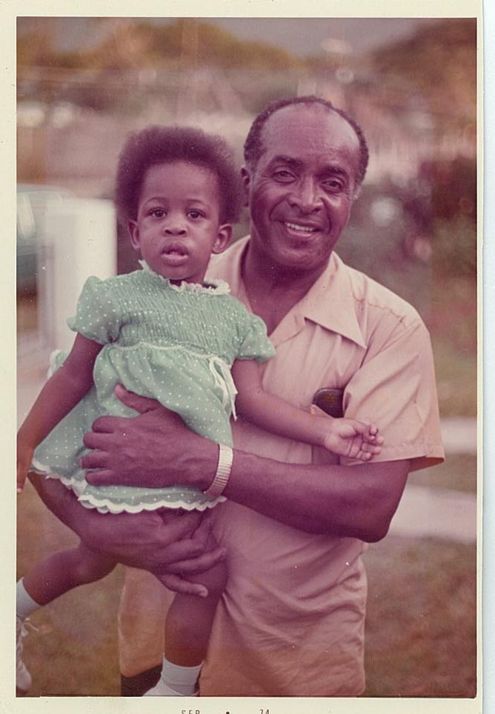
Grandpa

Slide 6
VFOA’s Work
Advancing intergenerational and intercultural understanding
Harnessing the power of autobiography production and engagement
  the life-changing power of creating your own autobiography
  the life changing power of listening to and learning from other peoples’ life stories
Producing innovative programs, courses, and materials

Slide 7
VFOA’s Work
VFOA is dedicated to collecting, preserving, and disseminating forgotten, hidden, or neglected narratives of American experience.
Advancing Learning through Listening
Through interviews, curriculum development materials, youth and senior programs, and public exhibits, we aim to advance understanding across the cultural and generational complexities of life in Our America.

Slide 8
VFOA’s Work
200 interviews and counting
40 events and activities, including youth programs, community exhibits, and teacher workshops
Digital archive, the Wisdom of the Elders program, innovative student projects

Slide 9
Wisdom
Diane Smith
Treat people the way you want to be treated. Take the
time to find out about that person. You’ll be surprised
to find out what you find out. They’re not as bad as
you think. They don’t know that much more than
you. They want the same things that you do. Don’t
jump to conclusions.

Slide 10
Wisdom
Anonymous
I think that most of our younger people need to try
to develop better coping skills for problems and issues
that come up in life. If you have a job, [and] you’re
not the boss, you need to realize that and make the
best of what you have.

Slide 11
VFOA’s Roots
Part of the genesis story recalls Paule Marshall’s essay “From the Poets in the Kitchen.”
Marshall celebrates her mother, aunts, and female family friends and the intellectual and political acumen they displayed during their everyday conversations in the kitchen:
“That freewheeling, wide-ranging, exuberant talk functioned as an outlet for the tremendous creative energy they possessed. They were women in whom the need for self-expression was strong, and since language was the only vehicle readily available to them they made of it an art form that - in keeping with the African tradition in which art and life are one - was an integral part of their lives.”

Slide 12
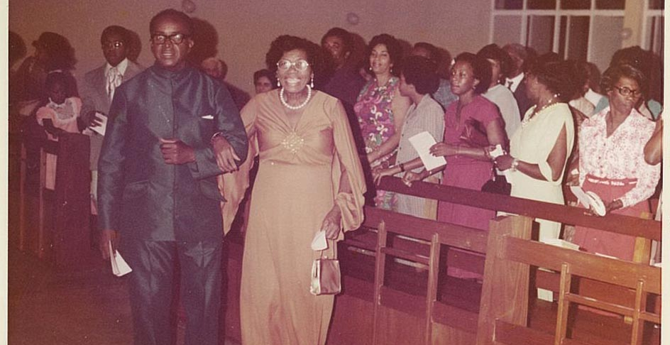
Grandpa & Grandma

Slide 13
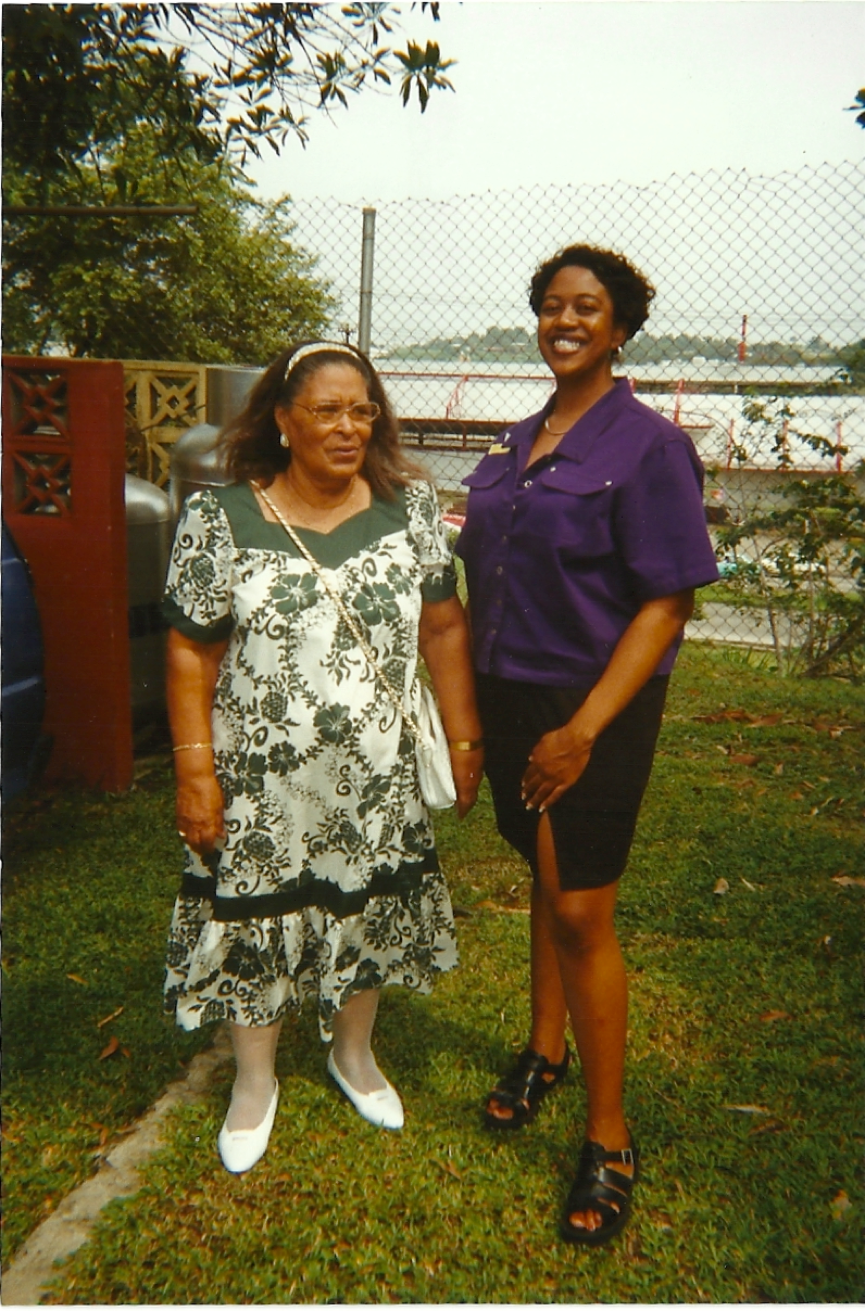
Ms. Carmen

Slide 14
VFOA Panama Soundscape
  https://www.youtube.com/watch?v=gR70XmI2j6w
  https://www.youtube.com/watch?v=SHul3gUj4tY
  https://www.youtube.com/watch?v=fDiNn36QzYs
  http://lib16.library.vanderbilt.edu/VfOA/Bushnell5.html
  http://lib16.library.vanderbilt.edu/VfOA/moore2.html

Slide 15
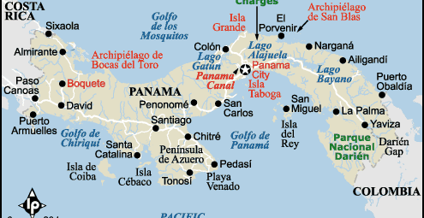
The Republic of Panama

Slide 16
Historical Background
Migrants from the British West Indies
  Building the Panama Railroad
  Building the Panama Canal
  Working for the United Fruit Company

Slide 17
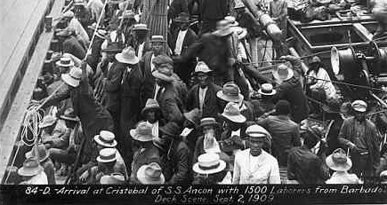
Historical Background

Slide 18
Sounds of History
Song by Ruben Blades https://www.youtube.com/watch?v=SHul3gUj4tY
Grandaddy was a West Indian man,
Y vivió y murió en Panamá.
West Indian man, I want to recognize
Your iron will, your sacrifice.
You gave your life to build a path,
So oceans could meet inside the heart of Panamá

Slide 19
VFOA Panama Interviews
Recurrent themes
  Life on the Canal Zone
  Music
  Education
  Religion
  The strength and wisdom of their elders
  The younger generation not holding on to the cultural traditions and memories

Slide 20
VFOA Panama Interviews
  Life on the Canal Zone
  Music
  Education
  Religion
    http://lib16.library.vanderbilt.edu/VfOA/branch5.html
  Ancestral Heritage
    http://lib16.library.vanderbilt.edu/VfOA/lewis1.html
  The strength and wisdom of their elders
    http://lib16.library.vanderbilt.edu/VfOA/crussell1.html
  The younger generation not holding on to the cultural traditions and values
    http://lib16.library.vanderbilt.edu/VfOA/branch4.html

Slide 21
Wisdom
“Try to be good. Do the best you can when you can…. If you can’t be perfect, be good.”
"No debemos preguntarnos de donde somos, sino quienes somos , y a donde vamos.” (We shouldn’t be asking ourselves were we’re coming from, but rather who we are and where we’re going.)

Slide 22
VFOA Panama :
Products and Programs
http://lib16.library.vanderbilt.edu/students.php
http://lib16.library.vanderbilt.edu/work-activities.php
http://lib16.library.vanderbilt.edu/diglib.php
http://www.voicesamerica.org/content/digital-information-packets
http://lib16.library.vanderbilt.edu/work-workshops.php

Slide 23
VFOA Middle Tennessee:
Products and Programs
Middle Tennessee Worldviews Youth Program
The Wisdom of the Elders Program
Vanderbilt Student Projects
  On/with their own family members
  On/with Middle Tennessee individuals and communities

Slide 24
VFOA Middle Tennessee:
Products and Programs
http://lib16.library.vanderbilt.edu/whatnew.php
http://news.vanderbilt.edu/2014/09/elders-wisdom-exhibit/
https://app.box.com/s/asoicawrjicmdqyo7wqb2xmwodvyiawr
https://events.vanderbilt.edu/index.php?eID=64324
https://my.vanderbilt.edu/ifeomanwankwo/category/student-projects/

Slide 25
VFOA Middle Tennessee
Student Projects and Publications
  https://my.vanderbilt.edu/ifeomanwankwo/sample-page/
  https://my.vanderbilt.edu/ifeomanwankwo/2014/05/a-musical-narrative-in-open-key-for-steel-pan-flute-alex-weill/
  http://www.blurb.com/b/2598890-annie-zachery-part-of-my-life-hardcover
  https://docs.google.com/presentation/d/1G_9f053R0B3kqcDmqrdB624f5TabI4ONleNKdgwdito/edit#slide=id.p

Slide 26
Wisdom
Dorothy Orr
Forget and remember. Forget all the negative things that come upon you, just forget the negative, and remember all the good things.

Slide 27
VFOA: Past, Present, and Future
Your Voice, Your America
  Your thoughts, comments, questions
  Your hopes re: intergenerational relations
  Your wisdom
  Your vision for the future

