Slide 1


iGEM 101: Session 1
2/12/15 Jarrod Shilts
2/15/15 Ophir Ospovat

Slide 2
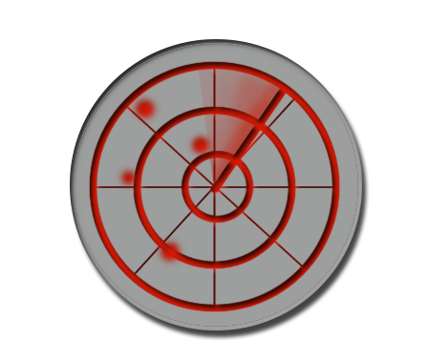
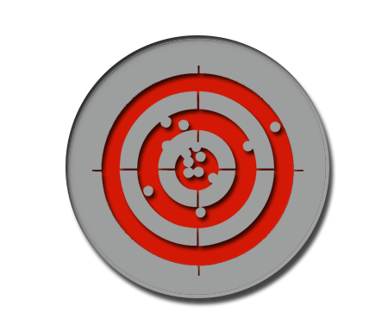
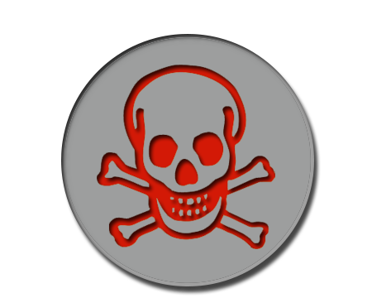
Future of Fighting Pathogens
Problem: Antibiotics
1. Cost
2. Effectivity
3. Adaptability
Solution: Synthetic Biology
1. Living
2. Custom
Notes:
Sense, Target, Destroy

Slide 3
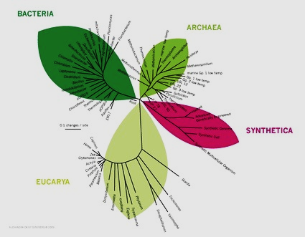
Synthetic Biology
Applying rational and systematic principles of engineering to biological systems
Reconstructing life from the bottom-up and top-down
Synthesizing biologically-based constructs not found in nature
Standard, interchangeable parts

Slide 4








Uses of Synthetic Biology
Notes:
Energy Food and Nutrition Foundational Advance Information Processign
Manafacturing Health and Medicine Environment Other

Slide 5
Central Dogma of Biology
DNA
RNA
Protein

Slide 6
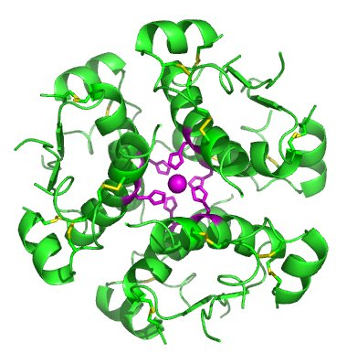
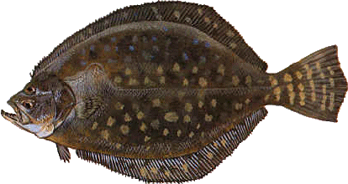
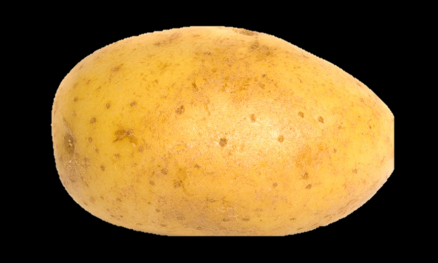

Recombinant DNA Technology

Slide 7
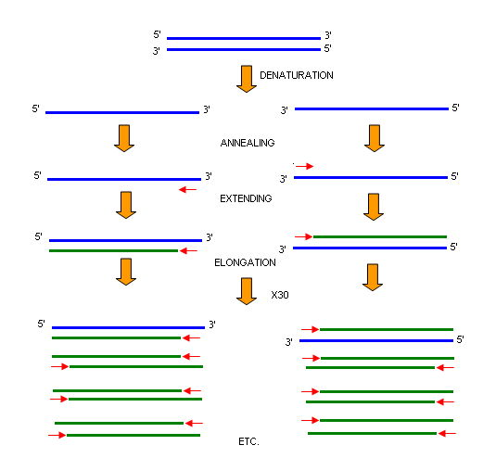
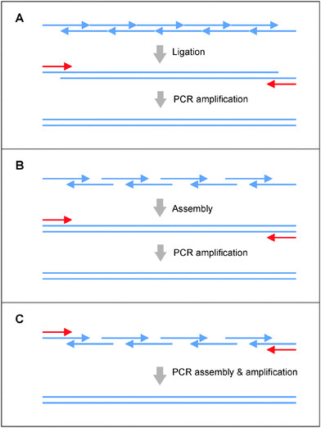
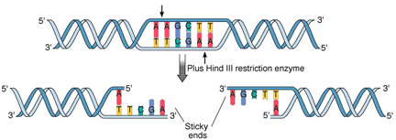
Advances in Synthetic Biology – The Early Years
Notes:
Restriction Enzymes first characterized specifically in 1970 (HindIII) by Smith, Kelly, and Wilcox (1978 Nobel prize)
Synthesis of first gene, 1972, Khorana
PCR 1983 Kary Mullis (1993 Nobel Prize)

Slide 8
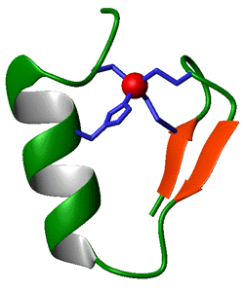
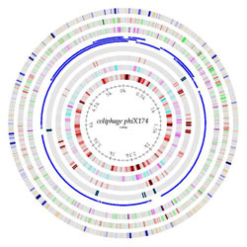
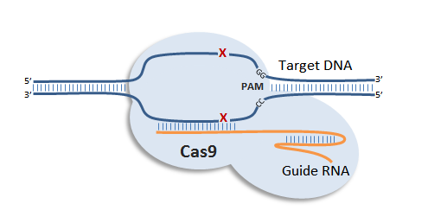
Advances in Synthetic Biology – Precise Editing
Notes:
Early 2000’s – zinc finger nuclease
Craig Venter Institute - First chromosome 2007, first bacterial genome 2010
2009 – CRISPR Doudna

Slide 9
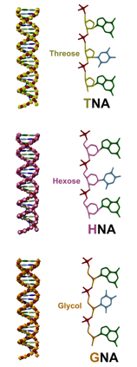
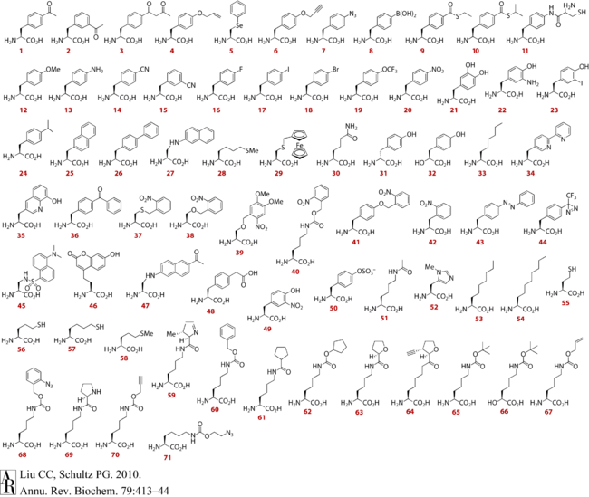
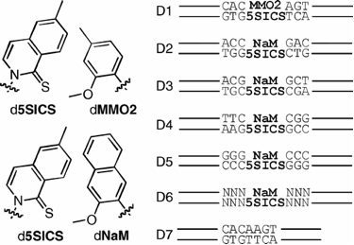
Advances in Synthetic Biology – Artificial Life
Notes:
1990 – non-canonical amino acid
2011 – XNA (HNA, CeNA, TNA, GNA, LNA, PNA)
2014 – unnatural base pair

Slide 10

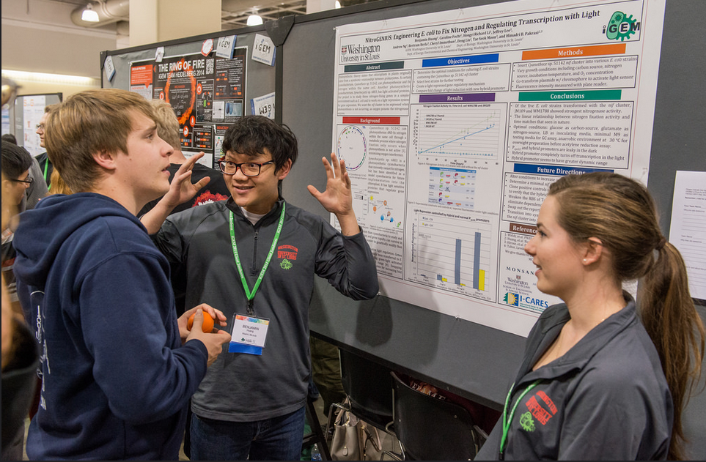
iGEM Competition
Undergraduate teams finding novel applications of genetic technologies to showcase at an international conference and competition
Teams at leading edge of scientific advances
  Among first to use and develop targeted gene editing tools (ZFNs, TALENs, and Cas9)
  Published discoveries in biosensors, therapeutics, and foundational biology
  Founded companies and patents for practical uses of biotechnology
Undergraduate-driven at all stages
  Project idea
  Design and protocols
  Experimentation
  Data analysis
  Presentation

Slide 11
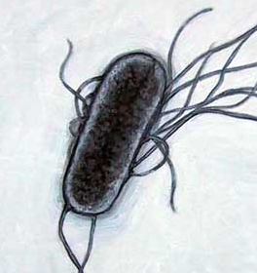
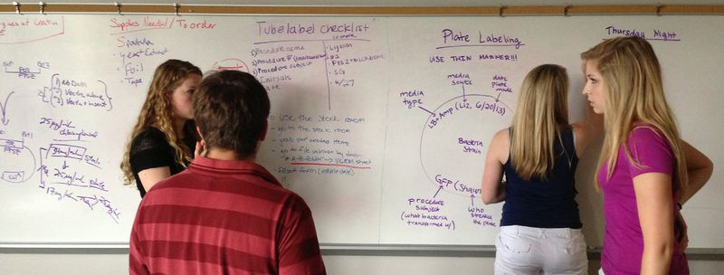
Thinking Like a Synthetic Biologist
1. Coming Up with a Plan
Identify the problem : Safe and efficient way of getting rid of microbial pathogens in the body
Applying concepts of Synbio : Genetically engineer bacteria to defeat infections
  Insert gene that, when
  activated, can produce an
  antimicrobial compound
  Place gene under
  regulation so that only
  expressed in conjunction
  with nearby pathogen
  Introduce stand-in for
  pathogen that can be
  easily quantified
  Incorporate additional
  mechanisms to increase
  efficiency and safety
Notes:
As zoom in, note alternation between “what need” (identify problem, design system, optimize) and “what have” (applying concepts to plan, creating a strategy)

Slide 12
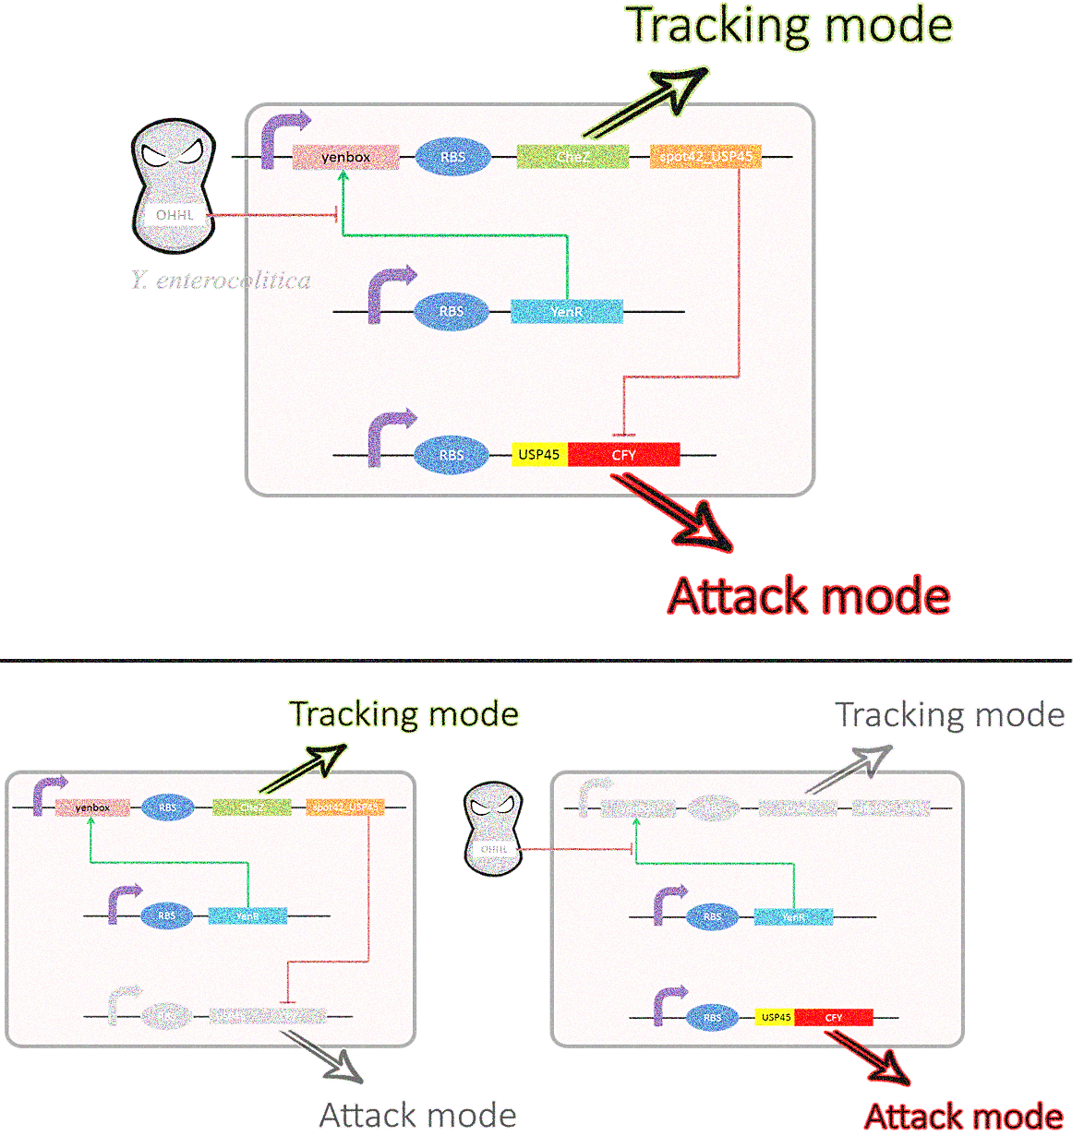
Thinking Like a Synthetic Biologist
2. Designing a System
Sensing:
  Distinct signal produced by target pathogen that can detected by system
  Specificity of signal. Unique to pathogen
  Tie reception of signal to activator of gene regulatory element controlling both the targeting and attacking modes
Targeting:
  Introduce proteins that enhance general cell mobility or guide targeting mobility (chemotaxis)
  Selectively turn off motility to remain in sufficient contact with pathogen once detected
Attacking:
  Express antimicrobial protein once sensing and targeting systems activated
  Secrete antimicrobial to reach pathogen
  Finely tune gene activation for quick shut down to prevent autotoxicity and quick activation to maximize lethality

Slide 13
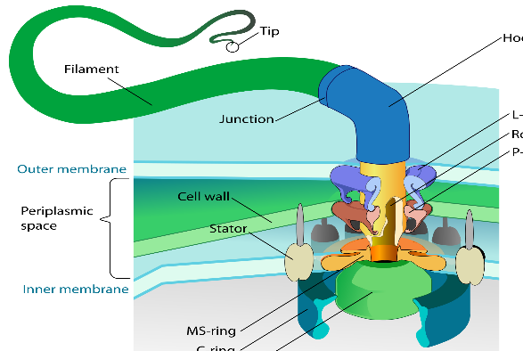
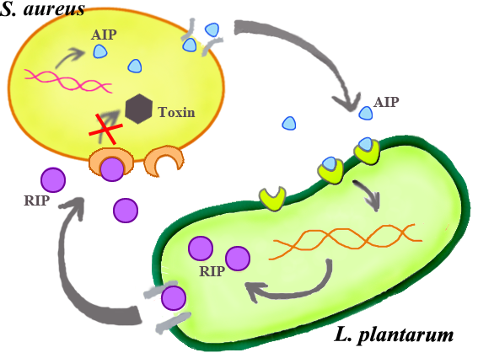
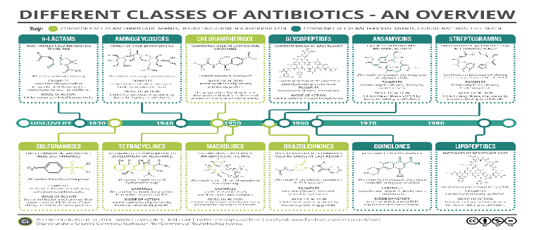
Thinking Like a Synthetic Biologist
3. Creating a Strategy
Sensing:
  “Quorum Sensing” signals secreted by pathogen species
  Entry of quorum signal to system detected by pathogen-specific quorum receptor
  Bound quorum receptor inhibits genes with certain promoter (in this example)
Targeting:
  Knock out endogenous protein responsible for inhibiting flagella movement for “search” mode
  Re-insert chemotaxis protein under control of quorum receptor promoter
  Link new chemotaxis receptor to motility inhibitor for brakes (guided chemotaxis not feasible)
Attacking:
  Insert genes for biosynthesis of antimicrobials, specialized for lethality against type of cell of interest
  Regulate gene with quorum receptor promoter
  Add second gene to help rapidly halt the system after activation
Notes:
Keep in mind design process is dynamic. Reciprocal connections so that if say in system phase want to physically latch on to pathogen for more efficient targeting, then find that practically not possible or tools not available, then revise and reformulate plan.
-ex of no guided chemotaxis. Trial and error. Come up with idea, then see if tools available to make it happen
-Rapid halt needed because even if stop txn, still proteins in cytosol from before. Instead can very rapidly transcribe second gene that either removes protein or removes mRNA being txn‘d

Slide 14
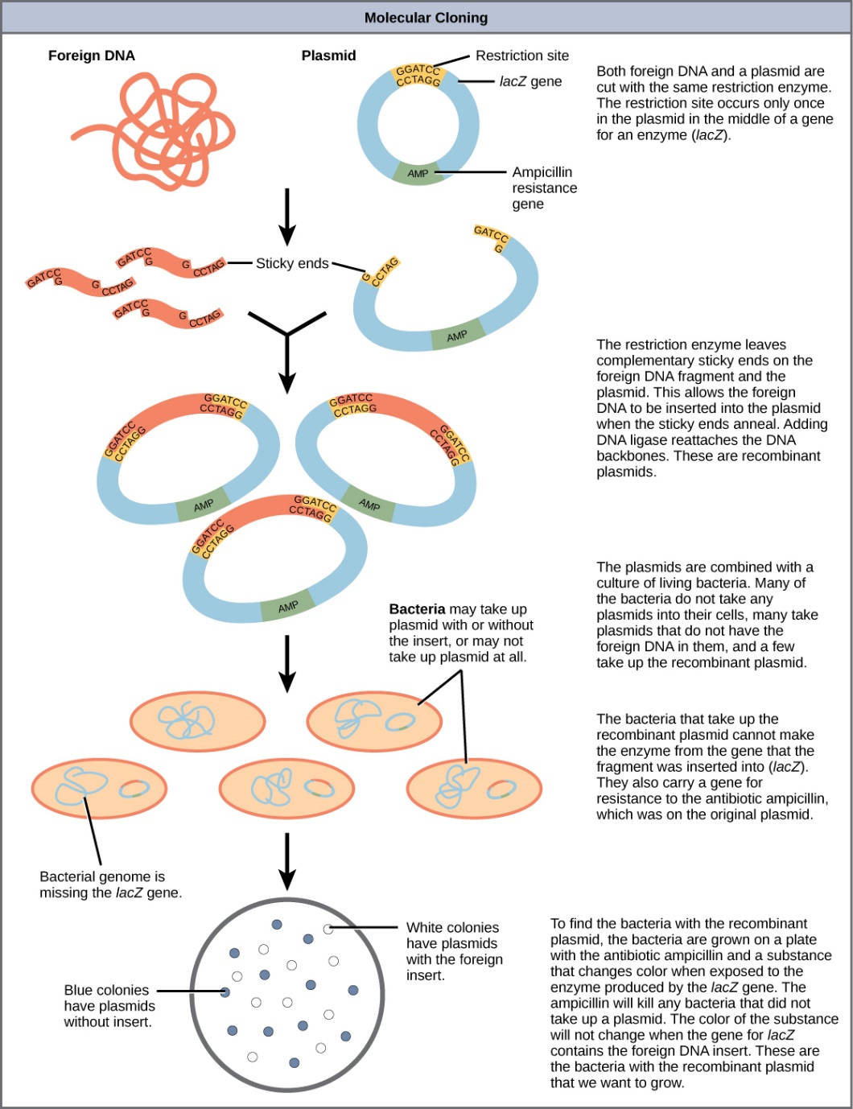
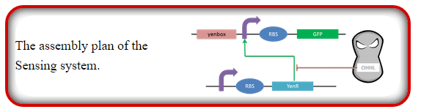
Thinking Like a Synthetic Biologist
4. Building a System
Put together each gene with its corresponding regulatory elements on a vector
Repeat for all genes and regulatory proteins that make up gene circuit
  One vector for expressing quorum receptor for detection, another for activating targeting mechanism, and another for activating attacking mechanism
Introduce and test vectors one at a time. After confirmation, consolidate into single system
Notes:
-multi-plasmid transformation inefficient and or dififcult , as is transformation/transfection of larger constructs. Design consideration

Slide 15
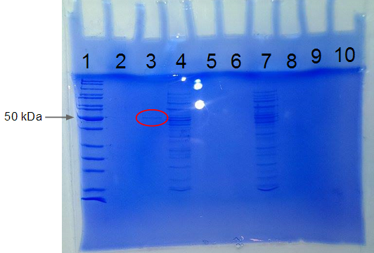
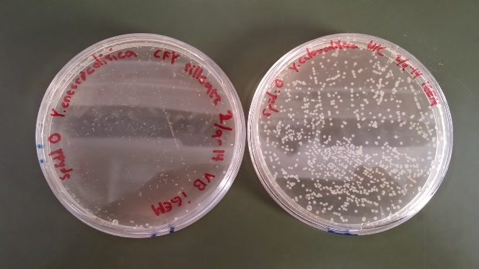
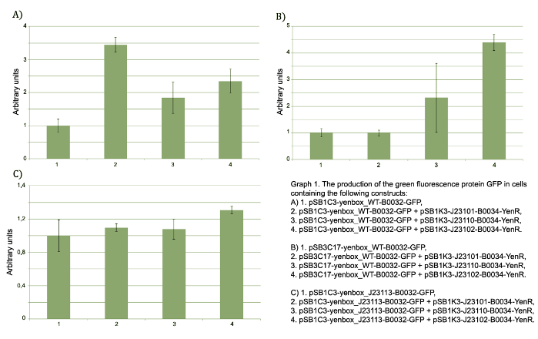
Thinking Like a Synthetic Biologist
5. Testing that it Works
Measure each component of circuit individually
  Check for levels of expression, if expressed at right time, and if being toxic to system
  Check that gene products are all functional
See if parts of circuit interact properly when combined
  Check that expression of quorum receptor is inhibiting the parts of the circuit it is supposed to
  Check nothing in the circuit is breaking the sequence of events
Make sure parts are functioning under controlled conditions
  Check that able to detect quorum signal
  Check chemotaxis mechanism is working for targeting
  Check that toxin being produced and is lethal on short time scale
Simulate experimental conditions
  Check that system able to effectively and selectively kill pathogen
Notes:
-First very basic check that gene producing what supposed to produce. Second that circuit is activated like supposed to. Third actually tests parts of circuits individually to see if behaving as expected. Finally simulate real condition to make sure all those individually tested circuits are working together as expected and, more importantly, that the system is practical

Slide 16
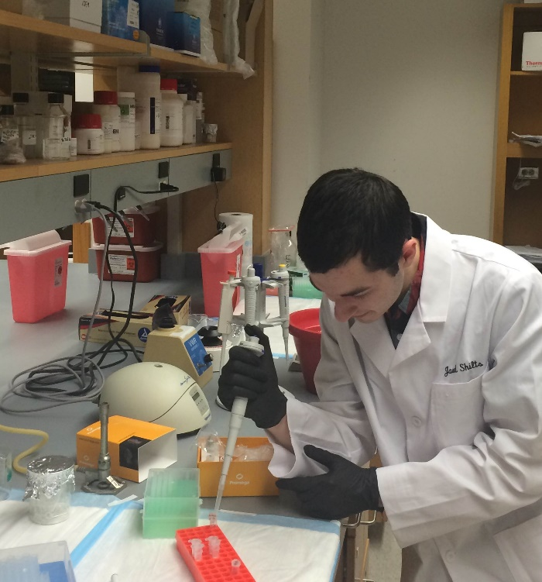
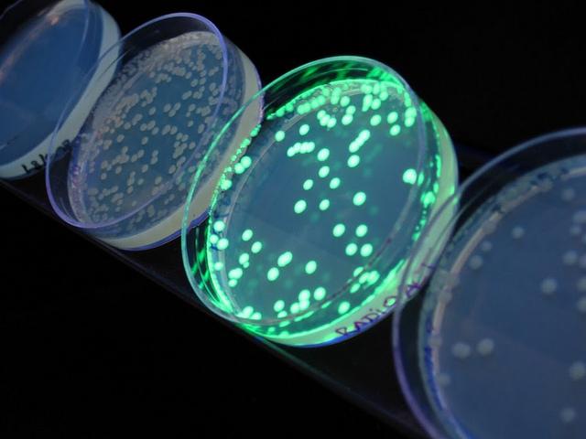
Where Your Work Comes in
Validate that system is effective against a pathogen-mimic
  E. coli that produces the same quorum signal as pathogen
Easily measurable target to quantify how well system is preforming
  Tag E. coli with GFP. Convenient to track and can be precisely measured by fluorimeter

Slide 17
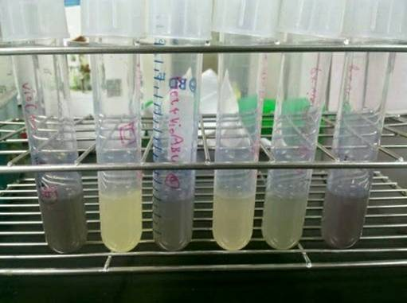
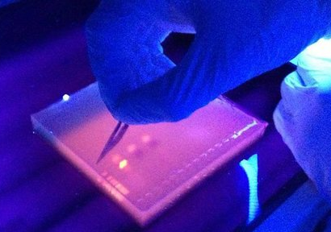
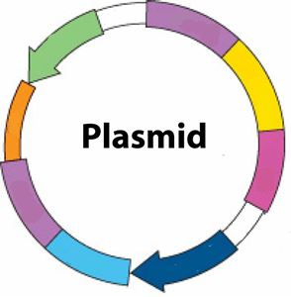
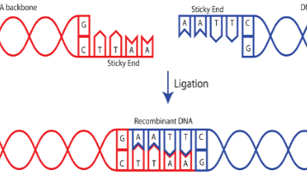
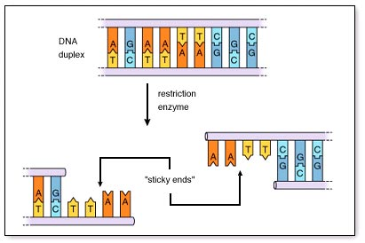
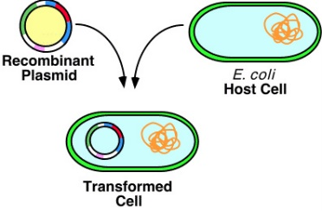
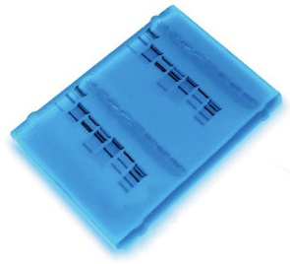
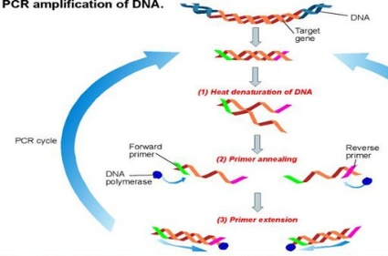
How to do it
Cell Culture
  Grow E. coli cells under sterile conditions for use in experiments
Miniprep
  Extract plasmid DNA from E. coli cell cultures
Restriction Digest
  Cut plasmid DNA into fragments that can be recombined
Gel Electrophoresis
  Separate and identify DNA fragments based on their size
Gel Extraction
  Extract DNA once it has been identified and separated by electrophoresis
Ligation
  Seal together DNA fragments into a single plasmid
Transformation
  Cause E. coli to incorporate foreign plasmid DNA
PCR
  Amplify specific DNA sequence for confirmation or other applications

Slide 18
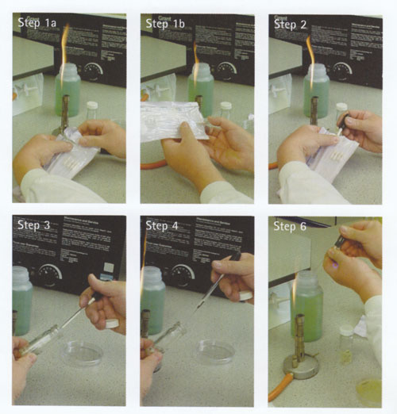
1. Cell Culture and Sterile Technique
Not just for cell cultures- fundamental principles for every experiment you do
Steps to avoid contamination (true for just about everything)
  Wear gloves at all times
  Spray gloves, sleeves, and work area down with ethanol
  Minimize exposure times
  Keep work area clear from clutter
Extra precautions for cell culture
  Bunsen burner
  Flaming spreaders and bottles
  OCD is a virtue
Notes:
-Caps on bottle always on. Minimize opening times. Work briskly, but do not rush so much might do something incorrectly. Especially when learning, start slower
-Bunsen burner mechanism, acting by sucking in air, and at same time any particles falling down in air. Drawn toward flame and incinerated, rendering harmless
-Close to flame but not dangerously close. About 1 petri dish worth of separation close enough. Flame useless at long distances
-When first opening bottle of culture media or culture tube, quickly flame mouth. Kills anything that may have been living on lid waiting for opening to fall in
-If were using spreaders, would flame as well. Using single use toothpicks. As long as technique sterile, can drop in, but if unsure if entirety of toothpick is sterile, can quickly swipe in media and pull out
-To set flame, hold striker about inch above nozzle with gas blowing as gentle breeze that can hear. Single quick motion best for lighting. Rotating burner bottom knob can change air intake. Want blue flame that is not too high

