Slide 1
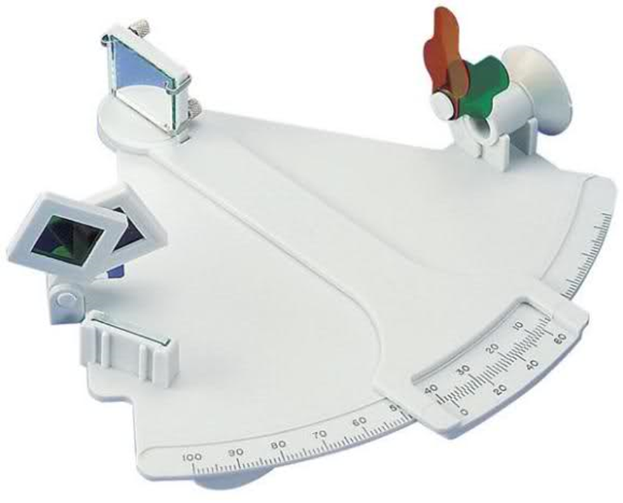
Measuring Altitude
The Davis Mark 3 Marine Sextant (aka “lifeboat” sextant)

Slide 2
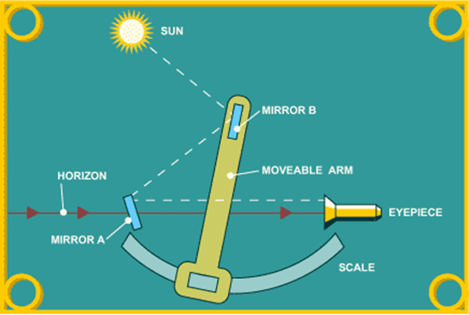
Light Path through a Sextant
The moveable arm adjusts the angle of Mirror B

Slide 3
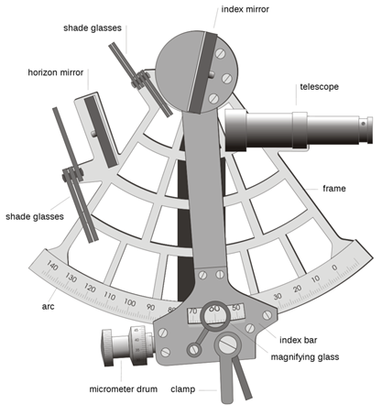
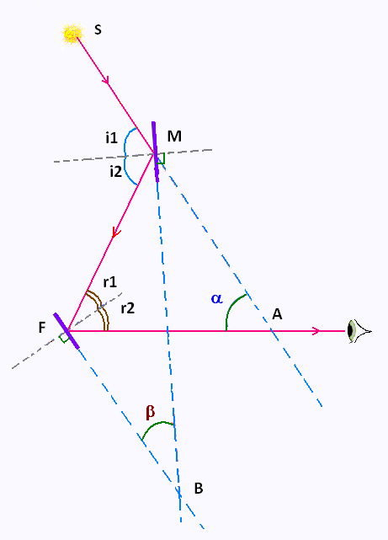

Sextant Geometry
The arc is about one sixth of 360 degrees, hence a “sextant”
Through geometry, it can be proven that:
altitude (α) = two times angle observed between the mirrors (2 β)
Sextant graphic courtesy of Joaquim Alves Gaspar - own image, CC BY 2.5, https://commons.wikimedia.org/w/index.php?curid=1314046

Slide 4
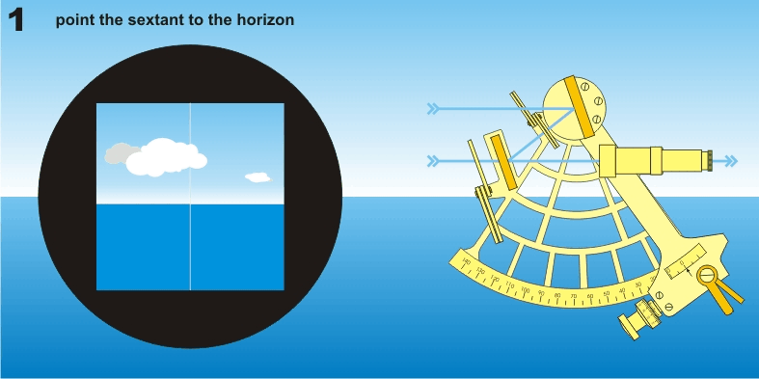
View through a Sextant
A sextant produces a split screen, one stationary (from the
horizon mirror) and one adjustable (from the index mirror)

Slide 5
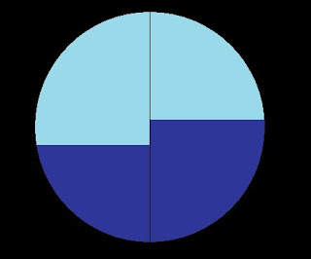
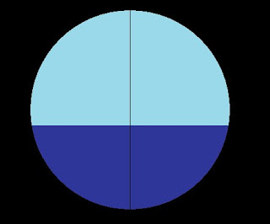
The instrument error called Index Error
must be accounted for prior to an altitude measurement.
Set the sextant to zero and observe the horizon. If it is “broken” between the two images, there is index error.
Remove the error by adjusting the index mirrors until you have a continuous horizon at zero. Alternatively, adjust the angle until you have a continuous horizon. This angle is your index error.
The index correction is the negative value of the index error. Therefore, the index correction is always removed from the altitude reading.

Slide 6
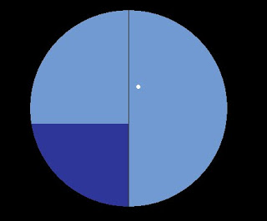
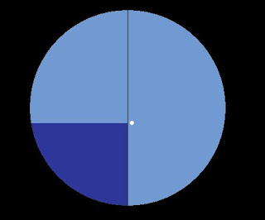

Taking a stellar sight
Align horizon image with the horizon
and find a star with your index mirror
Adjust the index mirror until the
star lines up with the horizon
Rock the sextant in an arc motion to confirm
that you were level with the horizon when
making the measurement.

Slide 7
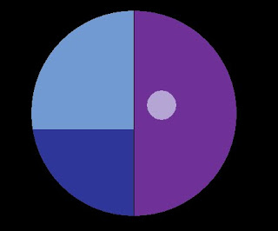
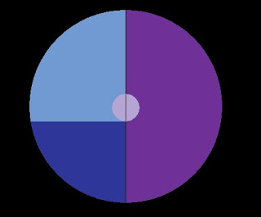
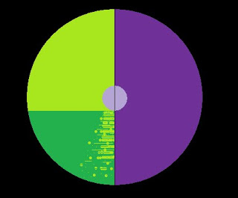
Taking a Sun Sight
Here you will need the index filter. Never look at the Sun though a sextant without a filter!
Usually, the lower limb of the Sun is
used to measure solar altitude.
You may also need a horizon filter to
shield the glare of the Sun on the water.

Slide 8
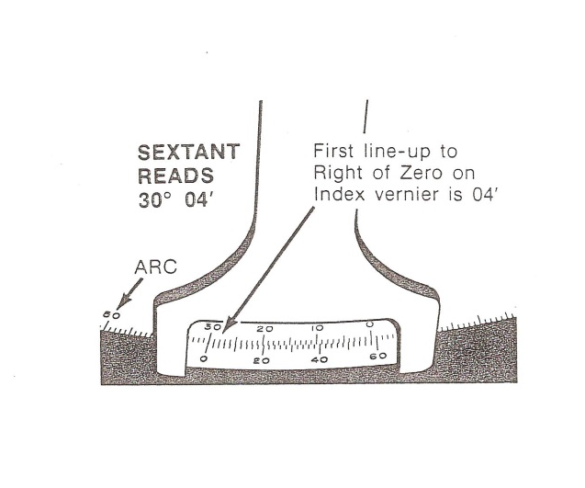
Reading a Sextant
Arc reads whole degrees
“0” on Venier is the benchmark to read Arc
(always read lower value)
Venier reads arcminutes
(in 2’ increments)
The first alignment of Vernier and Arc tickmarks to the right of zero is the benchmark to read the Venier.
VENIER
Remember 60’ = 1º (60 arcminutes = 1 degree)

