Slide 1
Lecture 8
Normal model

Slide 2
Reminder from previous lecture
If we have some data, then
$\overline{y}=$it’s mean value,
s²$=$it’s corrected variance
For a single observation y, it’s z score is
$$z=\frac{y−\overline{y}}{s}$$
and shows how many st. deviations is our observation far from the mean value

Slide 3
Modeling
To make understanding the data and making predictions easier, we will assume that our data satisfies some `a priori’ property
For example, in physics people often assume that acceleration of a particle is constant, even though it is never completely true

Slide 4
Two parameters
Our `a priori’ law will have two parameters that we will denote by Greek letters: $μ \text{and} σ$ (for `mean’ and `standard deviation).
The “Greek” numbers do not come from the data. Rather, we choose them to help specify the model.

Slide 5
Ok, really?
In fact, this is roughly what they are. There are 324,099,593 people in the US. Let’s assume we want to know some numerical characteristic.
Let’s assume we actually collected this characteristic from every single person. Then we can compute it’s mean and st. dev., and they will be $μ \text{and} σ$

Slide 6
But in practice we can never ask all 324,099,593 people. So we never actually know $μ \text{and} σ$
So let’s assume we asked only 100,000 people. This will be our data, and we can use it to predict what actually happens with the whole population
If we compute it’s mean and st. dev., we will get $\overline{y}$ and s

Slide 7
If we want to use the normal model, we will, therefore, have to make our best guess about values of $μ \text{and} σ$.
Making the right guess is a huge part of Statistics, and we will discuss is later.

Slide 8
Moving and rescaling
Recall: if we subtract a fixed number from each value of the data, we shift the mean by this number and do not change the st. dev.
If we divide by a fixed number, we divide both mean and the st. dev. by this number

Slide 9
Thus, if we assume our data fits into the law with mean $μ \text{and} \text{standard} \text{deviation} σ$, then the “z-scores”
$z=\frac{y−μ}{σ}$
should fit into the same law, but with mean 0 and standard deviation 1.

Slide 10
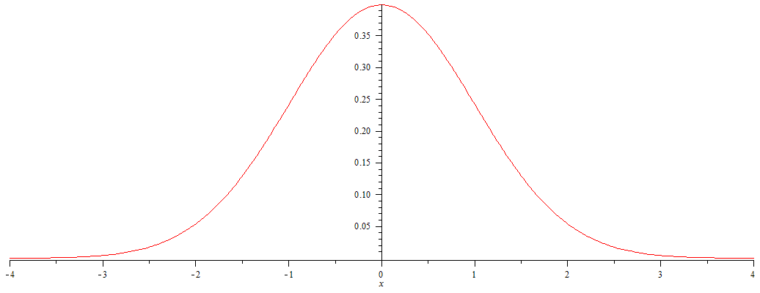
The actual law
Consider the curve $y=\frac{1}{\sqrt{2π}}e^{−\frac{x^{2}}{2}}$

Slide 11
This is the Normal model with mean 0 and st.
dev. 1
This means that the shape of distribution fits
into this curve

Slide 12
How to use it?
This curve is, in fact, very practical. If our model is correct and want to know how many values of our data are in a certain interval, we need to compute the area under this curve for this interval

Slide 13
Area of the orange part is proportion of values between -2 and 1.
Since the curve is given by formula, any calculator will compute the area

Slide 14
However, we do not need a calculator: this curve is used so often that most of such values are computed and summarized in tables (see, e.g., Table Z in Appendix D)

Slide 15
Let’s check ourselves
Area = 1/2

Slide 16
The 68-95-99.7 rule
Area of blue part is 0.68
Area of (red + blue) part is 0.96
Area of (red+blue+green) part is 0.997

Slide 17
The 68-95-99.7 rule again
Thus, approximately 68% of our values should be between -1 and 1
Approximately 96% should be between -2 and 2
And around 99.7% should be between -3 and 3

Slide 18
What about other values of $μ \text{and} σ?$
Remember we shifted by $μ \text{and} \text{then} \text{shrinked} \text{by} σ?$
This means that in general the “center” of our curve should be at $μ$ and the “scale” should be $σ$

Slide 19
$$μ−3σ$$
$$μ−2σ$$
$$μ−σ$$
$$μ$$
$$μ+σ$$
$$μ+2σ$$
$$μ+3σ$$
$$μ−3σ$$
$$μ−2σ$$
$$μ−σ$$
$$μ$$
$$μ+σ$$
$$μ+2σ$$
$$μ+3σ$$

Slide 20
Is this class gonna be curved?????????
So how does the curve work?
0.96 | 0.8768 | 0.8272 | 0.7664 | 0.7072
0.9488 | 0.8704 | 0.8272 | 0.7552 | 0.6432
0.9472 | 0.864 | 0.8032 | 0.7408 | 0.6288
0.9264 | 0.8496 | 0.7936 | 0.7312 | 0.5696
0.88 | 0.832 | 0.792 | 0.7136 | 0.552
Average = 0.78
St. dev. = 0.12

Slide 21
I want roughly 68% do get something around C
Roughly 13.5% to get a B
Roughly 13.5% to get a D
Roughly 2.5% to get an A
And roughly 2.5% to get an F

Slide 22
C
F
B
D
A

Slide 23
Average = 0.78
St. dev. = 0.12
0.78+0.12=0.9 0.78+0.24=1.02
0.78-0.12=0.66 0.78-0.24=0.55
So with these scores the model does not work ☹
0.96 | 0.8768 | 0.8272 | 0.7664 | 0.7072
0.9488 | 0.8704 | 0.8272 | 0.7552 | 0.6432
0.9472 | 0.864 | 0.8032 | 0.7408 | 0.6288
0.9264 | 0.8496 | 0.7936 | 0.7312 | 0.5696
0.88 | 0.832 | 0.792 | 0.7136 | 0.552

Slide 24
There are more options.
C
B
F
D
A
A
Then 34% get B and 34% get C
13.5% get D, 2.5% get F
The rest 16% get an A

Slide 25
What would normal model do in our class?
The enrollment is 45 people. 2.5% of 45 is 1, so only 1 person should get an F
16% of 45 is 7. So 7 people get an A.
Thus, if you know 7 people who’s total is better than yours, then you are not getting an A
In reality, of course, this is not so strict

Slide 26
Homework
Pp. 132+: 1, 3, 5a, 8, 10, 24b, 25
Pp. 139+: 1ab (you can choose your favorite display and statistic, provided it is not useless), 6d (do it assuming the normal model), 22
And any problem you find useful to solve to prepare for the test!

