Slide 1
Lecture 7
Harry Potter and the Normal Model

Slide 2
Temperatures again
Average of registered temperatures in Nashville in July is 79.1, while the highest temperature is 88.7
Average of registered temperatures in Nashville in February is 41.3, while the highest temperature is 51.4
The difference in both cases is about 10F, but what was less expected?

Slide 3
Standartizing
To answer this question we need more information.
We will begin with computing the standard deviation of daily temperatures in July. That is, typically, how far a daily temperature can be from the monthly average?

Slide 4
78 | 79 | 79 | 80 | 79
78 | 79 | 79 | 80 | 79
78 | 79 | 79 | 80 | 79
78 | 79 | 79 | 80
78 | 79 | 79 | 80
79 | 79 | 79 | 80
79 | 79 | 80 | 80
We have 31 numbers.
Average=(sum them up)/31=79.09
Corrected Variance =
sum of (each number – 79.09)² /30
=0.423656
St. dev. = square root of 0.423656=
0.65
Finally, we compute
(highest – average)/st.dev.=(88.7-79.09)/0.65=14.75

Slide 5
We conclude that in July the highest temperature was 14.75 standard deviations larger than the average.
This is actually a very big fraction.

Slide 6
Now we do the same for February
38 | 40 | 41 | 43
38 | 40 | 42 | 44
38 | 40 | 42 | 44
39 | 40 | 42 | 44
39 | 40 | 42 | 44
39 | 41 | 43 | 45
39 | 41 | 43 | 45
Average = (sum)/28 = 41.28571
Corrected variance = 4.804233
Variance = square root = 2.191856
Finally,
(highest-average)/st.dev. =
(51.4- 41.28571)/ 2.191856 = 4.61

Slide 7
Conclusion
So, in July the highest temp. was 14.75 standard deviations higher than the average
In February the highest temp. was only 4.61 higher than the average
We should conclude that in July this temperature was less expected

Slide 8
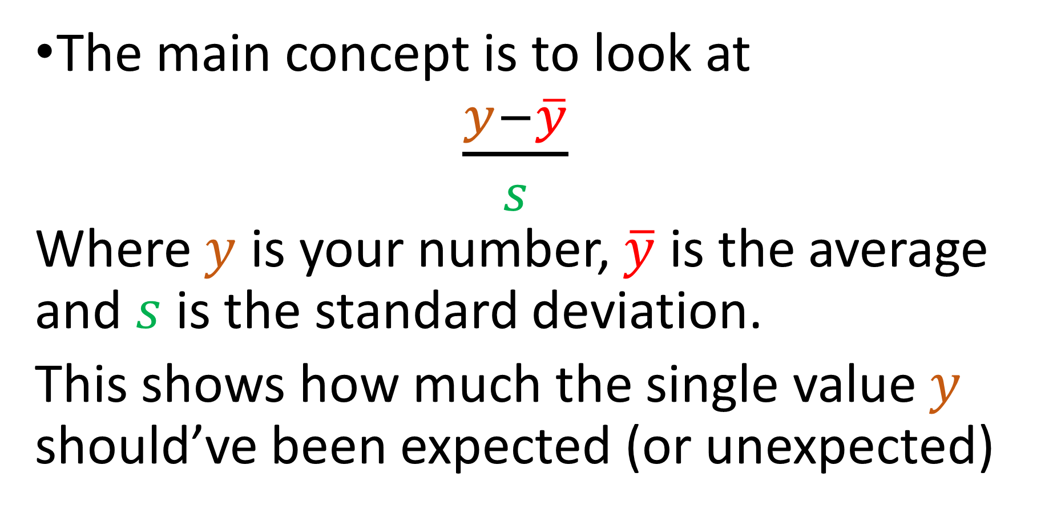
The concept
The main concept is to look at
$\frac{y−\overline{y}}{s}$
Where $y$ is your number, $\overline{y}$ is the average and $s$ is the standard deviation.
This shows how much the single value $y$ should’ve been expected (or unexpected)

Slide 9
Why “standardized”?
If you have many numbers, you compute their average and standard deviation, and instead of initial numbers take new data: (each number – average)/st.dev., then this new data will have average 0 and st. dev. 1.
No matter how initial data looked like.

Slide 10
Example
69, 53, 4, 80, 64
Average = 54
69-54=15, 53-54=-1, 4-54=-50,
80-54=26, 64-54=10
Now 15+(-1)+(-50)+26+10=0

Slide 11
Further,
15²=225, (-1)² =1, (-50) ² =2500
26² =676 10² =100
Corrected variance =
(225+1+2500+676+100)/4=875.5
St.dev.=29.59
So, instead of 69 we consider (69-54)/29.59 = 0.51, and so on.
You can now check that the sd. dev. of new data is 1

Slide 12

Terminology
We denote
$$z=\frac{y−\overline{y}}{s}$$
and call it “z-score”.

Slide 13
Shifting to adjust the center
In all previous examples we subtracted the average. In general, we could subtract (or add) another number.
Then, it would shift all measures of position (mean, median, percentiles) by the same number

Slide 14
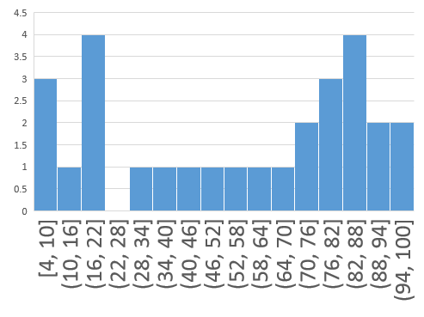
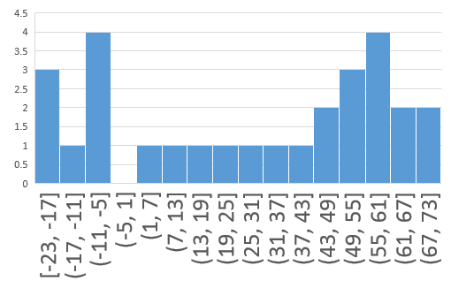
68 | 92 | 11 | 98
79 | 83 | 75 | 60
30 | 85 | 71 | 50
83 | 19 | 86 | 43
8 | 18 | 94 | 79
57 | 100 | 18 | 6
4 | 19 | 81 | 35
41 | 65 | -16 | 71
52 | 56 | 48 | 33
3 | 58 | 44 | 23
56 | -8 | 59 | 16
-19 | -9 | 67 | 52
30 | 73 | -9 | -21
-23 | -8 | 54 | 8

Slide 15
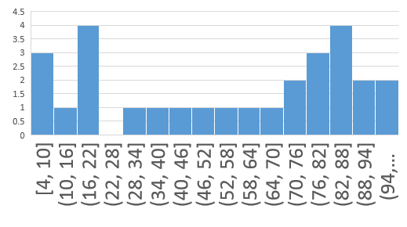
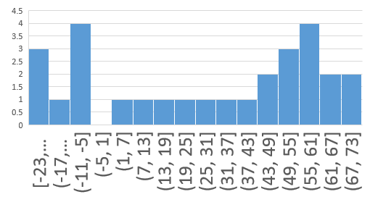
We subtracted 27 (my age) from every number,
and we see the same picture, except that values
on the x-axis of second histogram are 27 units
less than on the first one.
What happens with the variance?

Slide 16
We see that the spread did not change at all.
I.e., RELATIVE distances to the center are same.
Thus, adding (or subtracting) a fixed number
does not change the spread (variance, st. dev.,
IQR).

Slide 17
Rescaling
If we need to add or subtract to change the center, then we need to
multiply or divide
to change the spread
If we multiply by 5, the mean also multiplies by 5. The variance multiplies by
25

Slide 18
Example
3, 5, 10 vs 15, 25, 50
Average: 6 30
Corrected Variance:
((3-6)² + (5-6)²+(10-6)²)/2=
13 325
325=25*13

Slide 19
Plans for the future
Next Monday we finish Chapter 5
We will have a review on Wednesday the 21st
The test is as scheduled, on Monday the 26th

