Slide 1
Lecture 6

Slide 2
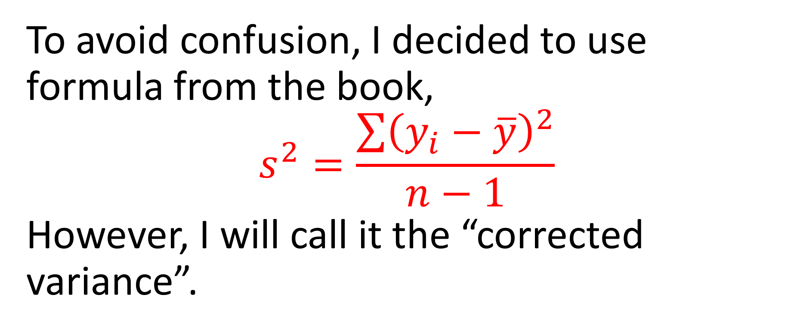
So, what is “variance”?
To avoid confusion, I decided to use formula from the book,
$$s^{2}=\frac{\sum{{\left(y_{i}−\overline{y}\right)}^{2}}}{n−1}$$
However, I will call it the “corrected variance”.

Slide 3
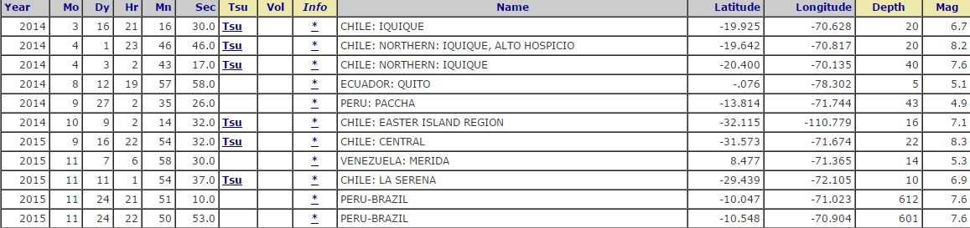
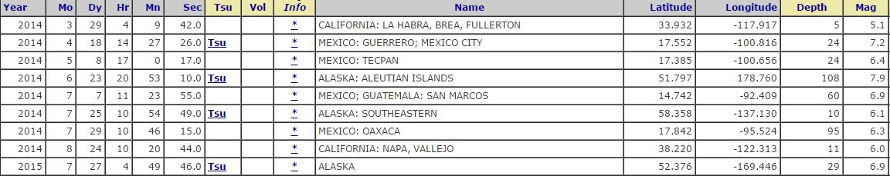
Understanding and comparing distributions

Slide 4
Magnitudes only
South America: 6.7 8.2 7.6 5.1 4.9 7.1 8.3 5.3 6.9 7.6 7.6
Median = 7.1 Mean = 6.84
North America: 5.1 7.2 6.4 7.9 6.9 6.1 6.3 6.0 6.9
Median = 6.4 Mean = 6.53

Slide 5
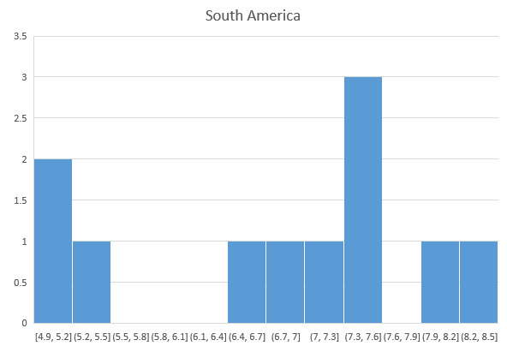
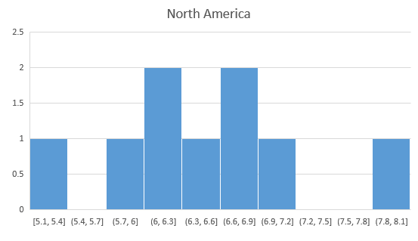
The distribution for North America is more
symmetric; also in South America a typical
magnitude is higher

Slide 6
Stem-and-leaf display
South America |  | North America
9 | 4
13 | 5 | 1
79 | 6 | 013499
1666 | 7 | 29
23 | 8
We see again that in NA the typical magnitude is 6*, and in SA magnitudes are in general higher.

Slide 7
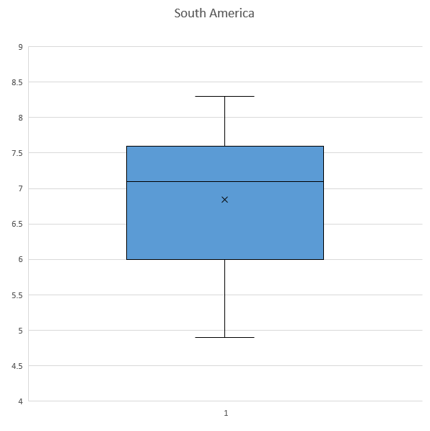
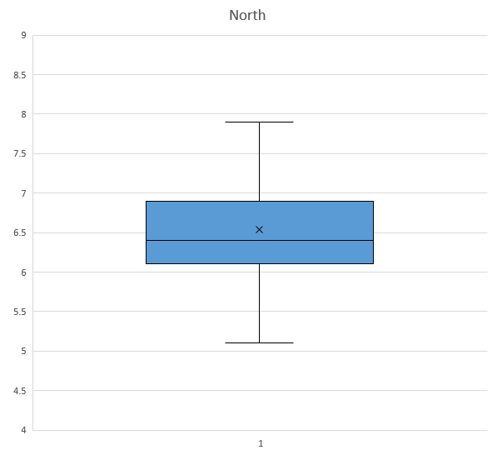
Boxplots

Slide 8
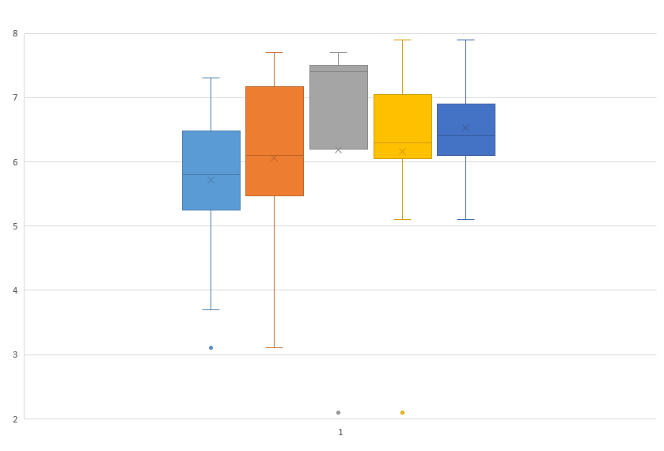
More boxplots: NA years 2010-2015

Slide 9
Outliers
An outlier is a value that does not fit in the data. However, there is no exact definition for “does not fit”
Boxplots provide one rule: anything that is greater than UQ+1.5xIQR or smaller than LQ-1.5xIQR is an outlier.

Slide 10
So what should we do?
One thing we can do is correct the value, if we are sure how. For example, if someone claims to be born in 20009, then most probably it’s 2009
Second good idea is to study two datas: one with the identified outlier, and one without

Slide 11
Timeplots
Suppose we have a lot of data. Say, some number for every day.
Before we summarized it in a histogram. But in this case we lost the “dynamics”: we do not see how things changed “day-by-day”
Also, we might want to see what happened every day, not in the average

Slide 12
Timeplots
Timeplots are good if we have “continuous time”. We would not do it, say, for a 100 vehicle models and their mpg’s.
We would do it in the “day-by-day” situation. (“year-by-year” too)

Slide 13
Daily temperature in Nashville (in F)
January | February | March | April | May | June | July | August | September | October | November | December
37 | 38 | 45 | 55 | 63 | 72 | 78 | 79 | 75 | 66 | 54 | 44
37 | 38 | 46 | 55 | 63 | 72 | 78 | 79 | 75 | 65 | 54 | 44
37 | 38 | 46 | 55 | 63 | 72 | 78 | 79 | 75 | 65 | 53 | 44
37 | 39 | 46 | 55 | 64 | 72 | 78 | 79 | 75 | 65 | 53 | 43
37 | 39 | 47 | 56 | 64 | 73 | 78 | 79 | 75 | 64 | 53 | 43
37 | 39 | 47 | 56 | 64 | 73 | 79 | 79 | 74 | 64 | 52 | 43
37 | 39 | 47 | 56 | 64 | 73 | 79 | 79 | 74 | 63 | 52 | 43
37 | 40 | 48 | 56 | 65 | 74 | 79 | 79 | 74 | 63 | 52 | 42
37 | 40 | 48 | 57 | 65 | 74 | 79 | 79 | 74 | 63 | 51 | 42
36 | 40 | 48 | 57 | 65 | 74 | 79 | 79 | 73 | 62 | 51 | 42
36 | 40 | 49 | 57 | 66 | 74 | 79 | 79 | 73 | 62 | 51 | 42
36 | 40 | 49 | 58 | 66 | 74 | 79 | 79 | 73 | 61 | 50 | 41
36 | 41 | 49 | 58 | 66 | 75 | 79 | 79 | 72 | 61 | 50 | 41
36 | 41 | 50 | 58 | 67 | 75 | 79 | 78 | 72 | 61 | 50 | 41
36 | 41 | 50 | 58 | 67 | 75 | 79 | 78 | 72 | 60 | 49 | 41
36 | 42 | 50 | 59 | 67 | 75 | 79 | 78 | 71 | 60 | 49 | 40
36 | 42 | 51 | 59 | 67 | 76 | 79 | 78 | 71 | 59 | 49 | 40
36 | 42 | 51 | 59 | 68 | 76 | 79 | 78 | 71 | 59 | 48 | 40
37 | 42 | 51 | 59 | 68 | 76 | 79 | 78 | 70 | 59 | 48 | 40
37 | 43 | 51 | 60 | 68 | 76 | 79 | 78 | 70 | 58 | 48 | 39
37 | 43 | 52 | 60 | 69 | 76 | 80 | 77 | 70 | 58 | 48 | 39
37 | 43 | 52 | 60 | 69 | 77 | 80 | 77 | 69 | 58 | 47 | 39
37 | 44 | 52 | 61 | 69 | 77 | 80 | 77 | 69 | 57 | 47 | 39
37 | 44 | 53 | 61 | 69 | 77 | 80 | 77 | 69 | 57 | 47 | 39
37 | 44 | 53 | 61 | 70 | 77 | 80 | 77 | 68 | 56 | 46 | 38
37 | 44 | 53 | 61 | 70 | 77 | 80 | 77 | 68 | 56 | 46 | 38
37 | 45 | 53 | 62 | 70 | 77 | 80 | 76 | 67 | 56 | 46 | 38
37 | 45 | 54 | 62 | 71 | 78 | 80 | 76 | 67 | 55 | 45 | 38
38 |  | 54 | 62 | 71 | 78 | 79 | 76 | 67 | 55 | 45 | 38
38 |  | 54 | 62 | 71 | 78 | 79 | 76 | 66 | 55 | 45 | 38
38 |  | 54 |  | 71 |  | 79 | 76 |  | 54 |  | 37

Slide 14
It was not observable
Computing an average does not make too much sense: who cares about the average over a year??
First, let’s compute the monthly averages.

Slide 15
January | 36.8
February | 41.3
March | 50.1
April | 58.5
May | 67.1
June | 75.1
July | 79.1
August | 77.9
September | 71.3
October | 59.9
November | 49.3
December | 40.5
That’s already a bit better.
Now, we want to picture
it. One option is the
“timeplot”.

Slide 16
A timeplot of monthly averages

Slide 17
Here the connecting segments just show us the direction: does the temperature increase or decrease?
We see the clear pattern here, which we could predict from common sense

Slide 18
A timeplot for daily temperatures

Slide 19
One particularly interesting thing we see from the timeplot is that the daily temperatures first only increase, then only decrease; with very few exceptions!
We would not get it from a histogram or a boxplot

Slide 20
Warning
On page 98 it is written that “Excel cannot make boxplots”. This is a lie: Excel can make boxplots very well.

Slide 21
Homework
Read Chapter 4. Be careful with Section 4.5: it is a little vague.
Do pp. 99+: 2,4 (write a few sentences about similarities, differences and patterns), 16, 18a, 19ade, 22bc, 25, 30abc, 31

