Slide 1
Lecture 4
Quantitative variables continued

Slide 2
The median
Let’s first order numbers in our data.
If there is an odd number of numbers, then median = the middle value:
1 4 6 7 10 19 26 Median =
If there is an even number of numbers, then average two middle values
1 4 6 7 10 19 26 28 Median =
7
(7+10)/2

Slide 3
Median: an example
Here is the data:
5.307479 0.37195 6.457738 6.926138 5.358067 5.288754 4.35266 3.438648 5.650973 8.726341 9.424503 9.989432 5.405536 8.899007 0.443621 3.777253 9.863241 9.957737
Can we tell the median fast? No ☹

Slide 4
Example continued
We first order the numbers above. It can be done by hand, or in Excel (Data->Sort)
0.37195 0.443621 3.438648 3.777253 4.35266 5.288754 5.307479 5.358067 5.405536 5.650973 6.457738 6.926138 8.726341 8.899007 9.424503 9.863241 9.957737 9.989432

Slide 5
Example vol. 3: 18 numbers
0.37195 0.443621 3.438648 3.777253 4.35266 5.288754 5.307479 5.358067 5.405536 5.650973 6.457738 6.926138 8.726341 8.899007 9.424503 9.863241 9.957737 9.989432
Median = (5.405536+5.650973)/2
Tip: “=Median” in Excel does the trick

Slide 6
Spread
Range: (maximal value) – (minimal value)
Quartiles: Divide the data in the middle by median, and repeat with left-hand part and right-hand part.
1 4 6 7 10 19 26 → 1 4 6 7 // 7 10 19 26
Lower quartile = (4+6)/2=5
Upper quartile = (10+19)/2 = 14.5
IQR = (upper q.) – (lower q.)

Slide 7
Example
Bad thing: we need to order the data. Good thing: we do it only once, and then keep it ordered.

Slide 8
184.976 104.0294 11.34551 199.5631 289.8293 139.119 40.09133 127.4971 45.97183 285.5655 49.02721 188.496 219.2398 241.8797 117.3478
↓↓
11.34551 40.09133 45.97183 49.02721 104.0294 117.3478 127.4971 139.119 184.976 188.496 199.5631 219.2398 241.8797 285.5655 289.8293

Slide 9
11.34551 40.09133 45.97183 49.02721 104.0294 117.3478 127.4971 139.119 184.976 188.496 199.5631 219.2398 241.8797 285.5655 289.8293
↓↓
11.34551 40.09133 45.97183 49.02721 104.0294 117.3478 127.4971 139.119
139.119 184.976 188.496 199.5631 219.2398 241.8797 285.5655 289.8293

Slide 10
Median = 139.119;
Upper Quartile = 209.40145
Lower Quartile = 76.528305
IQR = 209.40145 - 76.528305 = 132.873145

Slide 11
5-number summaries
From any quantitative data we can collect 5 numbers:
Minimal value --- Lower Quartile
---Median---
Upper Quartile --- Maximal value
That’s the simplest summary of the data

Slide 12
Pictures again: boxplots
We can further visualize the 5-number summary into a “Boxplot”
E.g., for our data we will get (see next slide)

Slide 13
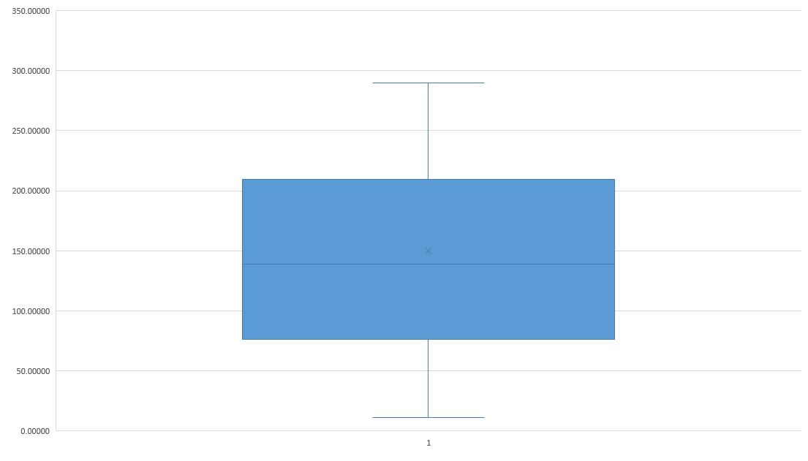

Slide 14
Please read how to draw boxplots on pp. 54 and 55 of the book!
Warning: Excel by default computes quartile “Exclusive median”. To make up for that, double click on the boxplot, then Chart Options→ Series 1 -> Series Options -> Inclusive median

Slide 15
Homework!
Read Chapter 3 (It won’t hurt if you read about mean and standard deviation, but we will cover it next time)
Do Page 72+: 6, 17a, 18, 19b, 21, 23 (try to do by hand, but check your answer on the calc), 25, 40abc, 42a
Yes, you can use a calculator or computer software. But in the paper you turn in you should explain all steps.
That is, you can’t ask Excel to find the median, but you can ask it to sort the numbers. Then you write: original data is …; sorted data is …
Then you highlight the median, etc.

