Slide 1
Lecture 3
End of lecture 2
+
Displaying quantitative variables

Slide 2
 | First Class | Second Class | Third Class | Crew | Total
Alive | 203 | 118 | 178 | 212 | 711
Dead | 122 | 167 | 528 | 673 | 1490
Total | 325 | 285 | 706 | 885 | 2201
 | First Class | Second Class | Third Class | Crew
Alive | 62% | 41% | 25% | 24%
Dead | 38% | 59% | 75% | 76%
Instead of “Alive + Total” we now have only
one number to compare

Slide 3
Bar chart again
We express survivor percentages depending on class

Slide 4
One more bar chart
And here is a side-by-side chart of survivors vs nonsurvivors

Slide 5
We (almost) see that the survival chance DEPENDS on the class. If all conditional distributions (conditioned to what?) were the same, we would say that survival chances and class are INDEPENDENT

Slide 6
Now Lecture 3 begins

Slide 7
Earthquakes from 2010 to 2015
Here is the full table: link Unpleasant, isn’t it?
Here is the column of magnitudes
(double click to open).
It is still unpleasant as it has too
many numbers.

Slide 8
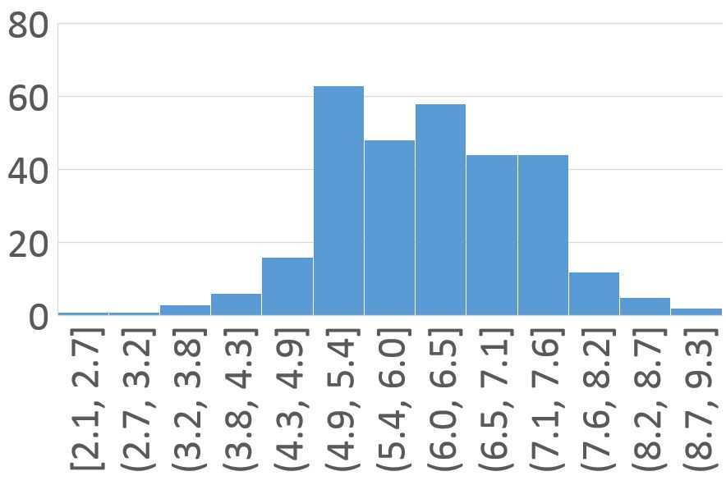
A histogram

Slide 9
On the x-axis we see intervals. Height of every rectangle = how many earthquakes had magnitude in this interval. I.e., around 60 of them had magnitude from 4.9 to 5.4

Slide 10
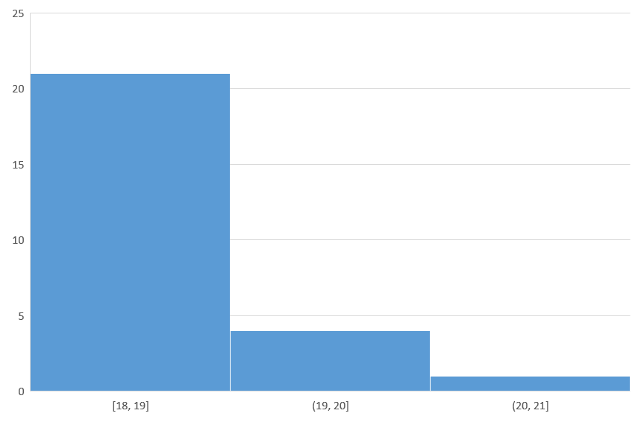
A histogram from our survey
20 | 19 | 18 | 18 | 19
18 | 19 | 18 | 19 | 20
19 | 19 | 18 | 20
18 | 18 | 18 | 19
19 | 18 | 18 | 20
21 | 18 | 18 | 18

Slide 11
Stem and leaf display
1 | 88888888888899999999
2 | 00001
20 | 19 | 18 | 18 | 19
18 | 19 | 18 | 19 | 20
19 | 19 | 18 | 20
18 | 18 | 18 | 19
19 | 18 | 18 | 20
21 | 18 | 18 | 18
This shows that we have “18” 12 times, “19” 8 times, “20” 4 times and “21” 1 time.

Slide 12
Shape
When looking at a histogram, we should first notice it shape. Is it somewhat flat? Or does it have pikes? How many?
Is it symmetric?
Does it have a tail?

Slide 13
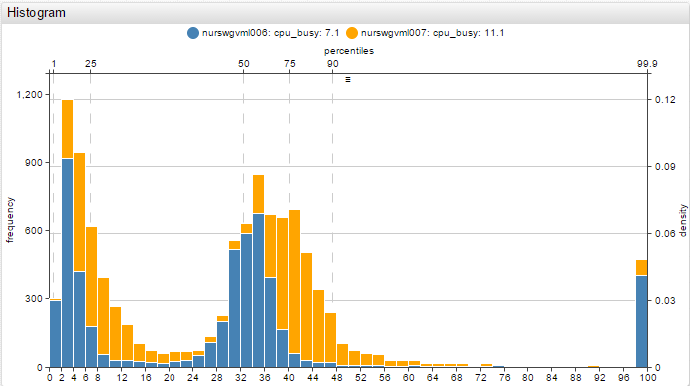

Slide 14
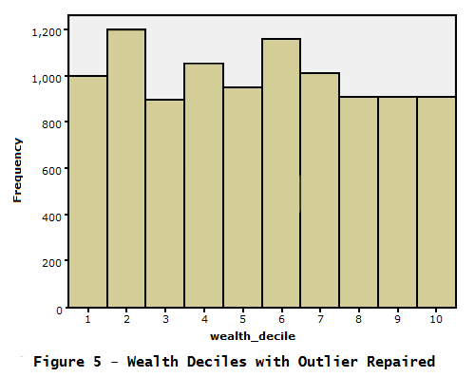

Slide 15
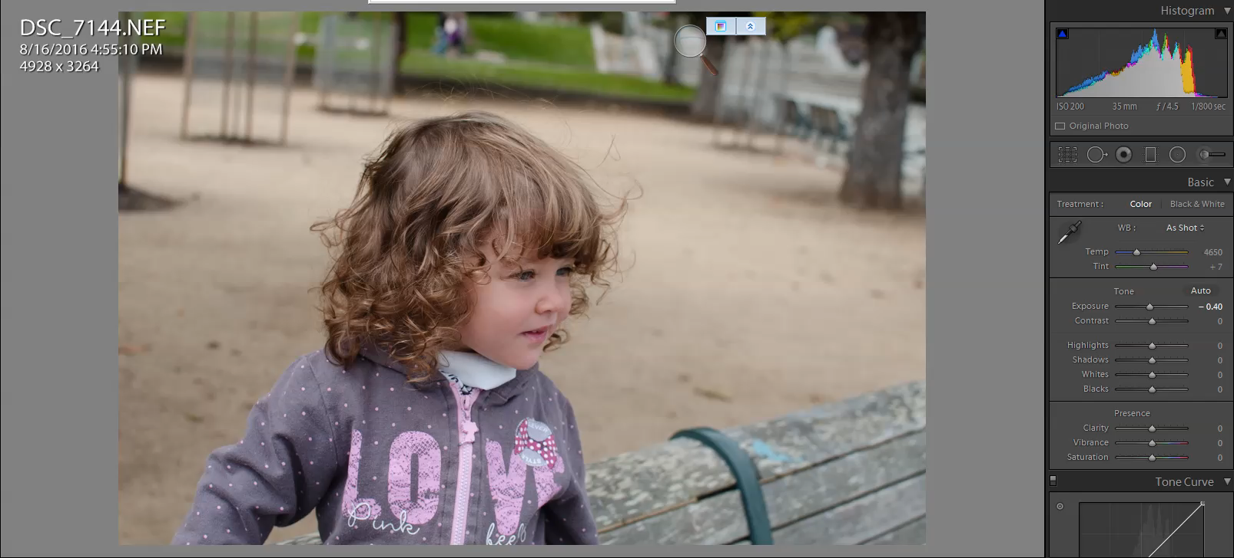
Sorry, can’t help it

Slide 16
From representing to summarizing
It is essential to find the “center” of our data. What is a “center”?
Assume you need to make ONE precise guess: what is the next outcome? In a sense, center is your most safe bet.
It somewhat tells you where most of the data is concentrated.

Slide 17
The median
Let’s first order numbers in our data.
If there is an odd number of numbers, then median = the middle value:
1 4 6 7 10 19 26 Median =
If there is an even number of numbers, then average two middle values
1 4 6 7 10 19 26 28 Median =
7
(7+10)/2

Slide 18
Spread
Range: (maximal value) – (minimal value)
Quartiles: Divide the data in the middle by median, and repeat with left-hand part and right-hand part.
1 4 6 7 10 19 26 → 1 4 6 7 // 7 10 19 26
Lower quartile = (4+6)/2=5
Upper quartile = (10+19)/2 = 14.5
IQR = (upper q.) – (lower q.)

