Slide 1
Lecture 2
Displaying and describing categorical data

Slide 2
Make a picture
Large tables are inconvenient: we see many many rows, but can not observe anything (see next slide)

Slide 3
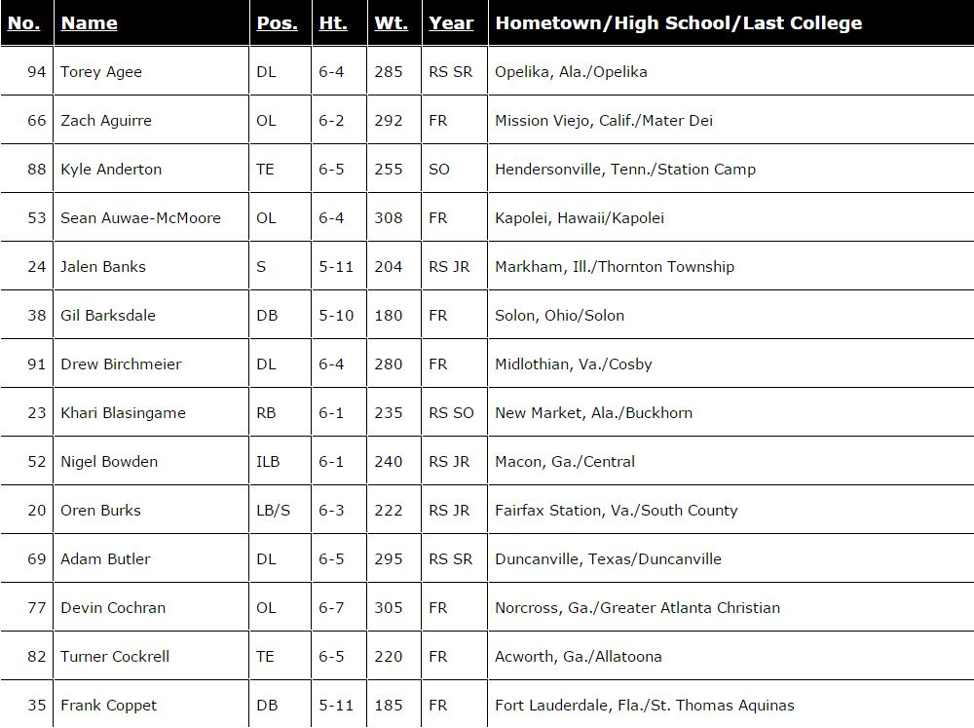

It has about 100 rows

Slide 4
Make a picture
In the previous table, what if we wanted to see proportion of freshmen/sophmores/juniors/seniors in the Commodores football team?
We would have to draw a chart. Chart should make our eye immediately capture differences between proportions.

Slide 5
A frequency table
We first summarize the table we have into a shorter one
Freshmen | 34
Sophmores | 25
Juniors | 30
Seniors | 14

Slide 6
This table is still a bit too hard. We can, of course, compare 4 numbers. But what if we had more rows? Say, ages 0—2, 2—4, 4—6, and so on. Or the numbers are large: compare 10123248 to 10123419.
Freshmen | 34
Sophmores | 25
Juniors | 30
Seniors | 14

Slide 7
A bar chart

Slide 8
A pie chart

Slide 9
And many more!
Just open MS Word and hit “Insert chart”
Why this one is bad?

Slide 10
Exploring the relationship
A single football player has two categorical “properties”: say, year of study and position?
We want to know: are they related or “independent”? I.e., if one is a senior, can we confidently say that, most probably, he is not a wide receiver?

Slide 11
Let’s switch to the book: Titanic survivors
 | First Class | Second Class | Third Class | Crew | Total
Alive | 203 | 118 | 178 | 212 | 711
Dead | 122 | 167 | 528 | 673 | 1490
Total | 325 | 285 | 706 | 885 | 2201
Let’s identify the “who”s and the “what”s. Can we now say that someone from the first class had more chances to survive?

Slide 12
 | First Class | Second Class | Third Class | Crew | Total
Alive | 203 | 118 | 178 | 212 | 711
Dead | 122 | 167 | 528 | 673 | 1490
Total | 325 | 285 | 706 | 885 | 2201
The bad thing is that we see too much. We see that 203 1st class passengers survived versus 178 from the 3rd class. But then we look down and see 325 vs 706

Slide 13
 | First Class | Second Class | Third Class | Crew | Total
Alive | 203 | 118 | 178 | 212 | 711
Dead | 122 | 167 | 528 | 673 | 1490
Total | 325 | 285 | 706 | 885 | 2201
 | First Class | Second Class | Third Class | Crew
Alive | 62% | 41% | 25% | 24%
Dead | 38% | 59% | 75% | 76%
Instead of “Alive + Total” we now have only
one number to compare

Slide 14
Conditional distributions
We can do, for example, this: how many alive passengers were in the first class? In the second class? And so on.
Mathematically we ask: what is the proportion of survivors CONDITIONED to the fact that they are in the first class?

Slide 15
We get the following table
First | Second | Third | Crew | Total
203 28.6% | 118 16.6% | 178 25% | 212 29.8% | 711
First column reads:
203 out of 711 survivors were from the first class. Or: 28.6% of all survivors were from the first class

Slide 16
Rule of thumb
The rule of thumb is: we have a table with certain property as row (alive/dead) and certain property as column (class). We then restrict ourselves to one particular column or row. Say, “how does the survival % differ for different classes?” This means that we care only about survivors; thus, so we condition to the fact that one survived.

Slide 17
Bar chart again
We express survivor percentages depending on class

Slide 18
One more bar chart
And here is a side-by-side chart of survivors vs nonsurvivors

Slide 19
We (almost) see that the survival chance DEPENDS on the class. If all conditional distributions (conditioned to what?) were the same, we would say that survival chances and class are INDEPENDENT

Slide 20

Homework
Read chapter 2. Work through examples and carefully read the “what can go wrong” section
Do p.33+: 1, 4, 5, 6, 17, 31, 34, 37bce, 41abd

