Slide 1
Modifying Alert Rules
“Click by Click” Guide
VBS FIRM VBS-FIRM@vanderbilt.edu
https://app-us.oceaview.com

Slide 2
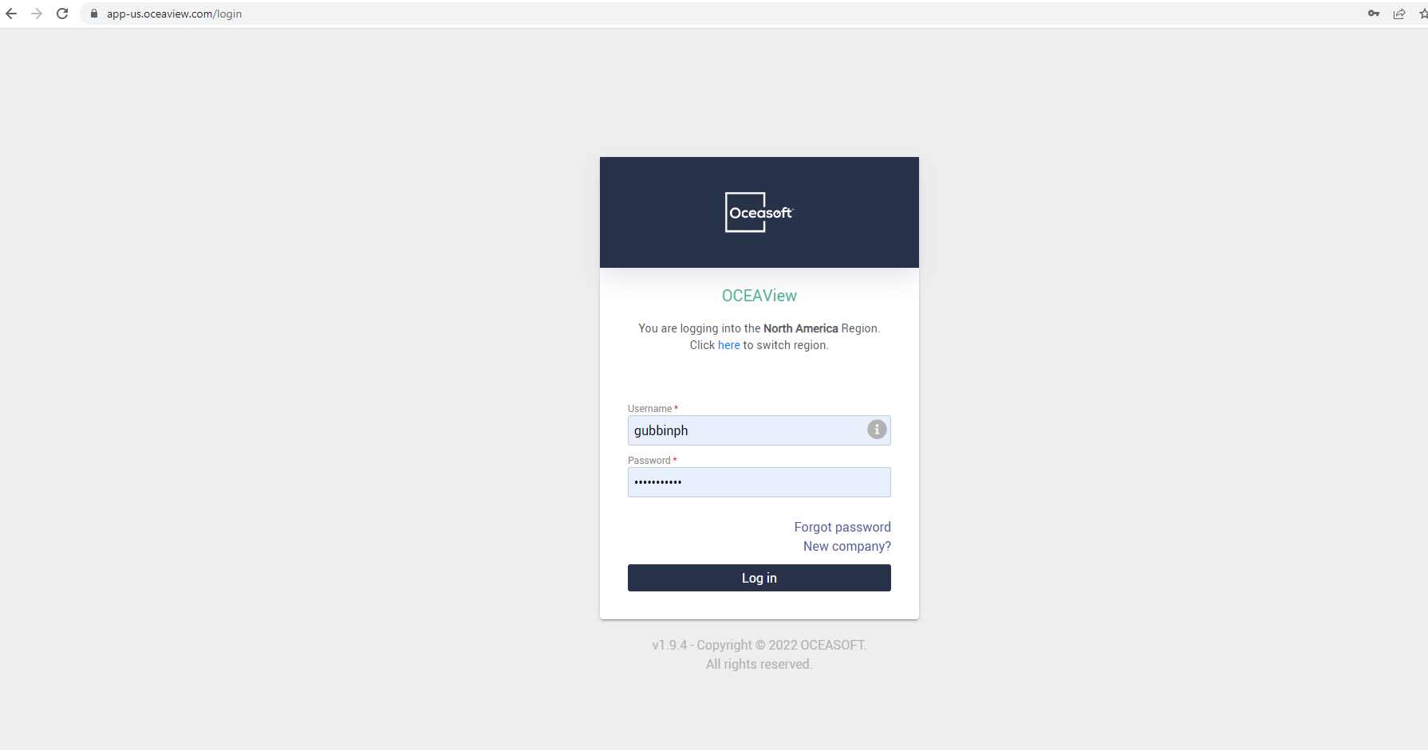
To View Equipment:
Go to this site: https://app-us.oceaview.com
And login using your VUNetID

Slide 3
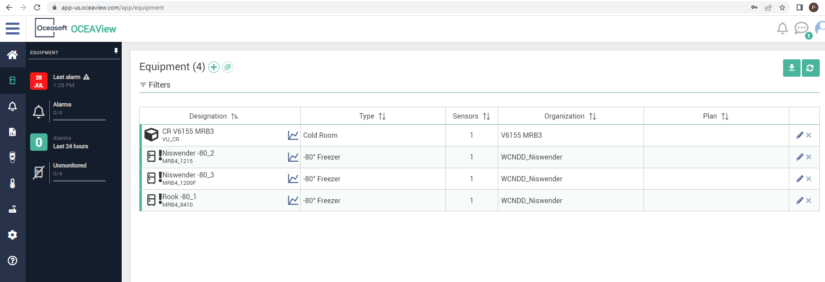
To View Equipment:
You will need to click on the equipment tab, circled in red below

Slide 4
To View Equipment:
Under the equipment tab, you can view all equipment associated with you, and by clicking on the graph icon (circled in red) for a specific piece of equipment you can view temperature data over time.

Slide 5
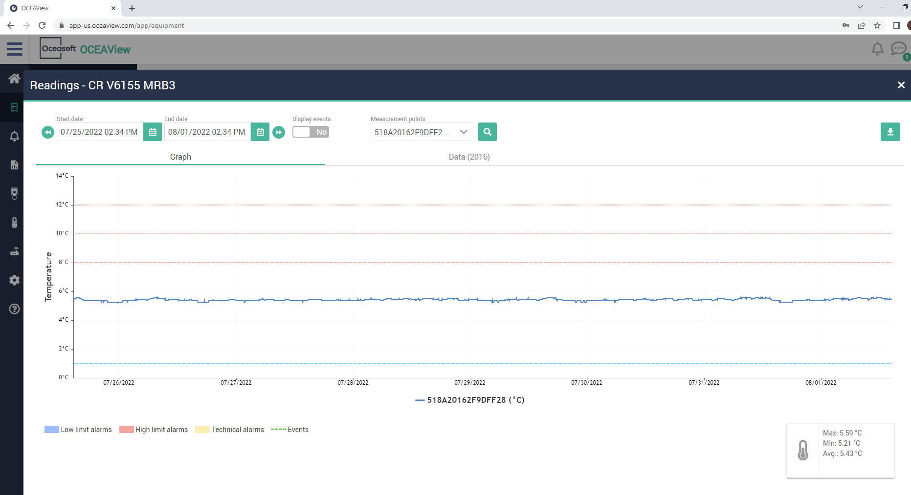
Viewing Equipment:
Freezers (-80s, -20s, Cold Rooms) generally have 3 high limits and 1 low limit. (And a technical alarm should the datalogging be interrupted.)

Slide 6
Viewing Equipment:
This cold room has 3 high limits, at 8 degrees, 10 degrees, and 12 degrees. It has one low limit, at 1 degree. We label these in ascending order:
High limit level 1 is “Oh Hey”, High limit level 2 is “Oh Heck”, and High limit level 3 is “Oh No!” with the low limit and technical being an “Oh No!” as well.
High Limit Lvl 3: Oh No!
High Limit Lvl 2: Oh Heck
High Limit Lvl 1: Oh Hey
Low Limit Lvl 1: Oh No!

Slide 7
Viewing Equipment:
Basically, if the data line passes above one of these dotted lines it will trigger an alert based on what your rule says for that line.
You can set different parameters/delays for alerts via the Modifying Parameters Guide.
Oh No!
Oh Heck
Oh Hey
Oh No!

Slide 8
To Modify Alert Rules:
Click on the settings Icon, circled in red here.

Slide 9
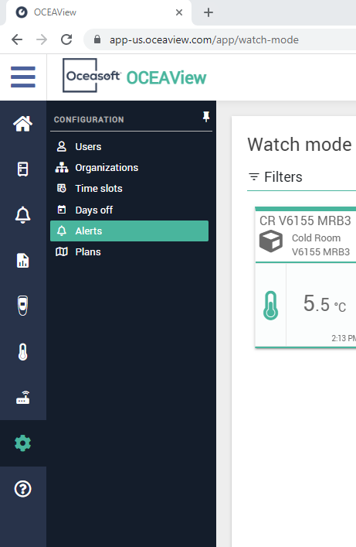
To Modify Alert Rules:
Click on Alerts, circled in red here.

Slide 10
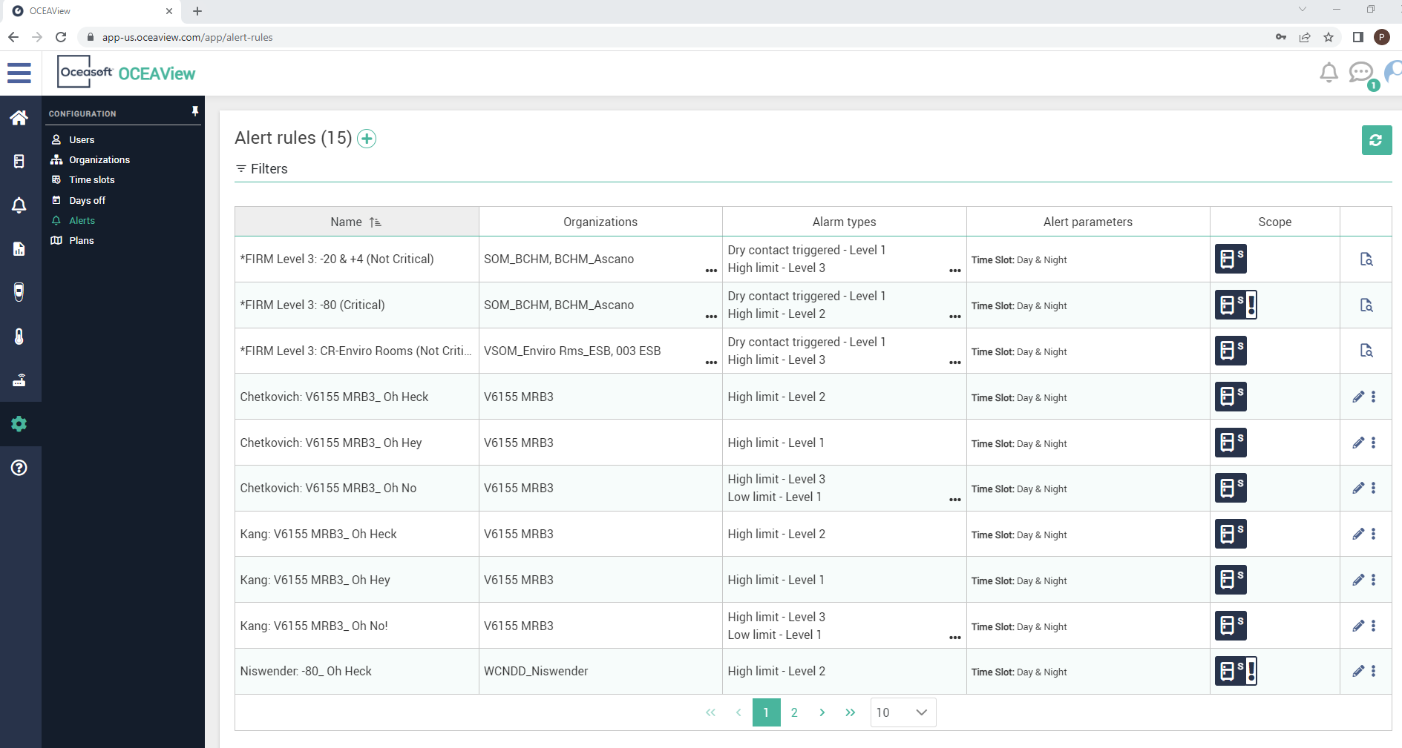
To Modify Alert Rules:
Each lab sets up their own alert rules. There is an alert rule corresponding to each level we saw earlier, labeled “Oh Hey”, “Oh Heck”, and “Oh No!”

Slide 11
To Modify Alert Rules:
If you wanted to create an alert rule for a type of equipment your lab does not have alert rules setup for, you would click the plus sign. For now, we will go over all the options within editing existing alert rules.

Slide 12
To Modify Alert Rules:
Click on the line of the alert you would like to edit.

Slide 13
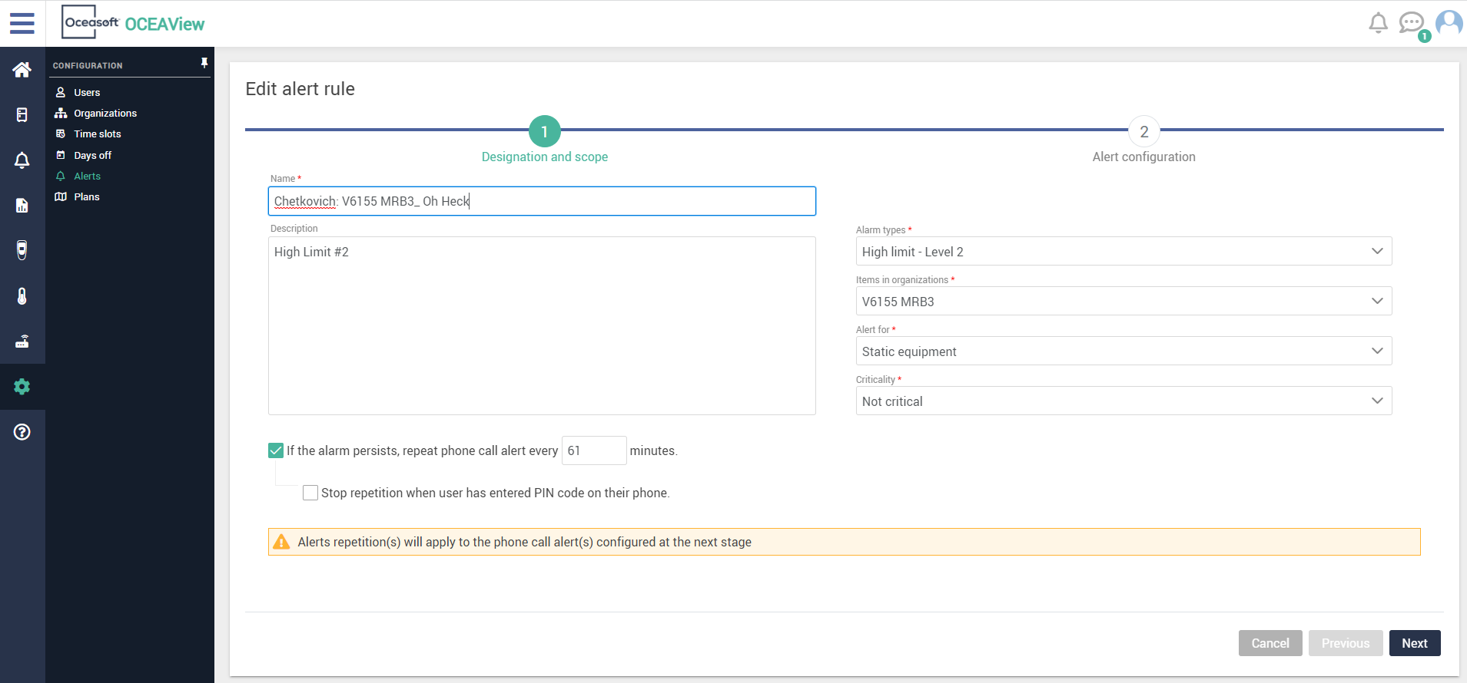
To Modify Alert Rules:
Please follow the nomenclature: “Lab Name: Equipment Type_Alert level name”

Slide 14
To Modify Alert Rules:
The Alarm type designates what temp threshold we are using, for “Oh Heck” we generally use High Limit – Level 2.

Slide 15
To Modify Alert Rules:
This item describes the piece of equipment itself, e.g. cold room V6155 MRB3. If the equipment is a -80 or -20, it would be your lab’s name as the organization.

Slide 16
To Modify Alert Rules:
All Freezers are labeled as Static Equipment.

Slide 17
To Modify Alert Rules:
Only -80s are labeled as Critical equipment, -20s and cold rooms as Not Critical

Slide 18
To Modify Alert Rules:
The Description is just for annotations.

Slide 19
To Modify Alert Rules:
If the alarm persists for more than an hour, it will call members again (if applicable, if you have calls set up for the alert, that is)

Slide 20
To Modify Alert Rules:
Click Next to edit the users associated with the alert rule.

Slide 21
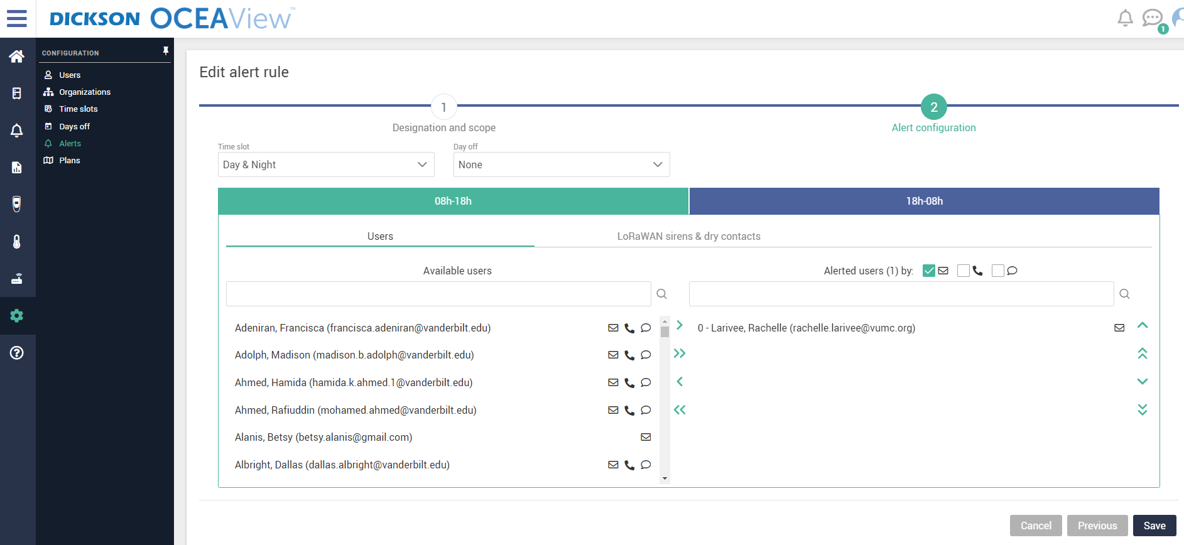
To Modify Alert Rules:
Circled red is the day section, to the right in blue is the night section

Slide 22
To Modify Alert Rules:
To add a user, you will have to search them up under available users

Slide 23
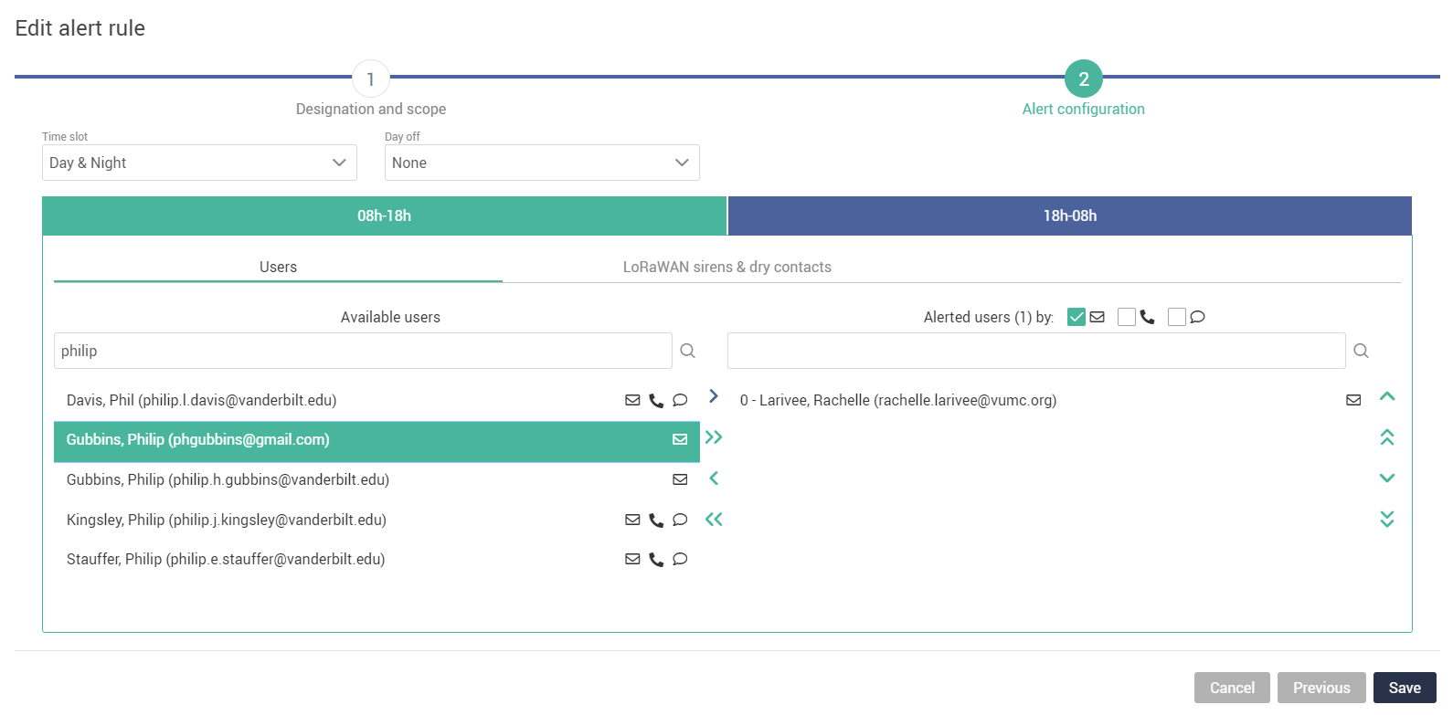
To Modify Alert Rules:
Click on the name, and then on the single arrow circled in red.

Slide 24
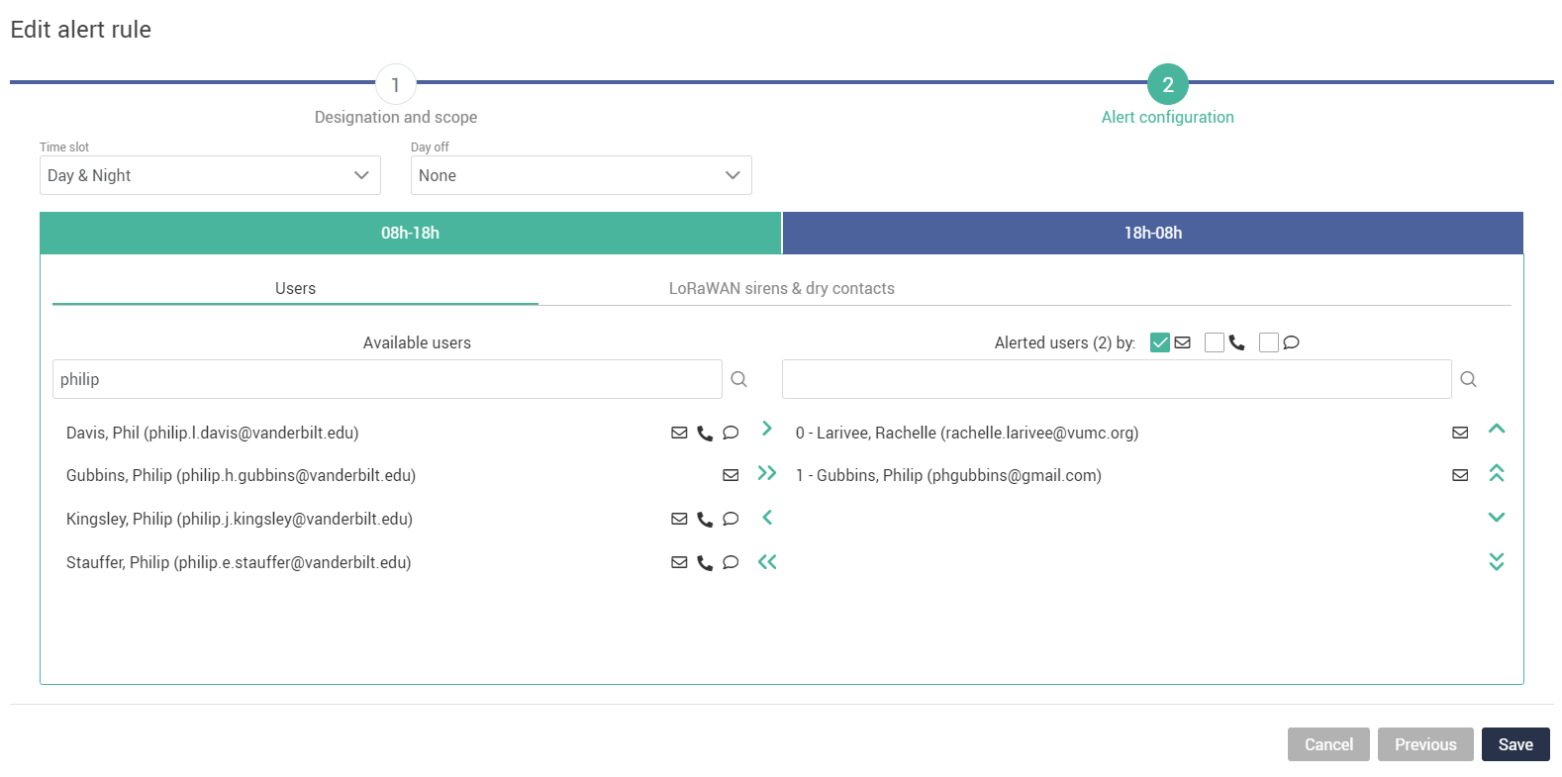
To Modify Alert Rules:
If you want email, phone calls, or text messages, check off those that apply.

Slide 25
To Modify Alert Rules:
Once you have added someone, be sure to do the same on the nighttime rule.

Slide 26
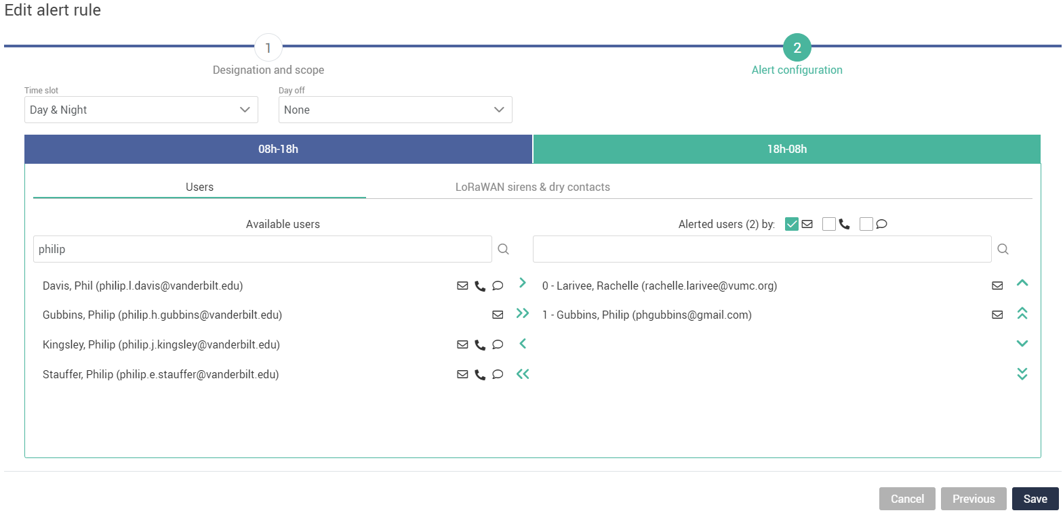
To Modify Alert Rules:
Once you have added someone, be sure to do the same on the nighttime rule.

Slide 27
To Modify Alert Rules:
Be sure to Save any changes or Cancel to do nothing.

Slide 28
To Modify Alert Rules:
So, we have now added Philip to the Oh Heck rule.

Slide 29
To Modify Alert Rules:
By adding Philip to the Oh Heck rule as we did, he will receive an email when the temperature data being logged goes above the 10 degree line, as that is the level 2 limit associated with the “Oh Heck” rule.
Oh No!
Oh Heck
Oh Hey
Oh No!

Slide 30
To Modify Alert Rules:
We should then add him to the Oh Hey and Oh No! alerts using the same process as the Oh Heck alert rule.
Oh No!
Oh Heck
Oh Hey
Oh No!

Slide 31
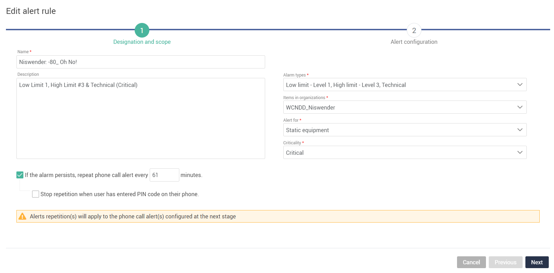
To Modify Alert Rules:
Recall that for the “Oh Hey” alert rule, the alarm type would be High limit – Level 1, and for the “Oh No!” alert rule, the alarm type should be Low limit – Level 1, High limit – Level 3, and Technical.
To the right is what an “Oh No!” Alert rule for a -80 might look like. Note the “Items in organization” is the lab itself… whereas with enviro rooms it is the enviro room itself.

Slide 32
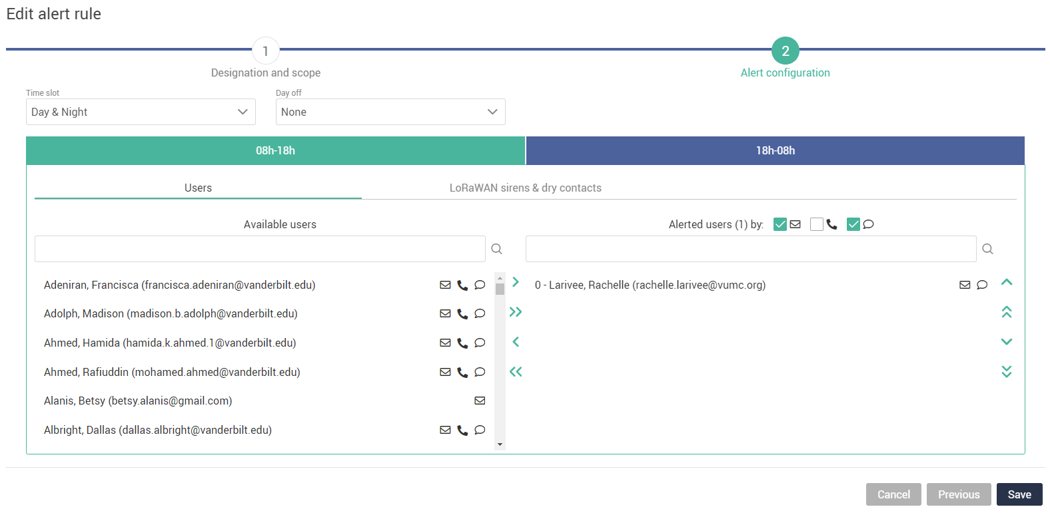
To Modify Alert Rules:
Add users however you would like to the various levels of alert rules. You could add the PI to only the highest level of alerts perhaps (Oh No!), or check off phone calls at night for critical equipment if you wanted to make sure you woke up should something important crash.

Slide 33
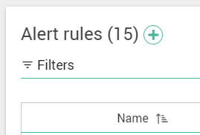
Creating Alert Rules
To do so from scratch, use the slides from this presentation that described each option within the edit alert rule screen. (Slides 12-26).
Again, you would have to click on the plus sign here:
Additionally, there is a way to copy and paste alert rules if you, for example, had an “Oh Hey” alert rule and wanted to make an “Oh Heck” or “Oh No!” rule.

Slide 34
To Modify Alert Rules:
For creating alert rules, a useful tip is to click on the three-dot icon, “Options” on a similar alert rule to the one you want to create.
And click on the Create from… option to make a copy of an alert rule.
Which you can then use as a template for other alerts you may want.

Slide 35
You should be all good for modifying alert rules!
There are also user guides for:
Adding users
Removing users
Editing temperature thresholds

