Slide 1
Modifying Alarm Parameters
“Click by Click” Guide
VBS FIRM VBS-FIRM@vanderbilt.edu
https://app-us.oceaview.com

Slide 2
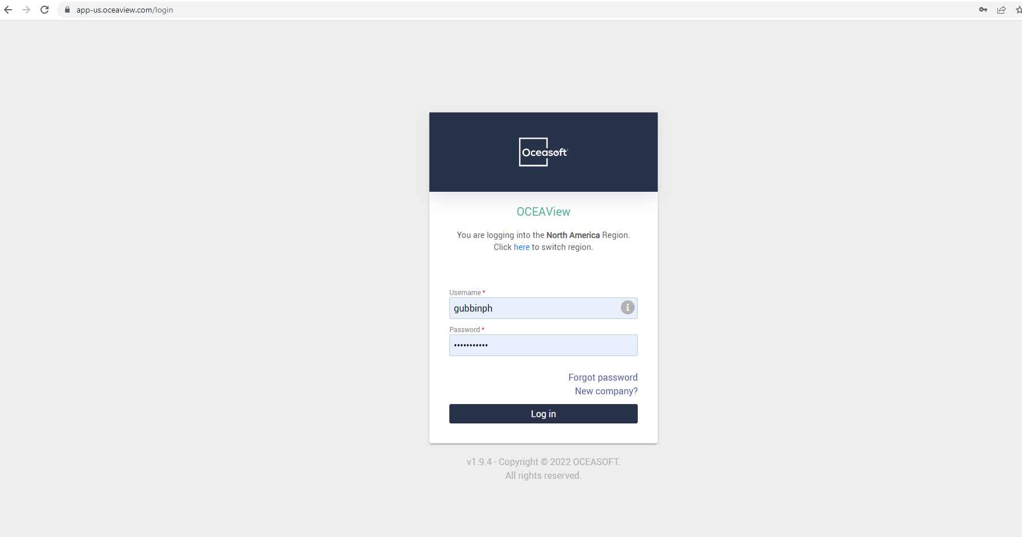
To View Equipment:
Go to this site: https://app-us.oceaview.com
And login using your VUNetID

Slide 3
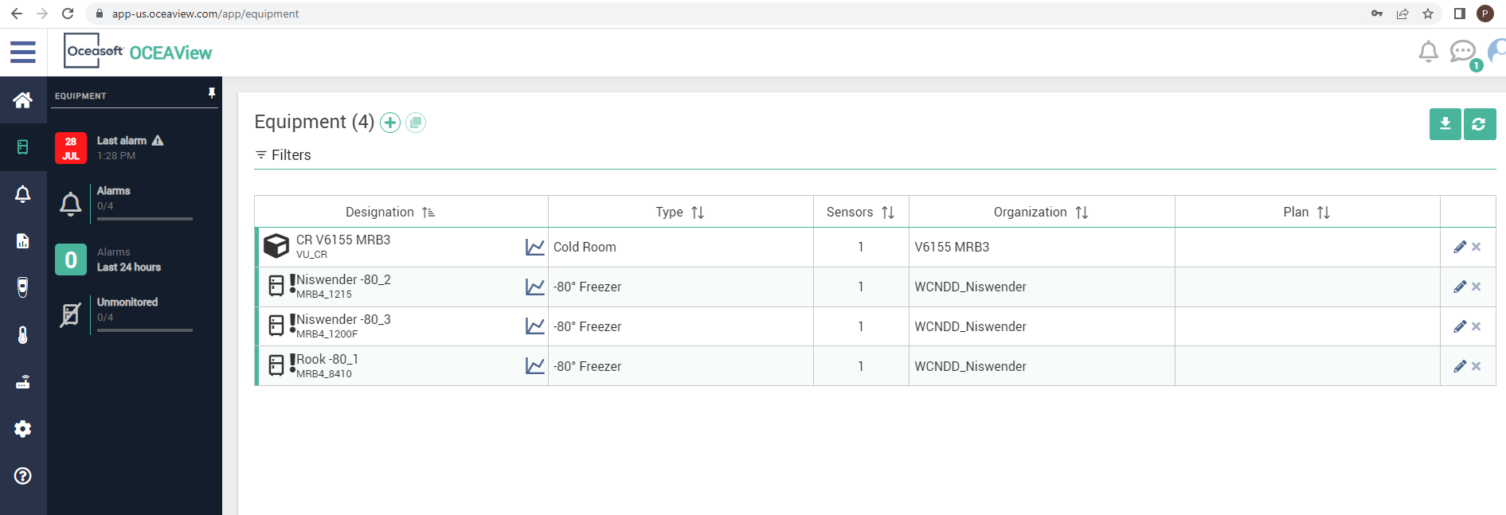
To View Equipment:
You will need to click on the equipment tab, circled in red below

Slide 4
To View Equipment:
Under the equipment tab, you can view all equipment associated with you, and by clicking on the graph icon (circled in red) for a specific piece of equipment you can view temperature data over time.

Slide 5
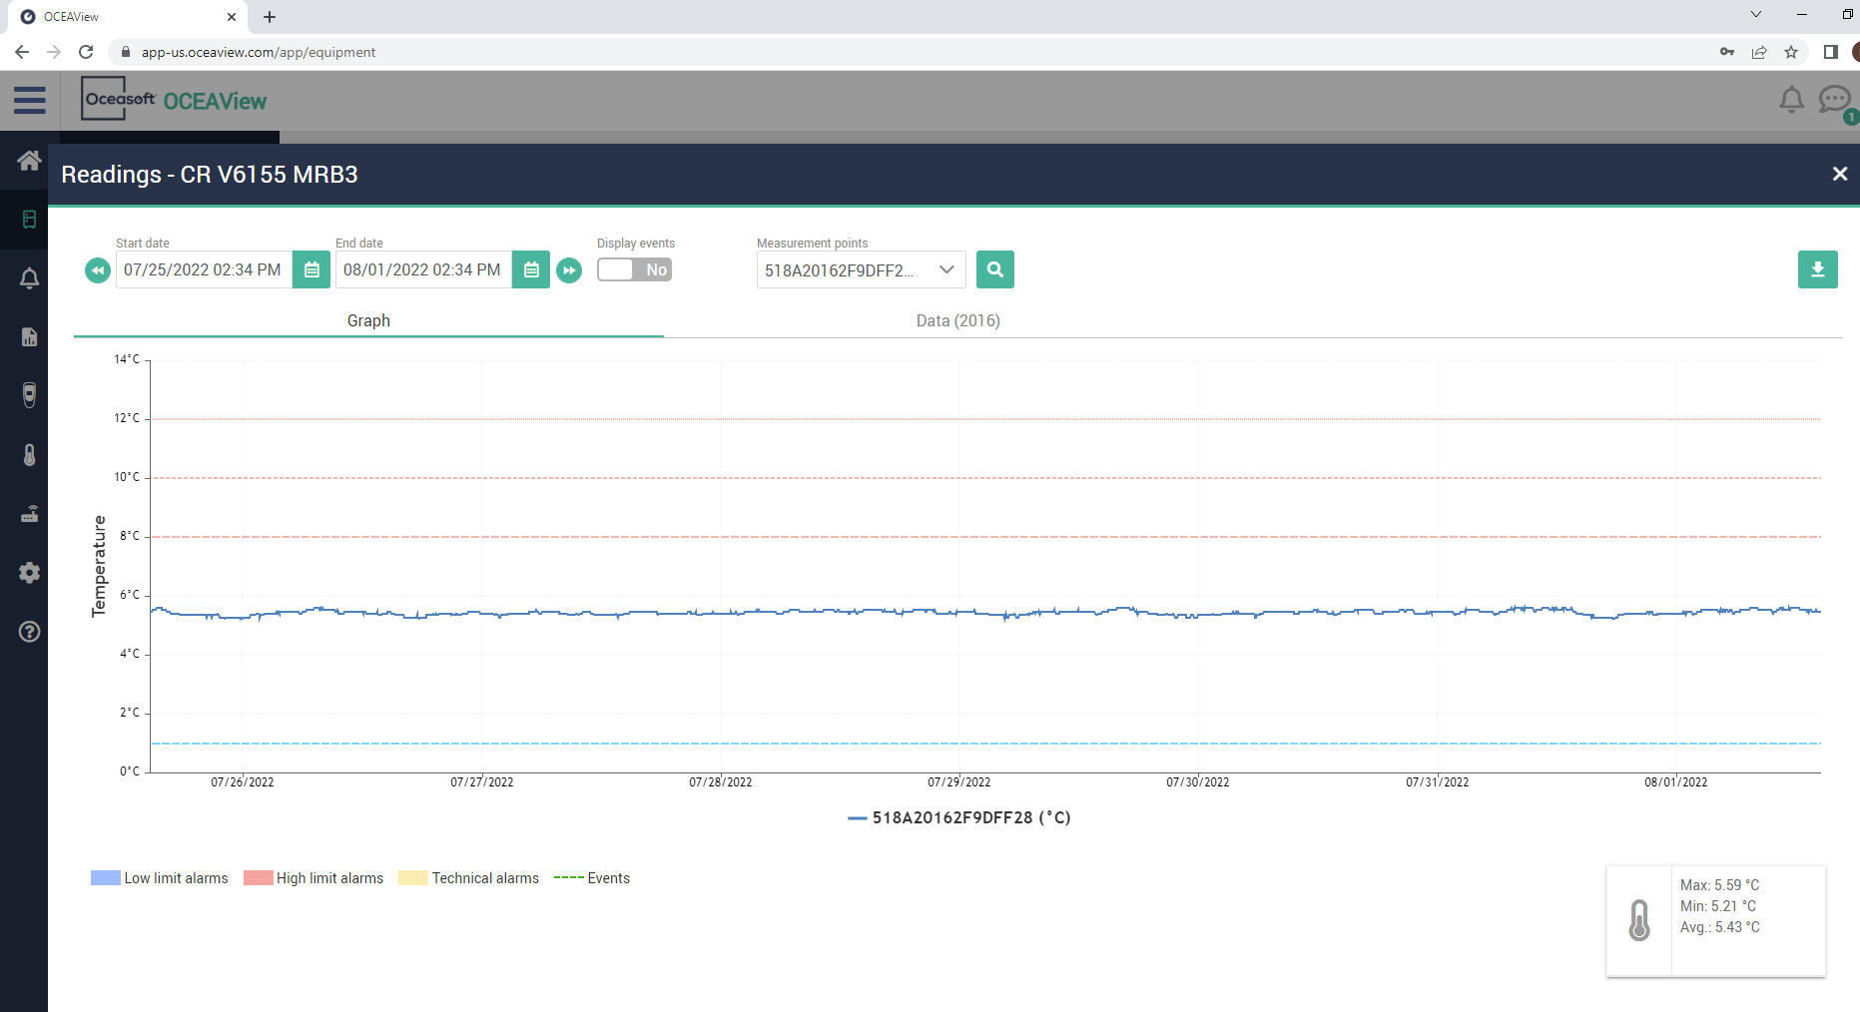
Viewing Equipment:
Freezers (-80s, -20s, Cold Rooms) generally have 3 high limits and 1 low limit. (And a technical alarm should the datalogging be interrupted.)

Slide 6
Viewing Equipment:
This cold room has 3 high limits, at 8 degrees, 10 degrees, and 12 degrees. It has one low limit, at 1 degree. We label these in ascending order:
High limit level 1 is “Oh Hey”, High limit level 2 is “Oh Heck”, and High limit level 3 is “Oh No!” with the low limit and technical being an “Oh No!” as well.
High Limit Lvl 3: Oh No!
High Limit Lvl 2: Oh Heck
High Limit Lvl 1: Oh Hey
Low Limit Lvl 1: Oh No!

Slide 7
Viewing Equipment:
Basically, if the data line passes above one of these dotted lines it will trigger an alert based on what your rule says for that line.
If you want to edit these temperatures and even put delays – this is the right guide.
Oh No!
Oh Heck
Oh Hey
Oh No!

Slide 8
To Edit Alarm Parameters:
Click on the line of the equipment to pull up the equipment side tab.

Slide 9
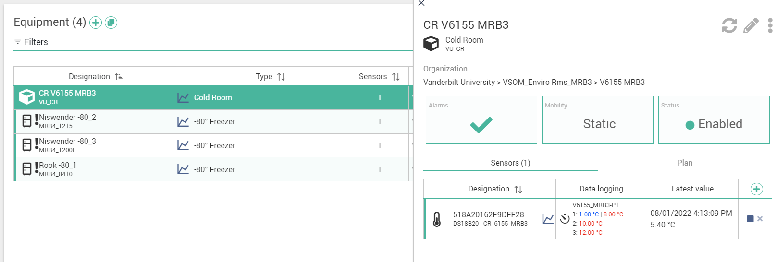
To Edit Alarm Parameters:
To change parameters, you will need to stop data-logging by clicking the stop button.

Slide 10
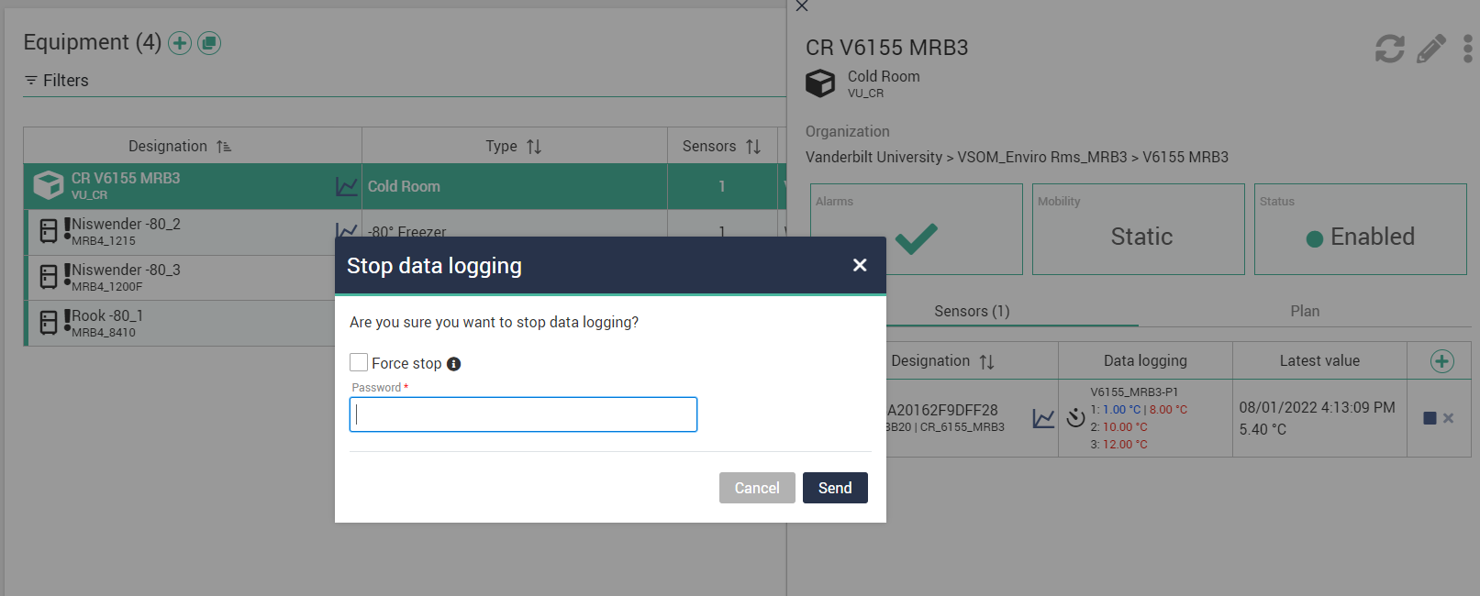
To Edit Alarm Parameters:
Input your account password, force stop if you want it to be a bit quicker but not receive data for the time being.

Slide 11
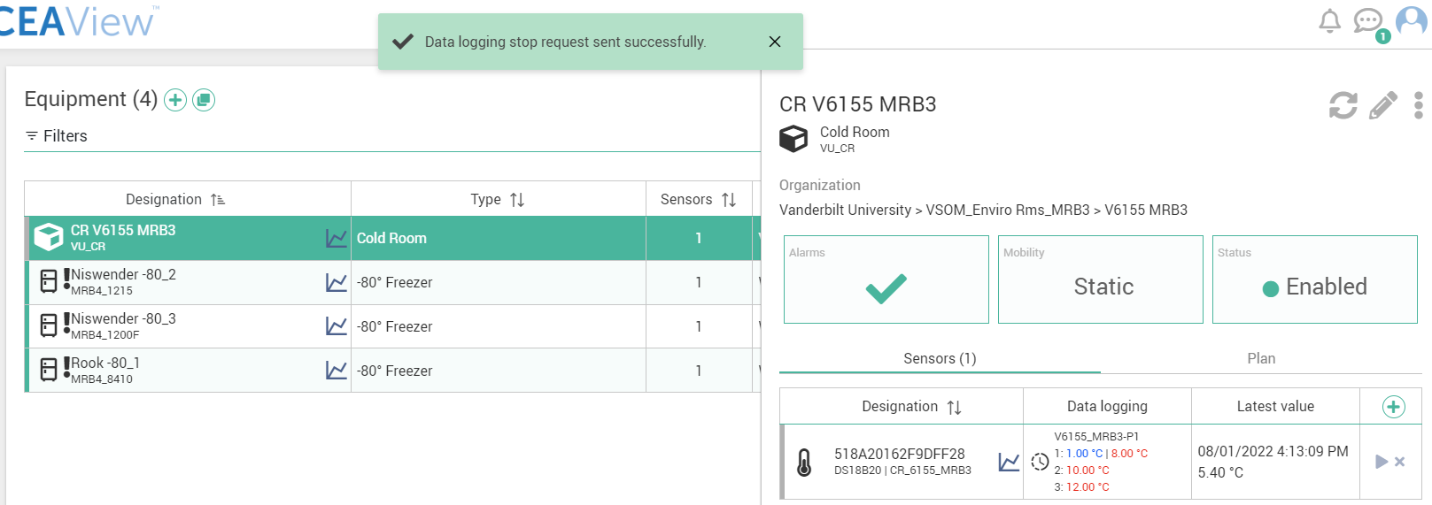
To Edit Alarm Parameters:
You will have to wait for the arrow in the bottom right to turn blue. This could take around a half hour, as it takes time for the network and equipment to register the command.

Slide 12
To Edit Alarm Parameters:
Now that the arrow is blue, click on it. You will have to enter your password again to start data logging.

Slide 13
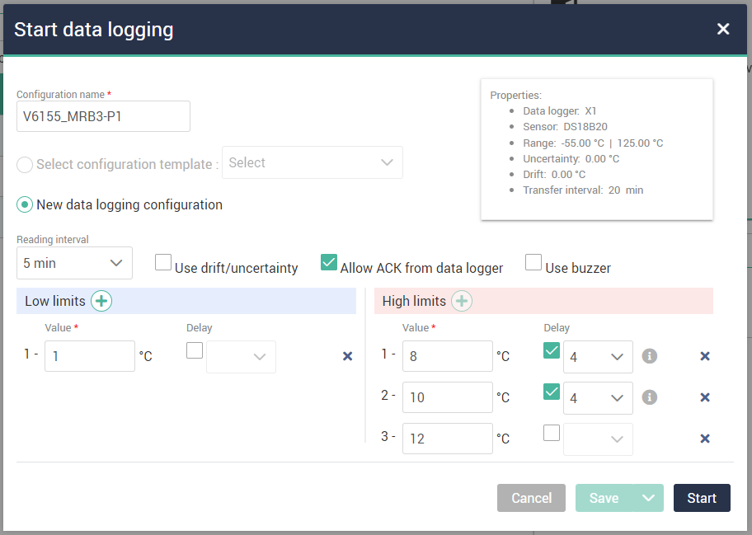
To Edit Alarm Parameters:
The “Start data logging” screen will pop up.

Slide 14
To Edit Alarm Parameters:
For these three, you should probably just leave them in this configuration, unless otherwise noted by your lab. Drift/uncertainty is not reliable, everyone wants to allow acknowledgement from the module on the freezer, and nobody has the buzzer installed (additional battery required).

Slide 15
To Edit Alarm Parameters:
The reading interval indicates how often the module will send data, doing more often will expend battery more rapidly, we suggest a 5 minute interval.

Slide 16
To Edit Alarm Parameters:
The reading interval being 5 minutes means that the delay of 4 presents itself as a delay of 20 minutes (4 intervals of 5 minutes).
This means that if your freezer crosses a parameter with delay 4 attached, it will actually take 20 minutes above that temperature for you to be notified.

Slide 17
To Edit Alarm Parameters:
This is now where you get to edit alarm parameters however you would like. You can lower or raise the limits as you would like. We suggest to have no delay on the low limit or the high limit level 3, so that you get notified immediately should those parameters be crossed.

Slide 18
To Edit Alarm Parameters:
Careful with removing limits entirely, by removing limit level 1, level 2 becomes level 1 and that may mess up the alert rules attached. Preferably you would just increase or decrease by a degree at a time to avoid nuisance alerts.

Slide 19
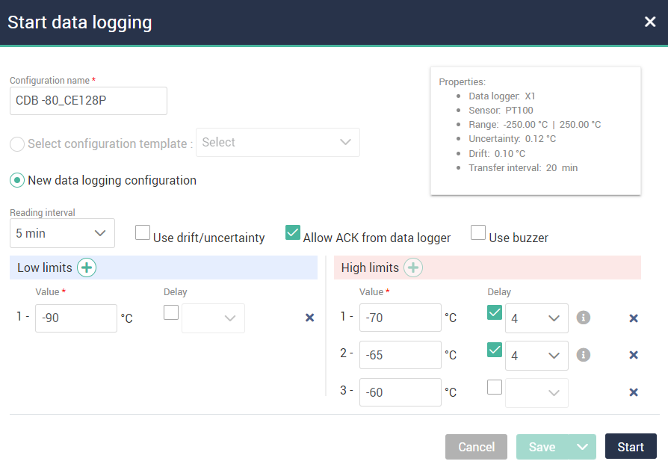
To Edit Alarm Parameters: ‘Some Defaults’
-80: HL1 -70, HL2 -65, HL3 -60. LL1 -90.
-20: HL1 -15, HL2 -13, HL3 -11. LL1 -25.
CR: HL1 8, HL2 10, HL3 12. LL1 1.
The right example is a -80 freezer now.

Slide 20
To Edit Alarm Parameters: ‘Some Defaults’
Once you have completed changing the parameters, be sure to click “Start”

Slide 21
To Edit Alarm Parameters: ‘Some Defaults’
It may take some time (half hour or so) for the datalogger to start up again.

Slide 22
You should be all good for modifying alarm parameters!
There are also user guides for:
Adding users
Removing users
Editing temperature thresholds
Defrosting Tips

