Slide 1
Defrosting Tips
“Click by Click” Guide
VBS FIRM VBS-FIRM@vanderbilt.edu
https://app-us.oceaview.com

Slide 2
Defrosting Tips:
There are two methods for stopping alerts, I will go through “Stopping Datalogging” first, then “Changing the Equipment Type”, which has more utility.

Slide 3
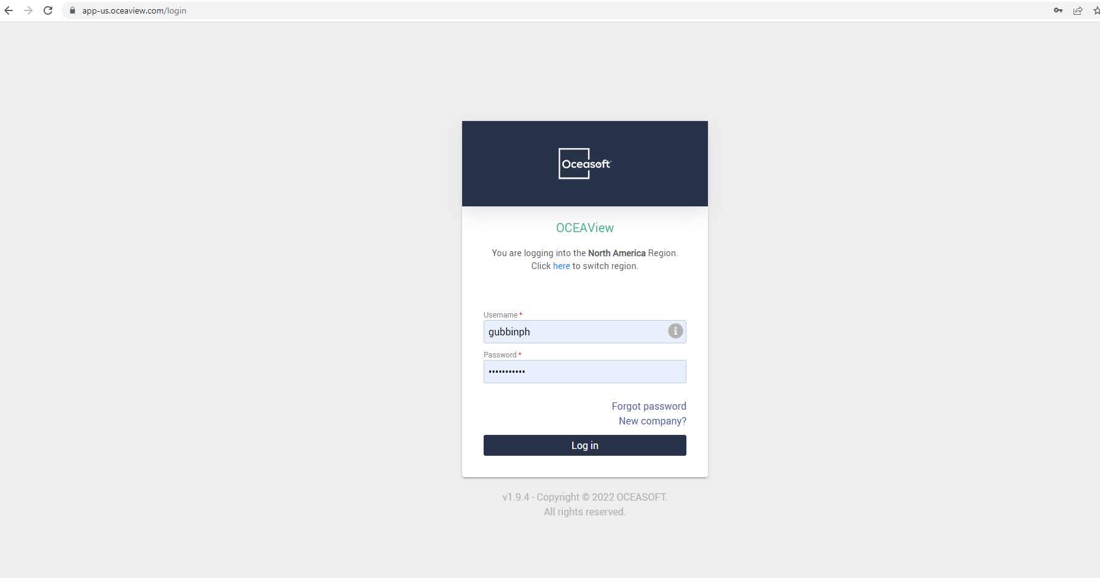
Access the site:
Go to this site: https://app-us.oceaview.com
And login using your VUNetID

Slide 4
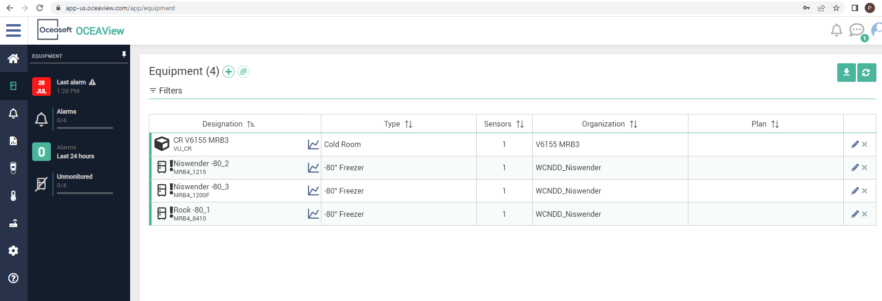
Stopping Datalogging:
You will need to click on the equipment tab, circled in red below

Slide 5
Stopping Datalogging:
Under the equipment tab, you can view all equipment associated with you, and by clicking on the graph icon (circled in red) for a specific piece of equipment you can view temperature data over time.

Slide 6
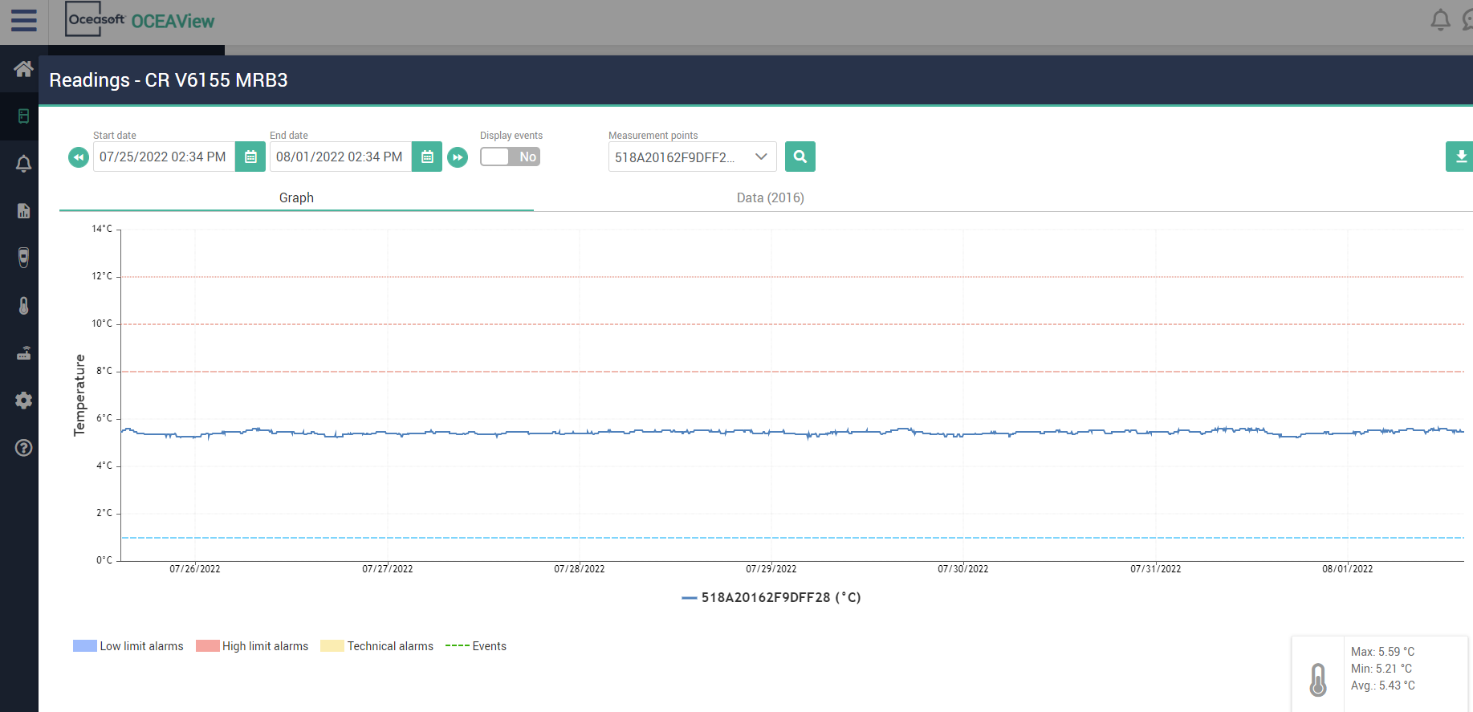
Stopping Datalogging:
Freezers (-80s, -20s, Cold Rooms) generally have 3 high limits and 1 low limit. (And a technical alarm should the datalogging be interrupted.)

Slide 7
Stopping Datalogging:
Exit out of the chart to get back to the main Equipment page.
Click on the line of the equipment to pull up the equipment side tab.

Slide 8
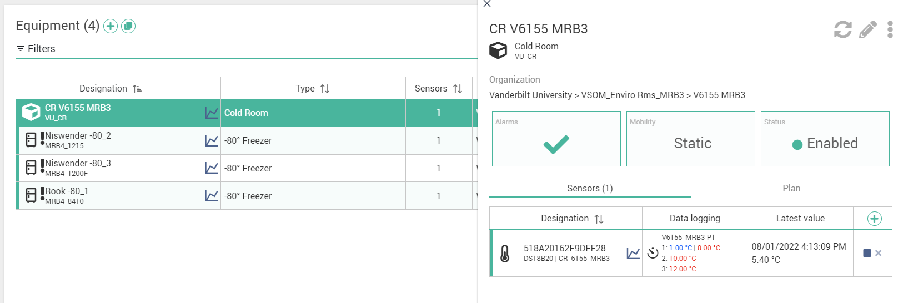
Stopping Datalogging
To change parameters, you will need to stop data-logging by clicking the blue stop button, circled in red.

Slide 9
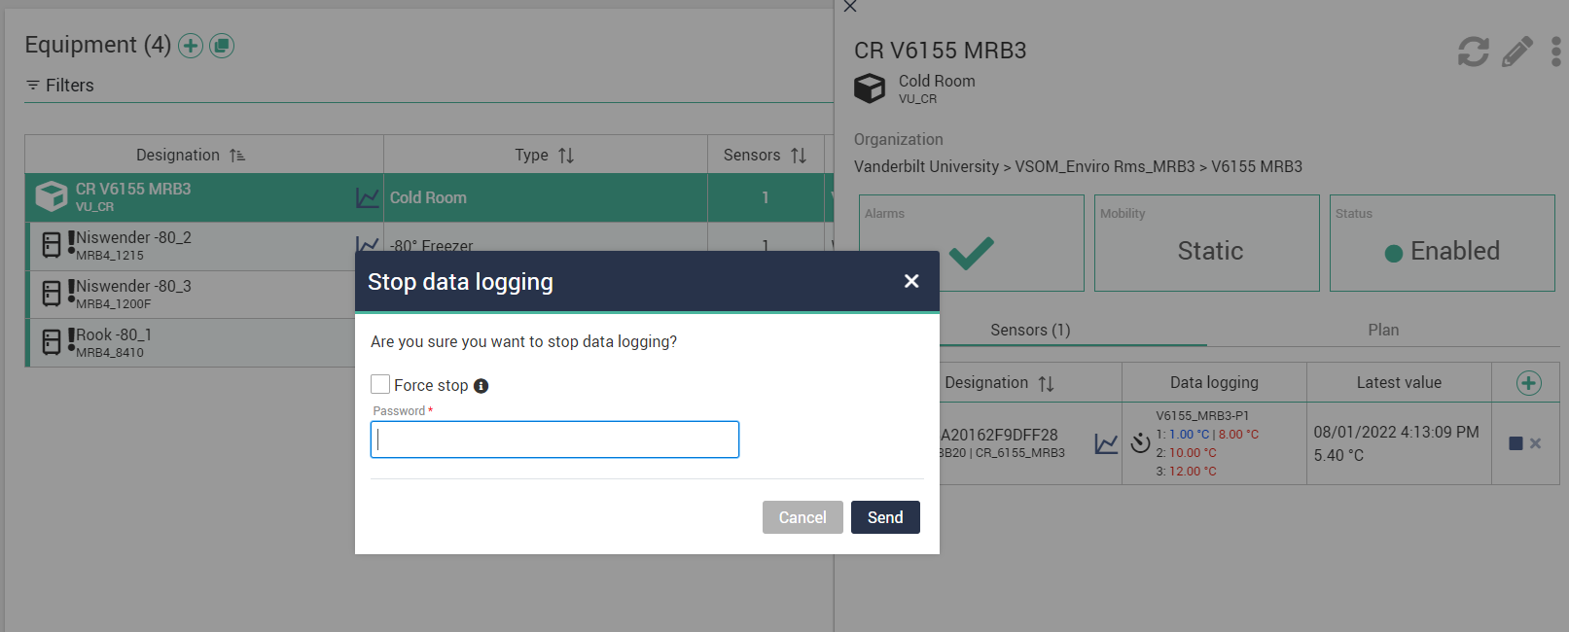
Stopping Datalogging
Input your account password, force stop if you want it to be a bit quicker but not receive data for the time being. These network actions can take a half hour+.

Slide 10
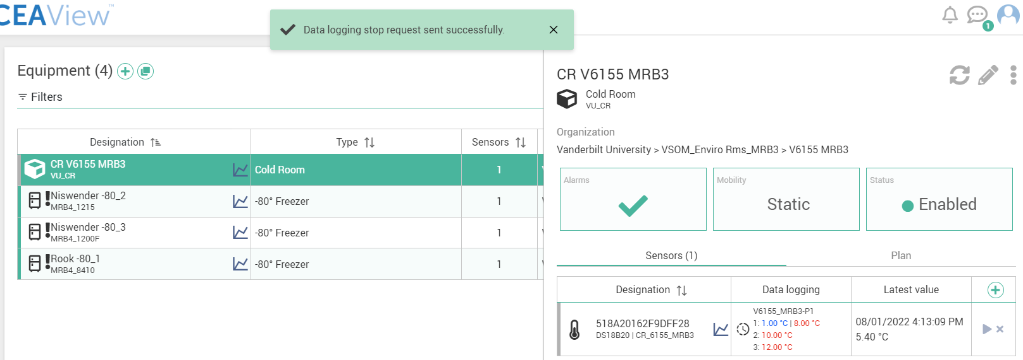
To Restart Datalogging
You will have to wait for the arrow in the bottom right to turn blue. This could take around a half hour, as it takes time for the network and equipment to register the command.

Slide 11
To Restart Datalogging – DO NOT FORGET!
Now that the arrow is blue, click on it. You will have to enter your password again to start data logging.

Slide 12
Activating Datalogging could take up to 30 min to Update – How to be sure it is Active:
Here is what the equipment looks like when datalogging:
Note the red (currently alerting) and green, both are active.
Meanwhile:
The greyed-out panel indicates the equipment is not datalogging.

Slide 13
If you follow the above steps, you should be good! The rest of this presentation just shows you another way to do the same thing, but would let you record the temperature data throughout defrost.

Slide 14
Changing Equipment Type
This option is great if you do not want to go through the hassle of stopping datalogging and if you wanted to continue receiving data throughout defrost.
This would allow you to see how long it takes your freezer to warm up and cool down. Note that if you do have mobile alert rules setup this will not work to not receive alerts.
However, it is also harder to tell whether something has a different equipment type versus whether or not the datalogger is stopped. So you really do have to remember to change it back – otherwise you will not receive alerts until you do so. Because the datalogger will look green from our side.

Slide 15
Changing Equipment Type
You will need to click on the equipment tab, circled in red below

Slide 16
Changing Equipment Type
Click on the line of the equipment to pull up the equipment side tab.

Slide 17
Changing Equipment Type
To change equipment type, you will need to click on the pencil “edit” button encircled in red.

Slide 18
Changing Equipment Type
You can then click on the Mobile button to change the designation of your freezer from static to mobile.

Slide 19
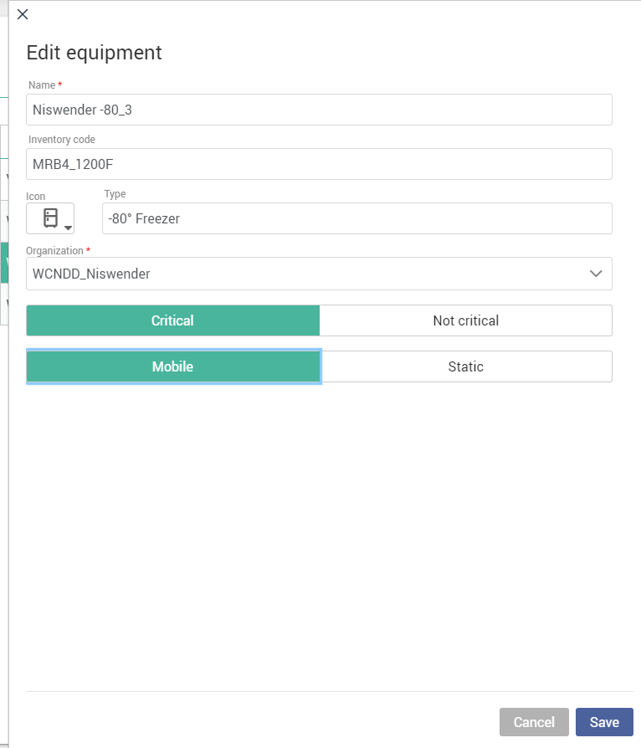
Changing Equipment Type
Be sure to hit Save, and as stated previously, be sure to not forget to change it back after done defrosting!
Otherwise, we may forget entirely and the freezer will no longer send alerts whatsoever.

Slide 20
You should be all good for defrosting.
There are also user guides for:
Adding users
Editing temperature thresholds
Editing alert rules

