Slide 1
Adding Users to Laboratory Organizations and Environmental Rooms
“Click by Click” Guide
VBS FIRM VBS-FIRM@vanderbilt.edu
https://app-us.oceaview.com

Slide 2
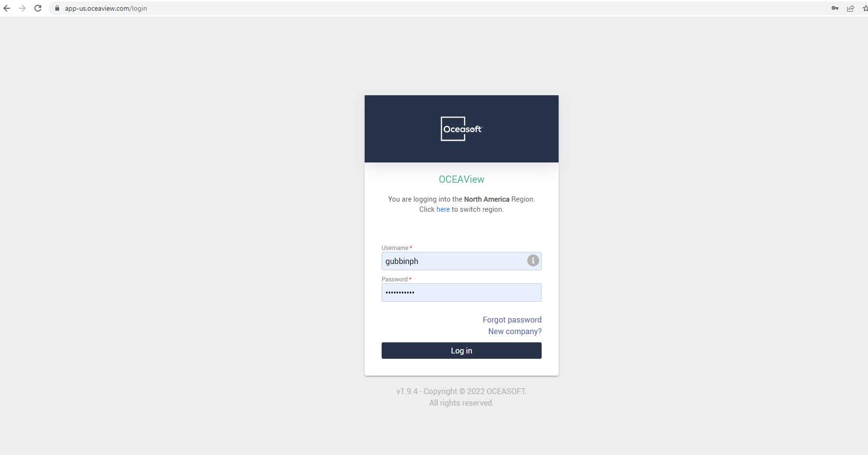
To Add New Users:
Go to this site: https://app-us.oceaview.com
And login using your VUNetID

Slide 3
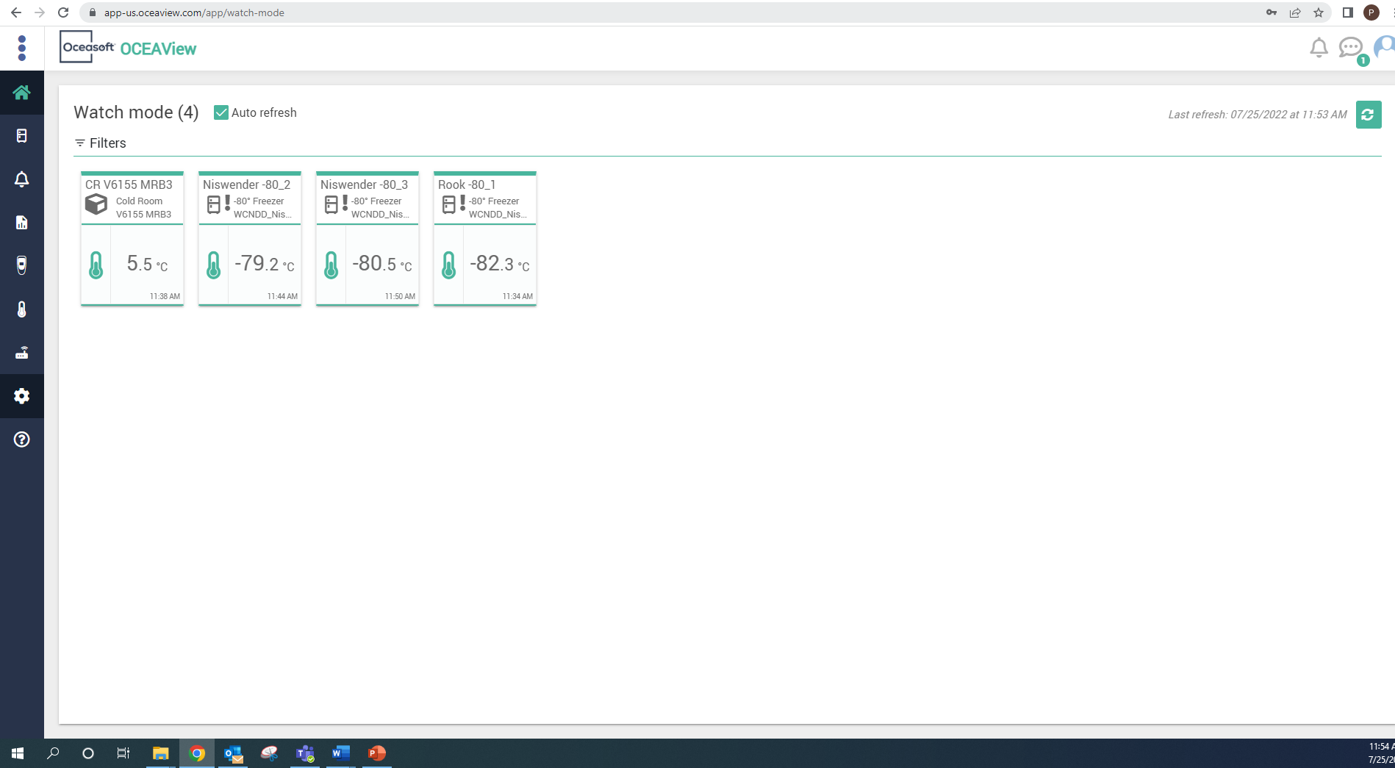
To Add New Users:
Click on the settings Icon, circled in red here.

Slide 4
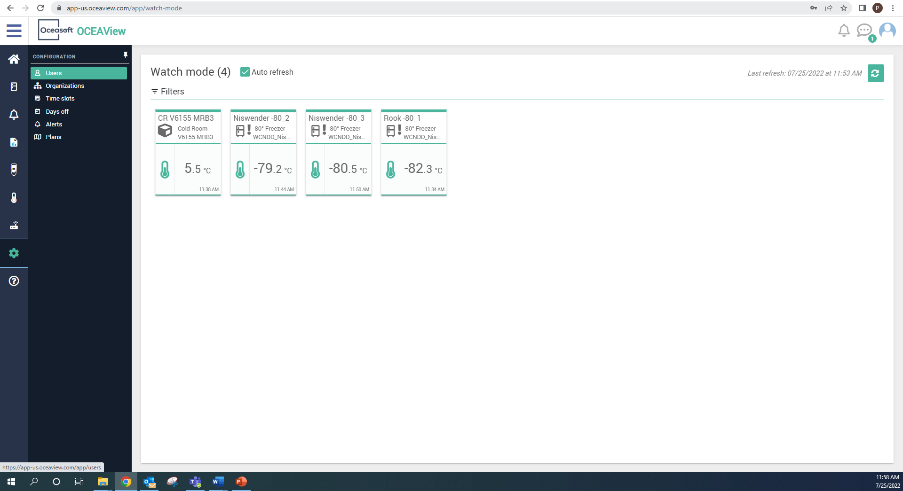
To Add New Users:
Click on “Users”, circled in red here.

Slide 5
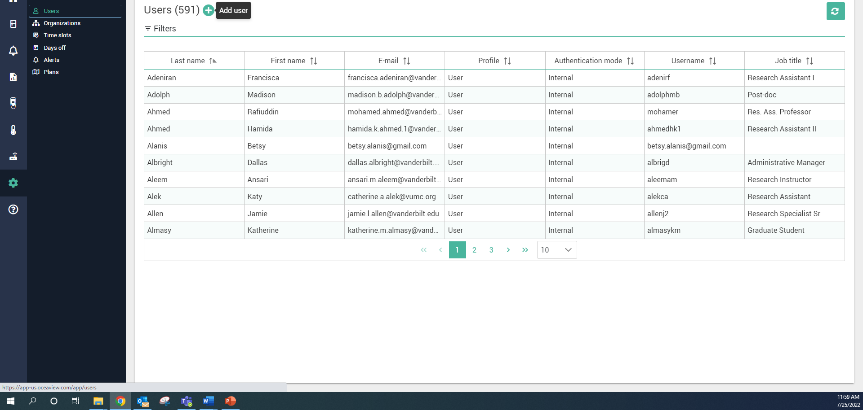
To Add New Users:
Click on the “Add User” button, circled in red here.

Slide 6
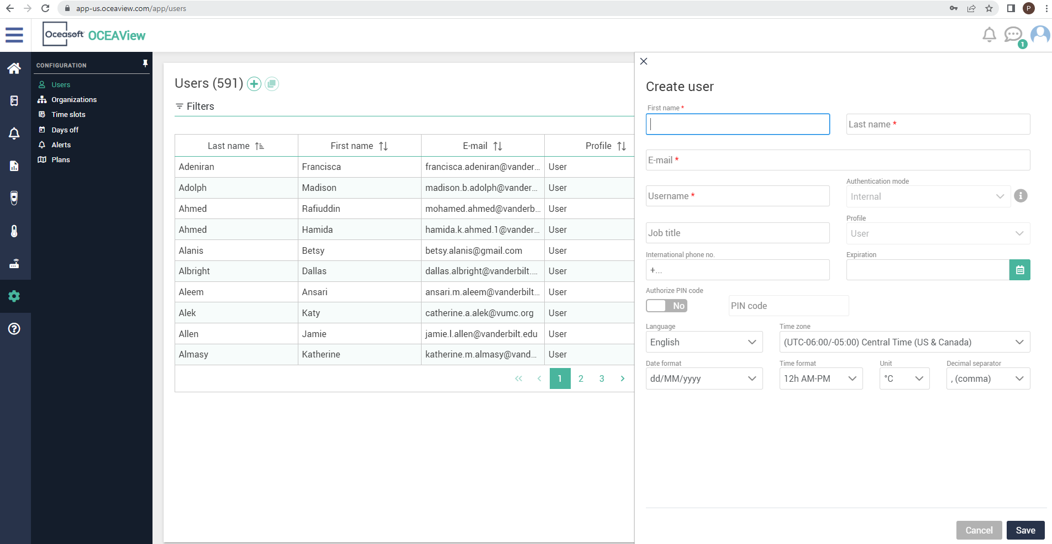
To Add New Users:
A tab should appear from the right to Create user, fill in relevant info:
Full name
VUNetID for Username
Email/phone #
Job title?
Be sure to Save!

Slide 7
To Add New Users:
Click on “Filters”

Slide 8
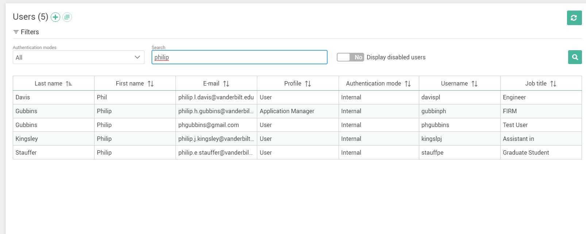
To Add New Users:
Click on the Search bar and type in name, then click enter or the search icon.

Slide 9
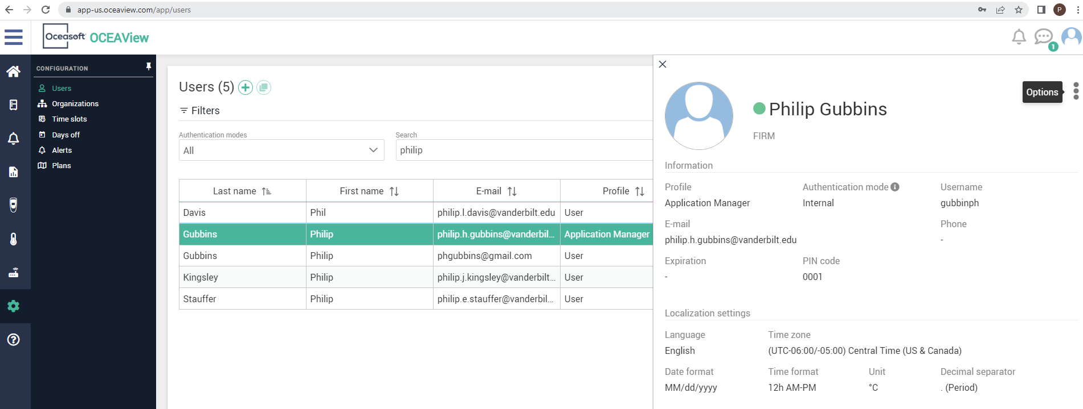
To Add New Users:
Click on the line containing the person

Slide 10
To Add New Users:
Click on the options button on the far right, circled in red.

Slide 11
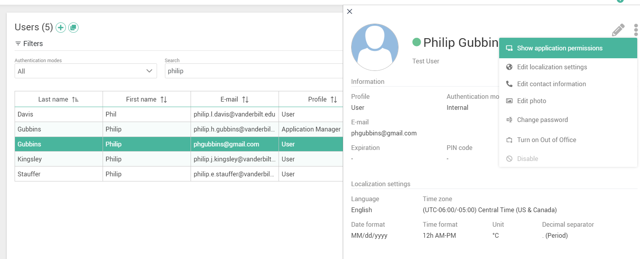
To Add New Users:
Click on the Show application permissions button

Slide 12
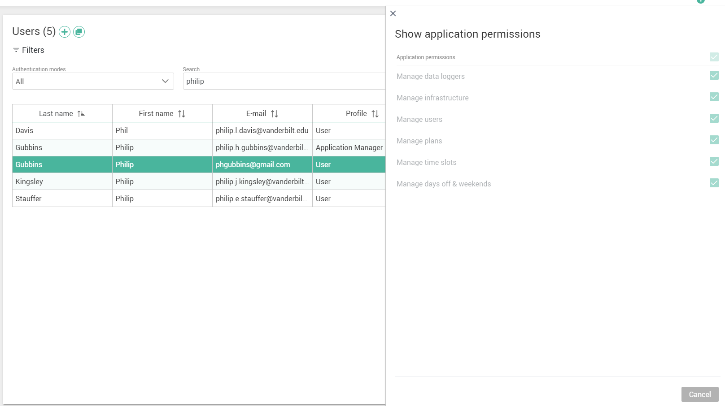
To Add New Users:
Make sure these permissions are checked off. Save.

Slide 13
To Add New Users:
Be sure the new User accepts the terms and conditions from the OCEAView activation email and creates a password to complete User account setup.
If they do not complete account setup they cannot receive alerts/access the system in any manner.

Slide 14
To Add New User to Alerts:
Once a user is added properly, let’s go back to settings

Slide 15
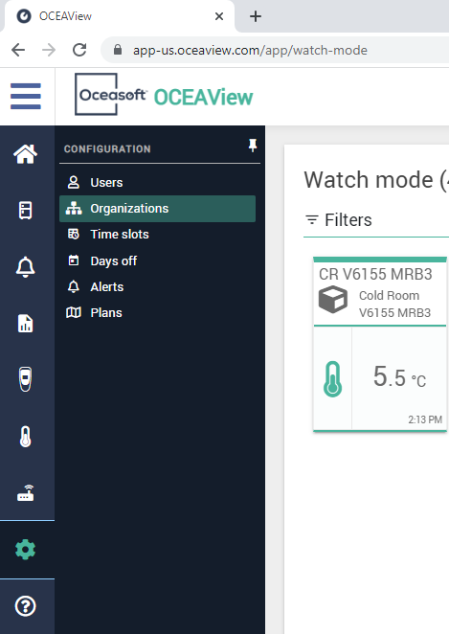
To Add New User to Alerts:
Click on “Organizations”.

Slide 16
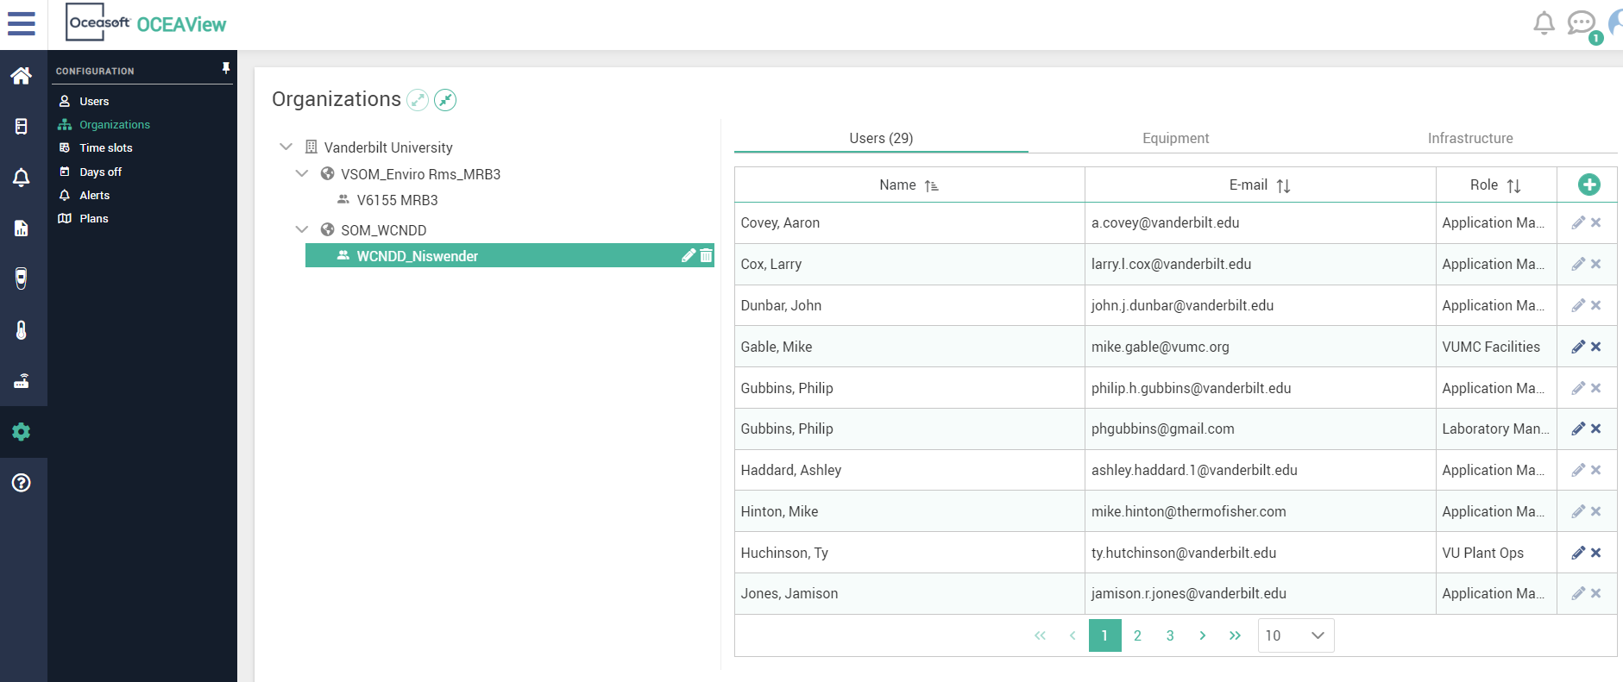
To Add New User to Alerts:
Click on the organization (for example, WCNDD_Niswender here) or environmental room that you want to add them to alerts for.

Slide 17
To Add New User to Alerts:
Click on the add button.

Slide 18
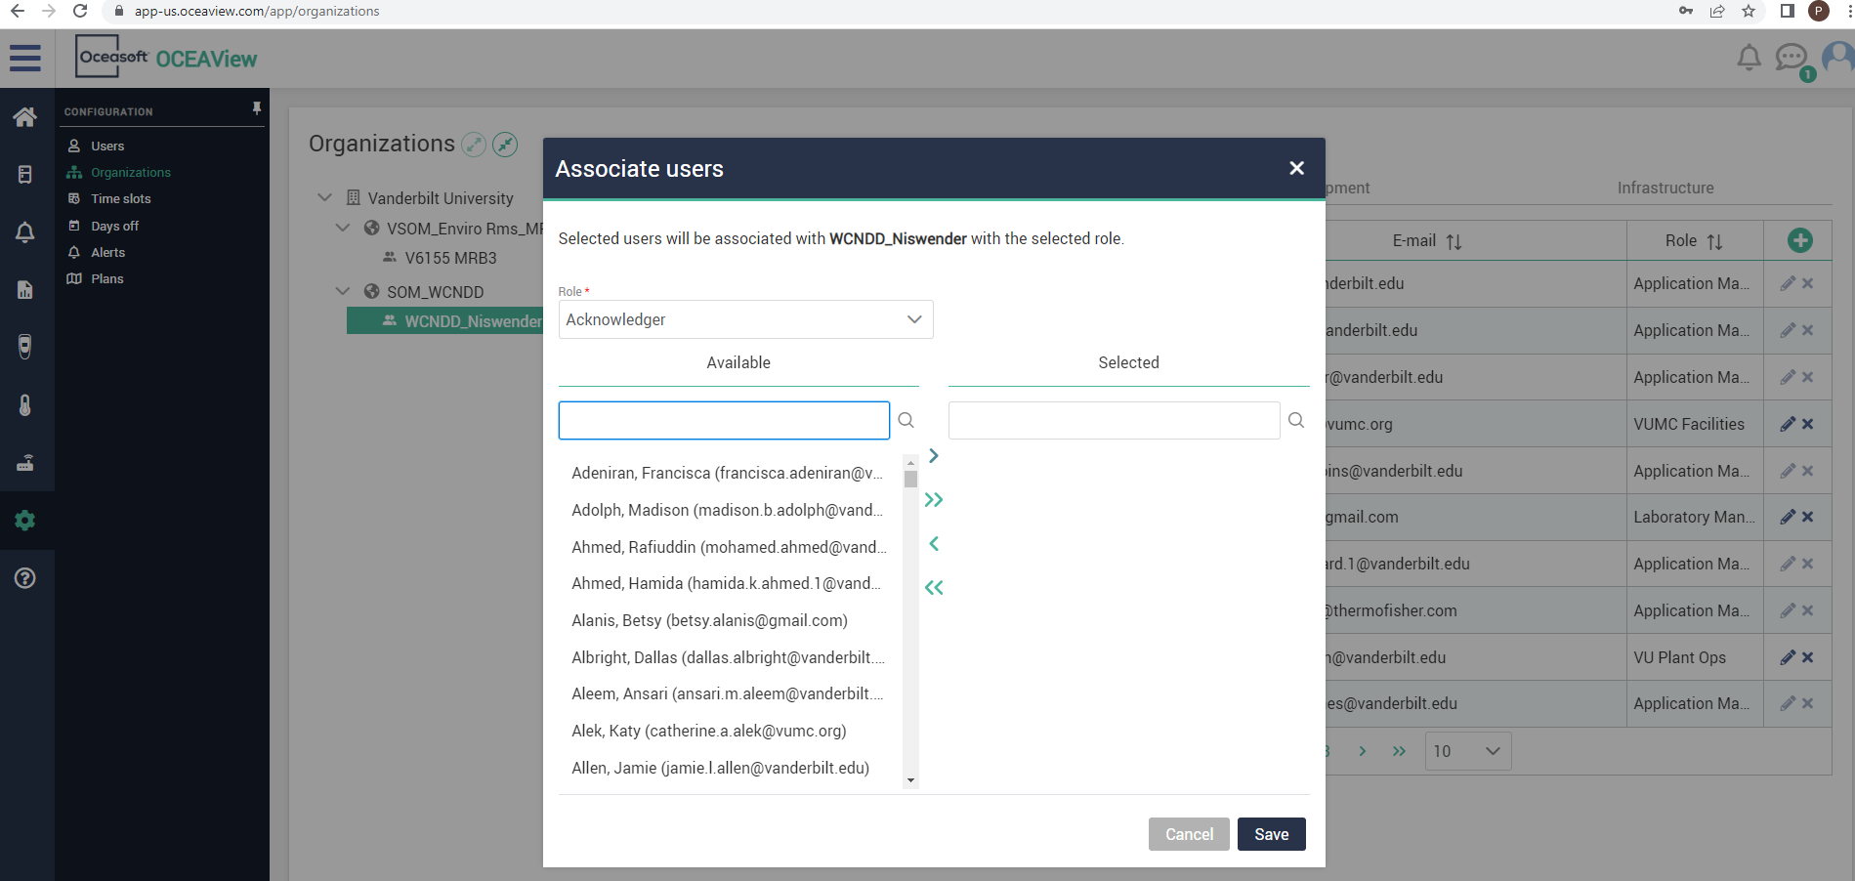
To Add New User to Alerts:
Within the Associate Users tab that pops up, click on the search bar under Available.

Slide 19
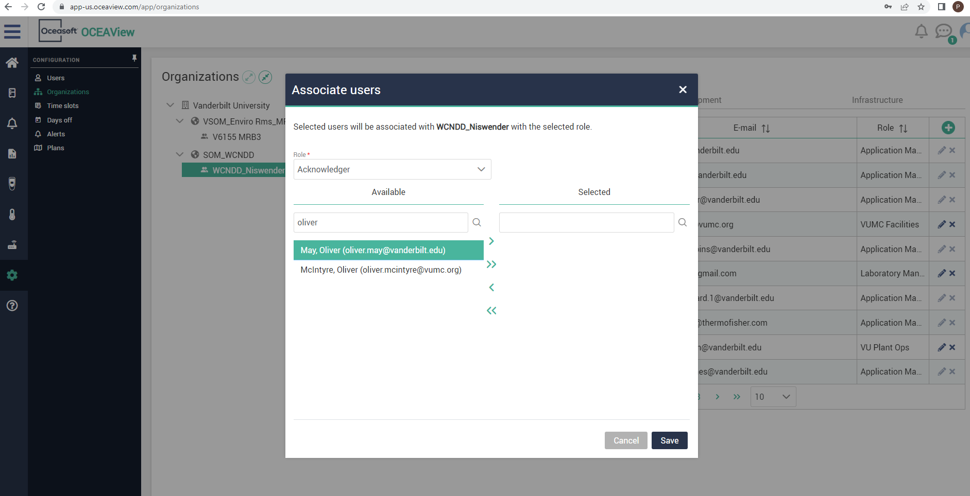
To Add New User to Alerts:
Once you have searched and found the user, click on their name.

Slide 20
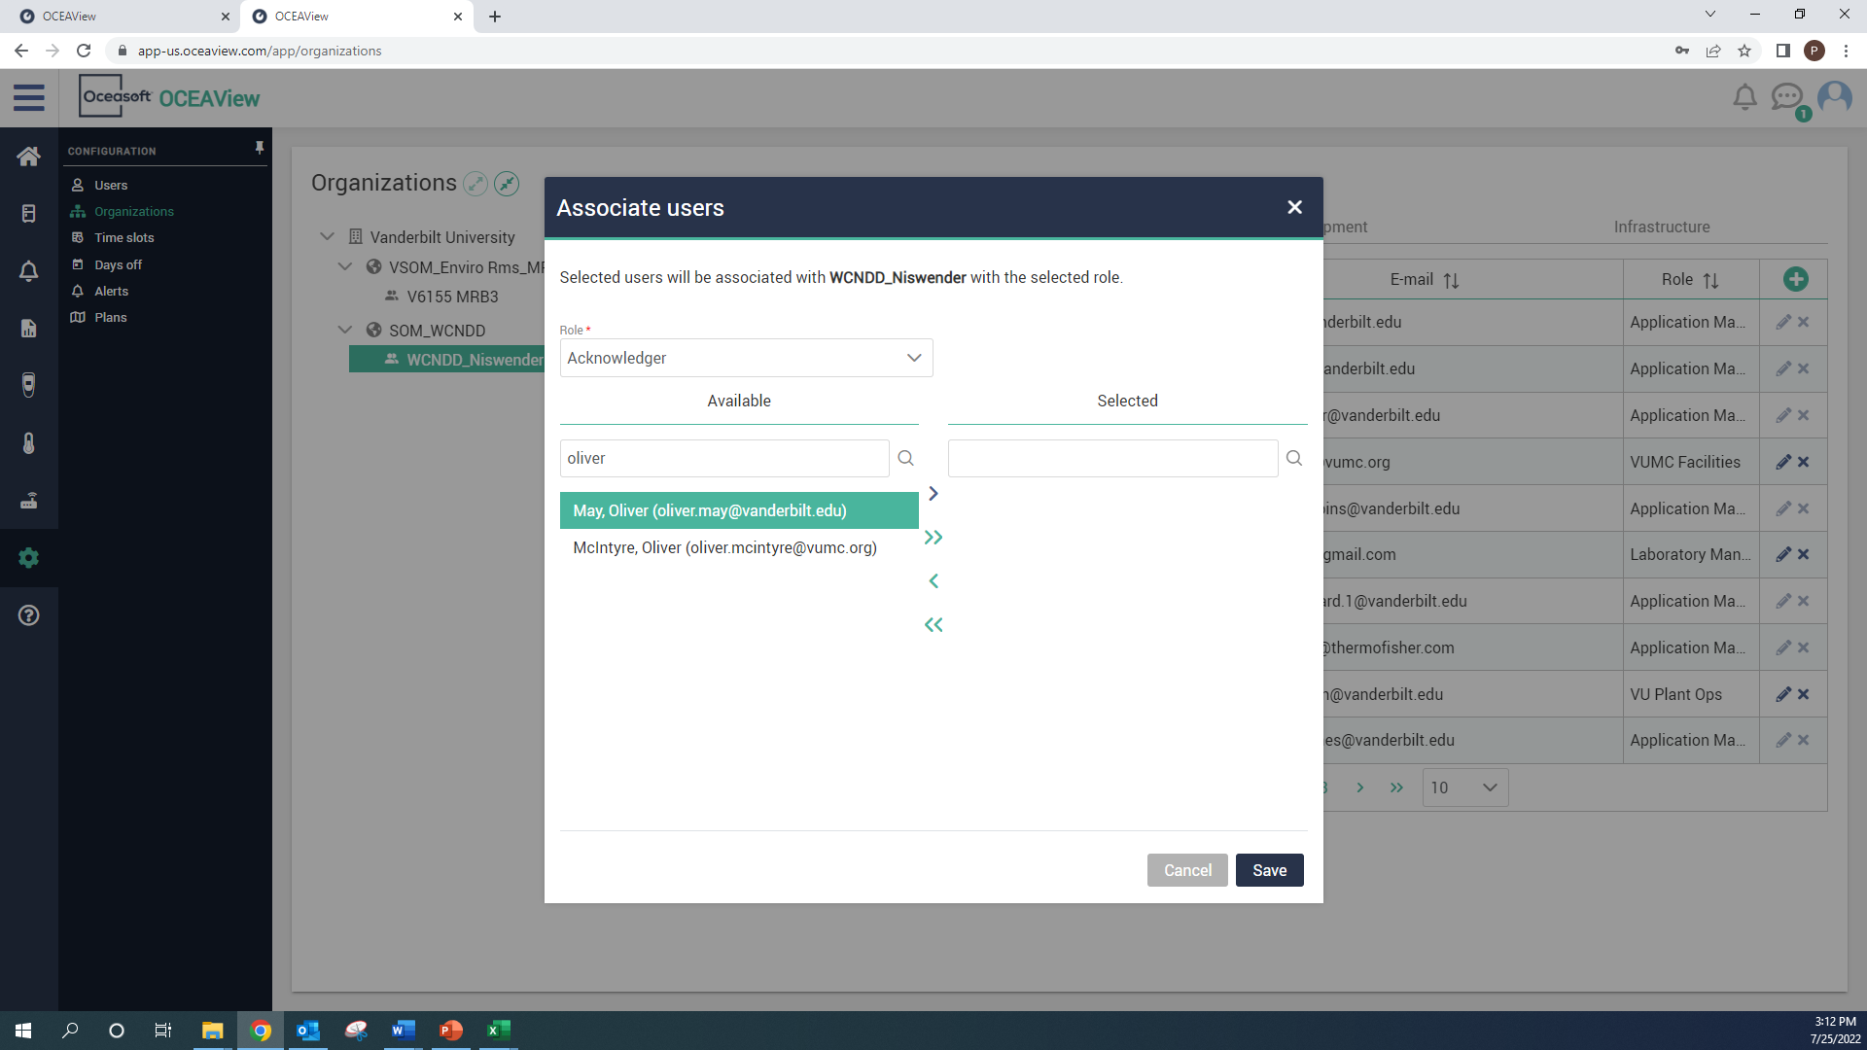
To Add New User to Alerts:
Click on the single arrow, encircled in red below.

Slide 21
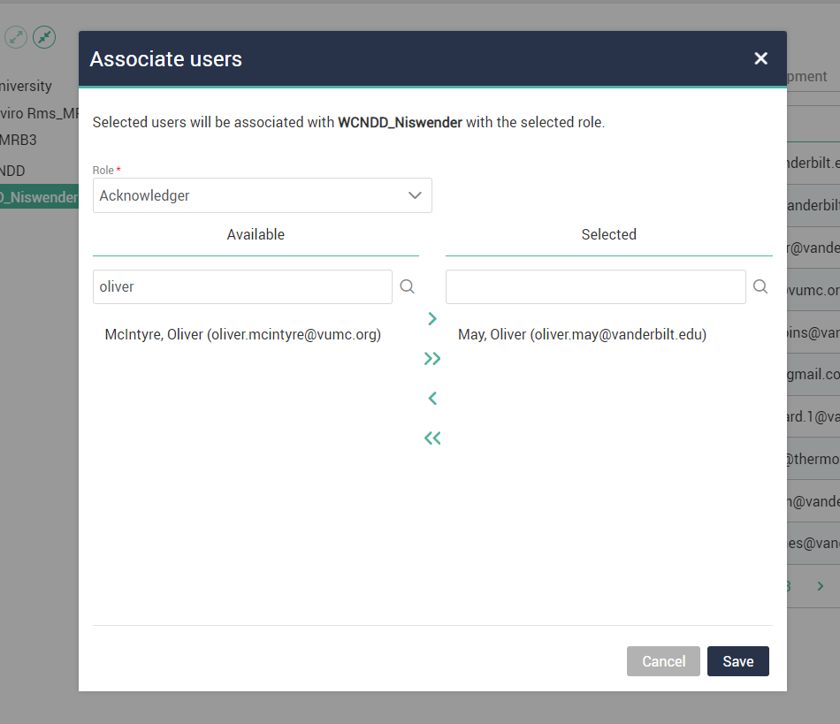
Note: To Add New User to Alerts:
Note, in most cases you will keep the user role to Acknowledger, but you can also add someone as a lab manager if you want them to be able to add/remove users, and you can add them as a viewer if you do not want them to be able to acknowledge alarms, only receive alerts.

Slide 22
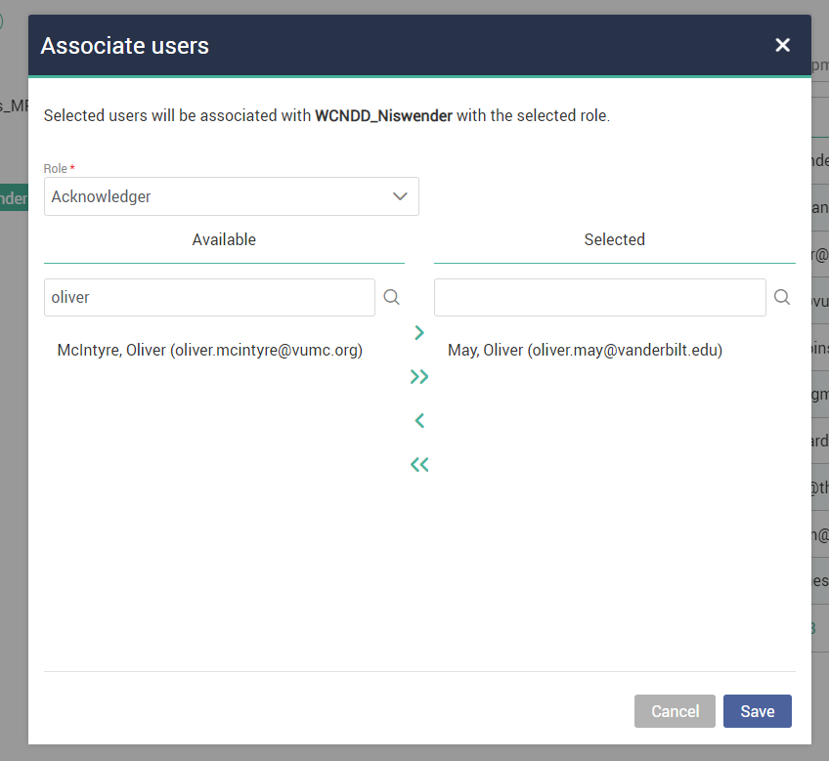
To Add New User to Alerts:
Once your user is under the Selected column, you must click save.

Slide 23
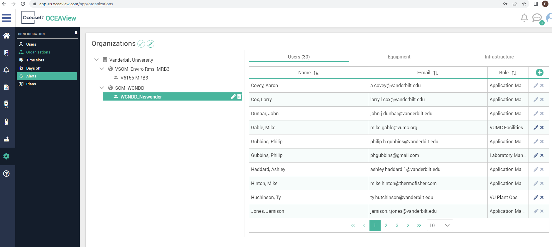
To Add New User to Alerts:
Now we will click on the “Alerts” tab

Slide 24
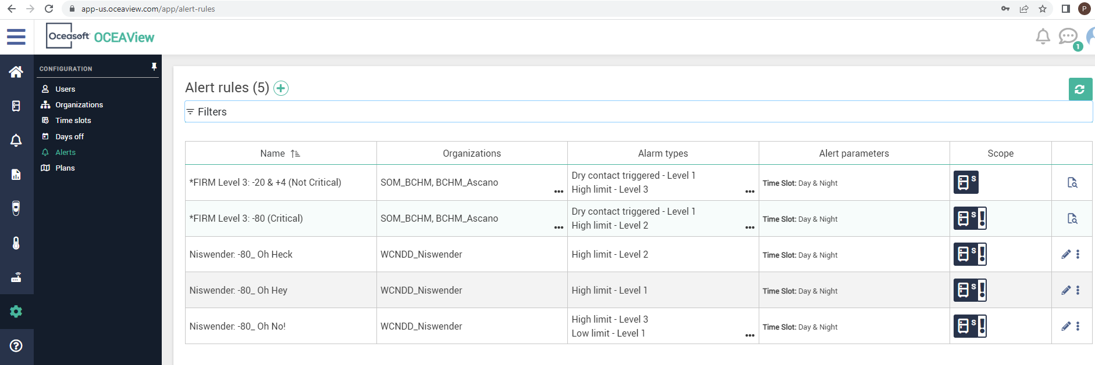
To Add New User to Alerts:
Click on the relevant alert rule, in this case I want to add the user to all -80 alerts, so I will have to click on all 3 alert levels eventually (in this case, -70 (Oh Hey), -65 (Oh Heck), -60 (Oh No!)). Let’s start with the highest High Limit, “Oh No!”

Slide 25
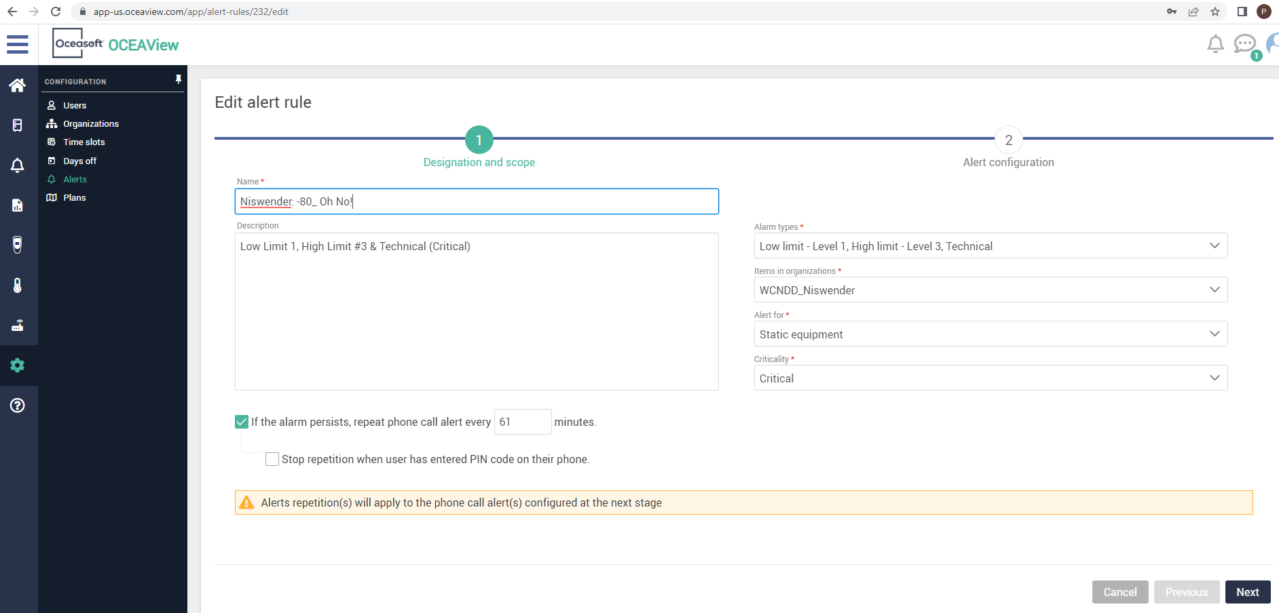
To Add New User to Alerts:
The Edit alert rule screen should appear when you click on any of the alerts. To add new users, just click “Next”.

Slide 26
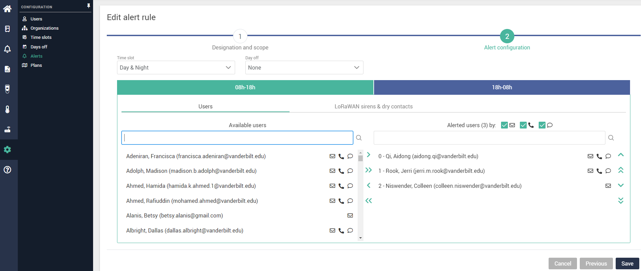
To Add New User to Alerts:
Now click on the search bar below Available users.

Slide 27
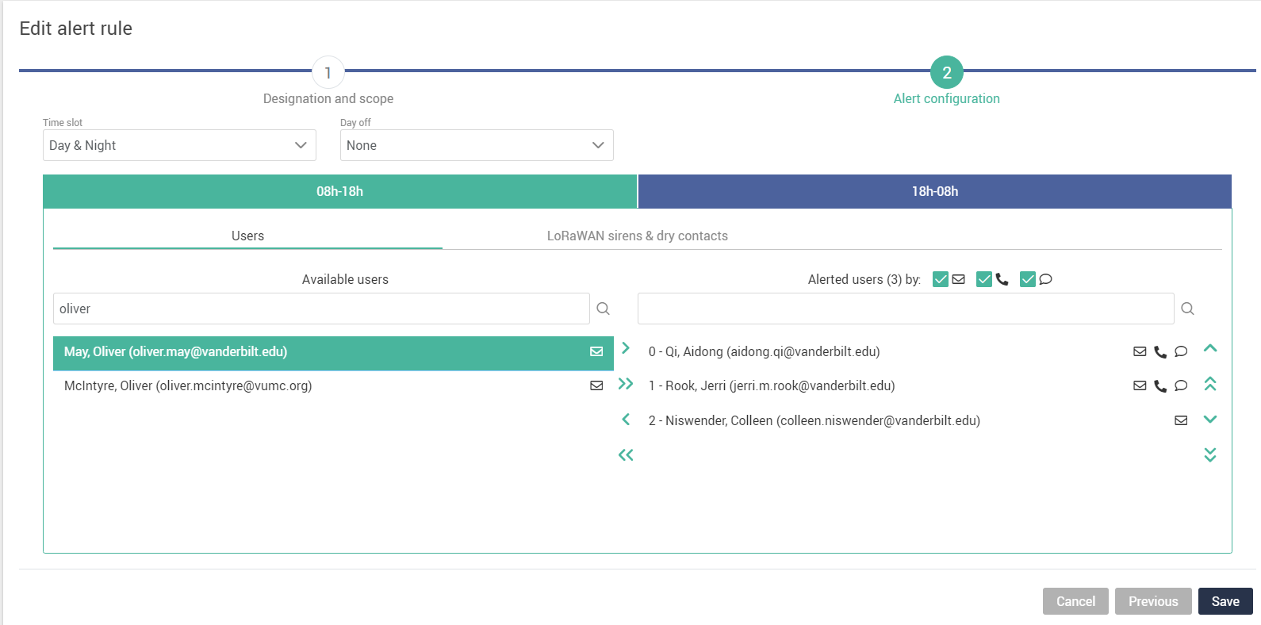
To Add New User to Alerts:
Once you have searched your user, click on the user.

Slide 28
To Add New User to Alerts:
Now click on the single arrow to add them to the daytime alert rule.

Slide 29
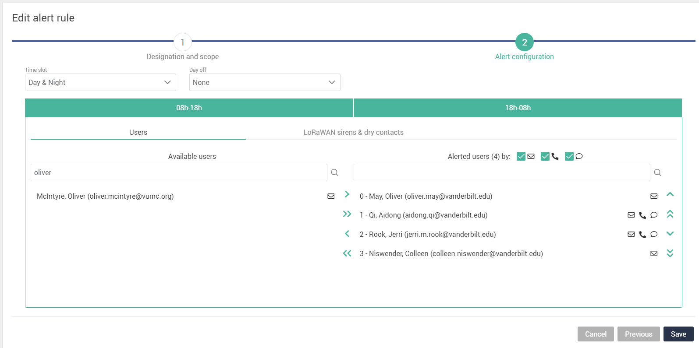
To Add New User to Alerts:
Now click on 18h-08h tab to add them to the Nighttime alert rule, as well.

Slide 30
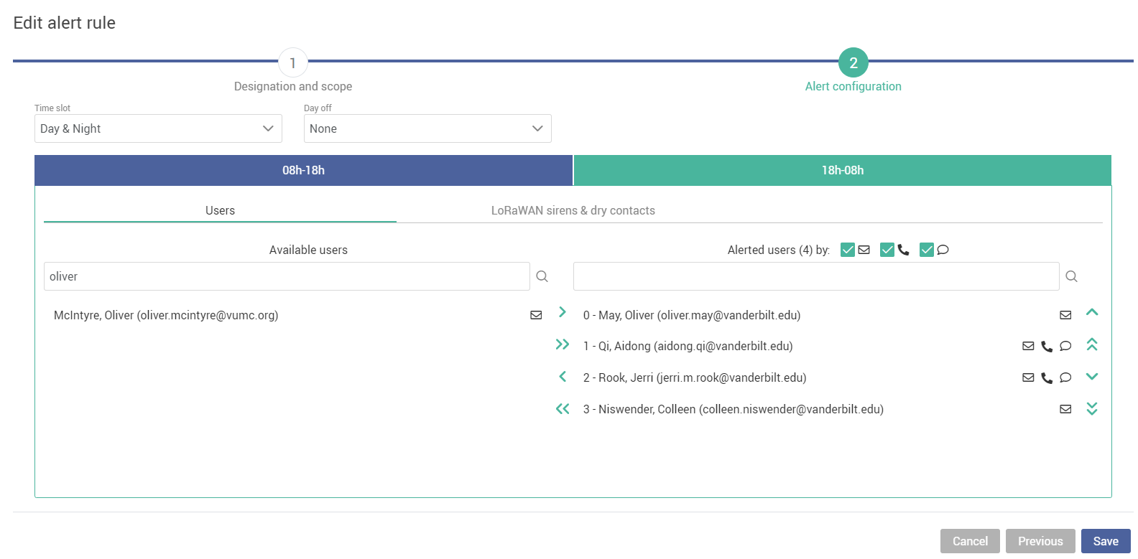
To Add New User to Alerts:
Be sure to click Save.

Slide 31
Note: To Add New User to Alerts:
Note: Now the new user is added to one parameter, the example was a -80 “Oh No!” alert rule, which means they will in this case be alerted if the -80 goes above -60. Let’s add them to the -65 and -70 alerts now.

Slide 32
To Add New User to Alerts:
Now let’s add the new user to the “Oh Hey” alert rule using the same steps that we just went through. Click on the Oh Hey line. Don’t forget the nighttime rule!

Slide 33
To Add New User to Alerts:
Now just add the user to the “Oh Heck” rule as well, click on that alert rule. Don’t forget the nighttime rule.

Slide 34
You should be all good for adding users!
There are also user guides for:
Removing users
Editing alert rules
Editing temperature thresholds

