Slide 1

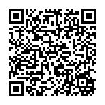
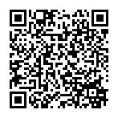
2025 VSSA Orientation
Light Hall June 2, 2025
Pre-Arrival Survey: For Independent Trainees
Orientation Check-In

Slide 2

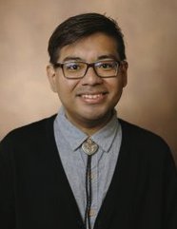
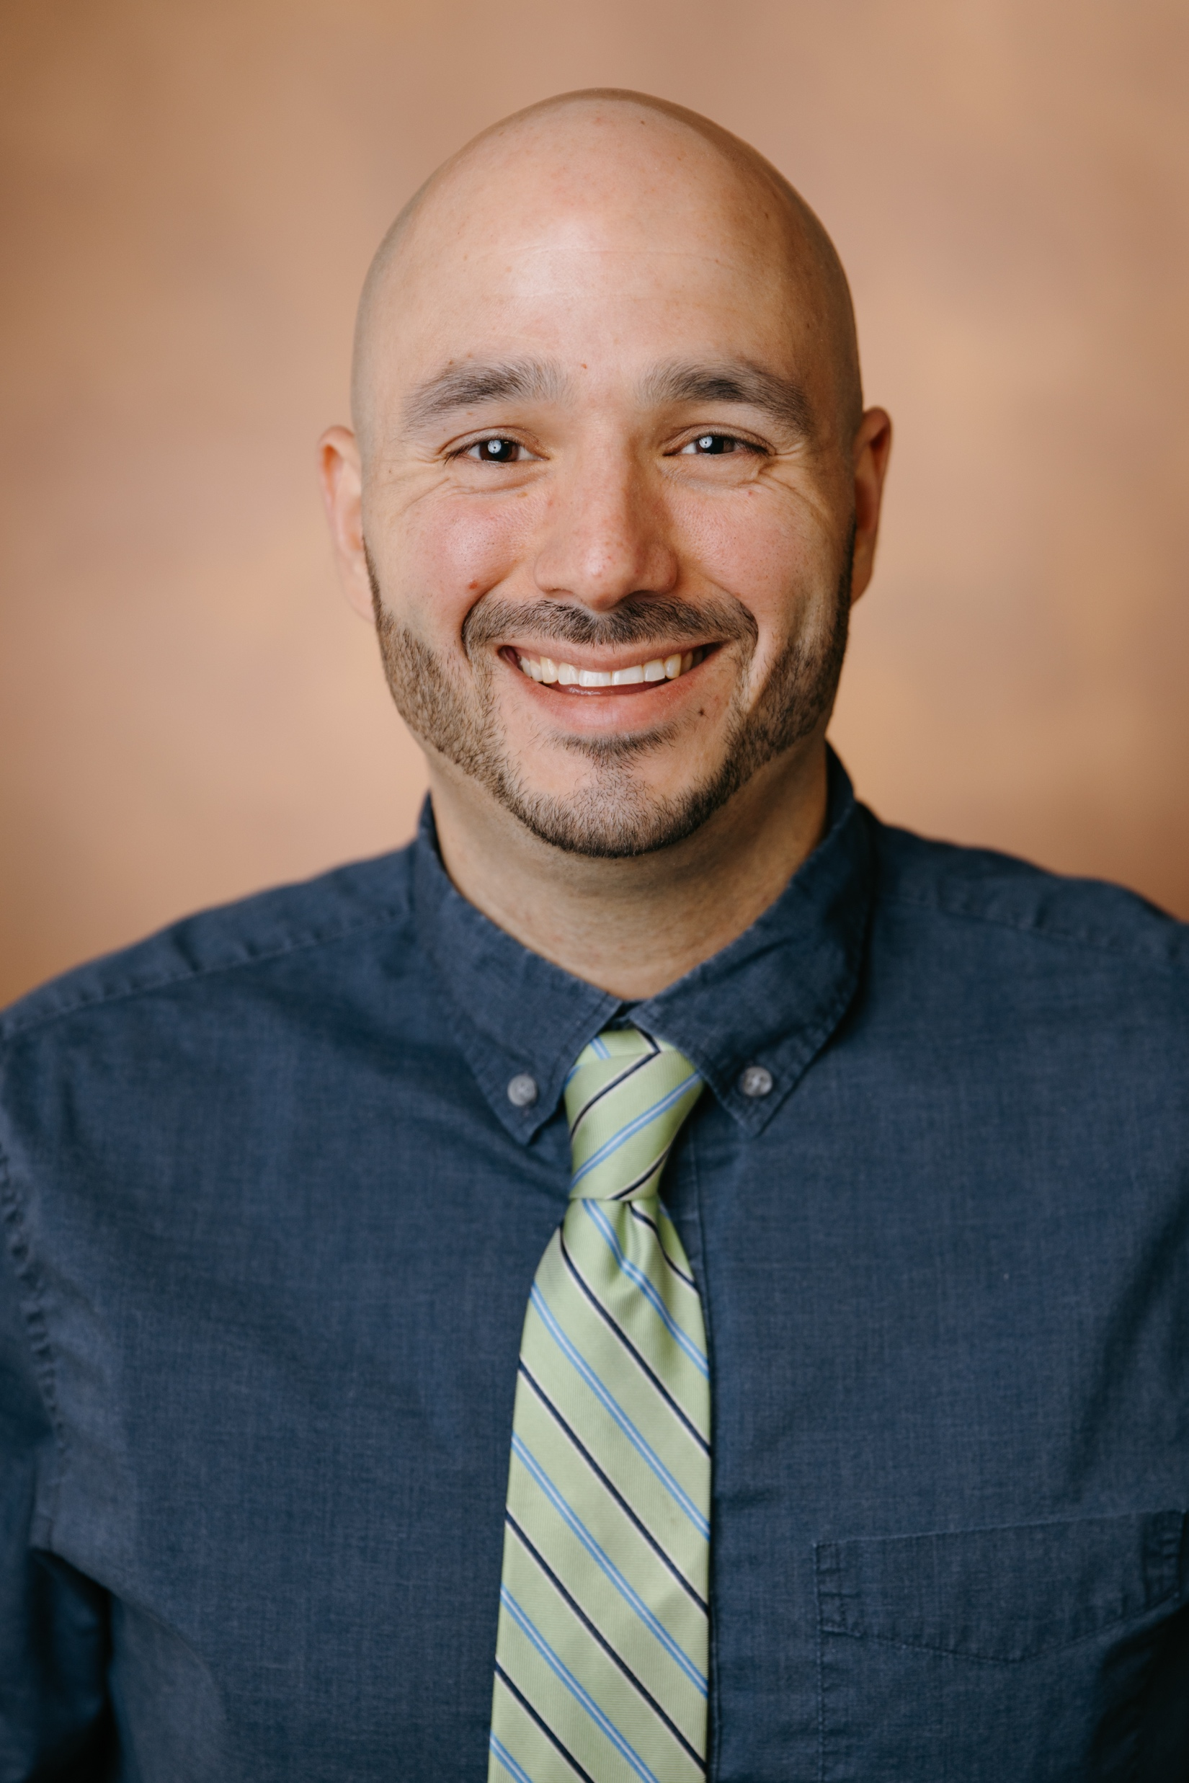
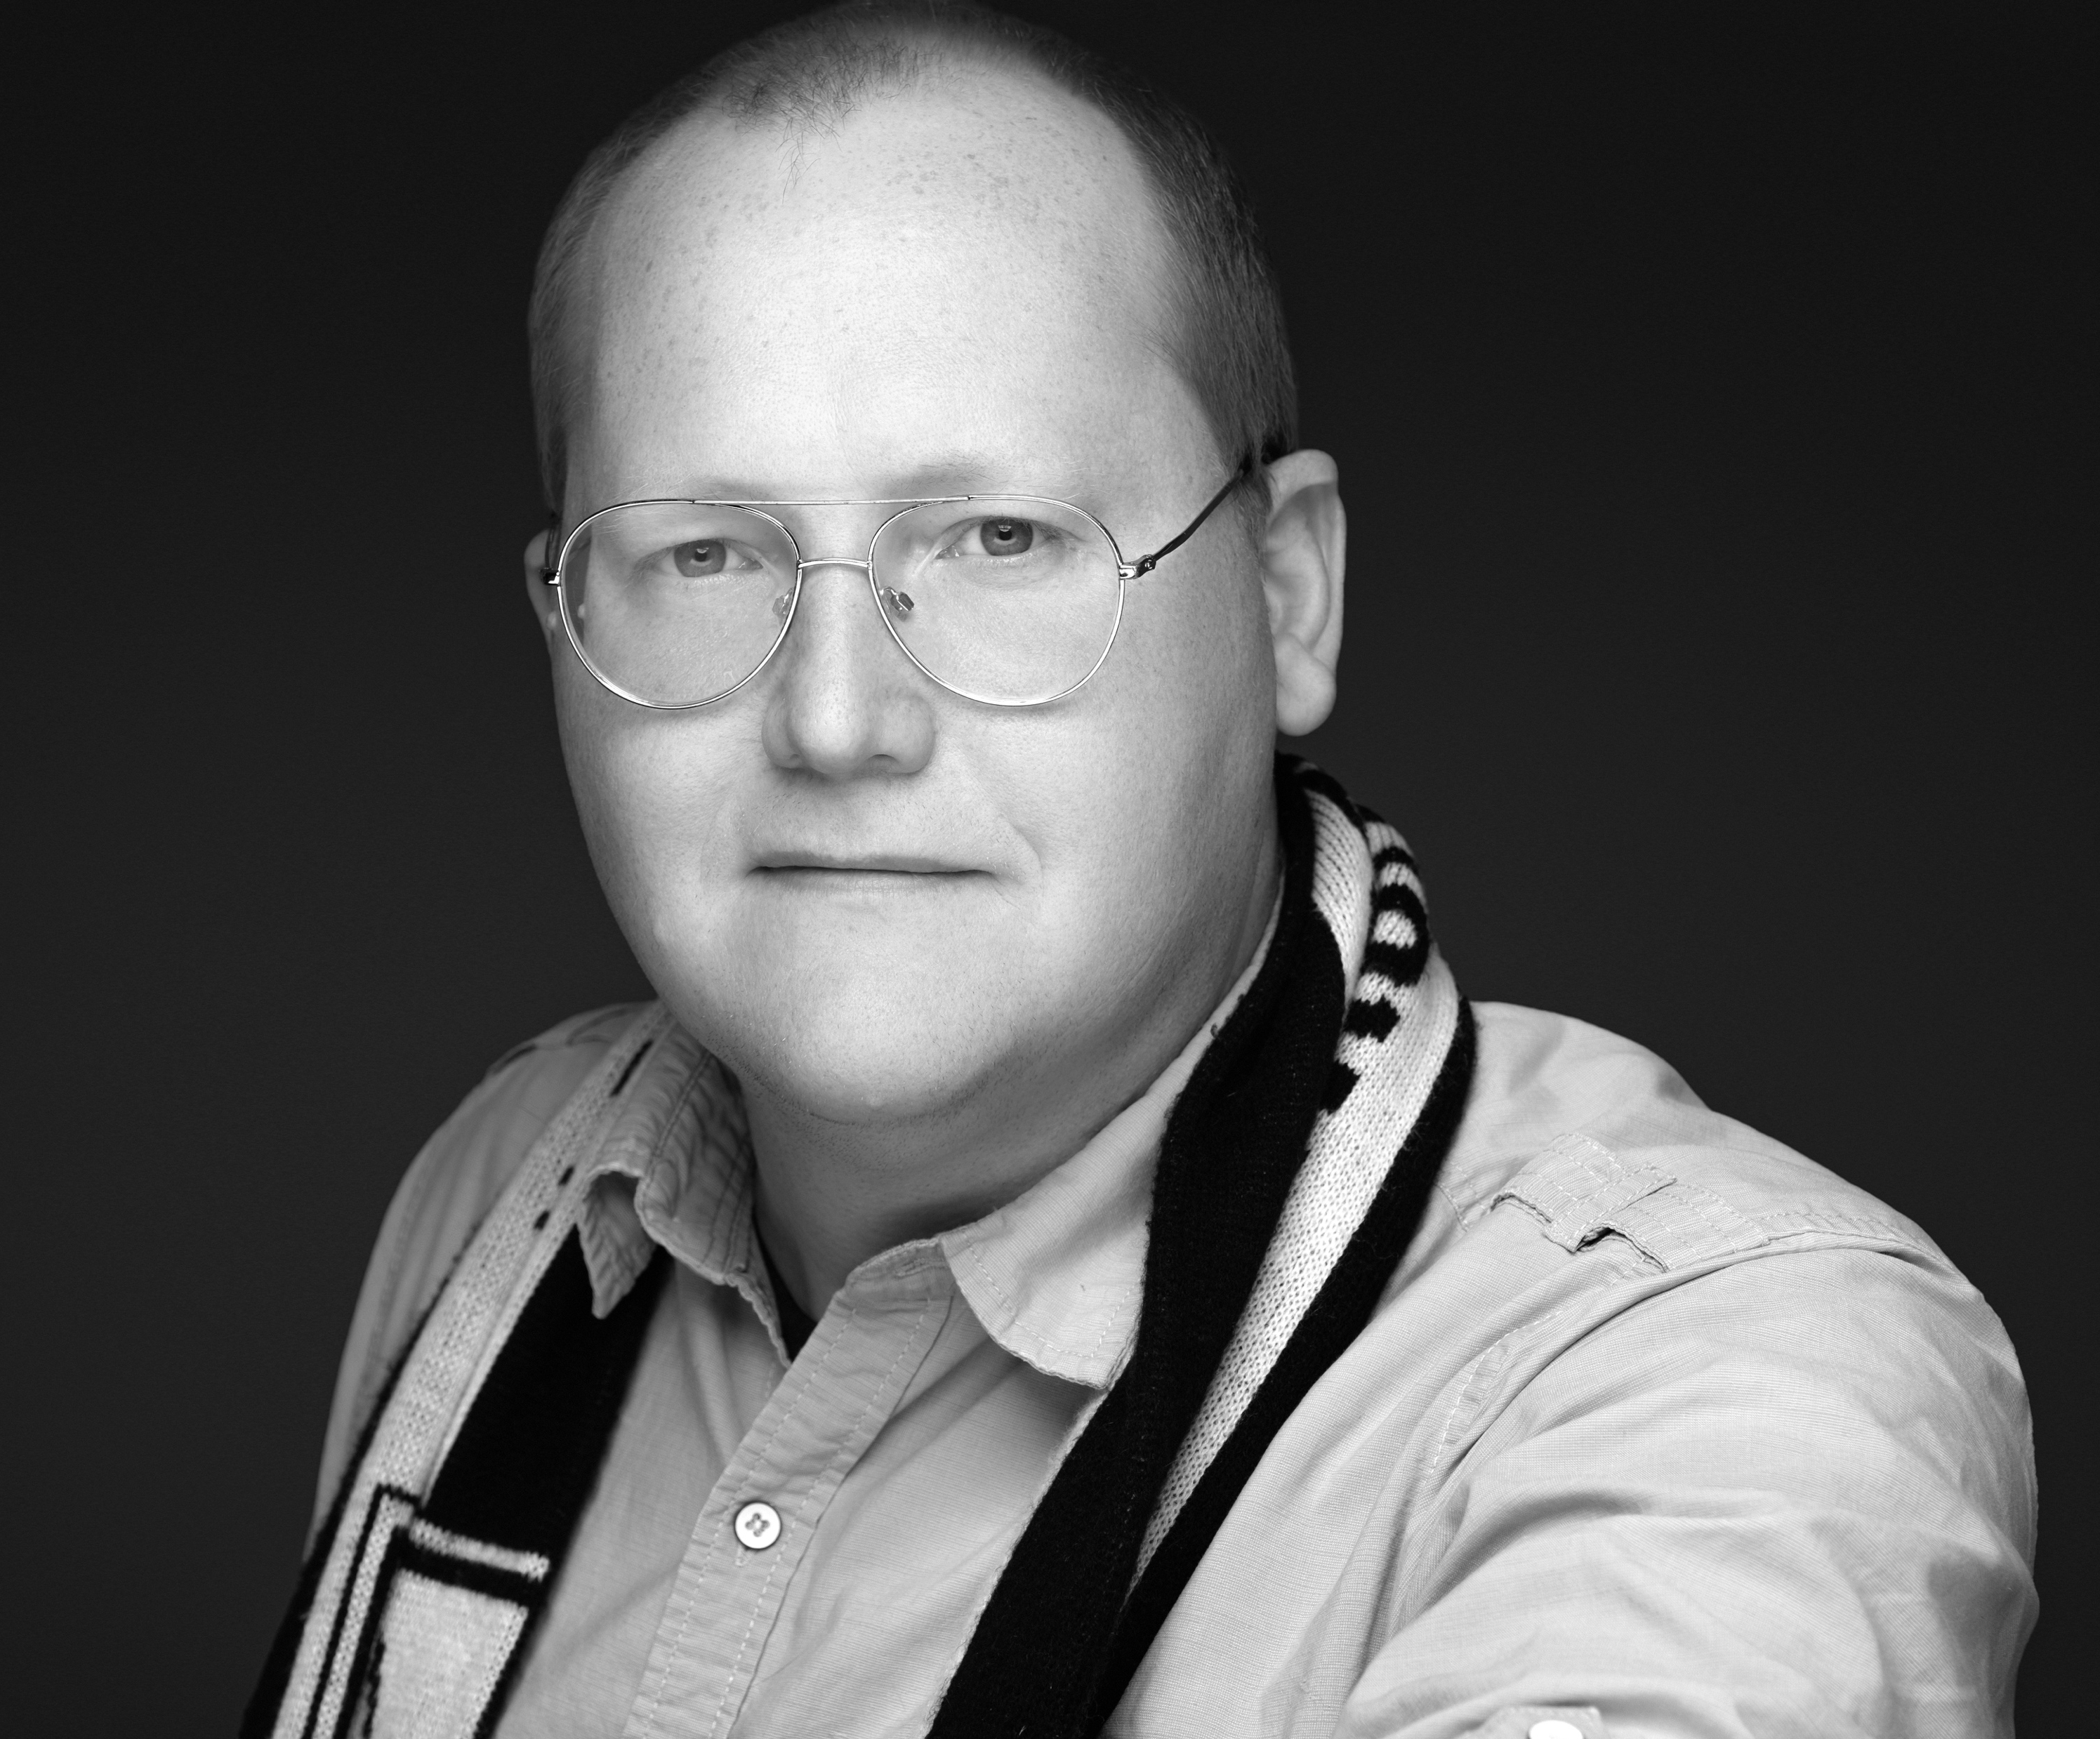
Your VSSA Team
Stephanie Richards, Ph.D.
Director
Davie Morales-Miranda, Ed.D.
Program Manager
RC Stabile, Ed.D.
Director of Student
Well-being
Aaron Howard
Program Coordinator

Slide 3
Social Activities & Sign Up
RC Stabile, Ed.D.
Director of Student Well-being

Slide 4

What is the VSSA?
AHA-SURE
ASPIRNAUT
BP-ENDURE
Beckman Scholars
CHEM-BIO REU
Leadership Alliance
MSTP
UCRIP
VBISP
V-SURE
V-START
V-SMART

Slide 5
Today’s Schedule
9:00 – 9:30 am 9:30 – 9:45 am 15 min break 10:00 am – 11:30 am 10 min break 11:40 am – 12:00 pm | Intro: VSSA team Radiation Safety: John Abraham Responsible Conduct of Research: Dr. Kathy Friedman Mentor/Mentee Relationships

Slide 6
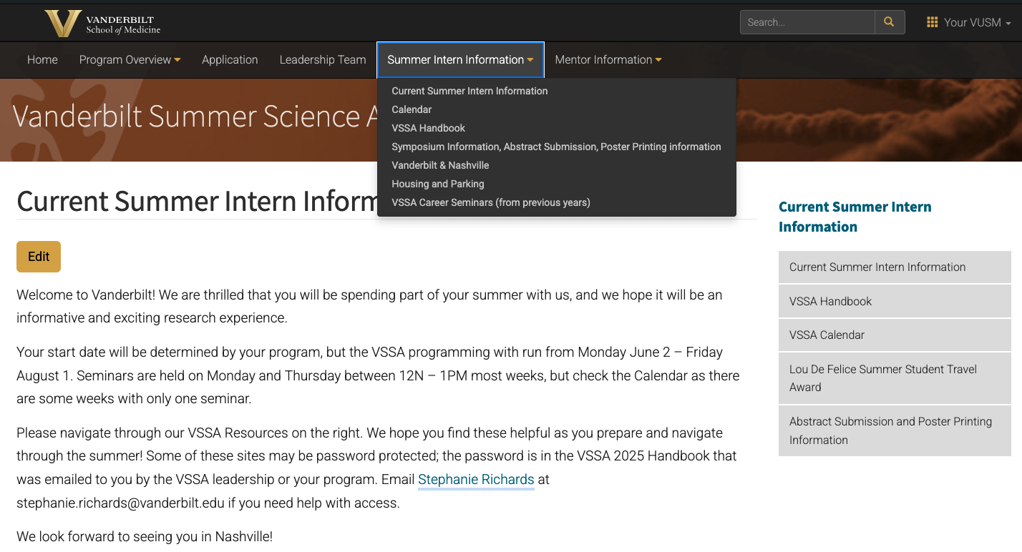
VSSA Handbook
Password: VSSAStudent

Slide 7

VSSA Survey & Evaluation
We strive to make each year a productive and fun experience
Initial program survey,
Survey at the end of the program
Follow-up survey, in 1 year

Slide 8
Registration Survey
If you have not yet filled this out, you will be getting a reminder email.
This is needed for us to send end-of-summer survey and to survey you a year from now.
It also has information about dietary restrictions.

Slide 9
Mail and Packages
From Amazon:
To place an order for delivery to an Amazon Hub:
Place an eligible item in your shopping cart and select Proceed to Checkout.
When choosing a delivery address, select Or pick up from an Amazon Locker.
Search by zip code, address, or landmark. For Vanderbilt University, enter zip code 37203.
Select Ship to this address beside your chosen location.
Complete your order.
There are two Amazon Hub Lockers located on campus. These are:
  Acquaio - Rand Hall - 2301 Vanderbilt Place, Nashville, TN 37235
  Umi - The Commons Center - 230 Appleton Place, Nashville, TN 37203
A smartphone with the Amazon Shopping app is required for pickup.

Slide 10
Mail and Packages
Other packages:
Davie Morales-Miranda
  c/o Your Name
  (You must list your name, or
  we don’t know who to give the package to)
465 21st Ave S, Ste U3218 MRB III
Nashville TN 37240

Slide 11
Student ID Card
The Commodore Card is the student ID card.
Students can use this one card to access debit spending accounts and campus buildings including residence halls, libraries, academic buildings, and the Vanderbilt Recreation and Wellness Center.
You can get your Commodore Card at the Commodore Card Office, 184 Sarratt Student Center, Monday through Friday, 8:30 a.m. to 4:00 p.m.

Slide 12
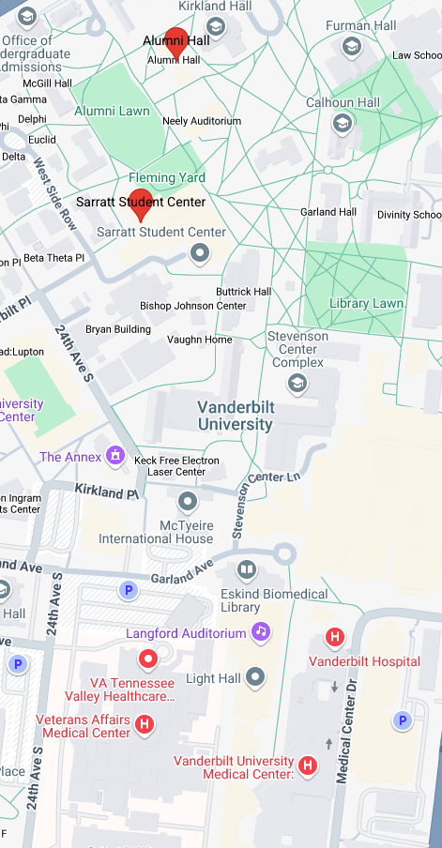
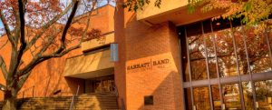
Sarratt/Rand Student Life Center
Commodore Card Office
A la carte dining options
Amazon pick up center
Mail room

Slide 13
Online Training
https://www.vanderbilt.edu/ehs/training/
You may be required to do additional online training:
Biosafety 101: Standard Microbiological Practices
Working Safely with Human-Derived Materials
Biosafety 201: BSL-2 Principles
Chemical and Physical Safety for Research Labs
VU Laser Safety Video Training
Animal Handling: only if you are working with animals, ask your mentor. Information can be found in the VSSA Handbook

Slide 14

Safety on Campus
Vanderbilt University Police Department
http://police.vanderbilt.edu/
Emergency: 911 or (615) 421-1911 Non-emergency: 2-2745 or (615) 322- 2745
We encourage you to download the VandySafe App from the Apple and Google Play stores
Contact VUPD via phone call or real-time chat
Trigger a mobile Bluelight that shares your location instantly
with VUPD
Initiate a "Virtual Walkhome" where VUPD can monitor your
walk home, to the car, or the office*
Submit iReports and crime tips
View information about VandyRide (previously Vandy Vans)
Access support resources, such as Facilities, EAP and
Project Safe
View emergency guides
Much more!

Slide 15
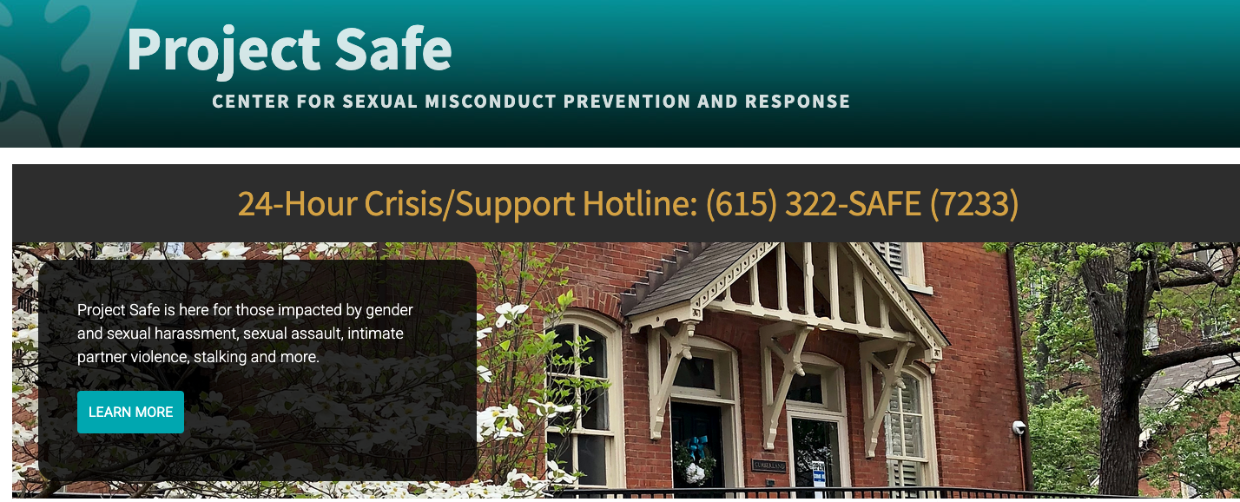
Safety on Campus
The mission of the Project Safe Center is to provide information, support, referrals, and education about sexual and intimate partner violence (including sexual assault, dating violence, domestic violence, and stalking) and gender and sexual harassment, as well as consent, healthy relationships, and healthy sexuality to the Vanderbilt University community.
Email: projectsafe@vanderbilt.edu
Office Phone: (615) 875-0660
24-Hour Crisis Hotline: (615) 322-SAFE (7233)

Slide 16
Summer Schedule
https://medschool.vanderbilt.edu/vssa/calendar
  Password: VSSAStudent
Schedule – online and in the weekly newsletter
Mondays @ 12 noon - 1pm
  Pizza/salad lunch. Bring your own water bottle!
Thursdays @ 12 noon– 1 pm
  No lunch provided, so plan to brown bag it.
The room number will vary, so be sure to check it each week!!

Slide 17
VSSA Calendar
Password: VSSAStudent

Slide 18
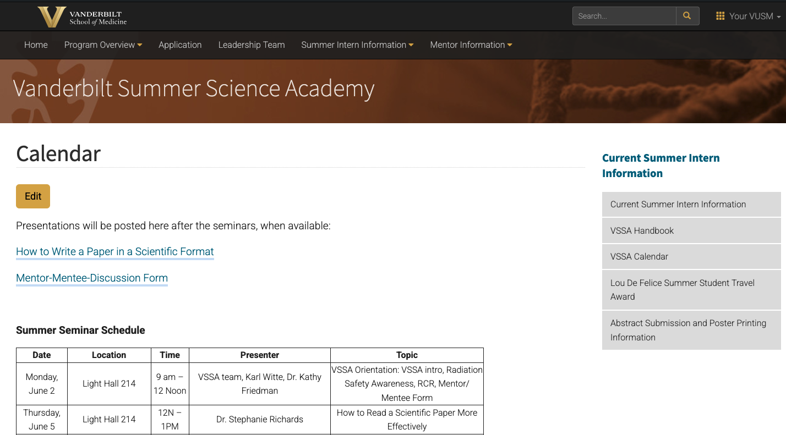
VSSA Calendar
Password: VSSAStudent

Slide 19
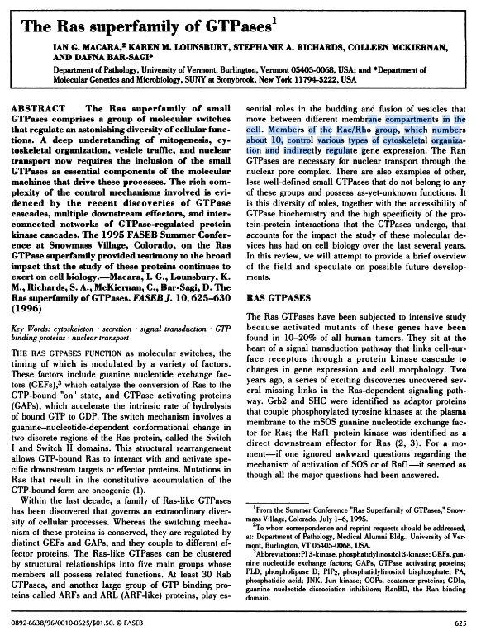

Coming Up!
Thursday June 5
Monday June 9
How to Read A Scientific Paper More Effectively
12N – 1PM
Light Hall 214
Speaker:
Dr. Stephanie Richards
Managing Your Time
12N – 1PM
Light Hall 214
Speaker:
Dr. RC Stabile

Slide 20
Vanderbilt Programs
Graduate programs
  Ph.D.
    IGP: https://medschool.vanderbilt.edu/igp/
    QCB: https://medschool.vanderbilt.edu/qcb/
    Chemistry: http://www.vanderbilt.edu/chemistry/graduate.php
  Ph.D. & Masters
    Biomedical Engineering: http://engineering.vanderbilt.edu/bme/GraduateProgram/
    Computer Science: http://engineering.vanderbilt.edu/eecs/Graduate/Programs.php
MSTP (M.D.- Ph.D.)
  https://medschool.vanderbilt.edu/mstp/
M.D.
  https://medschool.vanderbilt.edu/md-admissions/

Slide 21
Post-Grad Programs Information
For those interested in PhD programs:
Make an appointment to speak with Steph, come to the table on June 6!
For those interested in MD/PhD programs:
Attend Monday June 23, LH 214 @ 12N-1pm
Meet with Dr. Megan Williams and current MD/PhD students, July 16 @ 5:30 pm in Eskind Medical Library
For those interested in applying to medical school:
Attend Monday July 7 session, LH 214 @ 12N-1pm
For those interested in hearing about PhD, MD, and MD/PhD student experiences:
Student Panel on Thursday June 12, LH 214 @ 12N-1pm

Slide 22

Tips for a successful summer
In the lab:
Use the mentor/mentee form to clarify expectations
Understand your project
Be communicative
  Ask questions!
  Share your ideas
Be organized
Be a courteous lab mate
Remember that science is a
small world

Slide 23
Tips for a successful summer
Outside the lab:
Be courteous and professional to all
Participate in social events
Explore Nashville ~ free events will be listed in our newsletter
Be responsible and courteous in your apartment
Be safe
Have fun ~
If you have problems or concerns, contact your Program Director
or Steph at stephanie.richards@vanderbilt.edu
or RC Stabile at rc.stabile@vanderbilt.edu

Slide 24
Asking for a Letter of Recommendation
If you are applying this coming fall:
Ask near the end of your internship
Ask if they feel comfortable writing a strong and supportive letter for the programs you are applying to
Follow up this fall with a list of programs, with links and deadlines
Tell them what you learned/appreciated about your summer experience
If you work with a postdoc or student, make sure the letter is sent by and cosigned by the lab PI.

Slide 25
Asking for a Letter of Recommendation
If you are applying in a year or more from now:
Ask near the end of your internship
Ask if they feel comfortable writing a strong and supportive letter for the programs you are applying to in the future.
Next Year:…Follow up this fall with a list of programs, with links and deadlines
Tell them what you learned/appreciated about your summer experience
If you work with a postdoc or student, make sure the letter is sent by and cosigned by the lab PI.

Slide 26
End of Summer Presentations
Some Programs will organize their own presentation event
Some Programs will have their interns participate in the VSSA poster session
Thursday June 31, In Light Hall Lobby
Check with your Program Director or PI
Poster printing resources are in the VSSA Handbook

Slide 27
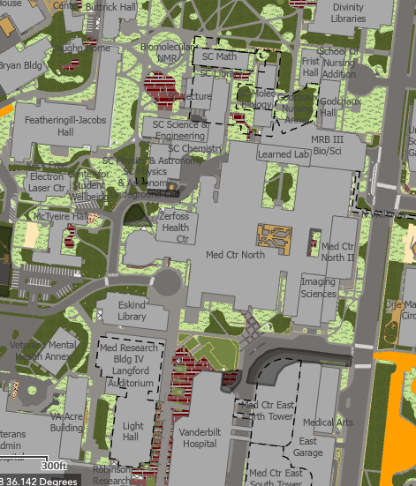
Questions?
Contact:
Steph: Stephanie.Richards@vanderbilt.edu
MRB III U3218 (up the ramp, behind Suzie’s coffeeshop)
Davie: d.miranda@vanderbilt.edu
MRB III U3218 (up the ramp, behind Suzie’s coffeeshop)
RC: rc.stabile@vanderbilt.edu
MRB IV 9405
Aaron: aaron.w.howard@vanderbilt.edu

Slide 28
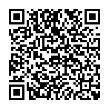
Radiation Safety Training

Slide 29
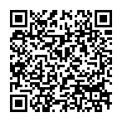
RCR Training

