Slide 1
Step 2 Clinical Skills Exam
How to pass with flying colors

Slide 2
Jeopardy Question
Answer: 3-5 students
Question: How many Vanderbilt students typically fail and have to repeat the CS exam each year

Slide 3
Overview of Exam
Twelve cases
10 are scored
Adults only
Pediatric cases will be parents
15 minutes per clinical encounter
10 minutes per progress note
Notes:
8 hours. Look on website for break details
Warning bell at 5minutes

Slide 4
Overview of Exam
Grading
Integrated Clinical Encounter
Data-gathering
Progress Note
Communication/Interpersonal Skills
Spoken English Proficiency
Passing is more challenging
Notes:
SP evaluates data gathering, physician evaluates the progress note
Communication includes: Fostering a relationship; Gathering data; Providing information to patient; helping patient make a decision; responding to patient emotions.
Most US students who fail, fail for the ICE (some for communication)
Passing is more difficult – in July they bar was raised such that the overall passing rate would have expected to drop by 3%

Slide 5
Clinical Encounter
Doorway Note (20 seconds)
History (7 minutes)
Physical (4 minutes)
Closure (4 minutes)
Tip: Don’t shortchange the closure, this is the primary means of evaluating communication skills
Notes:
Doorway: name/age/sex chief complaint, vitals
History: you can’t ask everything, stay focused
Physical: you can’t do everything, stay focused
Don’t try to save time by cutting short the patient’s questions or ignoring their emotional status
Make sure to save time to communicate the differential and the workup

Slide 6
Clinical Encounter
Doorway Note
Introduction
History
Physical
Differential Diagnosis
Workup
Answer questions
Provide counseling
Notes:
Doorway: Try to memorize the patient’s name
Introduction: shake hands, clearly state names/roles, sit down on stool (ok to drape patient if they aren’t already draped)
History: focus on HPI, only ask pertinent ROS. Avoid jargon. Avoid complex sentences. Ok to take notes, but don’t spend a lot of time doing it!!! Don’t interrupt the patient unless necessary. Address what you see (if the patient looks unhappy, mention it and ask why? If they are clutching their chest, mention it and ask why?) pay attention to nonverbal clues
Physical: inform patient of the need for exam and WASH YOUR HANDS. Ask permission before touching or uncovering the patient. Explain each step of exam. Tell the patient you want to do more intimate exams later (GU, rectal, etc). Stay focused. Don’t listen through the gown.
**remember that not every patient requires history and exam – if they are in regular clothes no exam needed and often this will be noted on the door-note
Differential: give impression of top 3 items on differential. Do not give them a single diagnosis. Explain why you are thinking each of those three. Avoid jargon.
Workup: give top 3-5 items that need to be done to work this up. Focus on workup NOT on treatment
Answer questions: almost every patient will have a challenging question – be honest, be compassionate, reflect back their emotion, assure patient you will be there to follow through until the answer is found. Then REPEAT the chance for patient to ask more questions!!
Counseling: don’t miss an opportunity to counsel about smoking, drinking, safe sex, etc. Briefly outline the reason for the counseling and then recommend a f/u appointment to discuss in more detail.
Before leaving the room repeat patient’s name, shake their hand, assure them you will be back when the tests return to talk about next steps in plan.

Slide 7
Progress Note
History
Bullet or narrative
Abbreviations are acceptable
Physical Exam
Be honest
Differential Diagnosis
3 items, prioritized by likelihood (not risk)
Provide supporting data
Work-Up
3-5 items
Tip: if you are running out of time, start at bottom of the page
Notes:
History: be concise and organized. Avoid long phrases. Bullet point or narrative are acceptable. Be sure to include CC, organized HPI, pertinent ROS other pertinents as you have time.
Physical: be HONEST, be brief
Differential: maximum of 3. List them in order of probability (not most likely to kill patient!). Don’t have to do all three. Give justification for why these are on your differential.
Workup: maximum of five. Don’t forget the intimate exam items. Do not include referrals, treatments, consults, dispositions, operations.

Slide 8
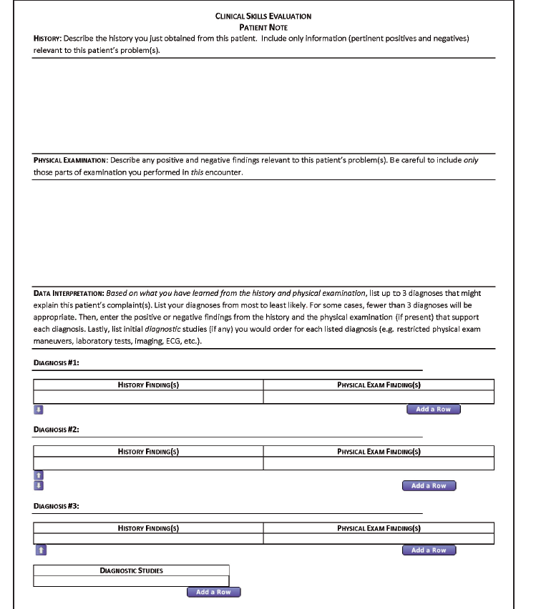

Slide 9
Why do folks fail?
Vanderbilt students do not fail because they lack knowledge.
Vanderbilt students do not fail because they lack communication skills.
Vanderbilt students DO fail because they fail to meet the checklist requirements that the SP and MD are looking for during the encounter.

Slide 10
Common Errors
Failure to introduce yourself to patient
Use patient’s name, state name, handshake, explain role
Failure to perform a patient-centered interview/exam
Repeat back what you hear, reflect back emotion, summarize
Ask permission to perform touch patient, introduce maneuvers, explain findings
Use of jargon
Notes:
Introduce self: use good eye contact, strong handshake
Patient-centered: this is not a disease centered interview or a student-centered interview, always focus back on the patient. Pay attention to context clues: when patients states they know HOW to take their meds but they just don’t, ask them why, be aware of underlying issues rather than just the obvious ones
Jargon – this is a common error among US medical students. Seems to come up more in the A&P than in H&P

Slide 11
Common Errors
Failure to show compassion
Acknowledge patient’s pain
Acknowledge patient’s emotion (sadness, anger, etc)
Touch the patient appropriately
Keep the patient comfortable (help them sit up, lie down, draping)
Failure to Summarize
Must be done at least once
Notes:
Compassion: don’t be afraid to touch the patient. Don’t be afraid to say “im sorry, this must be very hard for you.” even if you are a more reticent person, act out the role for the exam
Summarize: in VC3 at least half the time ( and sometimes more) there was no summary and no opportunity given to SP to clarify/verify the information

Slide 12
Common Errors
Lack of clarity of differential/plan
Verbalize your differential diagnosis
Outline a clear plan
Failure to ask for questions
After answering them, ask again
Missed opportunities to counsel
Most encounters require some counseling
Failure to empower/collaborate w/ patient
Notes:
Don’t be wishy washy!!! Don’t just say “talk to my attending”
Empower: try to seek out barriers (what is making it difficult to take your medicines). Make sure the patient is on board with the plan (are you willing to go to the lab and get bloodwork done now).

Slide 13
Common Errors
Missing or rushing through the “embedded concern”
Look for this in each patient (open ended question at the end)
Acknowledge the patient’s emotion (empathize with them!)
Answer honestly but reassuringly
Repeat the opportunity for them to ask further questions
Notes:
Sometimes can elicit this with general question: “What do you think is going on?” “What are you particularly worried about?”

Slide 14
Common Errors
Acting like an Intern instead of like a Clerkship Student
Remember this is testing the basics
You will likely know the answer with the history alone
Don’t let this stop you from a thorough ROS or physical exam
Unfamiliarity with Topics
Categories: cardiovascular, constitutional, gastrointestinal, genitourinary, musculoskeletal, neurological, psychiatric, respiratory, and women's health.
Notes:
Example: Let’s say your patient is presenting with SOB. He is a long-time smoker presenting with 5 days of change in sputum and cough, wheezing but no fevers or chills, no sick contacts and hasn’t been using his inhalers. What is the diagnosis? COPD flare
You might be tempted to cut short the rest of your history but don’t – think about all the ROS needed for SOB (cardiac, lung, anemia?)
You might be tempted to cut short your exam but don’t – do percussion, E-to-A, tactile fremitus, cardiac, etc

Slide 15
Scheduling
After taking CK
Recommendation: take during 3rd year
SOM Graduation Requires: Feb 1st (4thyr)
Prior to June → available for ERAS release
Prior to November → available for rank list
Schedule 6 months early
Website notifications of date availability

Slide 16
Final Tips
You don’t have to be perfect!
SPs are easier than real patients
There is a reason for everything you see
Notes:
Perfect: let go of the last case and move on, don’t let one bad case mess you up
SPs: they are actors. Don’t let their anger throw you. They know why you are here and are typically less complicated than real patients
Reason: don’t ignore anything – exam findings, weird clothes, tissues in the hand, efforts to avoid questions – everything is purposeful! Pay attention to context clues!

